Slide 1

Supplier Forum
April/May 2025
School Transport

Slide 2
Agenda
Introduction
DPS Trends
Tender Process
Authorisation Processes
Service Updates
Contacting School Transport
AOB/Questions

Slide 3
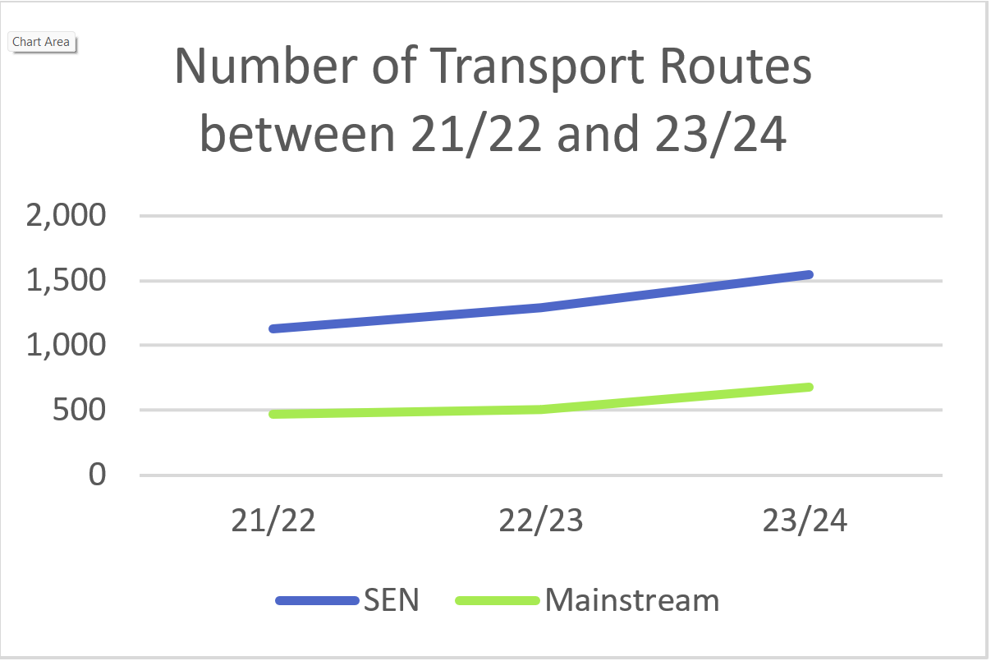
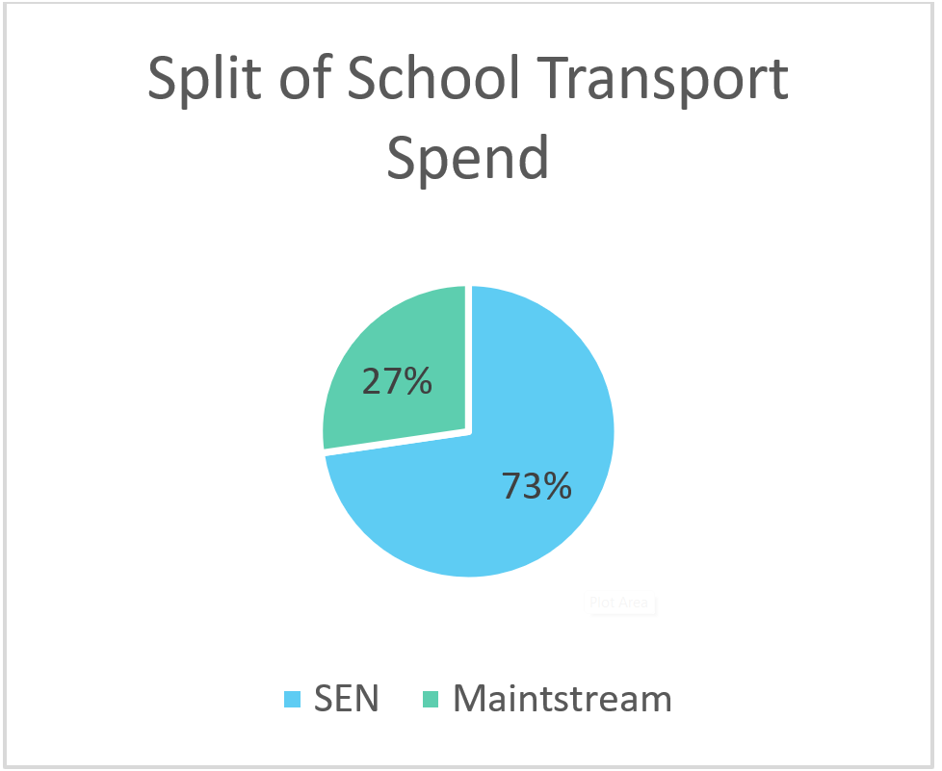
Introduction

Slide 4
Introduction
Financial Pressures
  Initiatives underway including updating the tendering process, review of solo routes, reassessing children's passenger assistant requirements and the Policy Consultation.

Slide 5
DPS Trends
School Transport

Slide 6
DPS for the Provision of Passenger Transport Services.
  Trends:
  An overall growth in the number of suppliers applying to join the DPS and the number of bids per tender.
  Insurance or Licence Documents
    Supplier are required to self-serve via Intend; documents should be uploaded to the ‘Company Document’ section of the account
    Please do not ignore requests for insurance or up to date licencing information
    Failure to provide these within specified timeframes will result in existing routes being cancelled and possibly being retendered.
  Supplier Compliance
  Since this time last year, the Council have issued 89 Supplier Suspensions;
    Failure to provide licence or insurance documents
    Not accepting a contract after submitting a winning bid
    Handing back contracts within the first 6 months
    Failure to notify us of legal action / traffic commissioner actions or rulings
    Not rectifying issues related to delivery, quality, performance or management of a contract
Notes:
The DPS for the provision of passenger transport services is the framework which all suppliers must join if they wish to tender for a Hampshire transport contract. Although the majority of the contracts tendered are school transport journeys, you will also find Adult Health and Care, community transport and local bus tenders are also tendered through the DPS.
There is a steady supply of operators joining the DPS – this currently stands at 360 approved suppliers.
DPS Bids
Approx 360 Approved suppliers to date.
This has resulted in increased competition, with the average number of bids received has almost doubled compared with the start of the DPS in April 2023.
In the last quarter (January – March 2025) the average number of bids received on tender was 11 and some received as many as 24 bids.
Demonstrates the success of the DPS and the benefit of using the E-auction function
Insurances
There have been a growing issue of updated insurance documents and licences being uploaded late. Please do not ignore requests for these updated documents for expiring documents. The team that operate the DPS usually send out reminders regularly prior to these documents expiring.
Timeframes – we ask for 5 working – Cut off – 3 licences, and 2 insurance – if there is an issue, we have time to address this.
We have a clear directive that unless we see evidence of valid insurance or licence documents, a route can not run. Failure to provide these therefore will result in all your existing routes being suspended, cancelled and possibly retendered.
Please do not ignore these reminders and ensure that you get the required documents to the DPS team within a reasonable timeframe.
Suspensions
This includes 35 suspensions issued for not accepting a tender upon award, 21 suspensions for failure to provide or maintain the relevant insurances or licences and 15 suspensions for handing back a contract within the first 6 months of the call-off or not adhering to the DPS terms around serving notice on routes.

Slide 7
Tender Process
School Transport

Slide 8
Tender Process
  All bids submitted are legally binding. As an operator, it’s your responsibility to ensure that any bid can be honoured, and should you be identified as the winning bidder that the bid will be accepted.
  Collusive bidding is illegal, any suspected instances of collusion or attempts to distort the competition will be investigated and acted upon appropriately.
  Details of all the tender rules can be found on every tender published via InTend, with the full requirement of the route included within the tender documentation.
  If unsure on any of details, please use the correspondence function on InTend relating to specific tenders.
Notes:
Responsibility to ensure that any bid can be honoured, and should you be identified as the winning bidder that the bid will be accepted.
Collusive bidding is illegal, any suspected instances of collusion or attempts to distort the competition will be investigated and acted upon appropriately.
Reminder that all the tender rules can be found on every tender published on InTend, any queries about the process or the specific requirement should come via the correspondence function on InTend.
The full route requirement is included within the tender documentation and will include details of the pick ups, young peoples needs and whether there is a PA requirement

Slide 9
Tender Process
  If awarded a contract, the route should be operated in accordance with the contract specification unless agreed by the Council in writing and invoices should only be submitted for services delivered. This means you must not:
    Merge routes with existing routes that you operate, whilst continuing to invoice for two separate routes.
    Move passengers onto different routes that you operate.
    Transport passengers to any destination other than those specified on the route schedule (e.g. after school clubs, parent’s new address).
  Failure to inform the Council of any of these changes may result in the Council issuing a suspension, termination notice and/or raising a credit note to recuperate all losses.
  You will not be reimbursed for any additional costs associated with unapproved changes to a route.
Notes:
All contracts should be operated in accordance with the contract specification unless agreed by the Council in writing beforehand.
This means you must not transport passengers to any destination other than those specified on the route schedule (after school clubs, parent’s new address etc.)
Merge routes with existing routes that you operate, whilst continuing to invoice for two separate routes – safeguarding issue
Move passengers around onto different routes that you operate.
Invoices should only be submitted for services delivered in accordance with the contract. You will not be reimbursed for any additional cost associated with unapproved changes to a route.
Failure to inform the Council of any of these changes may result in the Council issuing a suspension notice from the DPS (preventing bidding for a period of time), termination notice (not permitted to see or submit any bids for tenders) and/or raising a credit note to recuperate all losses.

Slide 10
Tender Process – Recent Updates
  The School Transport Service has introduced mileage variation rates for any changes in the total daily mileage on new or existing contracts.
  Any changes to contracts will be mutually agreed and any party may give notice to terminate the route.
Increase/Decrease to Total Daily Mileage | Price Increase/Decrease Per Mile
0 - 2.99 miles | £0
3 - 9.99 miles | £2.00
10 miles and over | £3.00
Notes:
In line with bordering local authorities such as Surrey and West Sussex we have introduced a mileage variation rate.
The Council’s is on screen.
Commissioners will use these rates for any changes in the total daily mileage rates on new or existing contracts.
Other factors may also be taking into consideration on an individual basis – 5 miles in one area may not be the same as 5 miles in another.
Regardless changes to contract will be mutually agreed and any party may give notice to terminate a route.

Slide 11
Tender Process – Recent Updates
  The School Transport Service has reintroduced the deadline extension feature ensuring there is enhanced competition on E-auctions and that the Council achieves best value for money for school transport routes.
    If a bid is received within the last two minutes of a tender’s submission deadline, then this deadline will be extended for two minutes to allow further bids to be received
    The deadline will be extended from the time of each subsequent bid until no new bids are received.
    The Commissioning Team will then proceed to award the contract to the supplier with the winning bid as per the usual process.
Notes:
The School transport service has reintroduced the deadline extension feature ensuring there is enhanced competition on E-auctions and the Council achieves best value for money on school transport routes.
If a bid is received within the last two minutes of a tender submission deadline, the deadline will be extended for a further two minutes from the point of this bid to allow further bids to be received.
The deadline will continue to be extended from the time of each subsequent bid until no new bids are received.
The commissioning team will then proceed to award the contract to the supplier with the lowest tendered price as per the usual process.

Slide 12
Authorisation Processes
School Transport
Notes:
KJ

Slide 13
Requirements
  To work as both a driver and a PA both authorisations must be in place:
Driver | Passenger Assistant
Enhanced DBS – ‘Other Workforce’ or ‘Child and Adult Workforce’ | Enhanced DBS – ‘Other Workforce’ or ‘Child and Adult Workforce’
Appropriate drivers/taxi licences | Induction/Customer Service Training
 | Certified Emergency First Aid Training
 | Safeguarding Training
 | Promoting Positive Behaviour Training
  Link to Authorised Driver Process
  Link to Authorised Operator PA Process
Notes:
Michelle to present
The safety and well being of the children and young people we transport is of the upmost importance.
Work on both process is currently underway to (a) make them as similar as possible and (b) streamline the process for operators.
The process for authorising Op PAs is currently under review with a view to streamlining it as much as possible. The shop has been introduced for booking training.
Operator PAs is a growing requirement for school transport. There are no plans to reduce the number of HCC PAs but new PA requirements will be tendered as Operator PAs more often than not.
As with drivers, PAs need to be authorised upfront, i.e. before a route commences. Before tendering for a route with an Op PA, you must have one ready to go.
Try to have your drivers/PAs authorised before tendering for a route on which you wish to put them on. Not being able to provide a driver or PA will result in going to the next bidder.

Slide 14
Service Updates
School Transport

Slide 15
Contracts
  SEN School bundles ending July 2025 are in process of being extended.
  SEN School bundles ending 2026:
School | Number of Routes | End Date | Extension Options
Wolverdene | 19 | July 2026 | No
Coxlease | 16 | April 2026 | Yes
Baycroft | 14 | July 2026 | Yes
Rachel Maddocks | 5 | December 2026 | Yes
Southlands | 6 | March 2026 | Yes
Glenwood | 6 | April 2026 | Yes
Notes:
KJ Old Bundles
Commissioning Manager will cover off summer tendering so this slide focusses on bundle routes.
Give overview of what a bundle is.
Bundles with only a couple of routes remaining will most likely be tendered as BAU and aren’t included in the table above.
Tendering may not be done in the same way as when the bundle was first tendered. We are currently doing comparisons between regular routes and bundle routes to see whether bundles are still more cost effective.
We may look to retender bundles differently to how we have done in the past, such as using lots based on geographical area, tendering for a certain number and type of vehicles etc.

Slide 16
Finance
Invoices on hold.
Affected operators will be contacted. Details will follow.
Invoices submitted in advance will be rejected.
Invoices should be submitted: not earlier than the last academic day of the month during which the transport is provided.
Purchase order format for the 2025/26 financial year has been communicated by email. Please make sure to use the correct PO numbers to avoid rejections and payment delays.
Notes:
KJ
Operators raised feedback that they do not know when invoices are put on hold creating uncertainty.
We are still receiving invoices submitted in advance.

Slide 17
Commissioning – Summer Update
  School Transport Application Deadlines
    Mainstream Education: 31st May 2025
    Post 16 & SEN: 30th June 2025
  Summer Tendering
    Approximately 650 routes are ending in July.
    Of these routes 310 have extension options. We may not take up all of these extensions.
    Routes that are due to be tendered this summer will be published on our website ahead of time and will detail whether a route requires an operator passenger assistant. Updates can be accessed at the following: https://www.hants.gov.uk/transport/transportoperators/procurement#step-4

Slide 18
Contacting School Transport
As per the recent communication, from 27 May the School Transport service will only be accepting calls regarding emergencies.
The emergency phoneline can only be used to report accidents, cancellations within 24 hours, or raise immediate safeguarding concerns.
You will be able to reach the emergency phoneline by calling 01962 846924.
This phoneline is only to be used in an emergency – for calls about anything else, you will be redirected to the online enquiry form.
Please DO NOT call any other numbers you have may have stored for school transport contacts as we cannot guarantee these staff will be available.
Notes:
The School transport service has reintroduced the deadline extension feature ensuring there is enhanced competition on E-auctions and the Council achieves best value for money on school transport routes.
If a bid is received within the last two minutes of a tender submission deadline, the deadline will be extended for a further two minutes from the point of this bid to allow further bids to be received.
The deadline will continue to be extended from the time of each subsequent bid until no new bids are received.
The commissioning team will then proceed to award the contract to the supplier with the lowest tendered price as per the usual process.

Slide 19

Questions
School Transport

