Slide 1

Hampshire HAUC
Hampshire County Council, Southampton City Council, Portsmouth City Council
12 November 2024
Team name (optional)

Slide 2
Agenda
Introductions / Apologies
SEHAUC / HAUC Update
Local Matters
Works Performance
Lane Rental
AOB
Next Meeting

Slide 3
SEHAUC / HAUC Update
……………………….

Slide 4
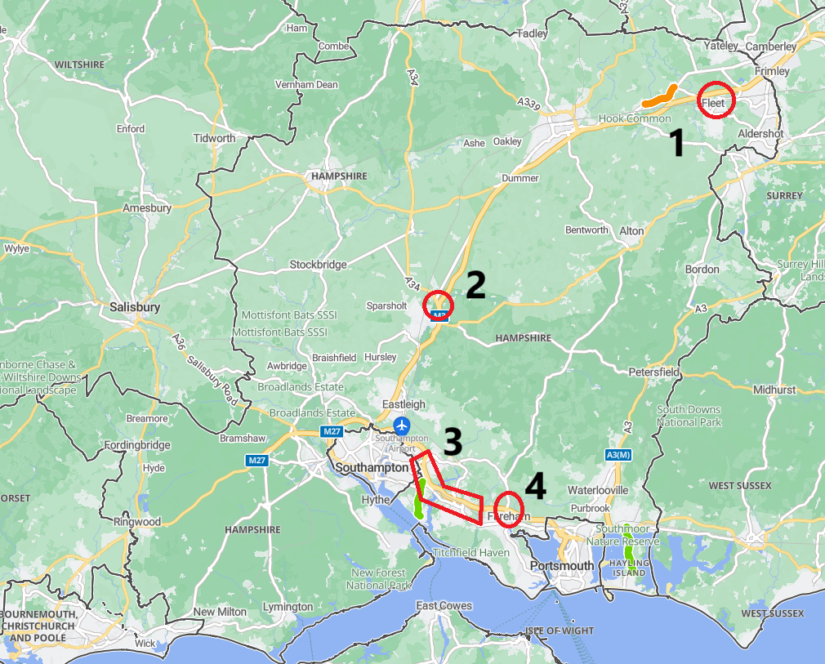
Local Matters – Coordination - HCC
Thames Water / SGN major works around Fleet / Elvetham Heath
DCO – M3 Junction 9, Winchester.
Major schemes along the A27 / M27 Corridor
Major housing development and M27 junction around Fareham

Slide 5
Local Matters – Policy / Procedure - HCC
Hants CC Permit Scheme. Into the 4th year. Seems to be operating well.
No plans to increase permit charges
Increase in EVCP’s – HCC strategy includes requirements for S50 licences for private installations. HCC would like SSE to assist in checking that they are not powering up illegal installations on the highway – SSE requested to check to see if the EVCP owner has a licence under S50.
Need to see greater visibility on wider ‘schemes’ rather than individual permits – to assess impact on an area
Interest from PC’s and Cllrs – driving increased comms and NCT11b

Slide 6
Local Matters – HCC Budget Constraints
Severe budget constraints require the County Council to review all of its services
The Council has already agreed severe cuts in services, including highway maintenance, other highway related cuts are expected
HCC is also moving towards operating at a ‘Legal Minimum Service Level” (LMSL). Essentially, if there’s no legal requirement for a service, or the service isn’t funded, then it will likely be cut.
Fortunately the streetworks service is mostly a statutory one, or funded by the permit scheme, so our services are largely unaffected. Having said that, we do have recruitment restrictions and several members of the team are off on being on long-term-sick meaning that our resources are stretched very thin.
Ancillary highway services that run alongside the streetworks service will be cut, meaning additional pressure on the streetworks team
All of this inevitably means that you might see a slower response to some enquiries or a cutting back of any services that are not statutory or fully funded by permits.

Slide 7
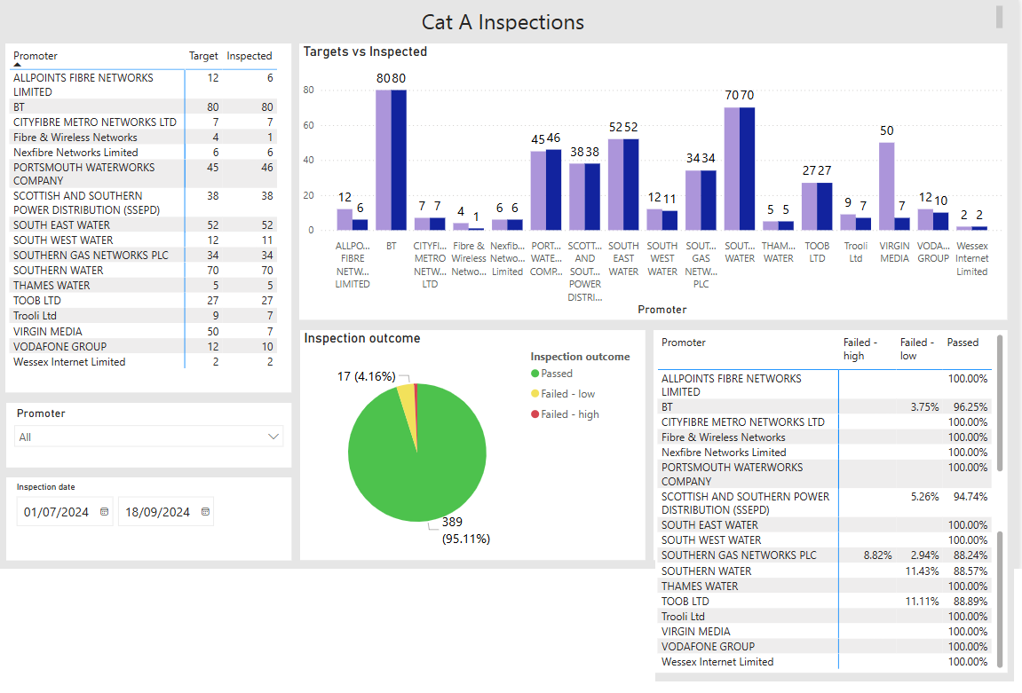
HCC - Works Perf. Cat A Samples. Q2

Slide 8
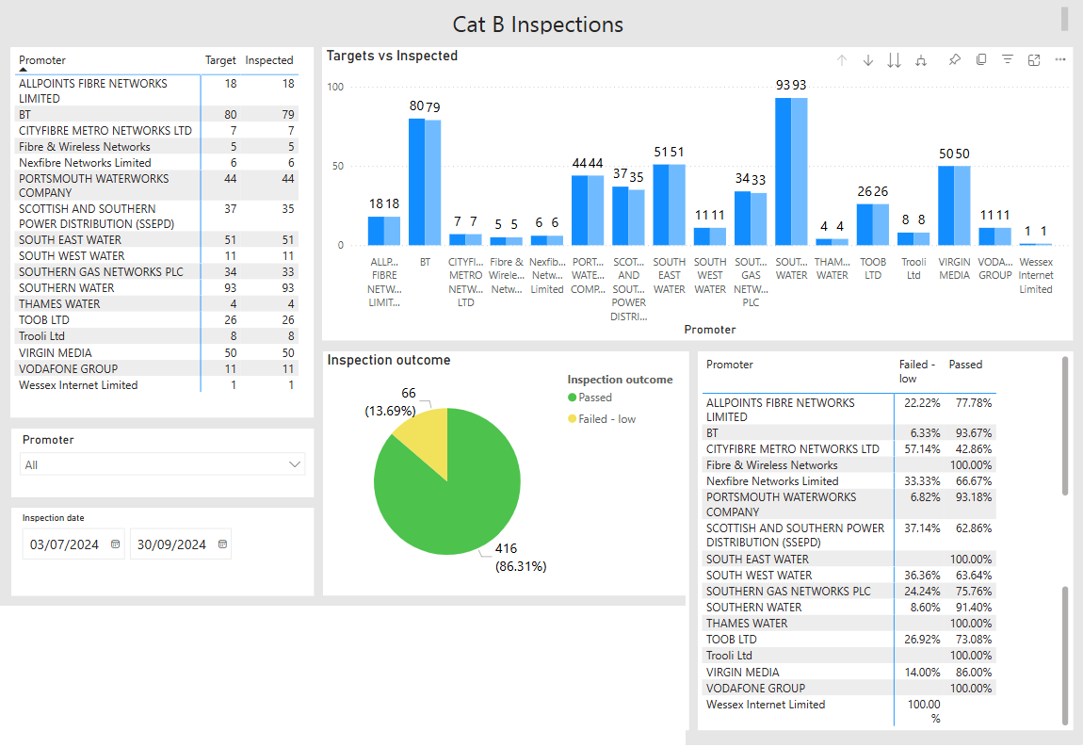
HCC - Works Perf. Cat B Samples. Q2

Slide 9
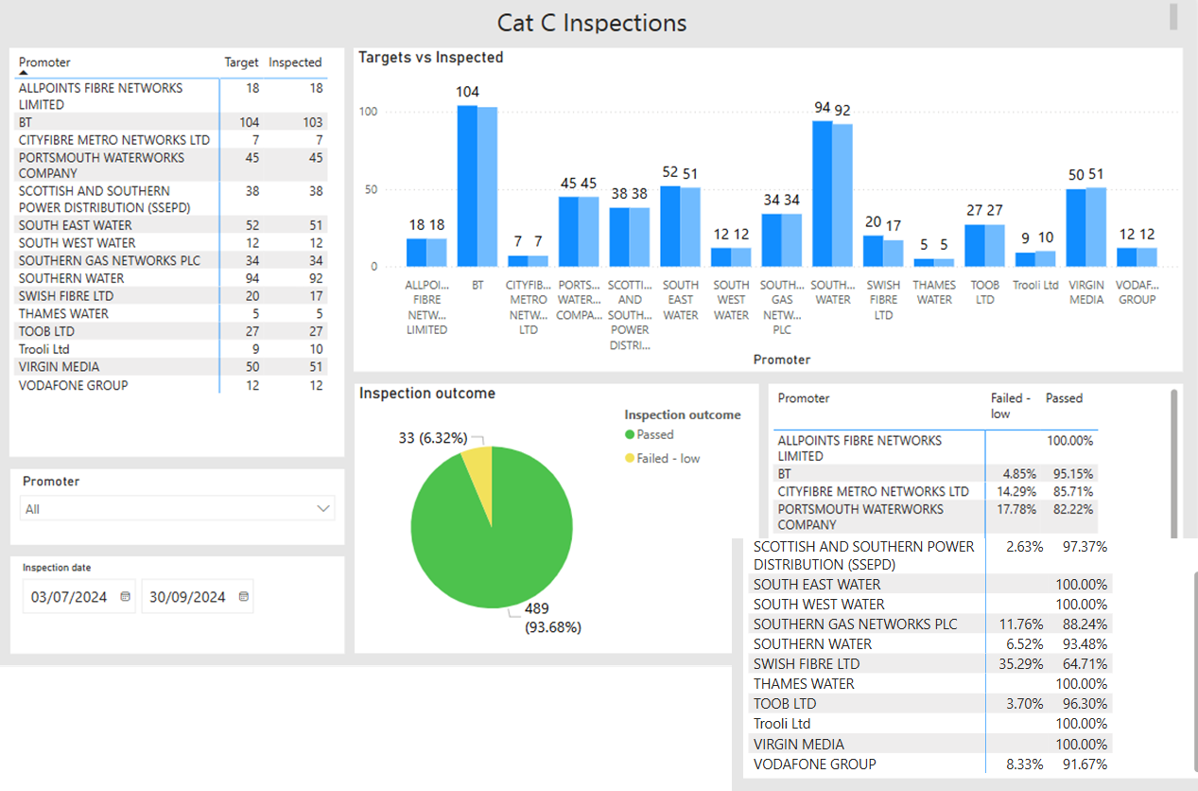
HCC - Works Perf. Cat C Samples. Q2

Slide 10
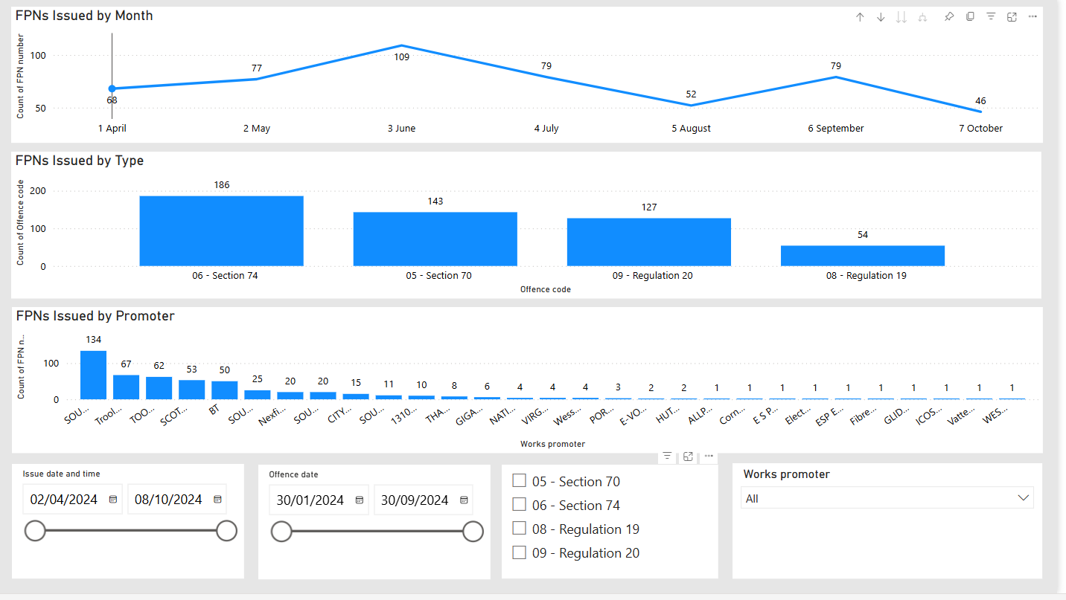
HCC - Works Perf. FPN’s, April - Oct

Slide 11
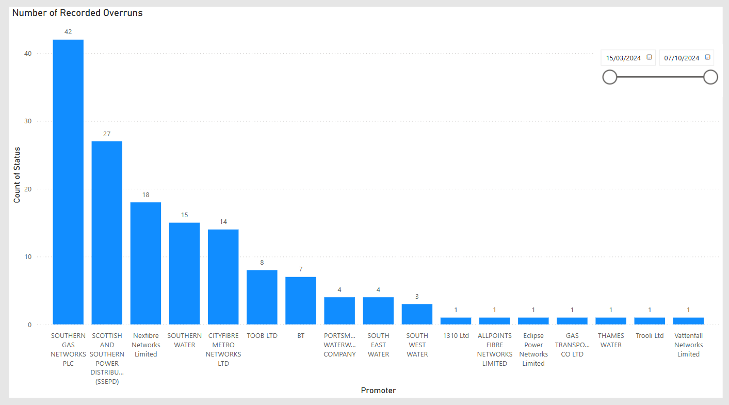
HCC - Works Perf. Overruns, Apr - Oct

Slide 12
Other Performance Matters
HCC has problems with SGN extending major projects and use of immediate permits
SGN / SW / Toob – more than 10% fail for ‘in progress works’
SSE / SGN + telco’s poor performance reinstatement-wise

Slide 13
Lane Rental Development- HCC
HCC is still in the process of developing a Lane Rental scheme for Hampshire
A consultant has been engaged to assess the data and determine likely routes for inclusion in the scheme.
HCC reviewing TS streets
HCC sharing data with neighbouring authorities and trying to ensure cross border continuity
Consultation on Draft scheme in spring 2025, informal consultation starting early 2025.
Proposed scheme sent to DfT in oct 2025
Scheme live in April 2026.

Slide 14
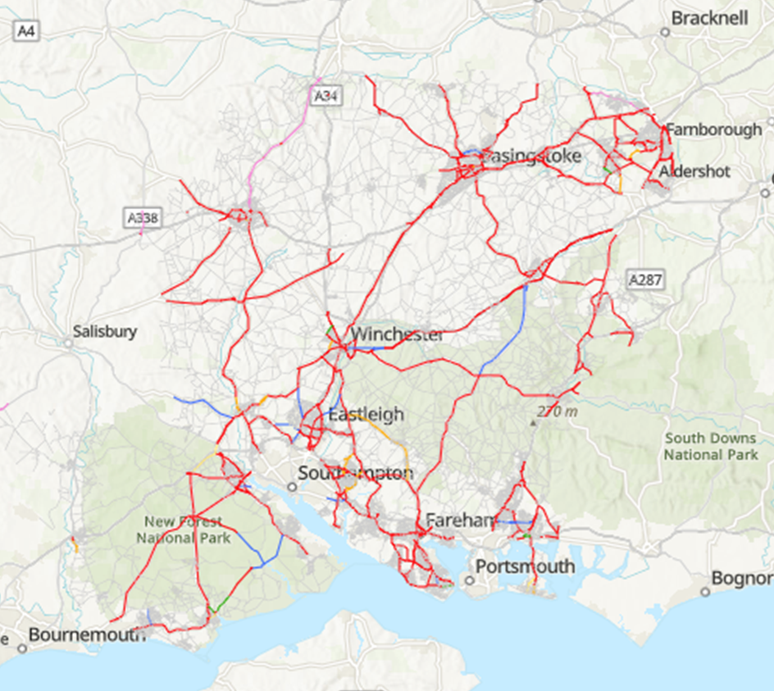
Lane Rental Map – HCC (indicative Only)

Slide 15
Lane Rental Charges - HCC
Road Closure = £2,500
Lane Closure / TTL’s = £1,500
Discounts applied as follows;
  First two days of Immediate work (100%)
  Major infrastructure work (66%)
  Long duration with high charge (66%)
  Work with collaboration (100%)
  Work under 6 hours (100%)
  Work with NCT2a (100%)
  Work not impacting carriageway traffic flow (100%)

Slide 16
Lane Rental Liabilities - HCC
Projected Liability by Works Promoter Sector based on 2023 works (adjusted for discounts etc)
Electricity = £0.5M
Gas = £1.2M
HCC = £1.0M
Telco’s = £1.2M
Water = £1.6M
Other = £0.4M

Slide 17
AOB

Slide 18
Next Meeting & Frequency of Meetings
To be 2 times / year depending on items for discussion.
Meeting to be hybrid
Meetings now logged on the SEHAUC diary.

