Slide 1

Hampshire HAUC
Hampshire County Council, Southampton City Council, Portsmouth City Council
26 February 2024
Team name (optional)

Slide 2
General ‘Admin’
Phones to silent please
Session will be a hybrid one with some colleagues joining via Teams
Fire alarm drill
Toilets

Slide 3
Agenda
Introductions / Apologies
SEHAUC / HAUC Update
Local Matters
Works Performance
Lane Rental
AOB
Next Meeting

Slide 4
SEHAUC / HAUC Update
2023 changes to the inspection process and performance related target setting. HCC confirmed that many sample targets are likely to reduce in the 2024/2025
NCT changes, including the requirement to notify the LA re any changes to TM for major works. No issues reported so far with this.
No SEHAUC event in 2024, planning one for 2025.
National Traffic Manager Conference in Oct 2024.
Many areas reporting difficulties in booking roadspace owing to large volume of works going on

Slide 5
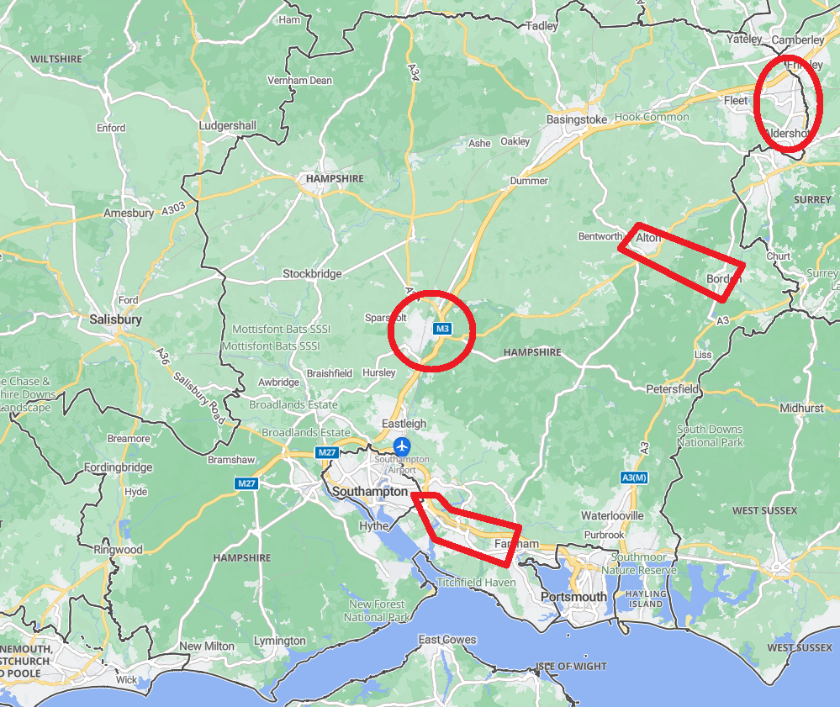
Local Matters - Coordination
Volumes of works / permits have increased significantly over the past few years; Fibre rollouts and new developments. In some areas ‘road-space’ is highly restricted.
Major new DCO for M3 J9 Winchester
A number of highway improvement / maintenance schemes along the M27 / A27 corridor
Major schemes in Farnborough and Alton-Bordon

Slide 6
Local Matters – Policy / Procedure
Hants CC Permit Scheme. Into the 4th year. Seems to be operating well.
No plans to increase permit charges
Owing to increase in permits / works HCC is likely to increase staff to cope
Increase in EVCP’s – HCC developing a rollout strategy
Interest from PC’s and Cllrs – driving increased comms and NCT11b

Slide 7
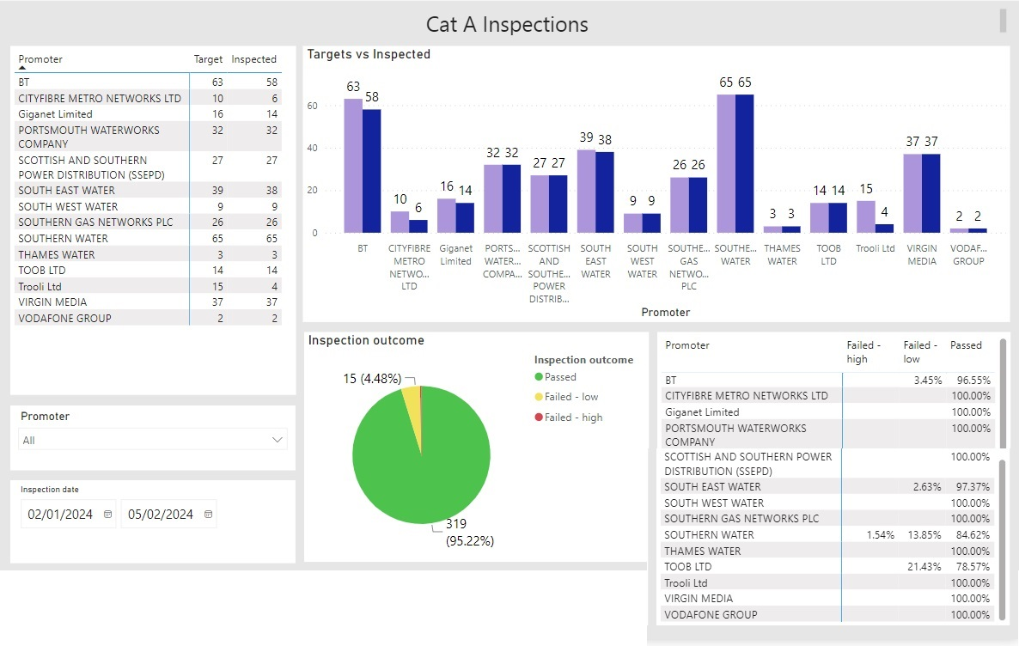
Works Performance. Cat A Samples. Q4

Slide 8
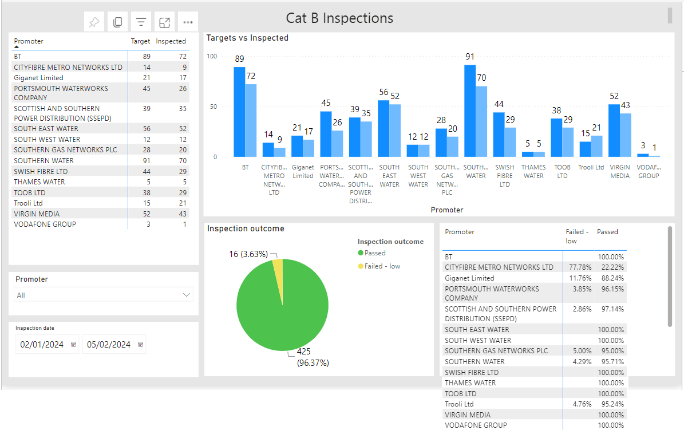
Works Performance. Cat B Samples. Q4

Slide 9
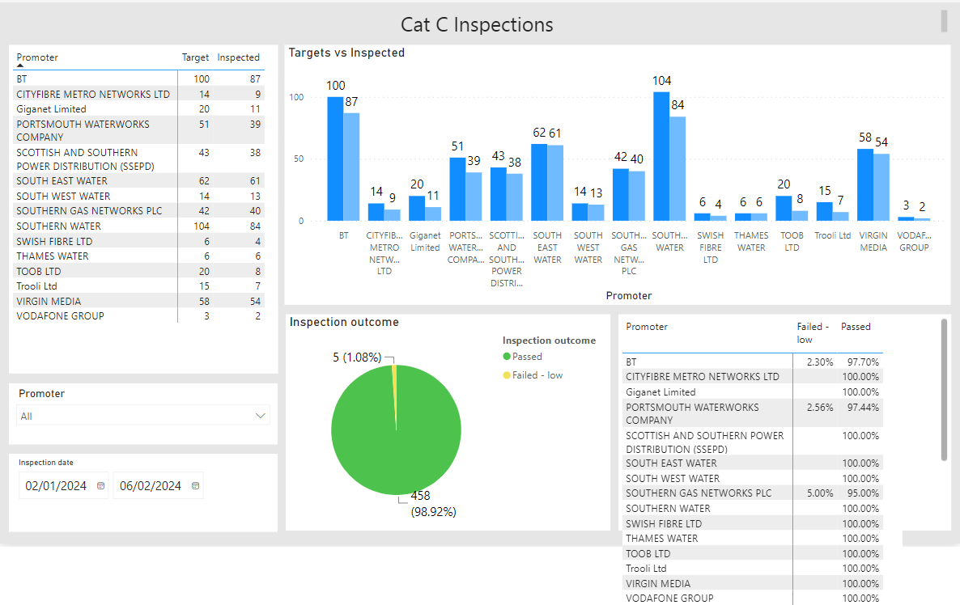
Works Performance. Cat B Samples. Q4

Slide 10
Other Performance Matters
HCC has problems with SGN extending major projects and use of immediate permits
SW Cat A performance has significantly dropped
Lack of volume of works in SCC can cause problems in determining trends.

Slide 11
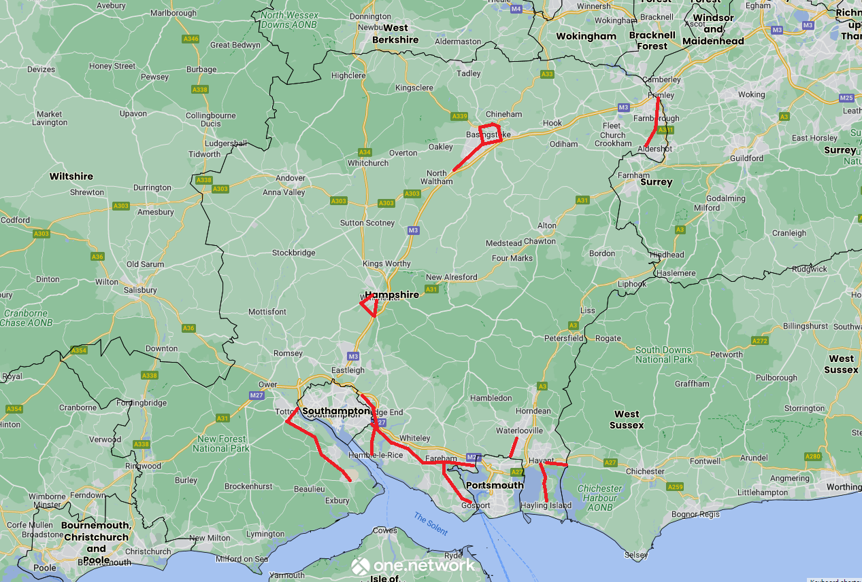
Lane Rental
Hants CC has appointed a consultant to assess the viability of a scheme.
Routes will link with neighbouring Authorities
Making use of good practice determined from WSCC, KCC and Surrey CC schemes.
Sharing development info with SCC and PCC

Slide 12
Lane Rental Discussion
SCC and HCC will be sharing information and will be collaborating on schemes in order to assist the development of each scheme and try to harmonise them so that they operate in similar ways.
PCC are considering options re LR but have concerns as to how this would operate under their PFI.
HCC confirmed that they have appointed a consultant to help develop their scheme.
HCC and SCC will keep the works promoters updated with progress and will undertake detailed consultation as the schemes progress.
Concerns raised re operation of the ‘funding pot’. Needs transparency with charging of fees and use of funds.
SU’s concerned about ensuring that LR fees reflect the traffic sensitivity and impact on the street.

Slide 13
AOB
1. IBAA (Incinerator Bottom Ash Aggregate) Discussion: Provided an overview of IBAA principles and its application in ensuring asset reliability and performance. Consideration given to exploring opportunities for collaboration and knowledge sharing regarding IBAA implementation.
2. Inclusion of Isle of Wight in Future Meetings. HCC to invite IOW to future Hants HAUC meetings

Slide 14
Next Meeting & Frequency of Meetings
To be 2/3 times / year depending on items for discussion.
Meeting to be hybrid
HCC to arrange a further Hants HAUC for Autumn 2024

