Slide 1
Training for Staff
What do staff need to know about smoking and vaping?

Slide 2
What do staff need to know about smoking?
80% of smokers start before the age of 20.
The younger the age of uptake, the more likely the chances of harm.
Cigarettes contain over 4,000 chemicals, 69 of which are known to cause cancer.
There is a notable association between smoking and other substances e.g. drugs and alcohol.
Smokers are more likely to get coughs/colds and be absent from college.
It is illegal for a shop to sell cigarettes or vapes to someone under the age of 18.
Source: Action on Smoking and Health (ASH). Young People and Smoking. September 2019

Slide 3
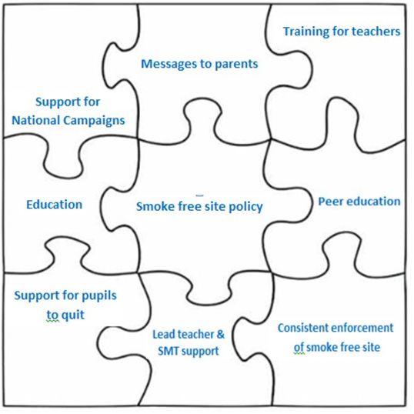
The college policy
The college site is smokefree. This includes [insert specific details to site].
The college Smokefree Champion is [insert name].
A ‘whole setting’ approach to smoking is required to
change the culture. This includes:
Strong Smokefree Policy
Leadership support
Communicating with families
Support to quit
Clear and consistent messages through education
Peer education

Slide 4
How can staff support the whole settings approach?
Recognise your place as role models. Follow policy on smoking and vaping. Support is available if you would like help to stop smoking.
Report breaches of the policy promptly – do not turn a blind-eye.
If you are aware of a place that is selling illicit tobacco or vapes, or carrying out underage sales, report it to: www.stop-illegal-tobacco.co.uk
Incorporate smoking related topics into lessons where you can. Tobacco can fit into a variety of subject areas including media, geography, health and social care. Visit www.hants.gov.uk/socialcareandhealth/smokefreeme for ideas.
Recognise the need to support, rather than judge students who smoke. They are likely to have a nicotine addiction and should be offered support to quit. Refer them to [Insert name of Smokefree Champion or college nurse] who can refer them on to www.smokefreehampshire.co.uk for support.
If a student is undertaking a quit attempt, be supportive and understanding of the fact that they may be temporarily distracted more easily and find it difficult in class.
Send clear messages about vaping (next slide).

Slide 5
What do I need to know about vaping?
95% less harmful than cigarettes, although not completely risk-free.
Vapes contain only a fraction of the chemicals found in cigarettes.
Although vapes are thought to be much less harmful than cigarettes, we do not yet know the long-term impact of some of the chemicals. Short-term effects include coughing, headaches, sore throat and dizziness. Some flavourings can cause allergic reactions. Vapes can also come with or without nicotine in them, which is addictive, especially to young people.
For young people, the key message is, ‘If you don’t smoke then don’t vape. If you do smoke, switching to a vape may be beneficial to your health’.
Vapes are subject to age restrictions – no under 18s.
No evidence to suggest that they cause harm to others through second-hand vapour.
A useful tool for quitting smoking, only if used exclusively (many people smoke cigarettes as well).
Smokefree site policy includes vapes, as it is difficult to differentiate the vapour and smoke. Also, to discourage use with young people as a ‘novelty item’.
There’s no evidence to suggest that vapes increase the likelihood of young people progressing to smoking tobacco.
Vapes should be used only with the correct charger and e-liquid sourced from a reputable UK company. Beware of young people buying online. In the US there are no restrictions on the levels of nicotine found in liquids.
More information can be found at www.nhs.uk/live-well/quit-smoking/using-e-cigarettes-to-stop-smoking

Slide 6
Where can I get more information?
Smokefree Me – This site contains lesson plans and information for the whole settings approach to smoking – www.hants.gov.uk/socialcareandhealth/smokefreeme
Smokefree Hampshire – Hampshire's Stop Smoking Service offer a free and confidential service to help you quit smoking. They provide free, expert advice and guidance on quitting smoking, along with access to stop smoking medications such as nicotine replacement therapy or Varenicline. They also offer a vape voucher scheme, should you choose to quit tobacco using an electronic cigarette – www.smokefreehampshire.co.uk
National Centre for Smoking Cessation Training – Provides lots of free online training courses on all aspects of smoking cessation – www.ncsct.co.uk

