Slide 1
Tobacco and the environment

Slide 2
Purpose of session
To help young people to develop their own understanding and opinion regarding the long-term impact of tobacco on their world.
Learning outcomes
Describe the main processes of tobacco production​.
Give examples of how tobacco can impact the environment​.
Give some key facts on smoking and the environment​.
Express an opinion on the impact of tobacco on the environment.

Slide 3
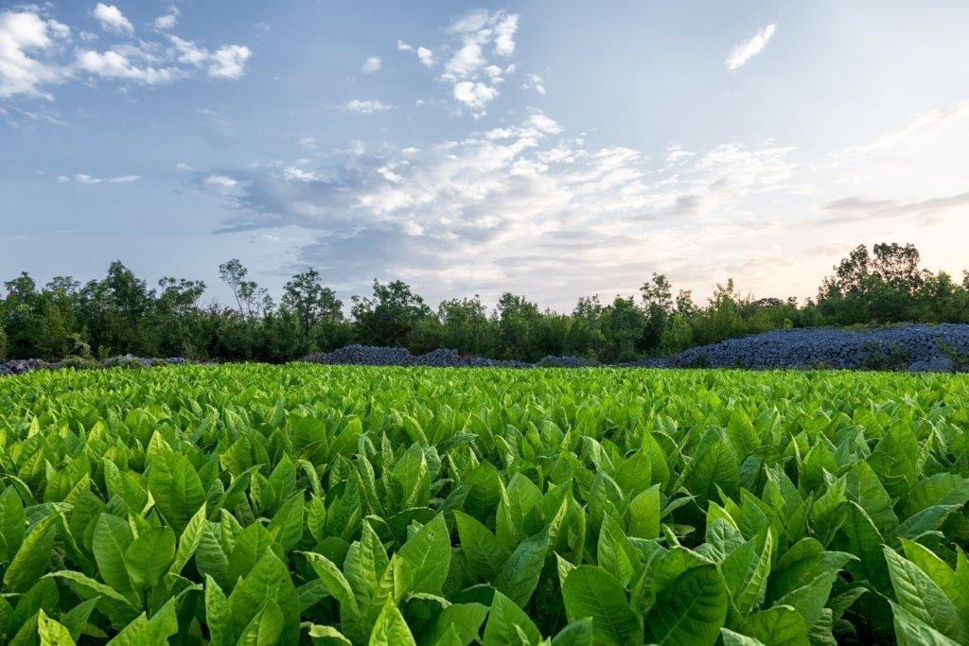
What are cigarettes made of?
Cigarettes are made from tobacco leaves
Tobacco is grown in places all over the world. The top five producers are:
China​
India​
Brazil​
United States​
Malawi
Tobacco leaves contain nicotine which is the addictive part of a cigarette.

Slide 4
How might cigarette production affect the environment?

Slide 5
How are cigarettes made?
1. Grow the tobacco
The tobacco plant is a large leafy crop. Almost all the plant is used in cigarette production, with different parts making higher and lower grade products.
Tobacco farmers use pesticides and fertilisers as required by the tobacco companies.

Slide 6
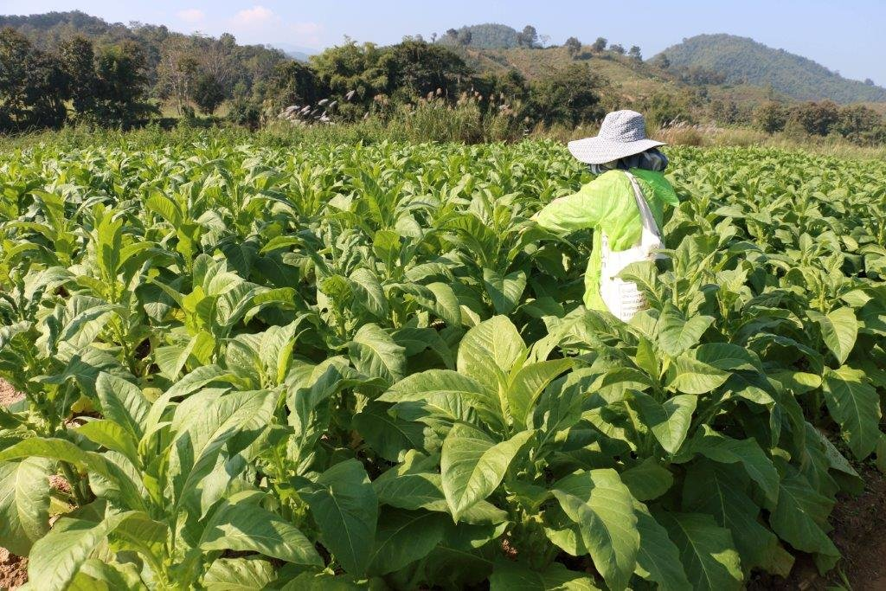
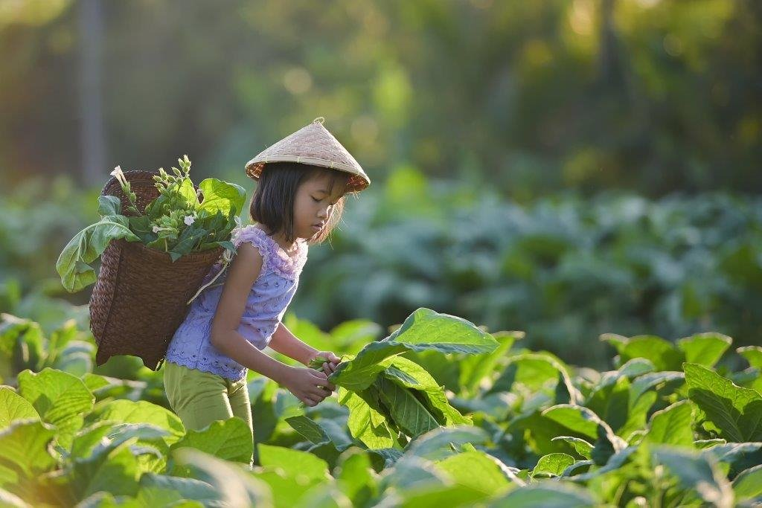
How are cigarettes made?
2. Harvest the tobacco
Harvesting tobacco – child labour is often involved in this process. Children as young as 5 years old sometimes pick tobacco and can get sick from doing this. They develop ‘Green Tobacco Sickness’ from absorbing the chemicals through their skin. This leads to sickness and muscle weakness.​

Slide 7
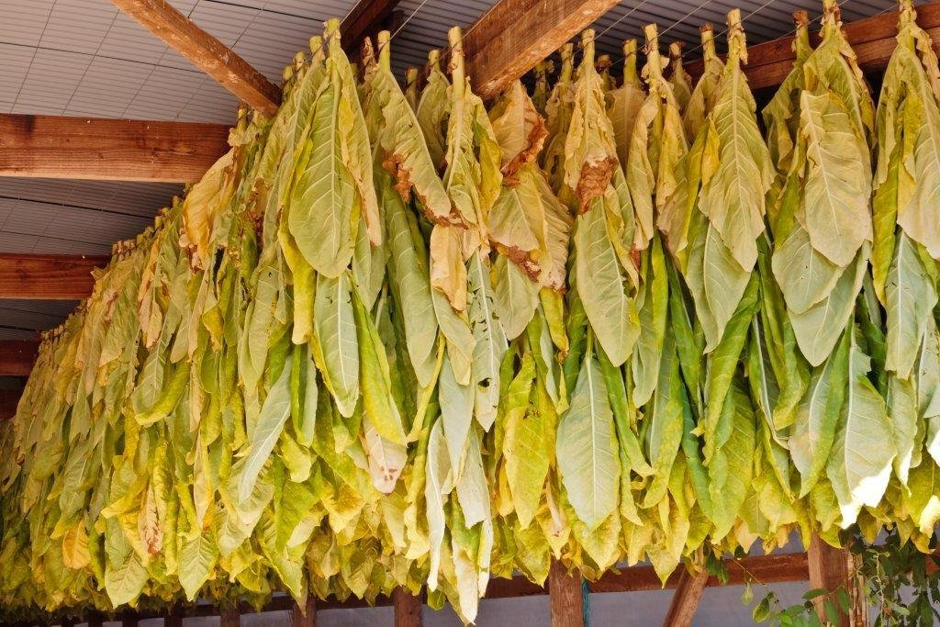
How are cigarettes made?
3. Cure the tobacco
Tobacco is ‘cured’ (dried out) often by storing in airtight barns with continual smoky fires.

Slide 8
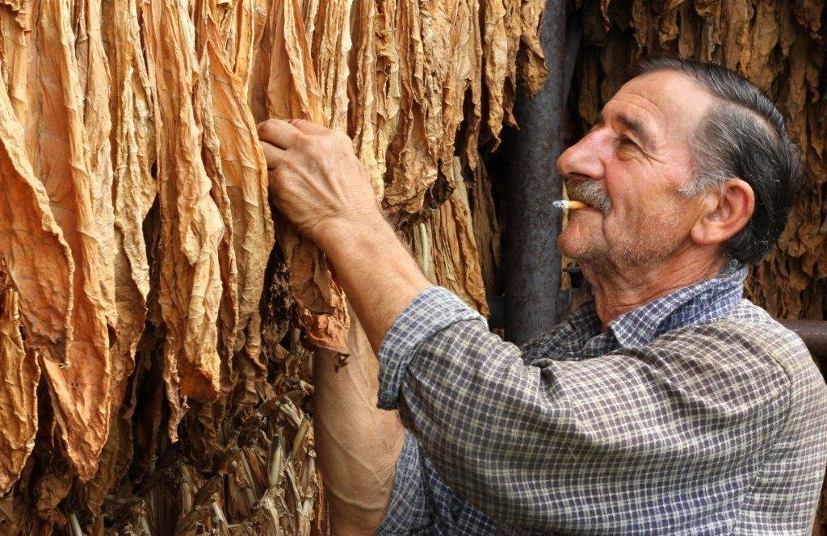
How are cigarettes made?
4. Sort into different grades
Dried leaves are sorted by hand to work out which are the best and which should go into different products.

Slide 9
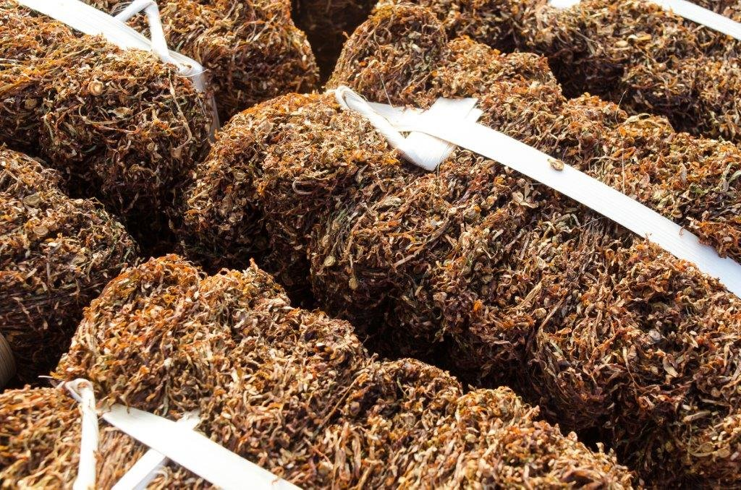
How are cigarettes made?
5. Shred the tobacco
Machines are used to shred the tobacco.

Slide 10
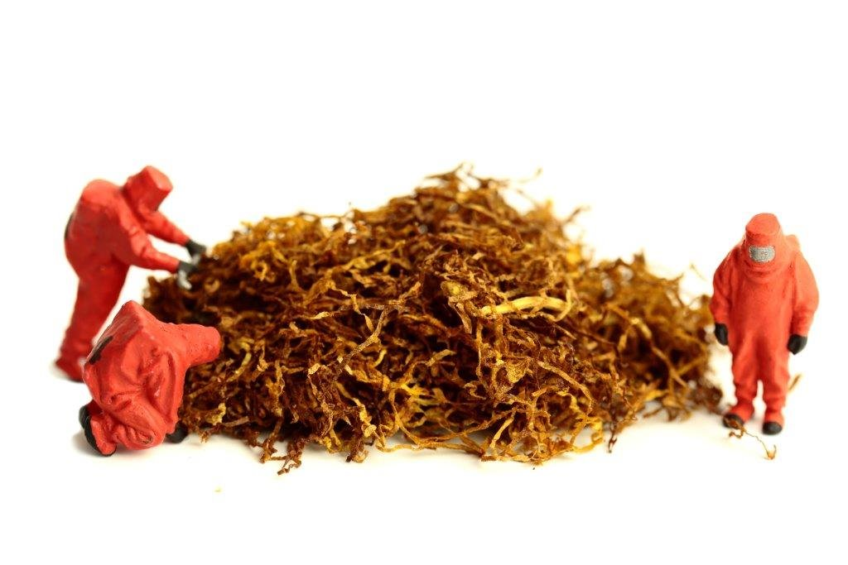
How are cigarettes made?
6. Blend the tobacco
Chemicals are added to the dry tobacco to make cigarettes:​
​
burn properly​
taste different​
deliver nicotine more effectively​
The exact mix of chemicals added is often a closely guarded secret.

Slide 11
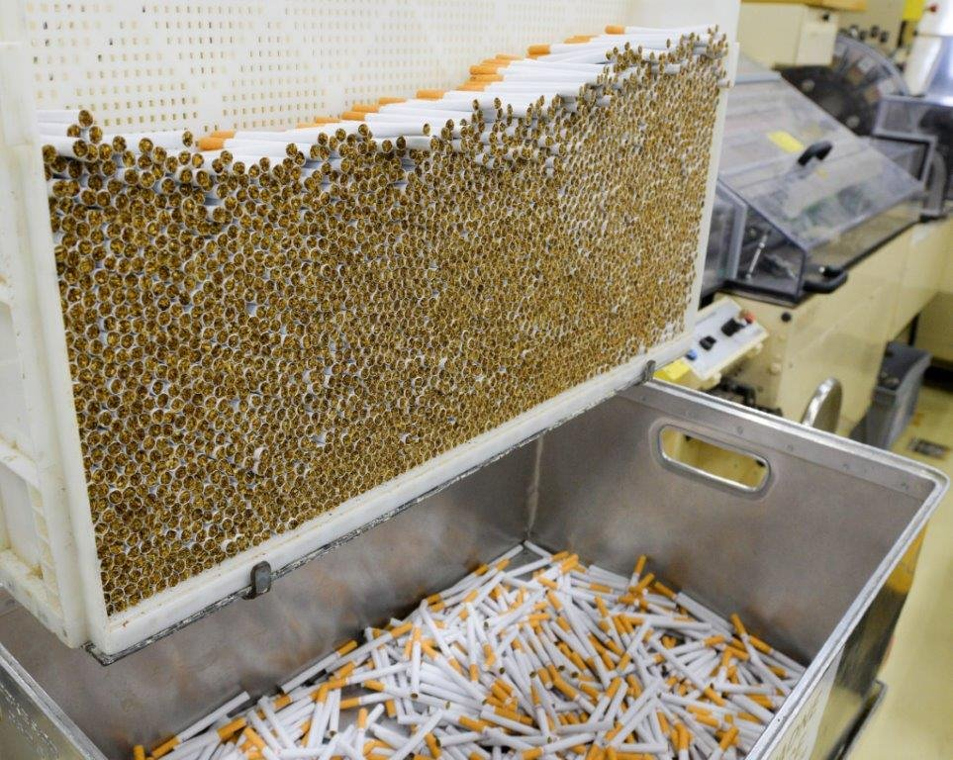
How are cigarettes made?
7. Manufacture

Slide 12
What is the impact on the environment?
How do the pesticides and fertilisers affect the environment?
​
How does the use of the land for tobacco growing affect the countries’ population?​
How does pollution in the manufacture of cigarettes impact the environment?​
How does litter from cigarettes affect the environment?

