Slide 1
Tobacco and the developing world

Slide 2
Purpose of session
To help you understand how tobacco production impacts on developing countries.
Learning outcomes
Explain the impact of tobacco production on developing countries.
Describe how the prevalence of smoking in developing countries differs from the developed world.
Give examples of how tobacco production can affect the lives of children in the developing world.
Understand the moral implications of tobacco companies’ work in developing countries.

Slide 3
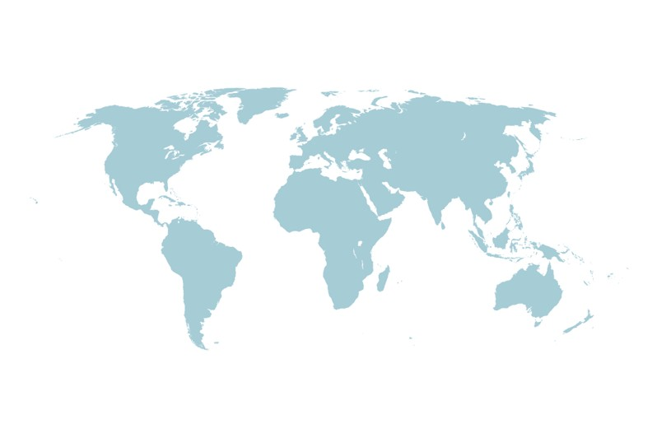
What is a 'developing' country?
A country that has a standard of living or level of industrial production that is below what is possible if they had financial help. Often agricultural and under industrialised.
Examples of developing countries:
Ethiopia
Bangladesh
Sierra Leone
Examples of developed countries:
USA
UK
France

Slide 4
Tobacco and the developing world
True or false?
Most smokers in the world live in richer countries.
False
There are around 1.3 billion smokers worldwide but most (over 80%) live in low to middle income countries, i.e. poorer countries.

Slide 5
Tobacco and the developing world
True or false?
The amount of tobacco used in Britain, America, Canada and Australia is likely to fall in the coming years.
True
Laws placed on tobacco companies and education means that the number of smokers in these developed countries continues to fall.

Slide 6
Tobacco and the developing world
True or false?
More men than women smoke in the world.
True
Of the approximate 1.3 billion people that smoke cigarettes or other products worldwide, around one billion are men and 250 million are women.

Slide 7
Tobacco and the developing world
True or false?
Tobacco companies are likely to target women across the world in the coming years.
True
Changes in traditions and cultures mean that an increasing number of women are starting to smoke.

Slide 8
Tobacco and the developing world
True or false?
The Chinese State Government gets funding from tobacco companies.
True

Slide 9
Tobacco and the developing world
True or false?
Cigarette smoking in China accounts for one of every four cigarettes smoked globally.
False
It's more than that. Cigarette smoking in China accounts for one of every three cigarettes smoked globally.

Slide 10
Tobacco and the developing world
True or false?
Tobacco is an easy crop to cultivate and grow.
False
Tobacco is a sensitive plant. The process is labour intensive and requires many pesticides and fertilisers.

Slide 11
Tobacco and the developing world
True or false?
Tobacco farming can make a small farmer in Brazil rich.
False
Farmers can often find themselves making a loss due to the situations they are placed in by the larger tobacco companies, e.g. paying a high price for fertiliser, receiving low pay for produce.

Slide 12
Tobacco and the developing world
True or false?
In all countries there are laws to protect farmers from dangerous conditions and children from child labour.
False
Child labour takes place in many countries. Farmers in many developing countries work without clothing to protect them from the harmful chemicals involved in tobacco production.

Slide 13
Key facts
In developing countries, a poorer population spends lots of their income on tobacco.
Tobacco farmers in developing countries risk huge financial losses if the crop fails.
Farmers can be exploited by a few tobacco companies who buy almost all the land.
Most of the profit from tobacco growing goes to the tobacco companies, the developing countries remain in debt and poverty.
In developing countries where there are few laws to control smoking, tobacco companies are free to promote cigarettes to the younger generation.

