Slide 1
The true cost of smoking

Slide 2
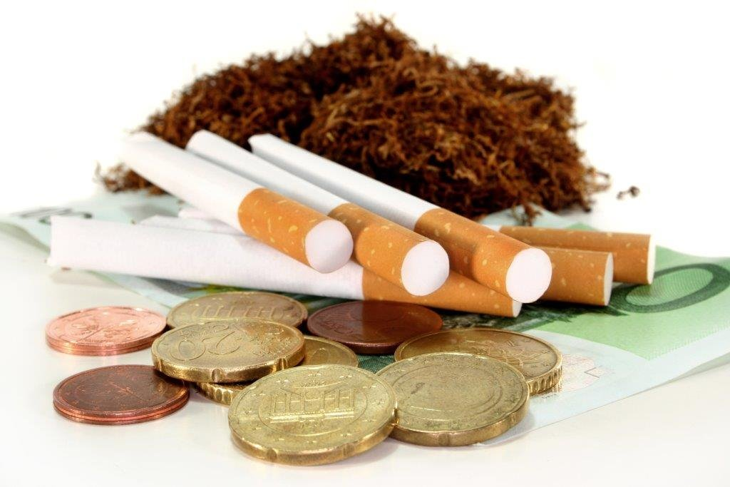
What does smoking cost?
How much is a packet of 20 cigarettes?
£16.35* per pack (to avoid increasing prices on the Budget, some cigarette companies have reduced packet sizes to 18 or 19)
How much is this per cigarette?
Approx 82p
*Correct as per average price Nov 2024

Slide 3
The cost to the family finance
Marcus and Janine have 2 children aged 2 and 6. Marcus and Janine both smoke. Marcus smokes about 20 a day and Janine smokes 10. Together how much do they spend on cigarettes?
A week
A month
A year
£171.68
£735.75
£8,951.63
What else could they have spent this money on?

Slide 4
What is the cost of smoking?
Environment – Pollution, deforestation, litter.​
Communities – Exploitation of farmers, child labour, exacerbation of poverty.​
Health – Early deaths of population. Impact on families caring for people with smoking related illness.​
Economy - Costs of treating smoking related illness.​

Slide 5
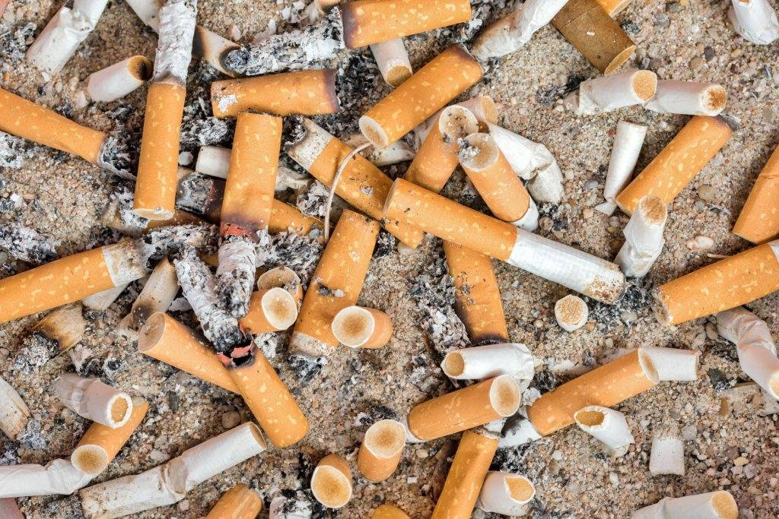
Environment
Growing tobacco requires lots of hazardous fertilisers and pesticides.​
200,000 hectares of land are cleared each year for the growing of tobacco.
​
Transportation and production of tobacco involves lots of fossil fuels.​
Cigarette butts are the most common form of litter and do not biodegrade.

Slide 6

Communities
Certain ethnic groups and communities around the world are more likely to smoke, putting a strain on their health systems. ​
Child labour is used in many tobacco growing countries with whole families working in the fields. Children are therefore unable to get an education.
Where tobacco is farmed, deprived communities are exploited for labour and poverty is made worse. ​
Illness from smoking often leads to unemployment and exacerbates poverty.

Slide 7
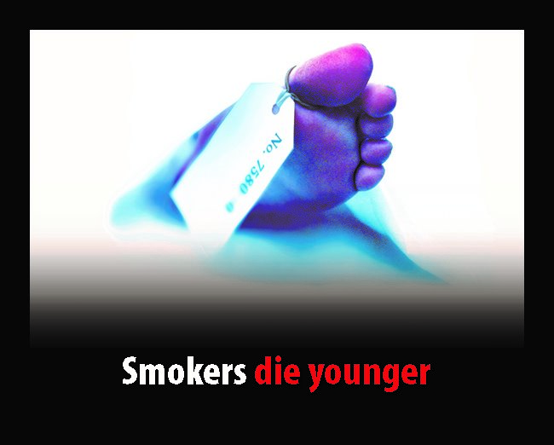
Health
Half of all smokers will die early as a result of their addiction.​
People with smoking related illnesses require care from family members. For children of smokers, this can result in them becoming young carers, affecting their education and future prospects. ​
Smoking causes a third of all deaths from house fires in England.

Slide 8
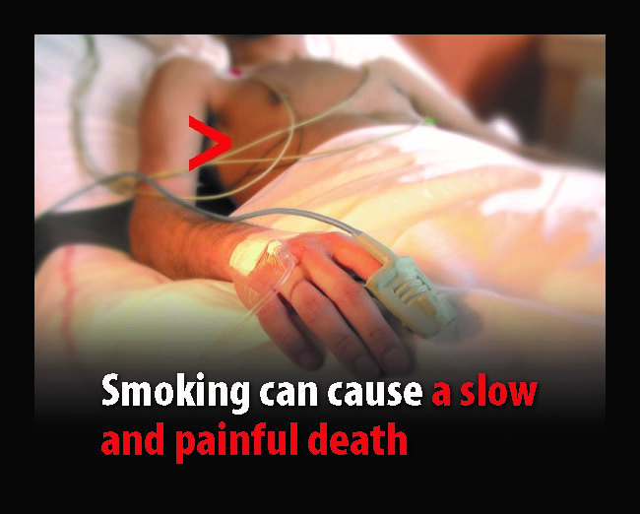
Economic costs
It is estimated that smoking costs the UK society £21.8 billion a year. This includes the cost of treating people with smoking related illness.
Although the UK Government receives tax from cigarettes, this is around £7.1 billion a year (less than the cost to society).

Slide 9
Illegal tobacco
What is illegal tobacco?​
Smuggled - Generally legitimately manufactured products, but illegally transported, brought into and sold in the UK.​
Bootlegged - Purchased legally in quantity in a country with low taxation and illegally brought into and sold in the UK.​
Counterfeit - Manufactured illegally from inferior materials. More often manufactured abroad, but sometimes in the UK.

Slide 10
The harms of illegal tobacco
All tobacco is harmful, but cheap, illegal tobacco is not regulated. So, you don’t know what is in it or where it comes from.
Makes it easier for children and young people to start smoking and become addicted.​
Makes your community attractive to criminals.​
Draws otherwise honest people into dealing with criminals.​
Can help fund organised crime.

Slide 11
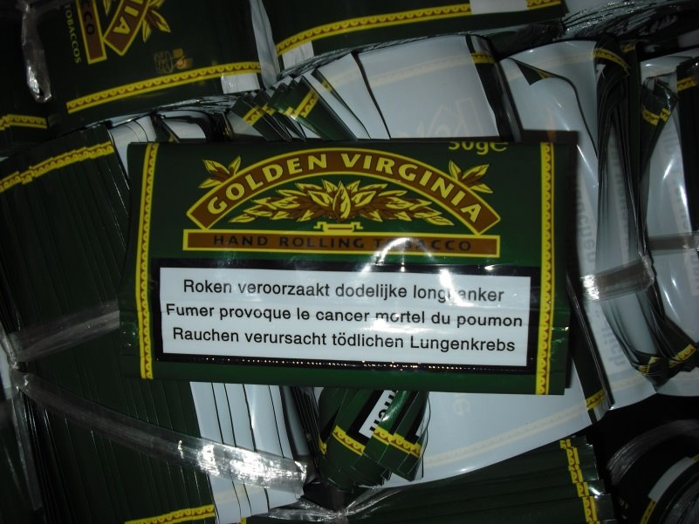
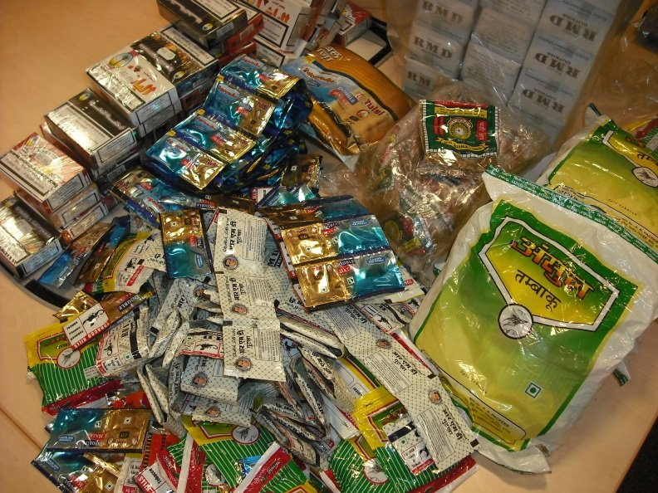
Spotting illegal tobacco
Really cheap prices (less than £3.50 a pack)​
Foreign health warnings​
Poor print/colour on packets​
Unusual taste or smell

Slide 12
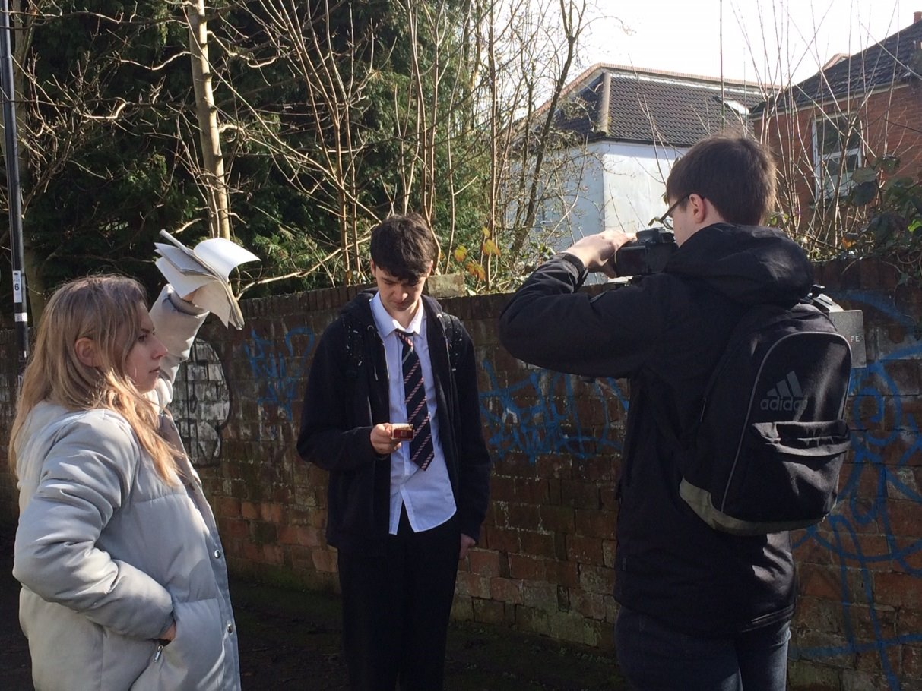
Illegal tobacco
YouTube video:
Illegal Tobacco – See it, Report it, Stop it!

