Slide 1
Smoking and the media

Slide 2
Purpose of session
To help young people understand how tobacco companies market their products.
Learning outcomes
Understand some of the strategies used in advertising and marketing campaigns.​
Explain how image and stereotyping can be used in advertising campaigns, including those of tobacco companies. ​
Reflect on what makes a good ‘anti-smoking’ campaign and the key elements they need to prevent smoking.

Slide 3
What is your favourite advert?
What product is being advertised?​
​
Why do you like the advert?​
​
Is the advert successful?

Slide 4
What are the elements of a successful marketing campaign?
Establish a goal​.
Know your audience​.
Clearly state your unique selling point (USP)​.
Choose your outlet wisely, i.e. where the advert will be seen​.
Follow up – once isn’t enough - e.g. Go Compare advert​.
Call to action – it calls the viewer to make a change.

Slide 5


Are people in adverts representative of the general public?
Advertising campaigns use unrealistic ‘ideals’. They do this to imply that buying the product brings you one step closer to becoming the image.

Slide 6
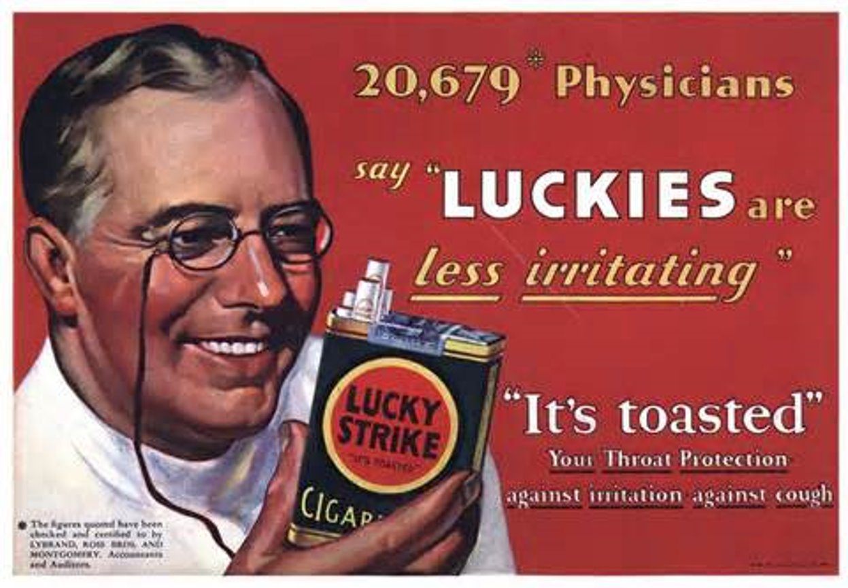

Slide 7
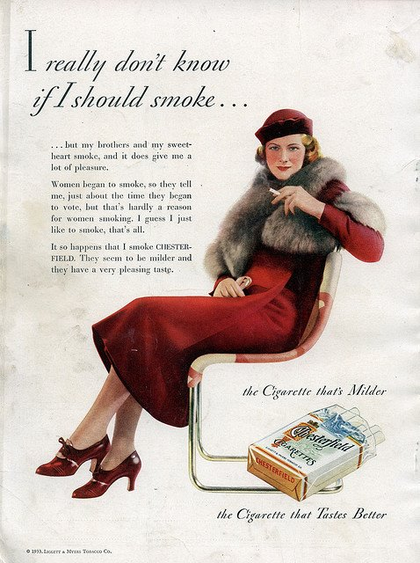

Slide 8
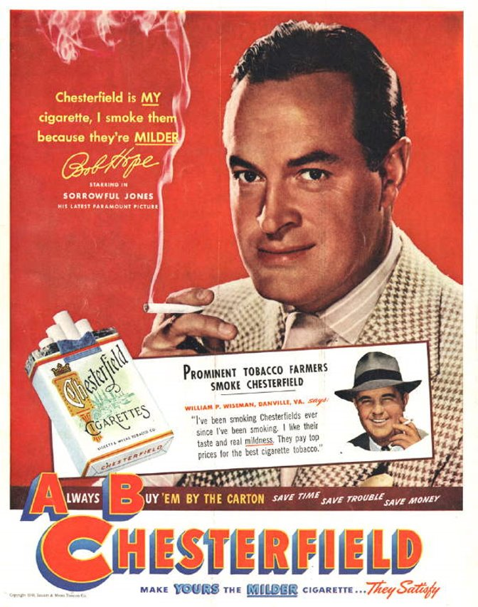

Slide 9
Summary - advertising by tobacco companies
The Tobacco Advertising and Promotion Act ended most advertising in the UK in 2002. This meant no TV adverts, sports sponsorship, posters, magazines or billboards.​
​
N.B. It is also illegal for a UK based company to directly advertise tobacco on the web.
So how might tobacco companies ‘get around’ these laws?

Slide 10
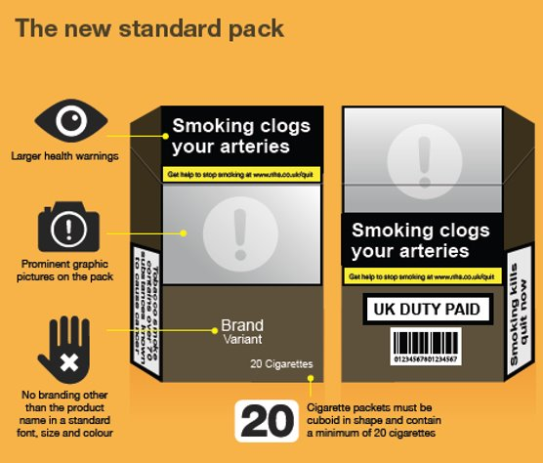
Summary - advertising by tobacco companies
Use of cigarette packaging as a marketing tool – even a dropped packet in the street can be marketing.
But, from May 2017, all
cigarette packets in the UK
became standardised as shown.

Slide 11
Summary - advertising by tobacco companies
There is some suggestion that the industry ‘may’ be using YouTube to get around laws by playing ‘pro-tobacco’ videos.​
Smoking in films is still prevalent (although there are moves to limit this).​
Festivals in the UK are sometimes sponsored by tobacco ‘rolling papers’ which are exempt from the ban.

