Slide 1
Smoking and the law

Slide 2
Purpose of session
To increase young people’s awareness of UK laws relating to smoking and the use of smoking policies in schools.
Learning outcomes
Give at least three examples of UK laws that relate to smoking and secondhand smoke.​
Explain why we have laws around smoking in the UK.​
Give different viewpoints on the existing UK laws.

Slide 3

Activity
Write down all the laws you are aware of relating to cigarettes and smoking.

Slide 4
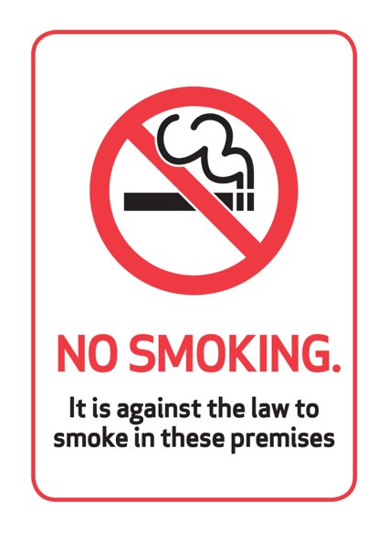
A selection of tobacco related laws
Health Act 2006​ Smokefree (Premises and enforcement) Regulation
A person who smokes in an ‘enclosed’ or ‘substantially enclosed’ public place is committing an offence.

Slide 5
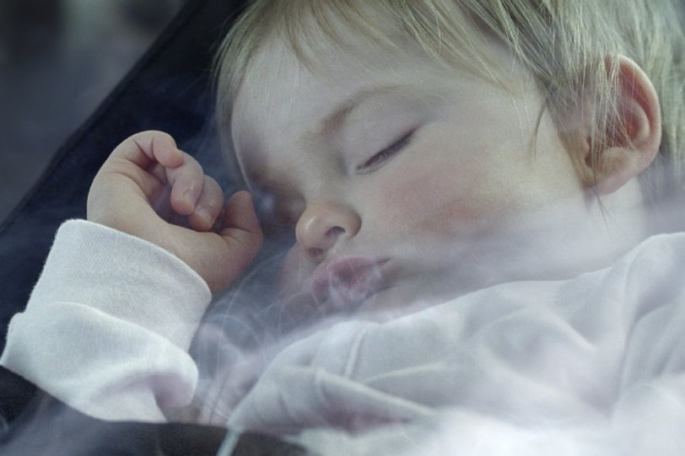
A selection of tobacco related laws
Smoking in Cars and Other Vehicles 2015
It is illegal to smoke in a private vehicle that is carrying someone under 18, or for the driver not to stop a passenger lighting up.

Slide 6
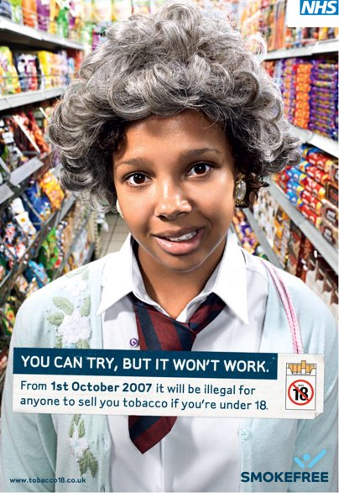
A selection of tobacco related laws
Children and Young Persons Act 1933​
Section 7
Any person who sells tobacco or cigarette papers to a person under the age of 18, whether for the buyer's own use or not, shall be guilty of an offence.

Slide 7
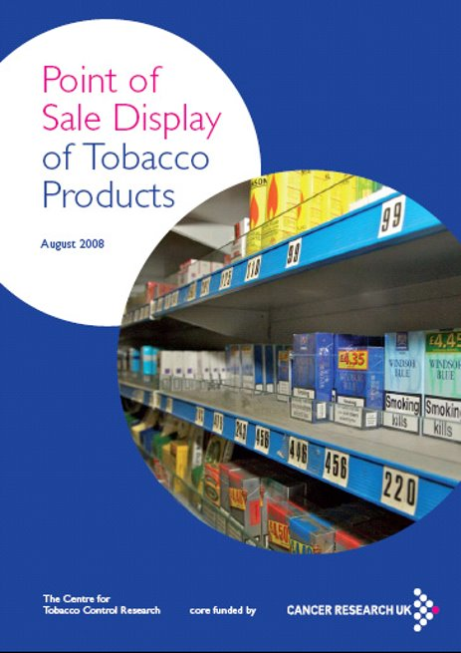
A selection of tobacco related laws
Health Act 2009​ Advertising and Point of Sale
It is illegal to display tobacco products at the point of sale in large stores, such as supermarkets.

Slide 8
Why do we have laws on smoking?
To protect non-smokers from the impact of secondhand smoke.​
​
To encourage smokers to quit.​
​
To reduce the opportunities for marketing of cigarettes to young people who may be influenced to smoke.​
​
To promote the public health and reduce the costs to the UK taxpayer of treating smoking related illness.

Slide 9
How effective do you think the UK laws are?
How effective are the UK laws at preventing young people from smoking?​
​
How helpful are the UK laws to encouraging adults to stop smoking?

Slide 10
What is a law?
A law is​
A rule, or body of rules, made by the legislature or other authority; legal. ​
​
A rule is ​
A statement of what is allowed, for example, in a game or procedure. ​
​
One of the basic differences is that, while there may be consequences for breaking a rule, you can be prosecuted for breaking a law.

Slide 11
Scenario 1
How would you deal with the scenario if you were a teacher
at your school? ​
​
Remember, you have seen your school Drug Education/
Smokefree Policy – how does this help?

Slide 12
Scenario 2
At a school celebration event, some Year 9 and 10 pupils are smoking outside the school gates.
One teacher walks past and ignores this, but a second teacher challenges the pupils.
The pupils reply by stating that it is not right for them to be in trouble for smoking, as they have seen teachers smoking.

Slide 13
Scenario 3
Whilst out shopping at the weekend, one of the teachers sees a group of pupils from the school smoking.

Slide 14
Scenario 4
The school receives a complaint from a member of the public.
The person states that several pupils are displaying poor behaviour and smoking in the street whilst travelling home from school.

Slide 15
Scenario 5
During a PSHE lesson on smoking, several pupils disclose the fact that they sometimes smoke.
When the teacher states that young people are not allowed by law to be sold cigarettes, the pupils reply with the fact that they get their cigarettes from a variety of places including older pupils, their parents, and one of the local shops.

Slide 16
Scenario 6
A parent comes into school at the end of the day and informs the staff that her child has been sold cigarettes by a pupil at the school.
When questioned, the parent states that they do not believe that it was during the school day.

Slide 17
If you are aware of tobacco being sold illegally in your area, you can share information anonymously to Trading Standards. Visit www.stop-illegal-tobacco.co.uk or call 0300 999 6999.

