Slide 1
Smoking and health

Slide 2
Purpose of session
To help you understand the effects of smoking on health and to be aware of different attitudes to smoking.
Learning outcomes
Explain the effects of smoking on health.​
Explain the risks of smoking to health.​
Describe different views that people have on smoking.

Slide 3
Write down one thing that you already know about smoking.

Slide 4
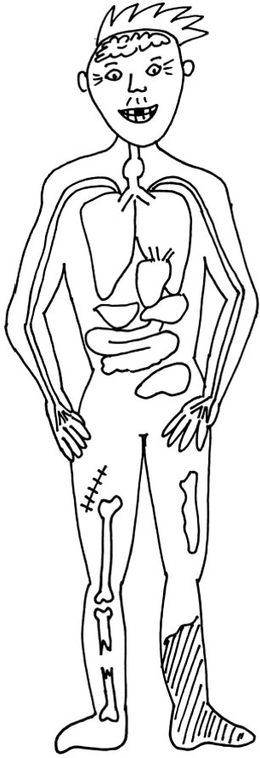
A smoker’s body​
Addiction
Smelly hair
More wrinkles
Thinner hair/hair loss
Increased risk of going deaf
Increased risk of blindness/cataracts
Risk of throat cancer/mouth cancer
6 x more likely to have a stroke
Double risk of heart attack
Yellow teeth
15-30 times more likely to get lung cancer
High blood pressure/blood clots
Leukaemia (blood cancer)
Lung disease (COPD)
Yellow fingers
Cancer of stomach/liver/bladder
Slower healing
Worsening of eczema and psoriasis
Increased risk of osteoporosis
Risk of gangrene and amputation

Slide 5
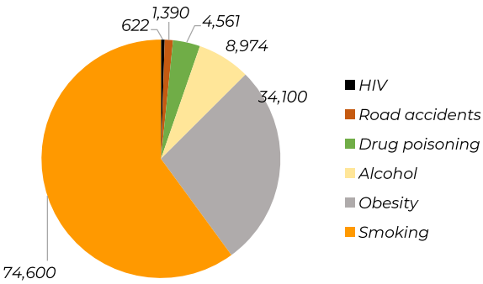
What are the risks of smoking?
Smoking causes over half the preventable deaths in England and almost double all the other causes put together.
Causes of preventable deaths in England including smoking
In 2019, there were an estimated 74,600 deaths linked to smoking in England.

Slide 6


What are the risks of smoking?
50 out 100 of all smokers will die from a smoking related illness before the
age of 65. You've got better chances:
Base jumping (1 in 60 chance of dying)
Climbing over 6000m in Himalayas​
(12.6 in 100 of dying)

Slide 7
​
What would be the top health risks that you would worry about?

Slide 8
If people know the effects of smoking, why do they still do it?
They are addicted​.
They down-play the risks – it’s easier to think that the risk is less, than to stop​.
They don’t know how to stop or don’t have the skills to stop​.
They can’t imagine their life without cigarettes​.
They can’t see the benefits of quitting​.
They don’t think they will be able to do it – they lack confidence.

