Slide 1
Secondhand smoke

Slide 2
Purpose of session
To help you understand the dangers of secondhand smoke.
Learning outcomes
Describe where secondhand smoke can be found.​
Explain the dangers of secondhand smoke to children.​
Describe ways to reduce exposure to secondhand smoke.​
Write a persuasive argument to encourage a smoker not to smoke around children.

Slide 3
What is secondhand smoke?
Secondhand smoke is the smoke that you breathe in from other peoples’ cigarettes. ​
​
It includes the smoke that people exhale (breathe out), and the smoke created by the lit end of the cigarette.

Slide 4
Where do children breathe secondhand smoke?
At home​
At grandparents’ home​
When visitors come around​
Outside shopping centres​
Around playgrounds when parents are smoking ​
Outside pubs and bars​
Since October 2015 it has been against the law for an adult to smoke in a car with someone under 18 present. ​
Where are you exposed to secondhand smoke?

Slide 5
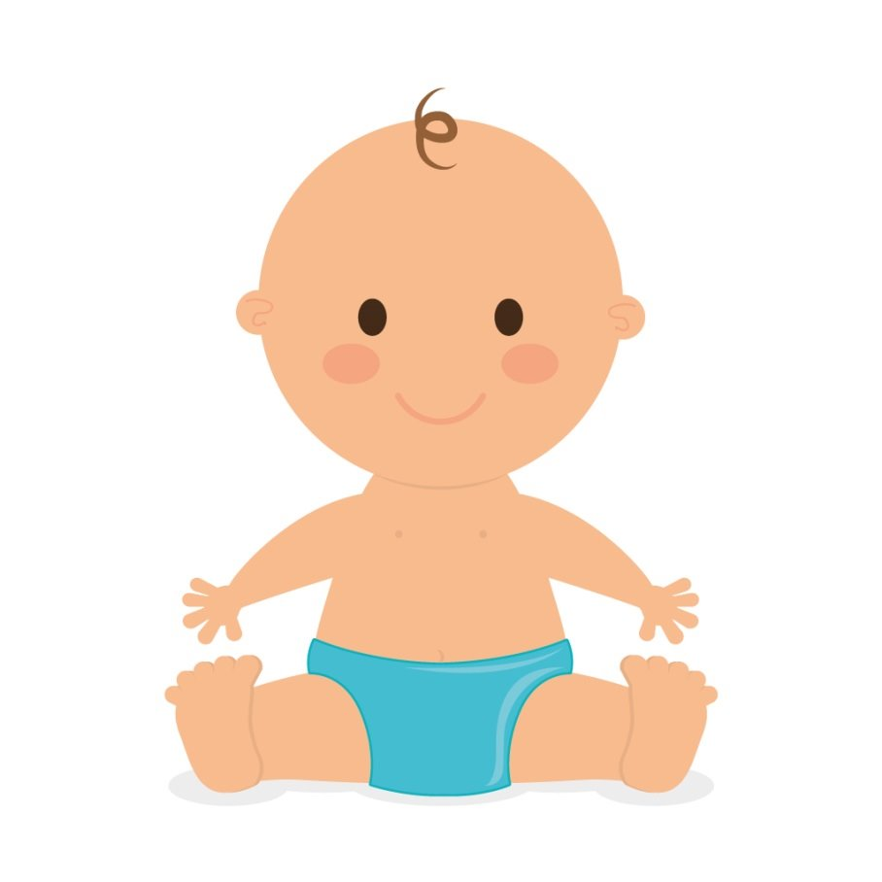
How does secondhand smoke affect children?
How does secondhand smoke affect a child’s development?
How will secondhand smoke affect the child socially?
How does secondhand smoke affect a child’s breathing?
What might be the long-term effects of second-hand smoke when the child grows up?

Slide 6
How does secondhand smoke affect children?
Development​
Increase in ear infections ​
Increased risk of middle ear disease (can lead to deafness)​
Increased risk of cot death​
Increased risk of bacterial meningitis​
More coughs and colds​
More likely to develop behavioural issues such as ADHD​
Social​
Clothes and hair likely to smell of smoke​
Other children likely to comment on smell​
Other parents may be less likely to allow their own child in the home
Long term​
Increased risk of lung cancer in later life, even if the child does not become a smoker.
More likely to go on to smoke themselves
Increased risk of developing cardiovascular disease as adults, even if they don’t smoke
Breathing​
Impaired lung function​
More risk of chest infections​
Increased risk of asthma/asthma made worse

Slide 7

Secondhand smoke also affects pets
Dogs who live with a smoker are 60% more likely to develop lung cancer.​
Cats living with smokers are twice as likely to get lymphoma (a type of cancer).

Slide 8
NHS secondhand smoke ads
NHS Fife's guide to the dangers of second hand smoke – YouTube​
NHS Smokefree: Secondhand smoke campaign – YouTube

Slide 9
How does secondhand smoke affect babies?
Greater risk of Sudden Infant Death Syndrome (Cot Death).​
Increased risk of ear infections and glue ear​.
Increased risk of coughs, colds and chest infections.​
Asthma and other illnesses are made worse​.
More likely to have conditions such as ADHD and lower reasoning ability.

Slide 10
How does secondhand smoke affect children?
More likely to be off sick from school with coughs and colds.​
More likely to smoke themselves.​
Affects social relationships if their house smells smoky, e.g. other parents may not want their child to visit.

Slide 11
How does secondhand smoke affect a child into adulthood?
Increased risk of lung cancer in later life, even if the child does not become a smoker.​
More likely to go on to smoke themselves. ​
Increased risk of developing cardiovascular disease as adults, even if they don’t smoke. ​
​
Remember: Although secondhand smoke is harmful, it is not as dangerous as if you smoked yourself. You don’t need to worry as there are steps you can take to reduce the amount of secondhand smoke you breathe.

Slide 12
How can you protect yourself?
Speak maturely to family members to ask them if they would like to stop smoking. Tell them about Smokefree Hampshire.​
Speak to family members in a sensible way about your concerns and ask if they would consider creating a smokefree home.​
If you can’t have a smokefree home, try to keep your bedroom smokefree and stay away from smokers when they are having a cigarette.​
Regularly open windows to air the building after someone has smoked inside.

Slide 13
Scenario
Tom is 6 years old and lives in a household with his mum, dad and
6-month-old baby brother.
His mum and dad smoke 20 cigarettes a day.
They do not smoke in the baby’s room but smoke in the kitchen and living room.

Slide 14
Activity
Write a persuasive letter to Tom’s parents explaining why they should make their home smokefree. Remember to include:​
The effects of secondhand smoke on both children.​
The benefits of making a home smokefree.​
The steps that they can take to make a home smokefree.

Slide 15
Remember
Although secondhand smoke is harmful, it is not as dangerous as if you smoked yourself.
You don’t need to worry as there are steps you can take to reduce the amount of secondhand smoke you breathe.

