Slide 1
A ‘whole settings’ approach to
smoking in school
Presentation for staff and SLT
When referring to smoking or smokefree, this applies to vaping and being vape-free

Slide 2
Why is preventing smoking in school important?
80% of smokers started before the age of 18.
School has a responsibility to protect young people and prevent them from developing a life-long addiction.
School has a smokefree site policy but [insert areas] are sometimes used for smoking.
School should reinforce and model healthy behaviours.
School should protect non-smokers from the effects of secondhand smoke.
Smokers are more likely to be absent from school due to sickness.
Smoking on site creates litter.
To prepare students for a workplace with a no smoking policy.
To enable students to develop healthy and productive ways to cope with life's stresses.

Slide 3
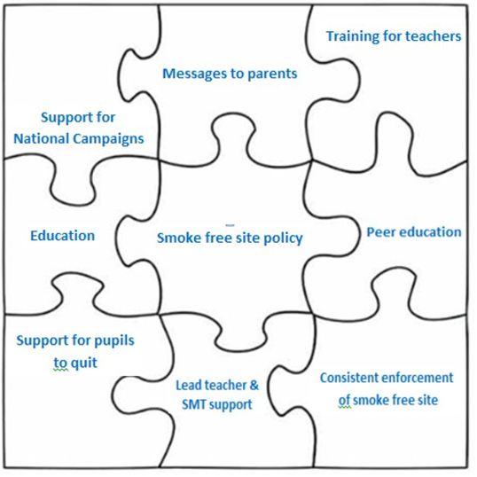
A ‘whole setting’ approach to smoking
What is a ‘whole setting’ approach to smoking?
This approach acknowledges that there is not one single initiative that leads to a smokefree culture in a school.
Action needs to take place at a variety of different levels, over a period of time, for change to take place.
i.e. That each piece of the jigsaw should be complete.

Slide 4
What is included in the whole setting approach?
Students need access to support to quit smoking.
Student led initiatives to address myths and culture.
Support and commitment from SLT.
Training for teachers to give the right messages, e.g. on vapes.
Taking part in national campaigns.
Recognising the role of parents and encouraging them to quit.
Improving the quality and quantity of education.
Central to the whole settings approach is smokefree site policy.

Slide 5
Benefits of a completely smokefree school site
It recognises the role of school in promoting the health of students.
Prepares young people for a smokefree workplace.
Prevents uptake and sets clear boundaries for students.
Students more likely to quit if smoking is more difficult.
Reduced litter on site.
Increased concentration and attention of students.
Fewer smokers result in a reduction in absenteeism.
Helps promote our staff as good role models for students.

Slide 6
Next steps
Identify a member of staff who can be a champion for the whole setting approach to smoking. The role needs to be included in yearly objectives.
Revisit school policy and consider a relaunch.
Look at each area of the whole settings approach and consider what can be achieved in each of the areas. Make a plan for when each aspect of the whole setting approach will be addressed, e.g. peer education, communications with parents/carers, training for staff.

