Slide 1
A ‘whole settings’ approach to smoking in college
Presentation for staff and SLT
When referring to smoking or smokefree, this applies to vaping and being vape-free

Slide 2
Why is preventing smoking in college important?
80% of smokers started before the age of 18.
Many students arrive at college as non-smokers but leave as smokers.
College has a responsibility to protect young people and prevent them from developing a life-long addiction.
College should reinforce and model healthy behaviours.
College should protect non-smokers from the effects of secondhand smoke.
Smokers are more likely to be absent from college due to sickness.
Smoking on site creates litter.
To prepare students for a workplace with a no smoking policy.
To enable students to develop healthy and productive ways to cope with life's stresses.

Slide 3
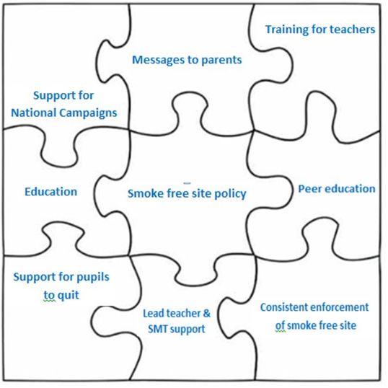
A ‘whole setting’ approach to smoking
What is a ‘whole setting’ approach to smoking?
This approach acknowledges that there is not one single initiative that leads to a smokefree culture in a college.
Action needs to take place at a variety of different levels, over a period of time, for change to take place.
i.e. That each piece of the jigsaw should be complete.

Slide 4
What is included in the whole setting approach?
Students need access to support to quit smoking.
Student led initiatives to address myths and culture.
Support and commitment from SLT.
Training for teachers to give the right messages, e.g. on vapes.
Taking part in national campaigns.
Recognising the role of parents and encouraging them to quit.
Improving the quality and quantity of education.
Central to the whole settings approach is smokefree site policy.

Slide 5
Benefits of a completely smokefree college site
It recognises the role of college in promoting the health of students.
Prepares young people for a smokefree workplace.
Prevents uptake (many young people do not start smoking until college, when the designated areas make smoking more accessible).
Students more likely to quit if smoking is more difficult.
Reduced litter on site.
Increased concentration and attention of students.
Fewer smokers result in a reduction in absenteeism.
Helps promote our staff as good role models for students.

Slide 6
Challenges of going completely smokefree
Resistance from staff, students and visitors.
Displacement smoking to neighbours.
Possibility of more lateness for lessons due to going off site.
Smokers may feel discriminated against.
Time commitment in enforcing the policy.
Withdrawal symptoms may be experienced by smokers.

Slide 7
Suggestions for coping with challenges
Resistance from staff, students and visitors
Undertake an insight exercise. Survey for opinions of all involved in policy development. Communicate the reasons/benefits before implementation and give plenty of notice. Gain students support - the majority are non-smokers.
Displacement smoking to neighbours
Write to local neighbours in advance, explaining policy and that displacement smoking is usually short lived. Encourage feedback.
Possibility of more lateness for lessons due to going off site
Deal firmly with lateness as according to normal policy. This period may also be short lived. Work with feeder schools so new students are aware.

Slide 8
Suggestions for coping with challenges
Smokers may feel discriminated against
The policy is not about who smokes, but where people smoke. Smokers and non-smokers have rights, but the rights of non-smokers (the majority) to breathe clean air, take precedent over those of smokers.
Time commitment to enforce
Initial commitment will reduce once ‘smokefree culture’ is achieved. Using peer led approaches can support enforcement.
Withdrawal symptoms may be experienced by smokers
Support is available from www.smokefreehampshire.co.uk. Be understanding of those who have nicotine addiction.

Slide 9
What are the next steps?
Identify a Smokefree Champion. Allow them time and SLT support.
Have a small working group (include students, staff, SLT etc.)
Review current issues, existing smoking areas and gain insight from students.
Consult/survey about changes to the policy.
Draft a policy (templates available).
Evaluate policy.
Get policy signed off. Communicate policy and give notice to all. Provide offer of support.
Implement policy.
Evaluate effectiveness, outcomes and review.
Smokefree Champion to slowly build in other aspects of the whole setting’s approach to college e.g. support for campaigns, engagement with parents, etc.

