Slide 1
Other forms of tobacco

Slide 2
Purpose of session
To help you understand about other forms of tobacco and their impact on health and communities.
Learning outcomes
Give examples of how tobacco is sometimes used (other than in cigarettes) and explain impact on health.​
Explain why people use other forms of tobacco and be able to write a persuasive argument about their impact on communities.

Slide 3
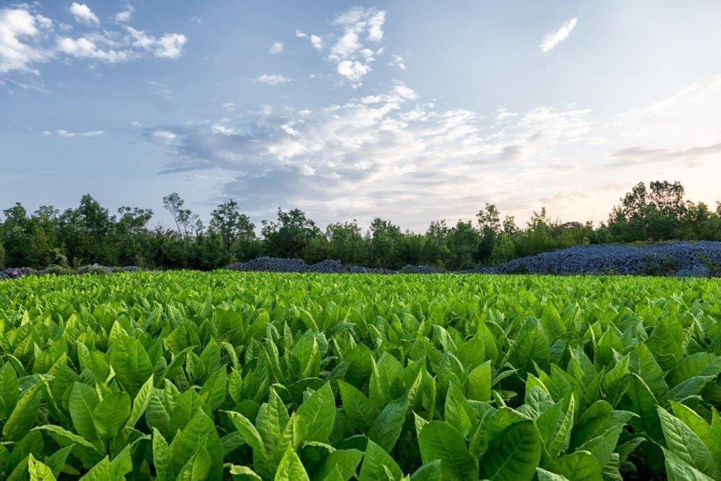
Cigarettes are made of tobacco leaves
Tobacco is grown in places all over the world. The top 5 producers are:​
​
China​
India​
Brazil​
United States​
Malawi
Tobacco leaves contain nicotine which is the addictive part of a cigarette.

Slide 4
Can you think of any other ways that people use tobacco?

Slide 5
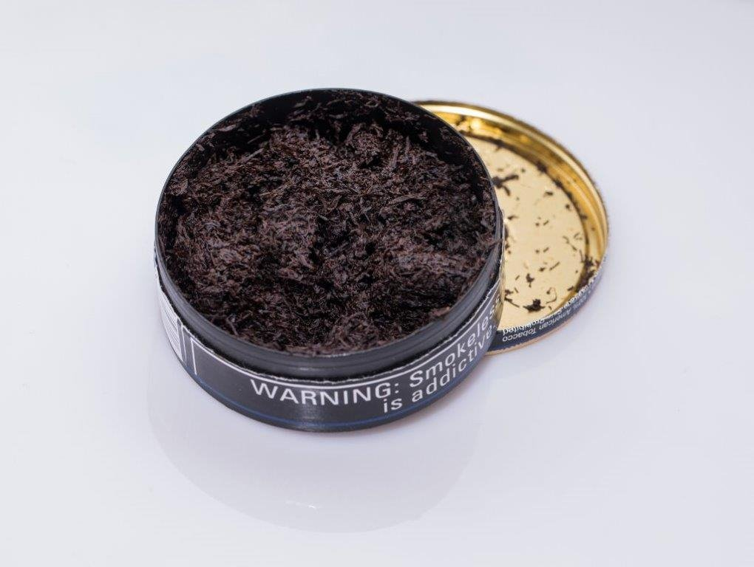
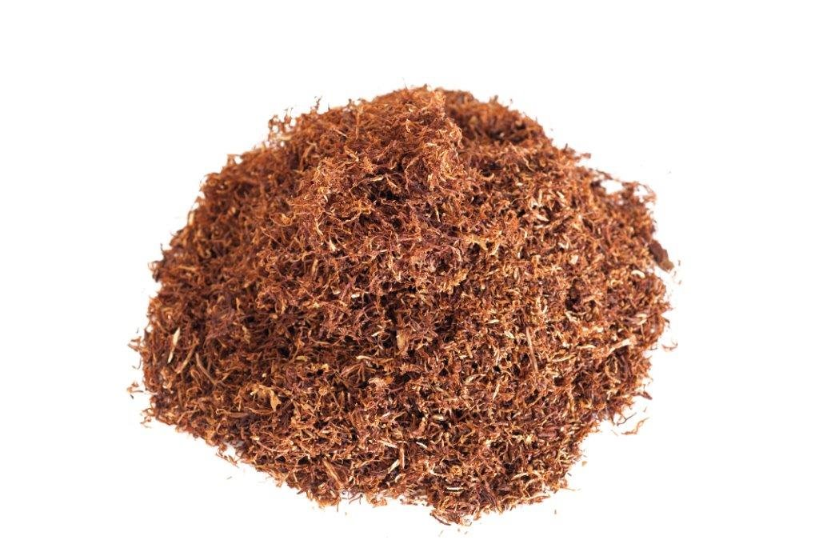
Smokeless tobacco
There are two main types of smokeless tobacco - snuff and chewing tobacco.
Snuff – A fine grain tobacco that comes in teabag-like pouches that people pinch and put between their gum and lip. Sometimes people stuff it up their nose. You may also hear this being called 'Snus'.
Chewing tobacco – Shredded or twisted tobacco, or tobacco in a brick that is put at the side of the gum.

Slide 6
How does smokeless tobacco work?
The tobacco is held in the mouth or nostril. This area has lots of very fine blood vessels close to the surface.​
​
When it softens, the nicotine in the tobacco is slowly absorbed into the bloodstream.​
​
The nicotine is delivered through the bloodstream to the brain with similar effects to smoking (although this delivery method is slower acting than smoking).

Slide 7
Health risks of smokeless tobacco
People who use smokeless tobacco will still become addicted to nicotine.​
Smokeless tobacco contains many harmful chemicals that are found in cigarettes.​
Cancers linked to smokeless tobacco include mouth, tongue, cheek and lip cancer. Use is also linked to cancer of the oesophagus (swallowing tube) and pancreatic cancer.​
Smokeless tobacco causes tooth loss, staining and bad breath.​
There is an increased risk of heart disease and stroke in people who use smokeless tobacco.

Slide 8
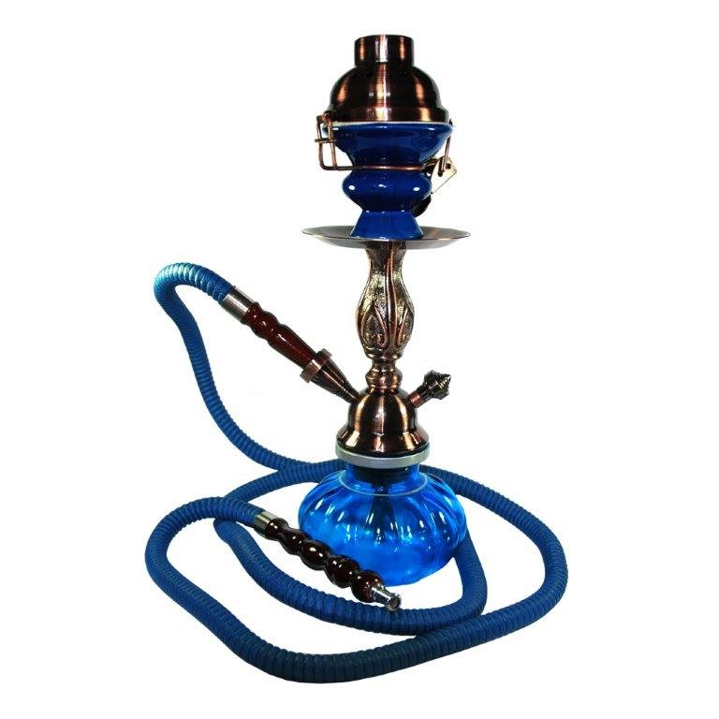
Shisha
Sometimes referred to as a waterpipe or hookah.​
Often found in places like Turkey and Egypt.​
Shisha cafés exist all over the UK.​
Is different from a bong which is used for drugs. ​
It's completely legal to purchase the equipment, although it is illegal to sell the tobacco to someone under 18.

Slide 9
How does shisha work? ​
Hot charcoal is added to the bowl at the top of the pipe along with sticky flavoured tobacco. ​
​
As someone sucks the pipe, oxygen is drawn through the coals and tobacco, increasing the heat. The smoke created is drawn down through the water in the bottom.​
​
As the smoke rises back out of the water it is inhaled through the pipe into the mouth.

Slide 10
What effect does shisha have on health?
The smoke from shisha contains cancer causing toxins. Although it is cooled by the water, it is not filtered. ​
Because the smoke passes through the water and is cooler, people use shisha for much longer periods than smoking - this causes even more damage to the body.​
In one session (20-80 mins) a person can inhale the same amount of smoke as 100 cigarettes.​
Nicotine in shisha is as addictive as in a cigarette.​
The charcoals in shisha add additional toxins to the body.​
Carbon monoxide and other chemicals from shisha put the user more at risk of heart disease.​
There is a risk of spreading infection through the use of uncleansed pipes and equipment e.g. tuberculosis. ​
There is a risk to other people of secondhand smoke from shisha.

Slide 11
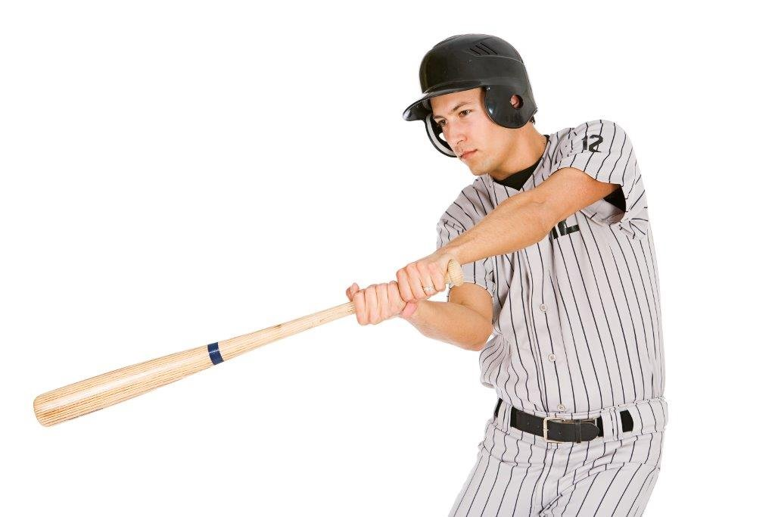
Who uses smokeless tobacco?
Smokeless tobacco has been around for a long time. Native people in North and South America used to chew tobacco. ​
It has been particularly popular in American culture with baseball players who chew it on the field.​
In the UK, it is most popular with South Asian communities.
Why do people use smokeless tobacco?
Some people prefer the fact that it does not create smoke, i.e. it is more discreet.​
Some people believe that it is safer than smoking.​
For some it is a cultural tradition.

Slide 12
Who uses shisha?
Shisha pipes originated in Persian communities.​
Shisha is more commonly used by people from mixed/multiple ethnic groups and Asian/Asian British.
Why do people use shisha?
People perceive it as being less harmful than smoking. People falsely think that the water in the pipe ‘filters’ the smoke. ​
It is seen as a social activity.

Slide 13

Activity​
You are a journalist for a local paper. A new shisha café has just opened in your town. Write an engaging report on the impact that this might have on the town.​
Remember to:​
Explain what shisha is to the reader.​
Consider who might be attracted to the venue.​
Explain how it will affect the town in the short and long term. ​
Tell people where they can get more information.

