Slide 1
Electronic cigarettes
E-cigarettes: A closer look at their impact on young people

Slide 2
Purpose of session
Awareness: Highlight the dangers of vaping, particularly for young people and people who do not smoke.
Informed decisions: Encourage young people to understand why avoiding both vaping and smoking is crucial for their health.
Empowerment: Equip young people with strategies to resist vaping and support their peers.

Slide 3
Learning outcomes
By the end of this session, young people will be able to:
Identify the components of e-cigarettes.
Recognise why vaping is harmful for young people and people who do not smoke.
Dispel myths about vaping.
Understand the reasons why some people may vape.
Advocate for healthy choices among peers.

Slide 4
What do you know already?
What is your opinion?

Slide 5
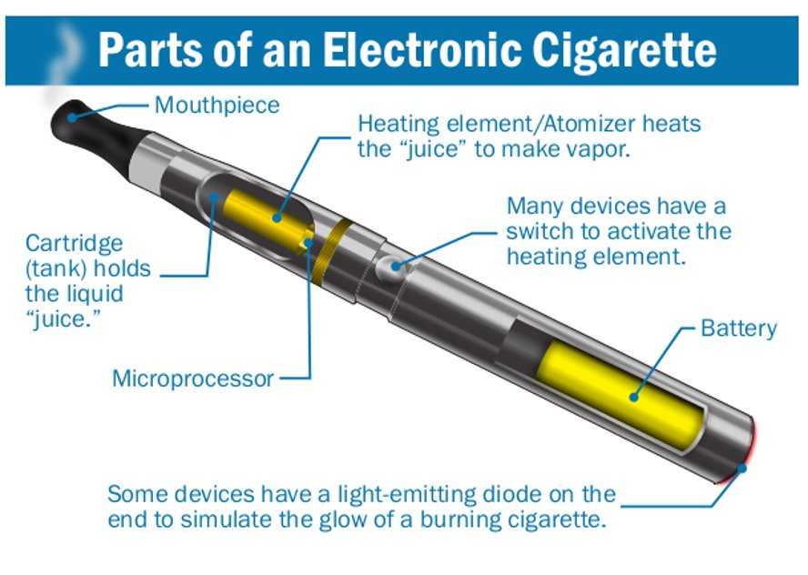
What are electronic cigarettes?
Electronic cigarettes work by super heating liquid nicotine and turning it into vapour (a bit like steam). When this vapour is inhaled it is absorbed by the mouth and lungs to enter the blood stream. When the nicotine hits the brain, it produces effects similar to smoking.

Slide 6
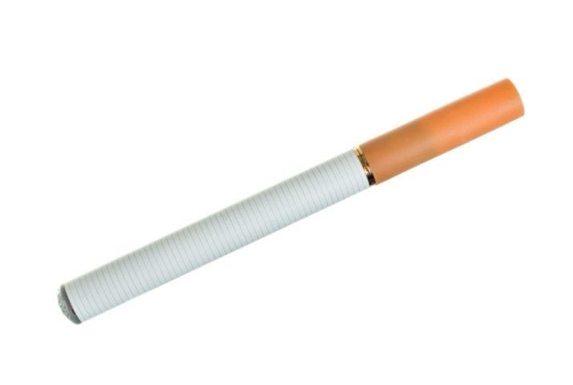
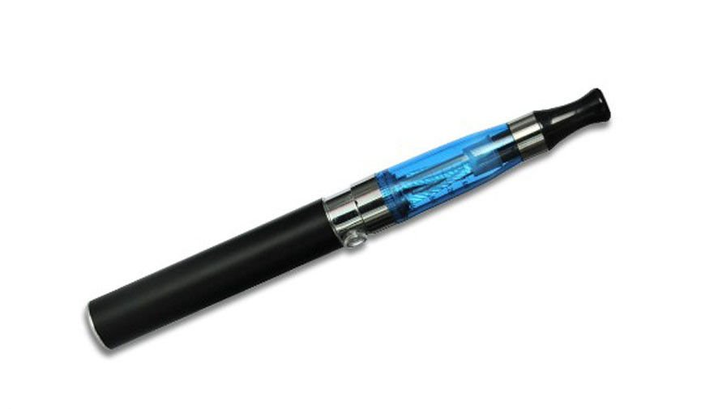
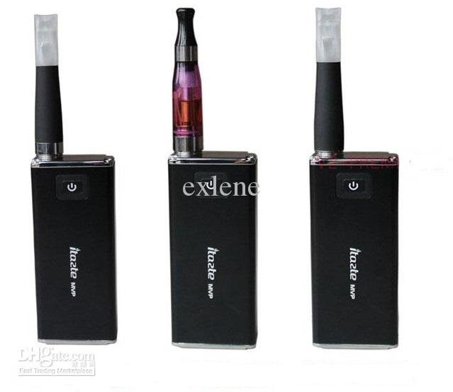
Types of electronic cigarette
Cigarlikes: Resemble traditional cigarettes; often disposable.
Vape pens: These devices come with a tank that you can fill with e-liquid. They feature a replaceable coil and a rechargeable battery.
Vape mods: Customisable devices that offer variable power settings. They require more maintenance and are more complex to use.
Vape bars: Shaped like a highlighter pen, these can be rechargeable and refillable with e-liquid capsules, though they are often disposable.
Compact pod devices: These are shaped like a flash drive or pebble. They can be either rechargeable and refillable with e-liquid capsules or disposable.
Vaping to quit smoking - Better Health - NHS

Slide 7
What do e-cigarettes contain?
Main ingredients are vegetable glycerine and propylene glycol
Most vapes also contain nicotine, which is an addictive substance, particularly for young people.
Vapes can come with different nicotine strengths but should not contain more than 20mg/ml or 2%.
Some illegal vapes say they don't contain nicotine, but they do.
Vapes also contain flavourings which can be attractive to young users and mask the harshness of nicotine.
Vapes do not contain the toxic chemicals found in cigarettes like tar and tobacco.

Slide 8
Electronic cigarette myths and facts
Myth: Vaping is as harmful as smoking
Fact:
Vaping is less harmful than smoking cigarettes as they do not contain the toxic chemicals found in cigarettes like tar and tobacco. This is why vapes are recommended to help adults quit smoking. However, they are not harmless and should not be used by children and young people, or people who don’t smoke.

Slide 9

Electronic cigarette myths and facts
Myth: Vapes are not age restricted
Fact:
In the UK, it is illegal to sell a vape or e-cigarette to anyone under the age of 18, or for an adult to buy one on their behalf.
If you know of anyone selling vapes to under 18’s, you can report them anonymously to trading standards.

Slide 10
Electronic cigarette myths and facts
Myth: Most young people vape
Fact:
Most young people don’t vape.
In 2024, 18% of young people aged 11-17 had tried vaping, which means the majority (82%) have not tried vaping.

Slide 11
Electronic cigarette myths and facts
Myth: Vaping is harmless
Fact:
Whilst vaping is less harmful than smoking, it is not harmless, and the long-term effects are still unknown. Short term effects include coughing, headaches, dizziness and sore throat. Most vapes also contain nicotine, which is a highly addictive substance.
Remember – if you don’t smoke, don’t vape!

Slide 12
Electronic cigarette myths and facts
Myth: Vaping helps you cope with stress and anxiety
Fact:
Vaping can actually make feelings of anxiety and stress worse.
Nicotine is a highly addictive substance and withdrawal from nicotine can cause irritability, difficulty concentrating, increased feelings of anxiety and low mood. Users incorrectly believe that nicotine will relieve this and become trapped in a cycle of nicotine addiction. If you are struggling with your mental health, there are better ways to cope.

Slide 13
Electronic cigarette myths and facts
Myth: All vapes are safe because they are regulated in the UK
Fact:
In the UK vapes are regulated under the Tobacco and Related Products Regulations (TRPR) and have restrictions on nicotine strength (max 2% or 20mg/ml), volume of e-liquid and product safety.
However, some vapes that are sold in shops and online are illegal and have not been properly regulated, therefore we don’t know what they contain – and they could contain harmful ingredients.

Slide 14
Why do some people vape?
Vapes are recommended as a quit aid for adults, so adults may vape for this reason. However, vapes are not recommended for children and young people, or people who do not smoke.
Some of the reasons young people or people who do not smoke may vape include:
Peer pressure: Many young people feel pressured to vape to fit in, and evidence shows that being around others who smoke or vape increases your chances of taking it up.
Marketing tactics: E-cigarette companies directly target young people with colourful packaging and appealing flavours. They are driven by profit – don’t be duped!
Social media: Platforms often glamorise vaping, increasing curiosity among young people.

Slide 15
Environmental harms
Aside from the health harms of vaping, there are also environmental harms to consider:
Approximately 1.3 million vapes are disposed of every week in the UK – enough to fill 22 football pitches!
Vapes are very difficult and expensive to recycle because of the different types of plastics and batteries that they contain.
Vapes in landfills can leak chemicals and pollute soil and water – harmful to the environment, humans and animals.
Lithium batteries are highly flammable and have been known to cause fires.
UK Tosses 1.3M Single-Use Vapes Weekly, Recycling Urged

Slide 16
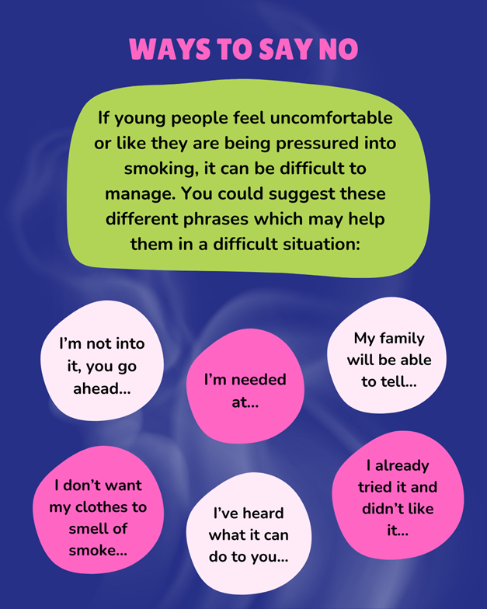
Refusal strategies
Think about methods that you could use to help you avoid pressure to vape, or to help your peers make informed decisions and be a positive influence.
What could you say?
Think about and write down some responses of your own.

Slide 17
Reflection
Spend some time reflecting on what you have learnt today and your opinion on vapes following this session.
Why is it important for
non-smokers and young people to avoid vaping?
How can you be a
positive influence
on your peers?

Slide 18
Remember...
If you don't smoke, don't vape!

Slide 19
Resources
Smokefree Hampshire
Free stop smoking service for anyone over the age of 12 who lives, works, goes to school, or is registered with a GP, in Hampshire. They also offer a quit vape service too. They can accept professional or self-referrals.
Talk to Frank
Trading Standards
It's important to remember that it is illegal to sell vapes to anyone under the age of 18. If you are aware of anywhere where underage sales are taking place, this can be reported anonymously to trading standards via the following routes:
  Report to our local trading standards team by calling 0300 999 6999.
  Or via Citizens Advice by calling 0808 223 1133, or by using their online form.

