Slide 1
Your Pension – Your Future
Your LGPS Annual Benefit Statement explained – active members
Hampshire Pension Services
August 2025

Slide 2
Checking your Annual Benefit Statement
Why is this important?
Your Local Government Pension Scheme (LGPS) is an important part of the package your employer offers.
The pension you build up will increase your income when you retire.
Each year we produce a statement that shows how your pension is building up.
It is based on the information held by Hampshire Pension Services
It is essential to check this each year to make sure the information held is correct.

Slide 3
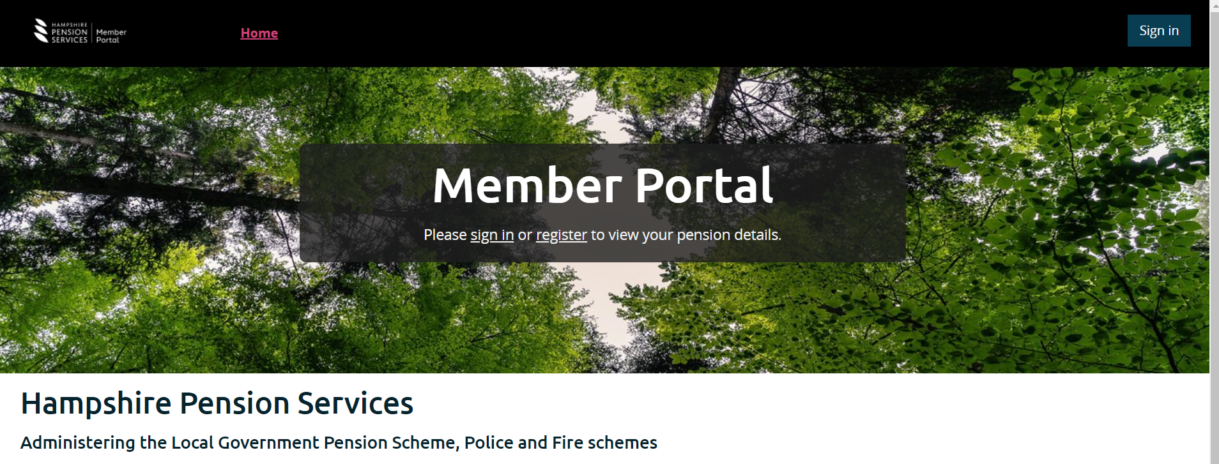
So how do I check my statement?
You can go online to check your statement on Hampshire Pension Service’s Member Portal:
Hampshire Pension Services - https://mypensionportal.hants.gov.uk/

Slide 4

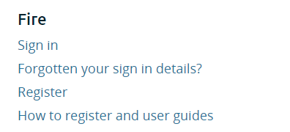
How do I log onto Member Portal?
If you are already registered for Member Portal – just click on the “sign in” link
If you have not yet registered for the Member Portal – click on the “register” link and follow the instructions for registering.
If you need help logging on or registering, click on the “How to register and user
guides” on the front screen under your relevant scheme.

Slide 5
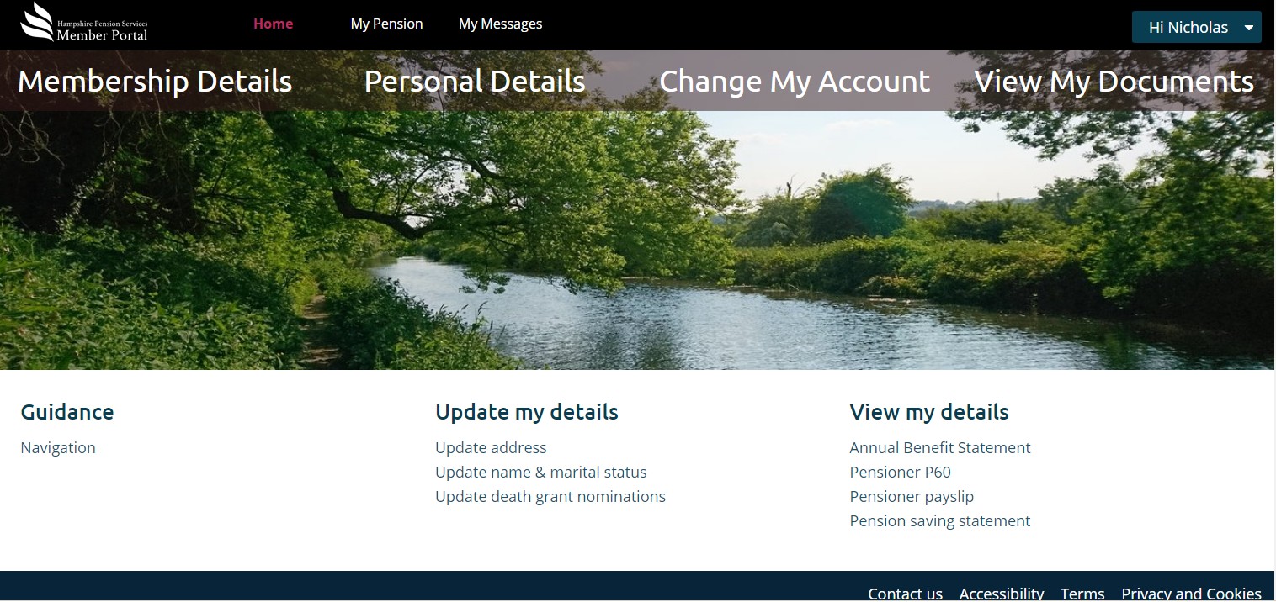
How can I view my statement?
You can view your latest Annual Benefit Statement on your documents.

Slide 6
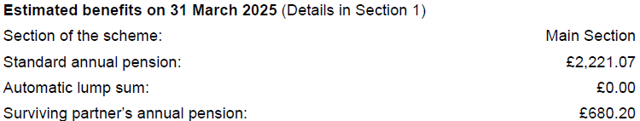
What does my statement tell me?
Section 1
Your statement is a snapshot of your pension benefits at 31 March 2025.
The benefits shown are based on you leaving the scheme at that date and not taking your pension until your Normal Pension Age and remaining in the same section of the scheme.
They do not show any reductions that would apply to your benefits if you were to take your pension early.
An automatic lump sum only applies if you were a member of the LGPS before 1 April 2008

Slide 7
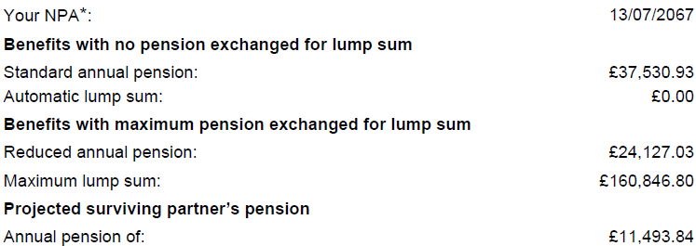
What does my statement tell me?
Section 2
Your statement will show a projection of benefits to your Normal Pension Age(NPA).
These figures are based on your current pensionable pay and are shown at today’s values
You should not use this statement to make any retirement decisions
These figures assume:
- Your pay will remain the same to your NPA
- You will stay in the same section of the scheme you were in at 31 March 2025
Note – if you have an in house AVC, you will not be able to exchange as much pension for lump sum

Slide 8


What does my statement tell me?
Section 2 – exchanging pension for lump sum
When you take your pension, you can decide to exchange some of your pension for a tax-free lump sum payment (subject to HM Revenue and Customs limits).
We show your projected pension based on you not exchanging pension for lump sum…..
….and you exchanging the maximum pension for lump sum (Based on an exchange rate of £1 pension for £12 lump sum)
If you have an in house AVC, you will not be able to exchange as much pension as shown.

Slide 9
What does my statement tell me?
Section 3 – Death Grant Lump Sum
Your LGPS membership gives you important life cover as a benefit of the scheme. This section shows you what your death grant lump sum would be if you were to die in service.

Slide 10
What does my statement tell me?
Section 3 – Death Grant Expression of Wish
The Pension Fund has absolute discretion over who receives your death grant lump sum.
If we hold an Expression of Wish from you saying who you would like this paid to, the Pension Fund will take this into consideration when making their decision.
It is important to complete your Expression of Wish and to keep this updated if your circumstances change.
You can complete, update or view your Expression of Wish through our Member Portal.

Slide 11
What does my statement tell me?
Section 4 – Final Salary
This section shows more detail on how your benefits up to 31 March 2025 have been calculated.
There are different ways we calculate your pension depending on how long you have been in the scheme.
If you were a member before 31 March 2008, the calculation for this period is based on:
Membership up to 31 March 2008 x Final Salary x 1/80
If you were a member between 1 April 2008 and 31 March 2014, the calculation for this period is based on:
Membership from 1 April 2008 to 31 March 2014 x Final Salary x 1/60
Scheme membership – if you were part-time then your service was adjusted based on the hours you worked
Final Salary - your average pensionable pay (based on full-time salary) in the 365 days up to 31 March 2025

Slide 12
What does my statement tell me?
Section 4 - CARE
From 1 April 2014, pension is built up each year. The calculation for this period is
Actual pay x 1/49
Actual pay = your actual pensionable pay for the year (the amount of pay you earnt that you paid pension contributions on).
It is important that you check this each year to make sure the pay we have used is correct.
If you do not agree with the amount of pay used, contact your employer.
If the amount is incorrect, they will need to provide us with a new pay figure so we can recalculate your pension for the year.
Your employer may not be able to review your past pay figures when you retire, so it is important you check this each year.
You can also view how your CARE pension is building up each year by using our Member Portal.

Slide 13
What does my statement tell me?
Section 5 – Lifetime Allowance
This section tells you how much of your lifetime allowance your current pension has used.
The Lifetime Allowance (LTA) was the amount you could take from all your pension savings without facing a tax charge. The Finance Act 2024 abolished the LTA in full with effect from 6 April 2024. The LTA has been replaced by two new tax allowances. See our website for more information: Pensions and tax | Hampshire County Council (hants.gov.uk)
For most people the amount used will not be anywhere near the HM Revenue and Customs limit.
Some people will be getting near the limit and may wish to take independent financial advice about their options.
Hampshire Pension Services cannot give financial advice.

Slide 14
What does my statement tell me?
Notes
Pensions can be complicated. There are explanatory notes in your statement, extended notes on our website and you can find further information in the Frequently Asked Questions section on our website.
If you have a query about your pay, contact your Employer.
For any other queries, or if you think any other information we hold about you is incorrect, please contact us.
  My Message – you can raise a query online by using “My Message” on the Member Portal. This is a secure way to raise a query with us.
  Email – Pensions@hants.gov.uk
  Write to us – Pension Services, The Castle, Winchester, SO23 8UB
  Phone – 01962 845588. Opening times – 09:00 – 16:30 Monday to Friday

