Slide 1
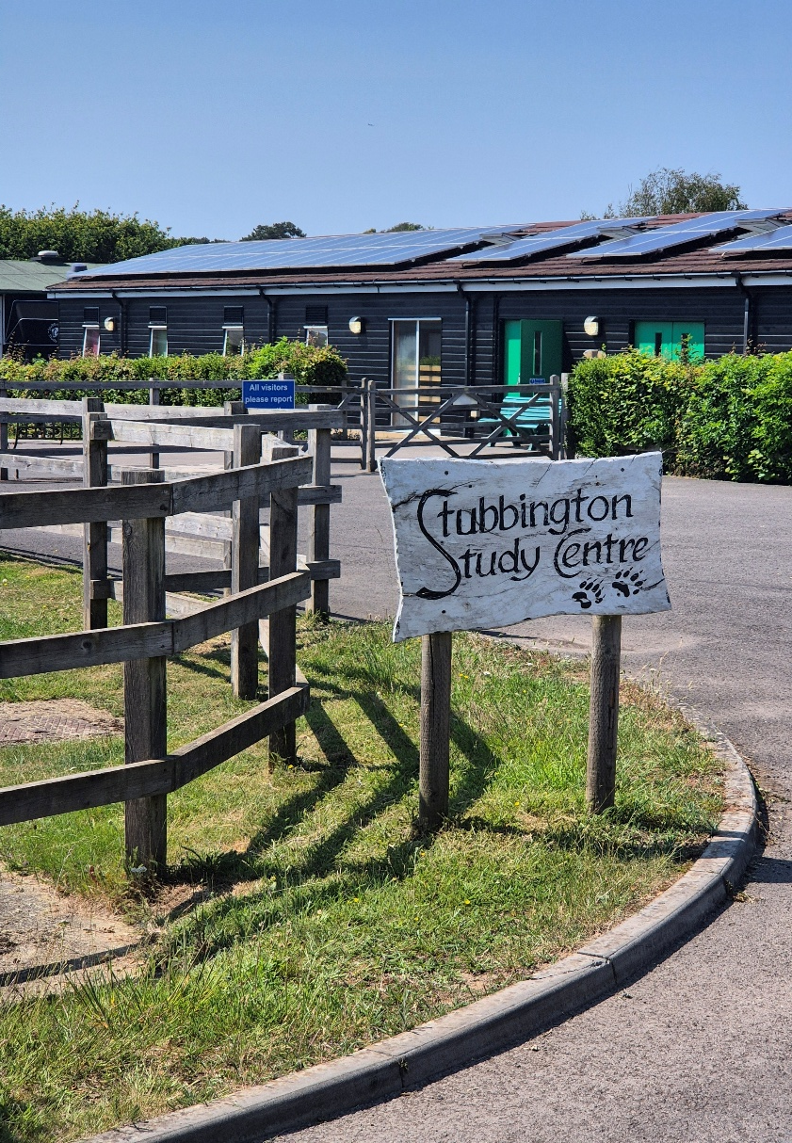
My visit to
Stubbington Study Centre

Slide 2
Soon I am going away with my school to Stubbington Study Centre.
I am going to stay there for a week with my friends and have lots of fun.
The children from (year group), who are going, are already very excited!

Slide 3
(name of adult) is going to be there to help me when we are away.
INSERT PHOTO

Slide 4
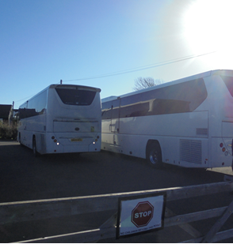
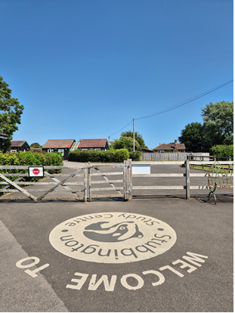
I will go on a coach with my school to get there.
This is the car park where the coach will stop.

Slide 5
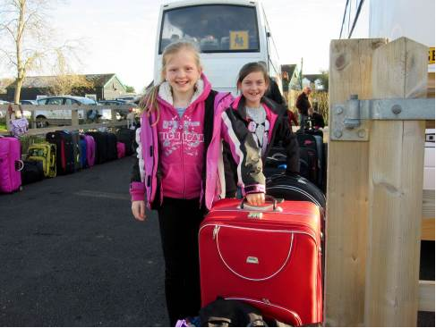
The Stubbington staff will meet us as we get off the coach.

Slide 6
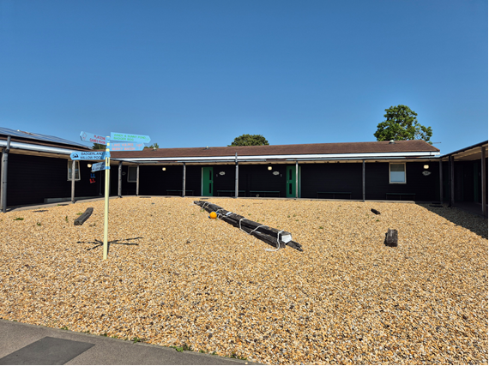
This is the entrance to the accommodation.
I will use the path to enter the building.

Slide 7
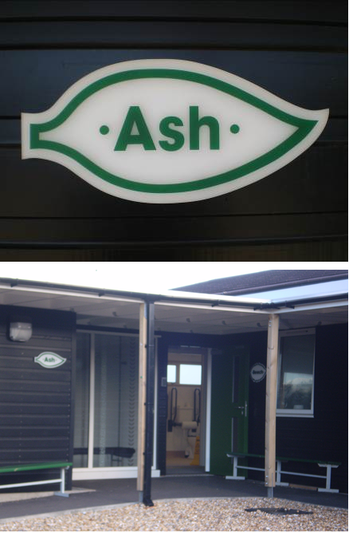
My school will be in the Ash section
This is the entrance I will use.

Slide 8
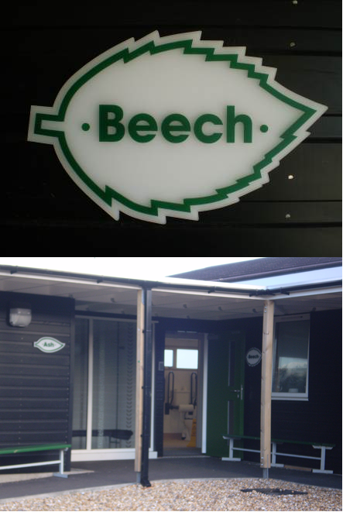
My school will be in the Beech section
This is the entrance I will use.

Slide 9
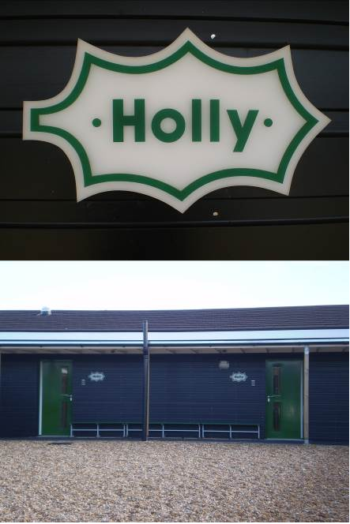
My school will be in the Holly section
This is the entrance I will use.

Slide 10
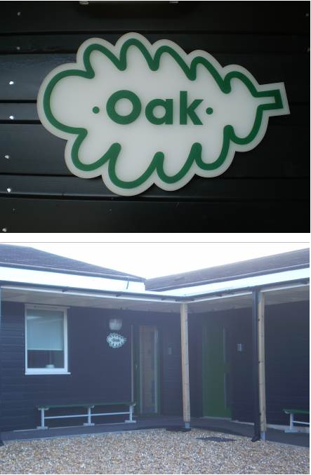
My school will be in the Oak section
This is the entrance I will use.

Slide 11
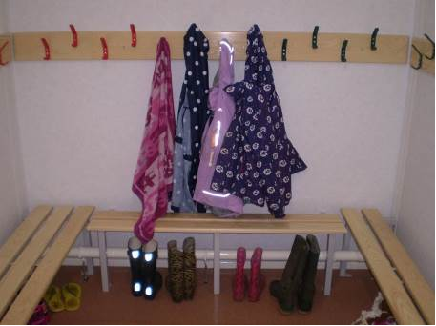
The drying room is near to the entrance. It is nice and warm in here.
I will put my coat on a hook and place my shoes below, neatly under the bench.
Any wet towels and wet clothing can go in here too.

Slide 12
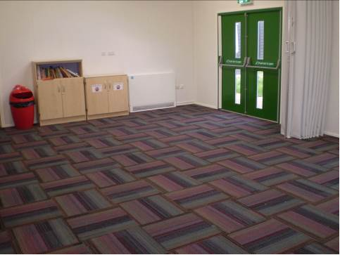
This is the gathering space.
We can use this space in free time and in the evening for activities.

Slide 13
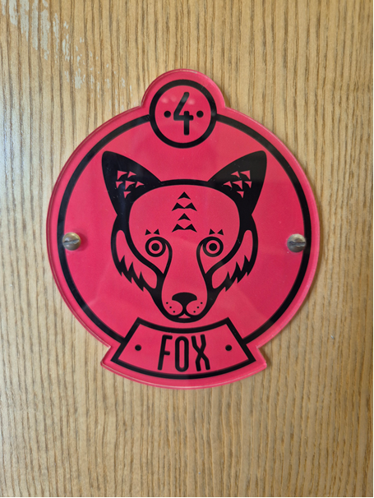
I will be in the Fox house and my room will be red.

Slide 14
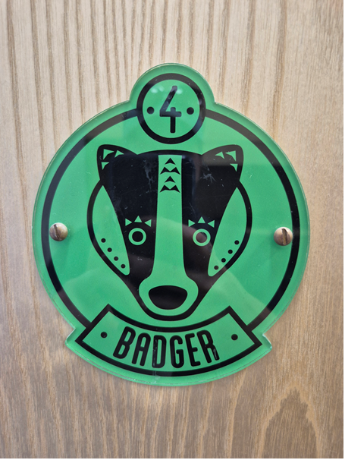
I will be in the Badger house and my room will be green.

Slide 15
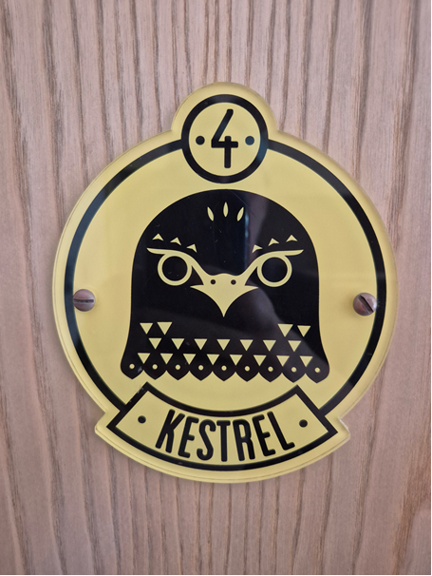
I will be in the Kestrel house and my room will be yellow.

Slide 16
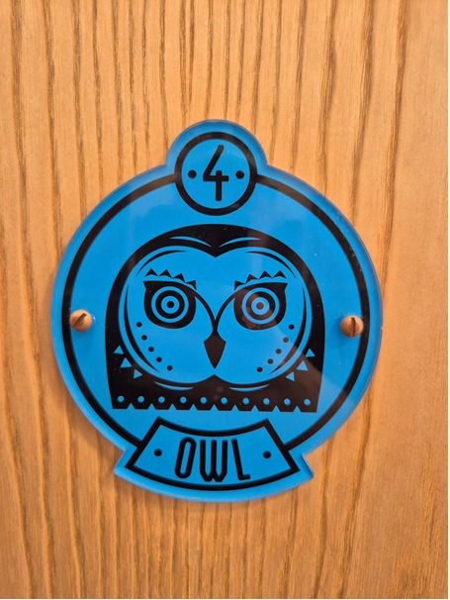
I will be in the Owl house and my room will be blue.

Slide 17
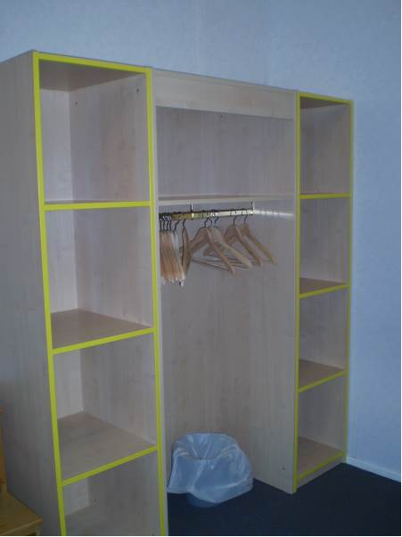
I will put my clothes in the wardrobe.

Slide 18
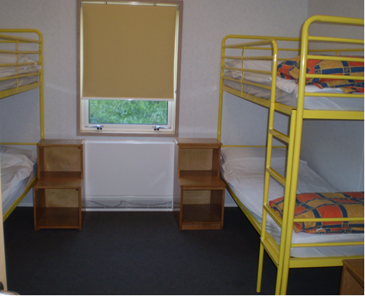
I will place my empty suitcase under my bunk bed.

Slide 19
Next to the bed there is a bedside table.
I can put things like my torch, book, drink and pencil case here.

Slide 20
(name of adult) will be sleeping close by.
INSERT PHOTO

Slide 21
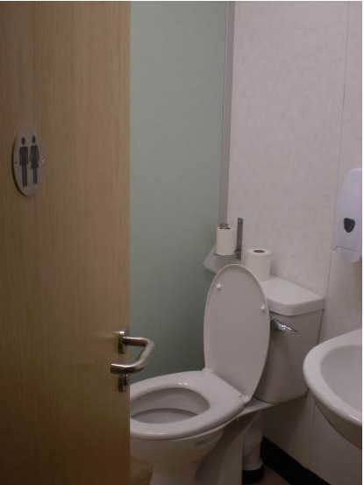
The bathroom is near to my room.
When I wash my hands, I will use warm water and soap.

Slide 22
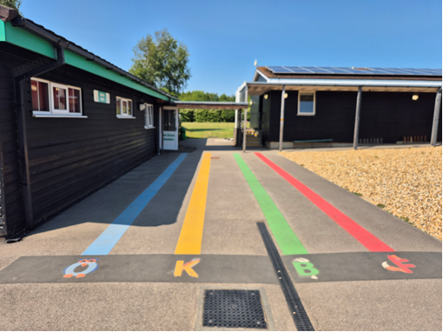
When I hear the bell, I will line up with my team on the coloured line that matches my house.

Slide 23
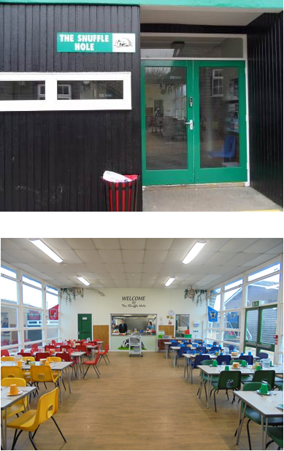
I will eat my meals in ‘The Snuffle Hole’ which is a big dining room.

Slide 24
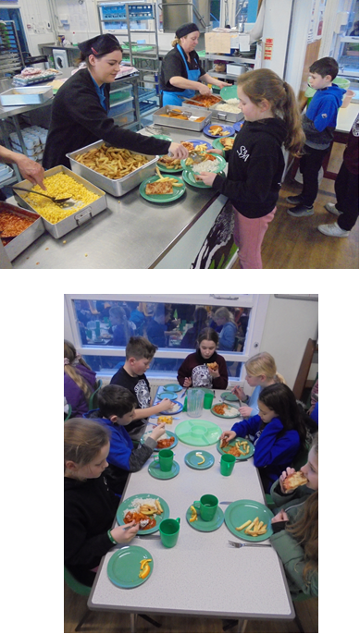
Each table group is sent up one at a time to choose what they would like to eat.
If my table is well behaved, we may be awarded the best table.

Slide 25
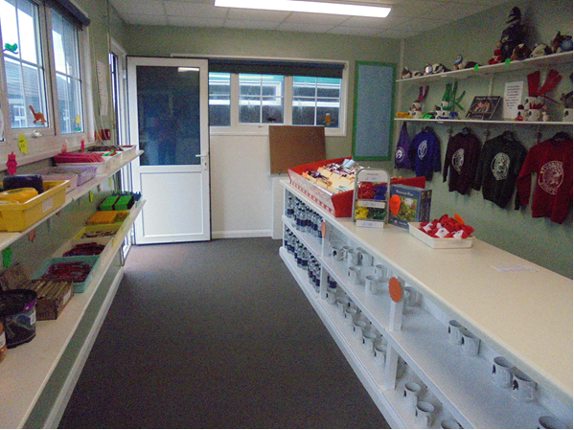
After lunch, I can visit the tuck shop to buy sweets, drinks and souvenirs.

Slide 26
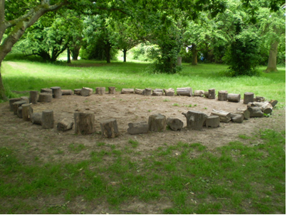
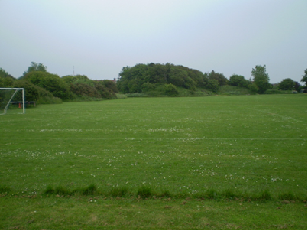
These are some of the places where I will take part in activities:
A log circle
The field

Slide 27
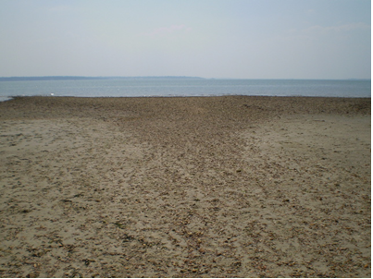
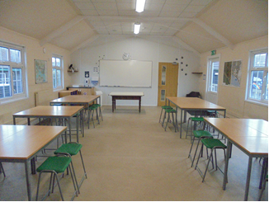
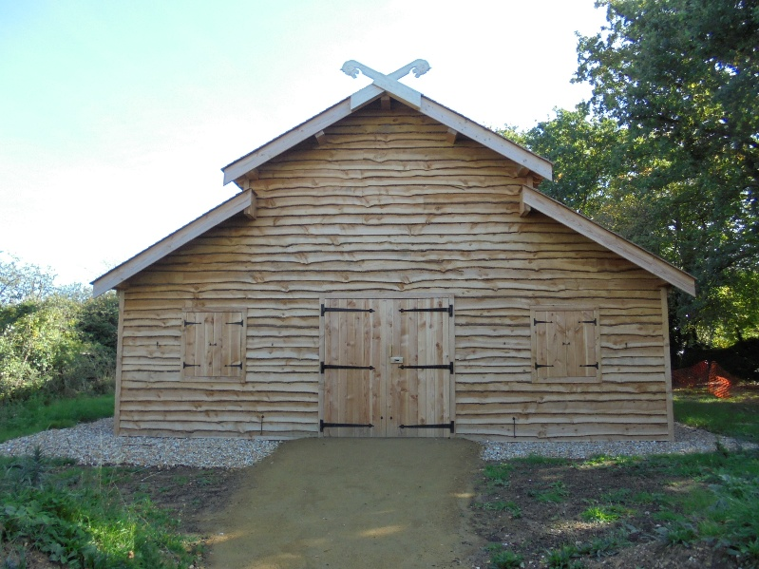
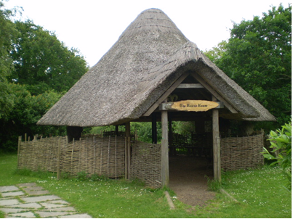
The beach
The classrooms
The roundhouse
The longhouse

Slide 28
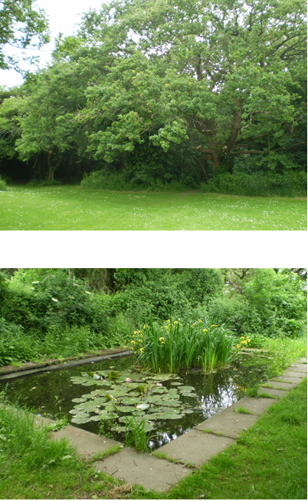
I will see lots of wildlife in the conservation area.
I must be with an adult here.
I need to be careful around the ponds, ditches and nettles.

Slide 29
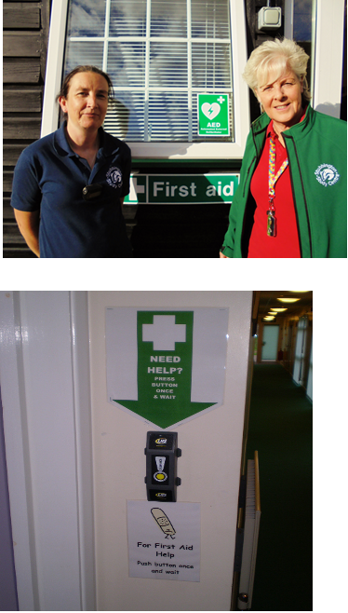
If I am hurt, I can go to the First Aid room and an adult will help me.
If there is no adult, I can press the buzzer which will send for help.

Slide 30
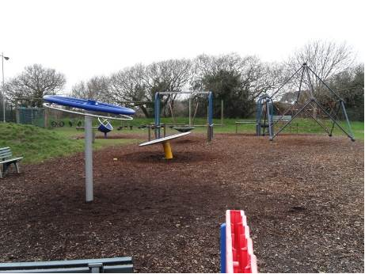
Free Time
During the day I will get some free time to choose what I would like to do.
I could play on the adventure playground if 2 adults are watching.

Slide 31
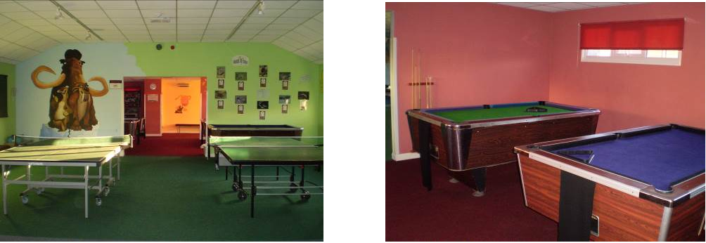
Free Time
I could visit the Games Room where I can play table tennis and pool.

Slide 32

Free Time
I could go to the field to play football or sit and chat with my friends.

Slide 33
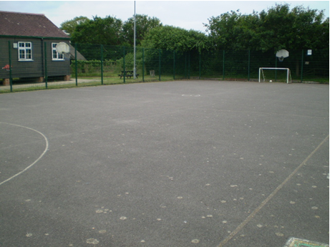
Free Time
I could play football or basketball on the hard court.

Slide 34
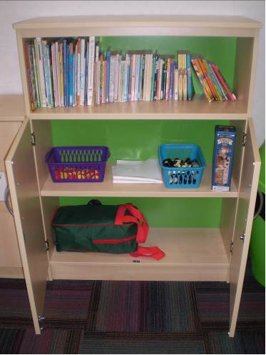
I could go to my accommodation, which will be a quiet area.
I could relax on my bed, read a book or play one of the games found in the gathering space.
Free Time

Slide 35
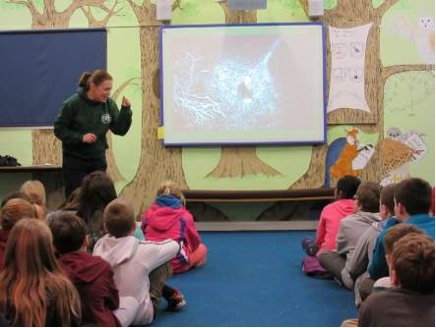
Before supper, there will be an activity such as: a wildlife presentation or a game.

Slide 36
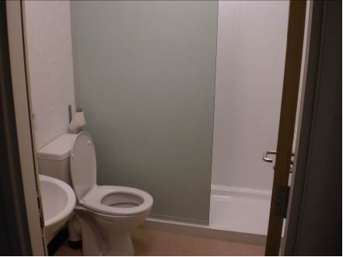
After supper I will have a shower.

Slide 37
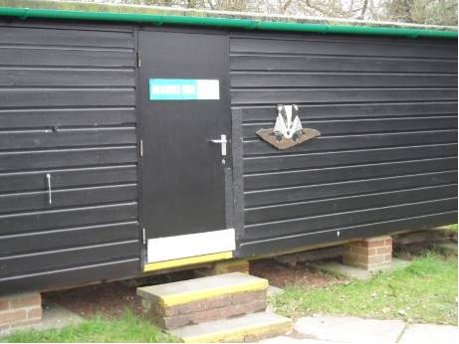
I will go to ‘Bramble Hide’ when it is dark to look for badgers and foxes.

Slide 38
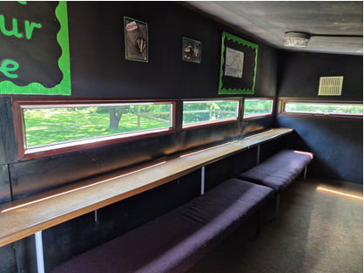
I will have to be very quiet!
Then it will be late and I will go to sleep.

Slide 39
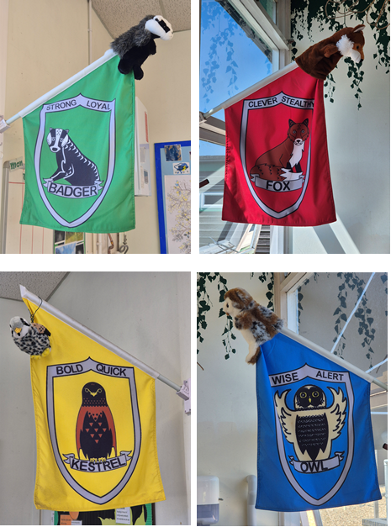
In the morning I can help my house to try to win the flag for being the tidiest.

Slide 40
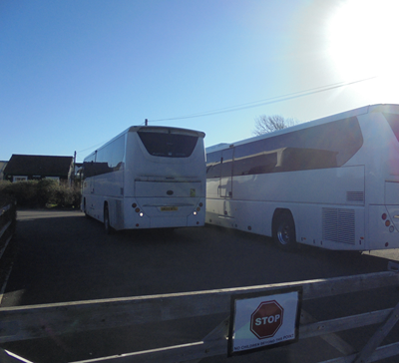
On Friday, after lunch it will be time to go back to school.

Slide 41
I will be able to tell my family about everything I did and what a lovely time I had.

Slide 42
Instructions for printing:
1) Delete the pages that you do not require.
2) This document can be printed up to 4 pages per sheet.

