Slide 1
School Transport Trends 2012/13 to 2022/23

Slide 2
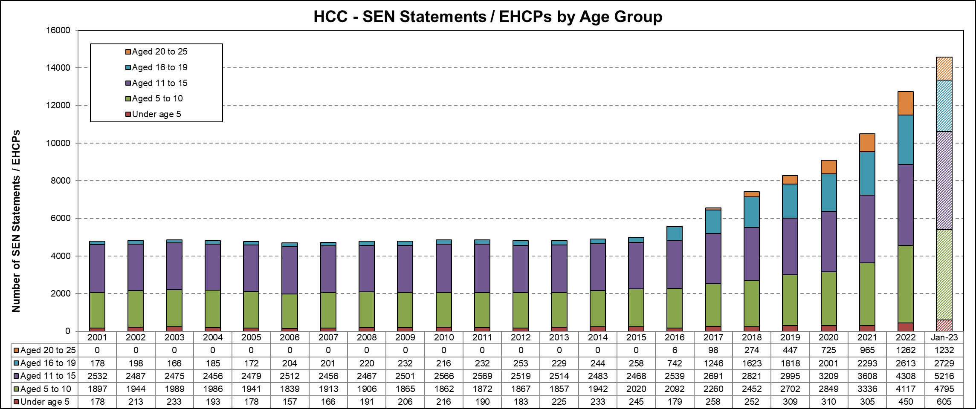
Growth in SEN
Between the reforms taking effect in 2015 and 2023 there has been a 192% increase in the number of EHC Plans being maintained. There has been a 202% increase since 2012.

Slide 3
Total School Transport Cost from 2012/13 to 2022/23

Slide 4
School Transport Cost from 2012/13 to 2022/23
Transport Type | 2012/13 £m | 2022/23 £m | £m Change | % Change
Primary | 3.8 | 2.6 | (1.2) | (32)
Secondary | 8.1 | 9.2 | 1.1 | 14
Special | 8.5 | 26.9 | 18.4 | 215
EIS | 0.8 | 0.9 | 0.1 | 8
Post 16/FE | 1.1 | 3.6 | 2.5 | 225
TOTAL | 22.4 | 43.2 | 20.8 | 93
Primary and secondary overall very slight decrease

Slide 5
School Transport Average Activity from 2012/13 to 2022/23

Slide 6
Total School Transport Average Activity from 2012/13 to 2022/23
Transport Type | 2012/13 average number of children | 2022/23 average number of children | Change | % Change
Primary | 2,459 | 1,605 | (854) | (35)
Secondary | 9,114 | 8,023 | (1,091) | (12)
Special | 2,220 | 3,023 | 803 | 36
EIS | 331 | 193 | (138) | (42)
Post 16/FE | 500 | 390 | (110) | (22)
TOTAL | 14,625 | 13,233 | (1,391) | (10)
Primary and secondary overall 17% decrease

Slide 7
School Transport Average Cost per Child from 2012/13 to 2022/23

Slide 8
Total School Transport Average Cost Per Child from 2012/13 to 2022/23
Transport Type | 2012/13 £ | 2022/23 £ | £ Change | % Change
Primary | 142 | 147 | 5 | 4
Secondary | 81 | 104 | 24 | 29
Special | 350 | 809 | 459 | 131
EIS | 226 | 419 | 193 | 85
Post 16/FE | 201 | 840 | 638 | 318

Slide 9
Summary of School Transport
 | Primary Mainstream | Secondary Mainstream | SEN | Post 16 | Other
2012/13 Student Numbers | 2,459 | 9,114 | 2,220 | 500 | 331
2012/13 Cost | £3.8m | £8.1m | £8.5m | £1.1m | £0.8m
2022/23 Student Numbers | 1,605 | 8,023 | 3,023 | 390 | 193
2022/23 Cost | £2.6m | £9.2m | £26.9m | £3.6m | £0.9m

Slide 10
Savings
  Nearly £6.8m of savings have been achieved in savings programmes from T15 through to SP23. These savings have largely been achieved through the following activities:
    Offering a statutory minimum service.
    External Contractor Spend – more robust commissioning of contracts let to external contractors to drive down cost wherever possible.
    Route Planning – more efficient planning of transport routes by combining routes and using technology to optimise route networks.
    Spend to Save – providing minibuses to schools for their own use. on condition that those schools use the vehicles to transport children to and from school using their own staff as drivers.
    Mileage Allowance – offering parents a mileage allowance to support them taking their own children to school. This is more cost-efficient than transport commissioned through transport operators.
    Process and Team Efficiencies – in the core service and Passenger Assistant teams.

Slide 11
The Future
 | 22/23 |  | 23/24 |  | 24/25 |  | 25/26 |  | 26/27
 | Year End Actuals | Variance to 22/23 Budget | Forecast | Variance to 23/24 Budget | Forecast | Variance to 23/24 Budget | Forecast | Variance to 23/24 Budget | Forecast | Variance to 23/24 Budget
Mainstream Primary | 2,601,808 | 151,808 | 2,769,713 | 228,713 | 2,909,038 | 368,038 | 3,059,710 | 518,710 | 3,216,584 | 675,584
Mainstream Secondary | 9,213,021 | 1,540,021 | 9,125,679 | 1,423,679 | 9,055,830 | 1,353,830 | 9,136,801 | 1,434,801 | 9,219,987 | 1,517,987
SEN | 26,903,142 | 5,869,142 | 32,313,263 | 11,907,263 | 38,297,010 | 17,891,010 | 47,147,673 | 26,741,673 | 57,722,131 | 37,316,131
EIS | 888,227 | 310,227 | 1,169,789 | 566,789 | 1,389,567 | 786,567 | 1,649,096 | 1,046,096 | 1,955,378 | 1,352,378
FE/ Post-16 | 3,598,988 | 1,343,988 | 5,468,064 | 3,147,064 | 7,094,599 | 4,773,599 | 9,550,170 | 7,229,170 | 12,700,363 | 10,379,363
Total Transport | 43,205,186 | 9,215,186 | 50,846,508 | 17,273,508 | 58,746,043 | 25,173,043 | 70,543,450 | 36,970,450 | 84,814,443 | 51,241,443

