Slide 1

Update on High Needs Provision Discussion Workshop - 9 March 2026

Slide 2
Purpose
Opportunities to provide support, challenge and receive assurance on current spend, new activities and associated consideration of value for money though regular updates to Schools Forum
However, the Headteachers Resources Committee was keen to explore other areas in order to:
  Better understand the processes, complexities and regulatory constraints
  Consider areas for potential improvements, either to provision or to achieve better use of resources
  Be more informed and able to contribute towards shared solutions recognising the key role schools play

Slide 3
Discussion feedback
Value for money from AP provision – The importance of getting the best price from AP provision was discussed including support commissioned by the LA and schools directly. Headteachers raised instances where they were having to meet higher costs than if centrally procured. Some challenges were identified with existing contractual arrangements which limited access however, the LA is continuing to explore what can be done.
Costed provision maps – Lack of awareness and purpose for producing maps with the use becoming too prevalent due to this alongside changes over time to complexity of need meaning agreed mainstream banding isn’t as aligned as in the past. Suggestions were to explore ways to simplify maps, reduce the number required through changes to the mainstream banding system and look to provide training to schools around the purpose and production of maps, all of which is in progress.
Criteria for placement in specialist provision – Discussion around a lack of broader awareness on how placements are made and the role the placement panel plays in this process to ensure appropriate and effective provision. Consideration to be given if ways can be found to share this knowledge wider with a recommendation heads may wish to observe a placement panel.

Slide 4
Discussion feedback
Reversing parental views – There was the recognition of the quality of maintained provision and the wide range of benefits to children and young people in attending their local mainstream school which also aligns well with the aspirations set out in the White Paper. Discussed what more can be done to improve parental understanding and confidence, marketing what they should expect through ordinarily available provision and the wider benefits. Local Offer Live Events will be helpful here.
Early intervention, reintegration and avoiding escalation of need – Strong willingness from schools to support this agenda providing they have access to the right resources. The LA confirmed there is now greater access to capital to support minor adaptions and provide specialist equipment. Revenue funding is also available for exceptional cases where an agreement can be reached with a school to keep a child rather than escalate into higher cost provision which would result in other challenges for the child e.g. increased transport distance (costs), lack of connection to community, reduced likelihood of attainment etc. The LA is also continuing to develop new provision, and also support for early intervention and reintegration and any further ideas or suggested opportunities would be welcomed
Mainstream revenue funding to schools – based on the current statutory funding arrangements, there is limited scope to develop novel approaches which would support schools with inclusion / SEND given the need to apply the national funding formula and the national approach to the SEN notional budget.

Slide 5
Discussion feedback
White Paper and SEND reform – The recent publications were discussed including the potential impact of the additional inclusion funding to mainstream schools and the experts at hand proposals. The potential positives were recognised alongside recognising risks around application and whether funding, resources and support would be sufficient to make the aspirations a reality. The LA will be leading on developing a reform plan in the next few months with other partners including schools which will inform the local direction of travel.

Slide 6

White Paper - Funding
The government's White Paper commits £4 billion in additional funding over three years to reform the Special Educational Needs and Disabilities (SEND) system.
Inclusive Mainstream Fund (£1.6bn)
What for: To help schools, early years settings, and colleges identify needs early and provide targeted, small-group interventions without the need for a statutory plan.
Where it's going: Paid directly to early years providers, schools, and colleges. This gives settings direct responsibility for proactive and flexible support.
'Experts at Hand' Service (£1.8bn)
What for: Establishing a programme of specialist support, including SEND teachers, educational psychologists, and speech and language therapists.
Where it's going: Allocated to local authorities and Integrated Care Boards (ICBs) to create local banks of specialists available to schools routinely.
Additional Funding
SEND Teacher Training (£200m): For universal SEND-specific Continuing Professional Development (CPD) to ensure all teachers are trained to support pupils with additional needs.
Best Start Family Hubs (£200m): To place a dedicated SEND practitioner in every hub over 3 years.
Reshaping SEND Delivery (£200m): Funding to help local authorities overhaul their SEND provision and management.
Training for professionals (£40m): To grow the educational psychology and speech and language therapy workforce

Slide 7
White Paper - Funding
Capital
New and adapted spaces (£3.7bn by 2030): To create new specialist places, including adapting mainstream schools to create more inclusive environments.
Existing revenue funding
Pupil Premium and National Funding Formula deprivation funding allocations currently provide over £8bn of funding to schools.
The Free School Meal indicator is the primary driver for eligibility and funding however, this does not enable disadvantage funding to reflect different lengths and depths of disadvantage
To better support the attainment gap, the government is proposing to develop a new model for targeting disadvantage funding
Key factors being considered include the use of income data, a stepped funding model and the use of a child's home address
Government intends to consult on proposals over the summer
Balance of funding between the Schools and High Needs Blocks
Over time, the intention will be a rebalancing of funding from the High Needs Block to the Schools Block linked to the transfer of responsibility and accountability
High Needs Stability Grant
Funding to meet 90% of the DSG deficit as at 31 March 2026, after excluding any expenditure or charges that are deemed ineligible, and net of any other surplus DSG balance recognised as at 31 March 2026.

Slide 8
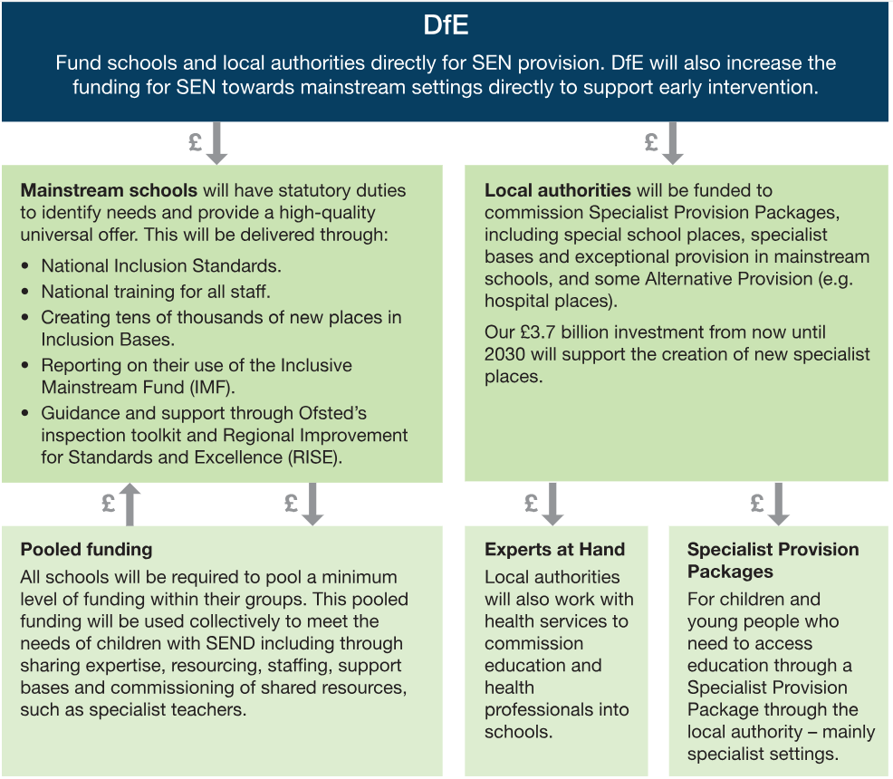
Funding routes for reform
Source: DfE consultation - SEND reform: putting children and young people first

