Slide 1
Special School Funding Framework
School’s Forum 12 December 2023
Steve Devlin
SEN Project Manager

Slide 2
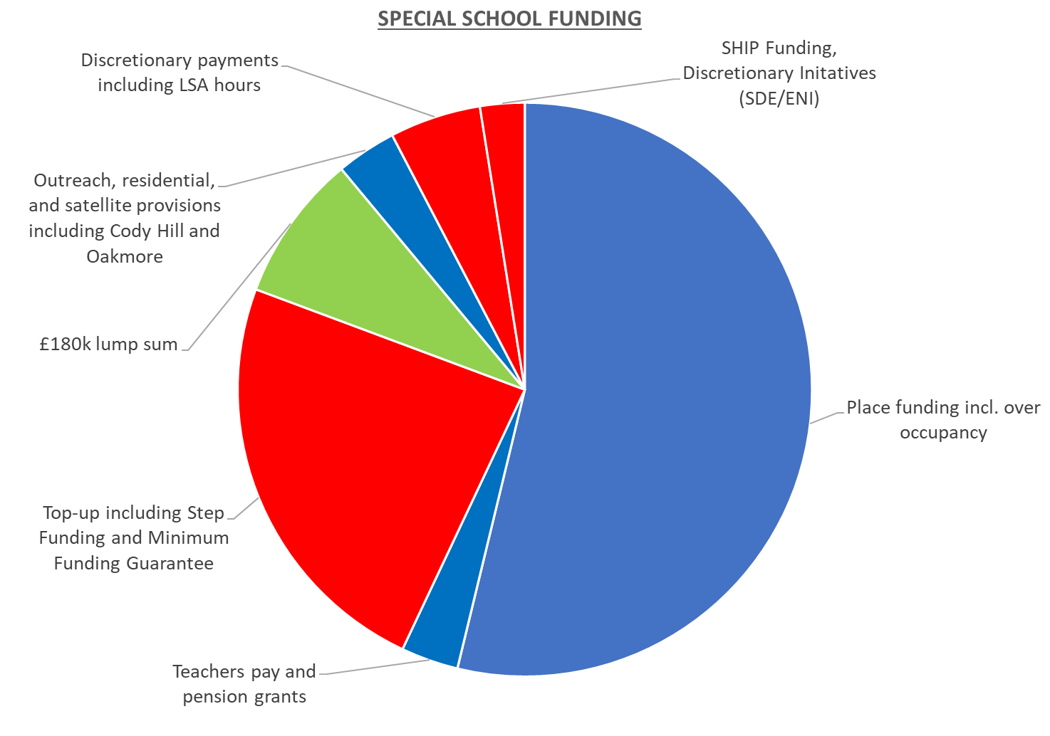

Special school funding breakdown
The slices in blue are fixed funding elements including place funding, outreach funding and split site/residential – there are no operational SEN Service decisions applied to these.
The slice in green is a fixed lump sum of £180k which is provided to all special schools toward core costs.
The slices in red are per pupil top-up payments including Step Funding, discretionary initiatives and additional LSA hours. These are all subject to operational SEN Service decisions.
Notes:
To understand the proposal, it will be helpful to understand how an EHCP is funded:
The funding attached to an EHCP comes from 3 places. As the diagram shows, the first 2 elements come from the school directly from a combination of funding schools will get for each pupil that attends the school and funding from a what is known as a SEN notional budget. Where a young person has an EHCP, the school is expected to fund the first £6k form that notional SEN budget.
The additional funding on top of this amount, is known as ‘top-up funding’. This top-up funding is paid to the school from the County Council.
It is only the way in which this top-up funding is paid to the school that is affected by this proposal.

Slide 3
Funding review and existing framework
A comprehensive review of special school funding was undertaken between April 2022 and June 2023 under the Improve Outcomes and Control Costs workstream.
The review considered the current processes, funding streams and values.
Special schools were consulted through each stage of the review and supported to provide information.
As a result of the review, a revised standardised framework is proposed for implementation from 1 April 2024.
The existing funding framework
Notes:
To understand the proposal, it will be helpful to understand how an EHCP is funded:
The funding attached to an EHCP comes from 3 places. As the diagram shows, the first 2 elements come from the school directly from a combination of funding schools will get for each pupil that attends the school and funding from a what is known as a SEN notional budget. Where a young person has an EHCP, the school is expected to fund the first £6k form that notional SEN budget.
The additional funding on top of this amount, is known as ‘top-up funding’. This top-up funding is paid to the school from the County Council.
It is only the way in which this top-up funding is paid to the school that is affected by this proposal.

Slide 4
Key findings from the review
Benchmarking: HCC special school funding is comparable to local and statistical neighbours. There are fewer intervals within the range of funding than some other local authorities.
Flexibility in the system: most schools can only access either two or three levels of step funding.
Rise in higher steps: over five years, the number of pupils at Steps 5 and 6 has increased. 140% increase at Step 6 which is the highest step for most schools.
Lump sum equity: smaller schools receive more per pupil funding proportionately than larger schools.
Needs based descriptions: existing framework based on description of need, not provision to meet need.
Consistency of application: some discretionary payment decisions are not made against a standard framework.
Discretionary spend: increased over five years from approximately £1.4m in 2017 to £4.4m in 2022. The largest area of growth is in LSA hours, which has increased from £824k to £2.4m over the same period.
Notes:
To understand the proposal, it will be helpful to understand how an EHCP is funded:
The funding attached to an EHCP comes from 3 places. As the diagram shows, the first 2 elements come from the school directly from a combination of funding schools will get for each pupil that attends the school and funding from a what is known as a SEN notional budget. Where a young person has an EHCP, the school is expected to fund the first £6k form that notional SEN budget.
The additional funding on top of this amount, is known as ‘top-up funding’. This top-up funding is paid to the school from the County Council.
It is only the way in which this top-up funding is paid to the school that is affected by this proposal.

Slide 5
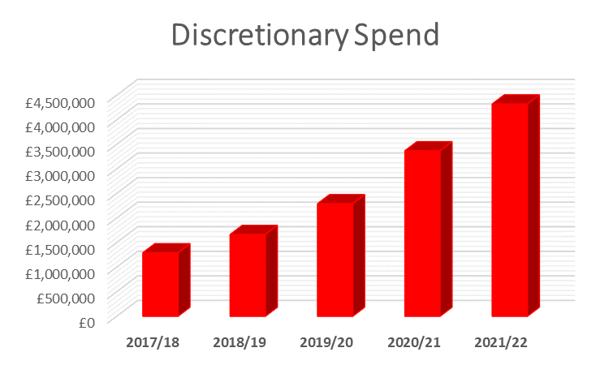
Discretionary payments
LSA hours and discretionary initiatives have all increased significantly.
The proportion of discretionary funding as overall funding per school is highly variable.
There are set criteria for SDE/ENI but no set criteria for LSA hours or other discretionary payments.
It is more difficult to plan and forecast via discretionary payments.
There is reduced control of costs where funding decisions are not made against a framework.
Discretionary payments are labour-intensive for schools and the SEN Service.
Notes:
To understand the proposal, it will be helpful to understand how an EHCP is funded:
The funding attached to an EHCP comes from 3 places. As the diagram shows, the first 2 elements come from the school directly from a combination of funding schools will get for each pupil that attends the school and funding from a what is known as a SEN notional budget. Where a young person has an EHCP, the school is expected to fund the first £6k form that notional SEN budget.
The additional funding on top of this amount, is known as ‘top-up funding’. This top-up funding is paid to the school from the County Council.
It is only the way in which this top-up funding is paid to the school that is affected by this proposal.

Slide 6
Proposed framework (1)
Proposed Special School Funding Framework
£10k place funding +
Step | Descriptor* | Value
1 | Provision is delivered without additional funding in excess of the core offer of the school. | £2,250
2 | Provision is delivered within the core offer of the school but with regular additional support/planning/liaison with other agencies. | £5,250
3 | Provision is delivered within the core offer but with frequent additional support/planning/liaison with other agencies, may require some 1:1 across the week, or a higher pupil to staff ratio. | £10,750
4 | Provision includes the requirement of higher staff to pupil ratio and specialist resources, some provision across the day requires 1:1 support, frequent support/planning/liaison with other agencies. | £14,750
5 | Provision includes the requirement of higher staff to pupil ratio and/or specialist resources and additional support/planning/liaison with other agencies. Requires 1:1 staffing for all of their school day and/or support with using highly specialist equipment. | £22,250
6 | Provision includes the requirement for 2:1 or more members of staff for some parts of the day, support with using highly specialist equipment, frequent multi-disciplinary liaison. | £26,250
7 | Provision includes the highly exceptional requirement for 2:1 or more members of staff at all times, support with using highly specialist equipment, frequent multi-disciplinary liaison, highly exceptional needs across EHC. | £41,250
*The descriptions against each step are ‘working descriptors’ for purposes of development of the framework. The final descriptors will be co-developed with local schools and services through a working group.
Notes:
To understand the proposal, it will be helpful to understand how an EHCP is funded:
The funding attached to an EHCP comes from 3 places. As the diagram shows, the first 2 elements come from the school directly from a combination of funding schools will get for each pupil that attends the school and funding from a what is known as a SEN notional budget. Where a young person has an EHCP, the school is expected to fund the first £6k form that notional SEN budget.
The additional funding on top of this amount, is known as ‘top-up funding’. This top-up funding is paid to the school from the County Council.
It is only the way in which this top-up funding is paid to the school that is affected by this proposal.

Slide 7
Proposed framework (2)
The proposed framework:
- replaces the existing Step 4-7 framework.
- replaces all but the most exceptional discretionary payments, including SDE/ENI
and LSA hours.
- accounts for 99.7% of funding for current HCC pupils in special schools.
- replaces the £180k lump sum which is incorporated and averaged across the values.
Testing:
- the framework has been modelled against the whole special school population.
- school-level tested against cohorts by 7 schools.
- 3 schools reported increased funding or no significant change.
- 4 schools reported decreased funding. When reviewed, shortfalls were against the funding
schools are allocating to pupils and not actual funding released by the SEN Service.
- 4 schools felt the intervals were appropriate, 1 too narrow and 2 too wide.
- schools were positive about the structure and simplicity of the framework.
Notes:
To understand the proposal, it will be helpful to understand how an EHCP is funded:
The funding attached to an EHCP comes from 3 places. As the diagram shows, the first 2 elements come from the school directly from a combination of funding schools will get for each pupil that attends the school and funding from a what is known as a SEN notional budget. Where a young person has an EHCP, the school is expected to fund the first £6k form that notional SEN budget.
The additional funding on top of this amount, is known as ‘top-up funding’. This top-up funding is paid to the school from the County Council.
It is only the way in which this top-up funding is paid to the school that is affected by this proposal.

Slide 8
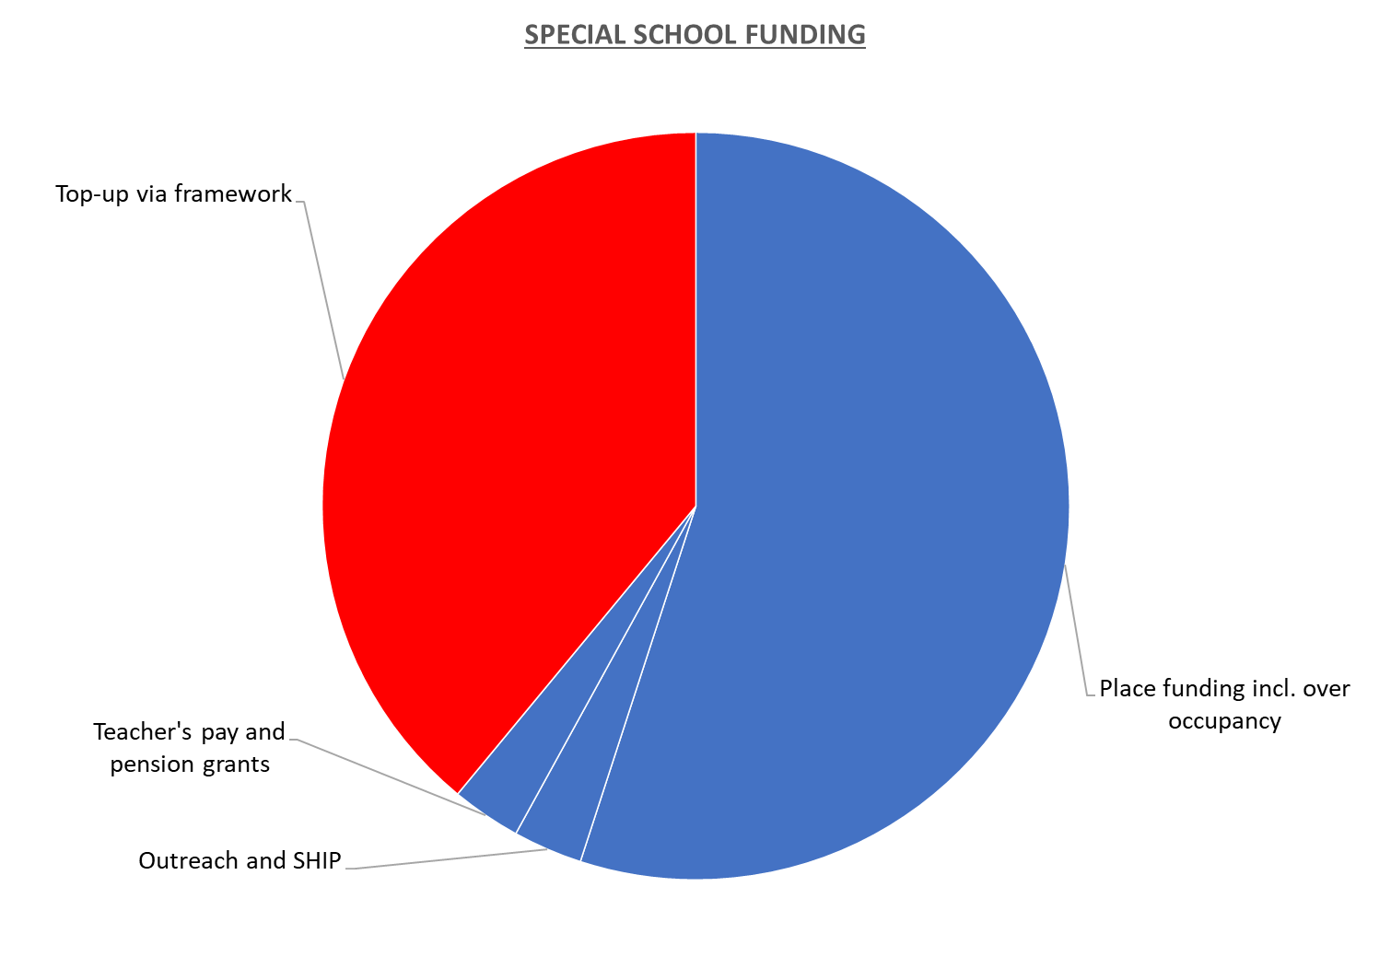
Changes to funding streams
CURRENT MODEL
PROPOSED MODEL
Notes:
To understand the proposal, it will be helpful to understand how an EHCP is funded:
The funding attached to an EHCP comes from 3 places. As the diagram shows, the first 2 elements come from the school directly from a combination of funding schools will get for each pupil that attends the school and funding from a what is known as a SEN notional budget. Where a young person has an EHCP, the school is expected to fund the first £6k form that notional SEN budget.
The additional funding on top of this amount, is known as ‘top-up funding’. This top-up funding is paid to the school from the County Council.
It is only the way in which this top-up funding is paid to the school that is affected by this proposal.

Slide 9
Funding implications
Implementation costs
The overall special school budget for 2024/2025 is forecasted at approx. £65m. There is no proposal to reduce the overall budget.
Modelling* of the proposed framework against the whole special school population showed an unmitigated position of:
- 14 schools receiving increased funding between 1% and 7%.
- 3 schools no change
- 10 reduced funding between -1% and -7%. Most of these schools are limited to Step 6 in the existing framework.
The unmitigated cost of implementation would result in an approx. +£700k impact on the High Needs Block.
Mitigations and protections
Mitigations will be applied where appropriate and possible.
The Minimum Funding Guarantee (MFG) is a protection against per pupil changes to funding, currently at £129k.
To mitigate the modelled reduction in funding to schools, the MFG would be forecasted at approx. £240k
The total modelled implementation cost is approx. £940k – 1.4% overall special school budget.
Budget shares for the 2024/2025 will factor-in the impact of the framework and consider mitigations or adjustments – e.g. enhanced MFG.
To assess impact in readiness for budget shares a transitional process will apply.
*modelling consists of theoretically moving pupils from their existing funding to the closest stap under the proposed system. It does not include an actual assessment of the pupil against the framework. The actual financial impact may therefore change as it is dependent on funding requirements of the pupil cohort at the time of implementation.
Notes:
To understand the proposal, it will be helpful to understand how an EHCP is funded:
The funding attached to an EHCP comes from 3 places. As the diagram shows, the first 2 elements come from the school directly from a combination of funding schools will get for each pupil that attends the school and funding from a what is known as a SEN notional budget. Where a young person has an EHCP, the school is expected to fund the first £6k form that notional SEN budget.
The additional funding on top of this amount, is known as ‘top-up funding’. This top-up funding is paid to the school from the County Council.
It is only the way in which this top-up funding is paid to the school that is affected by this proposal.

Slide 10
Transitional process
Special schools to provide autumn pupil data
HCC to produce top-up statement
Schools to feedback on individual top-up statements
Budget shares to be released
HCC consider adjusting funding where appropriate
SEN Service to review at whole school level to identified pupils who may be under/over-funded.
April 2024 and June 2024
Notes:
To understand the proposal, it will be helpful to understand how an EHCP is funded:
The funding attached to an EHCP comes from 3 places. As the diagram shows, the first 2 elements come from the school directly from a combination of funding schools will get for each pupil that attends the school and funding from a what is known as a SEN notional budget. Where a young person has an EHCP, the school is expected to fund the first £6k form that notional SEN budget.
The additional funding on top of this amount, is known as ‘top-up funding’. This top-up funding is paid to the school from the County Council.
It is only the way in which this top-up funding is paid to the school that is affected by this proposal.

Slide 11
Implementation planning
The proposal is to implement the framework from 1 April 2024.
Funding values would be applied from 1 April 2024 onwards with the switch-over manged internally within HCC.
The final descriptors against the values will be agreed by mid-February 2024.
A series of implementation presentations and Q&As will be held during February and March 2024 to prepare schools and services for the changes.
The SEN Service and decision-making partners will be trained prior to going live. There will be revised decision-making and moderation processes to ensure robustness and transparency.
Notes:
To understand the proposal, it will be helpful to understand how an EHCP is funded:
The funding attached to an EHCP comes from 3 places. As the diagram shows, the first 2 elements come from the school directly from a combination of funding schools will get for each pupil that attends the school and funding from a what is known as a SEN notional budget. Where a young person has an EHCP, the school is expected to fund the first £6k form that notional SEN budget.
The additional funding on top of this amount, is known as ‘top-up funding’. This top-up funding is paid to the school from the County Council.
It is only the way in which this top-up funding is paid to the school that is affected by this proposal.

