Slide 1
Dedicated Schools Grant Deficit Management Plan Update
July 2024
Natalie Smith
Assistant Director, Education & Inclusion

Slide 2
Overview
Delivering Better Value grant funding period now over. DfE continue to monitor Transforming Send against outcomes sought. All workstreams were delivered on time.
2024/5 TSEND scope extended to inclusion and educational engagement with a high dependence upon the engagement and support of schools and partners.
£123.7m Deficit for Hampshire Dedicated Schools Grant (DSG) at year end 2023/24. Represents 10% of total DSG and 62.9% of High Needs Block Funding.
The forecast cumulative DSG deficit at the end of 2025/26 has increased to £195.9m, 14.4% of total DSG and 94.7% of High Needs Block.
The estimated 2027/28 deficit is £530.6m using current funding assumptions and factoring in planned cost avoidance workstreams, lower than the £549.7m Stretch Target deficit projected by Newton for 2027/28.
The Transforming SEND Hampshire programme is currently forecast to make circa £30.3m savings / cost avoidance in 2024/5.
Hampshire remains one of the lower funded local authorities through the High Needs National Funding Formula.

Slide 3
Overview
Between the reforms taking effect in 2015 and 2024 there has been a 220% increase in the number of EHC Plans being maintained (as of January 2024).
As of the end of May 2024 Hampshire maintains 16,626 EHC Plans, an increase of 9.3% since May 2023.
The age group with the largest percentage increase is the under 5s group, where the number of EHCPs has seen an 18% increase.
Between September and May 2024, the SEN Service received 2,913 requests for assessment, an average of 324 requests a month and a 13% increase on the same period last year.
The service has issued an average of 188 plans a month this academic year.
Hampshire’s EHCP timeliness has improved drastically, improving by just under 30 percentage points in 2023, achieving 75.4% timeliness. So far in 2024 55% of EHC Plans have been issued on time.
Forecasting models indicate that there could be 21,661 EHCPs maintained by Hampshire in 2029. This is a significant 35% growth from 2024.

Slide 4
2023/4 key achievements
Launched the programme with schools and stakeholders through two Transforming SEND conferences.
Introduced the SENCO Helpline.
Introduced the SEN Support toolkit.
Released ‘Supporting Complex Learners in Mainstream Schools’ a fully funded e-learning course available for all staff in schools across Hampshire.
Processing 94% of the 5,943 ring-fenced overdue Annual Reviews.
Launched the following pilots;
  PCP No to Assess: assessing the impact of person-centred planning meetings following an LA decision not to carry out an EHC assessment.
  Transition to School: Piloting extending Portage into Year R to support successful transitions
  Access to Therapy: Making Communication and Interaction therapies available to children at the earliest point of need, prior to an EHCP.
New and existing workstreams avoided a total of £26.5m in High Needs costs in year.

Slide 5

DSG Medium Term Forecast – Cumulative
Deficit if Hampshire did nothing
Deficit if our TSEND work is successful.
 | Cumulative DSG Deficit
 | 2018/19 | 2019/20 | 2020/21 | 2021/22 | 2022/23 | 2023/24 | 2024/25 | 2025/26 | 2026/27 | 2027/28
HNB Mitigated Expenditure LA - Current Projection | 13,746 | 22,754 | 35,445 | 60,022 | 86,149 | 123,920 | 195,941 | 286,734 | 398,918 | 530,624
HNB Unmitigated Expenditure Newton - Baseline | 13,746 | 22,754 | 35,445 | 69,209 | 113,433 | 183,010 | 282,904 | 414,898 | 580,937 | 778,334
HNB Mitigated Expenditure Newton - Target | 13,746 | 22,754 | 35,445 | 69,209 | 113,834 | 167,450 | 254,716 | 362,614 | 489,916 | 633,179
HNB Mitigated Expenditure Newton - Stretch Target | 13,746 | 22,754 | 35,445 | 69,209 | 113,834 | 145,424 | 215,131 | 299,494 | 406,456 | 549,719

Slide 6
TSEND Hampshire Scope and Aims
‘All children and young people with SEND in Hampshire will be empowered to achieve outstanding outcomes’
Building a shared culture of inclusion
Adopting a consistent approach​
Working within budgetary constraints​
Being responsive to changing needs​
Inclusion and Educational Engagement
Right Support, Right Time
Improve Outcomes, Control Costs
NEW
The Hampshire system engages all children in education, keeps children safe, develops positive relationships, identifies and builds on strengths, and grows and strengthens support networks
Scope: Overarching.
The right support is provided at the right time and meets need effectively.
Scope: Early identification and intervention to meet need at the earlier stages of the SEND pathway.
Strength’s based, person-centred approaches are maximised to achieve improved outcomes for children and young people with an EHCP and control high needs costs.
Scope: When an EHCP is in place.

Slide 7
Key areas of focus in 2024/5
Inclusion and Educational Engagement
Right Support, Right Time
Improve Outcomes, Control Costs
Hampshire Approach - embedding a collective approach to inclusion and educational engagement.
Development of best practice approaches to improve educational engagement, that prevent children from missing education and improve outcomes.
Identify and address training needs across Hampshire schools supporting inclusion, education engagement and SEND.
Pilot and embed early intervention approaches that prevent escalation of Education Health and Care needs.
Improve the quality and consistency of Ordinarily Available Provision available in Hampshire Schools.
Improve Parental Confidence in SEN Support.
Ensure that CYP with SEND are educated in appropriate mainstream provision in their local community wherever possible.
Ensure that there are sufficient high quality specialist placements to meet the needs of CYP in Hampshire.
Provide equitable access to post 16 educational opportunities that enable young people with SEND to lead independent lives.

Slide 8
Fully funded LA support for schools*
HIAS | Supporting Complex Learners in Mainstream Schools - eLearning SEN Support toolkit SENCO helpline | SEN Support guidance SEN Matters
SEN Service | Tribunal Webinars
Early Years | Year R networks | Year R transition training
STAS | EHCP support and training
HIEP | Critical Incident support | Parent Support line
Virtual School | Reach to Teach App | Designated Teacher networks PEP toolkit
SEN Access and Resource | FISH Local Offer | Tribunal information videos
EMTAS​ | Specific case support (initial)​ in preparation for an EHC assessment request | Bespoke language and interpretation support work with parents
*County wide offer- check with LA teams as some additional services may be available in your district.

Slide 9
SLA or chargeable LA support for schools
HIAS | SENCO and RP networks SEND Conference | SEND Specific training SEN Advisor / Improver bookable time
Early Years | Year R networks | Year R transition training
PBS | School inreach and outreach and parent/carer support | Specific staff training
STAS | Assessment and training | Specialist equipment (dependant on situation)
Governor services | Governor SEND conference | Governor training on SEND
ISS | Statutory Advice guidance and support on exclusions, suspensions and PEX Wider attendance support offer | Advice on CME, EHE and RHP Casework to resolve complex cases EBSA Training
Virtual School | Attachment aware schools programme
*check with LA teams as some additional services may be available in your district.

Slide 10
SLA or chargeable LA support for schools
HIEP | Initial assessments, advice and individual work with CYP SENCo circles Training and support packages for PCP, EBSA, SWAN cognitive behavioural approaches Bereavement and loss training and support Adoption bookable consultations Person-centred approaches Headteachers discussion groups | Staff training, coaching, supervision ELSA and TALA programmes training oversight and supervision Systemic work Theraplay interventions and other therapeutic approaches Physical Intervention support and training

Slide 11
2024 SEN2 Headlines
 | Calendar Year | National | Hampshire
EHCP Timeliness | 2022 | 49.2% | 45.7%
 | 2023 | 50.3% | 75.4%
 | Difference | +0.9% | +29.7%
Total EHCPs | 2022 | 517,026 | 14,583
 | 2023 | 575,963 | 15,994
 | Difference | +11.4% | +9.7%
EHC Needs Assessment Requests | 2022 | 114,457 | 3,156
 | 2023 | 138,242 | 3,485
 | % Increase | +20.8% | +10.4%
Nationally, the number of EHC Plans and requests for EHC Needs Assessments increased substantially, the percentage of plans issued within the 20-week statutory deadline marginally increased by 0.9 percentage points.
Hampshire experienced a significant increase in requests for EHC Needs Assessments and EHC Plans.
Hampshire’s EHCP timeliness has improved drastically, improving by just under 30 percentage points in 2023, achieving 75.4% timeliness.

Slide 12
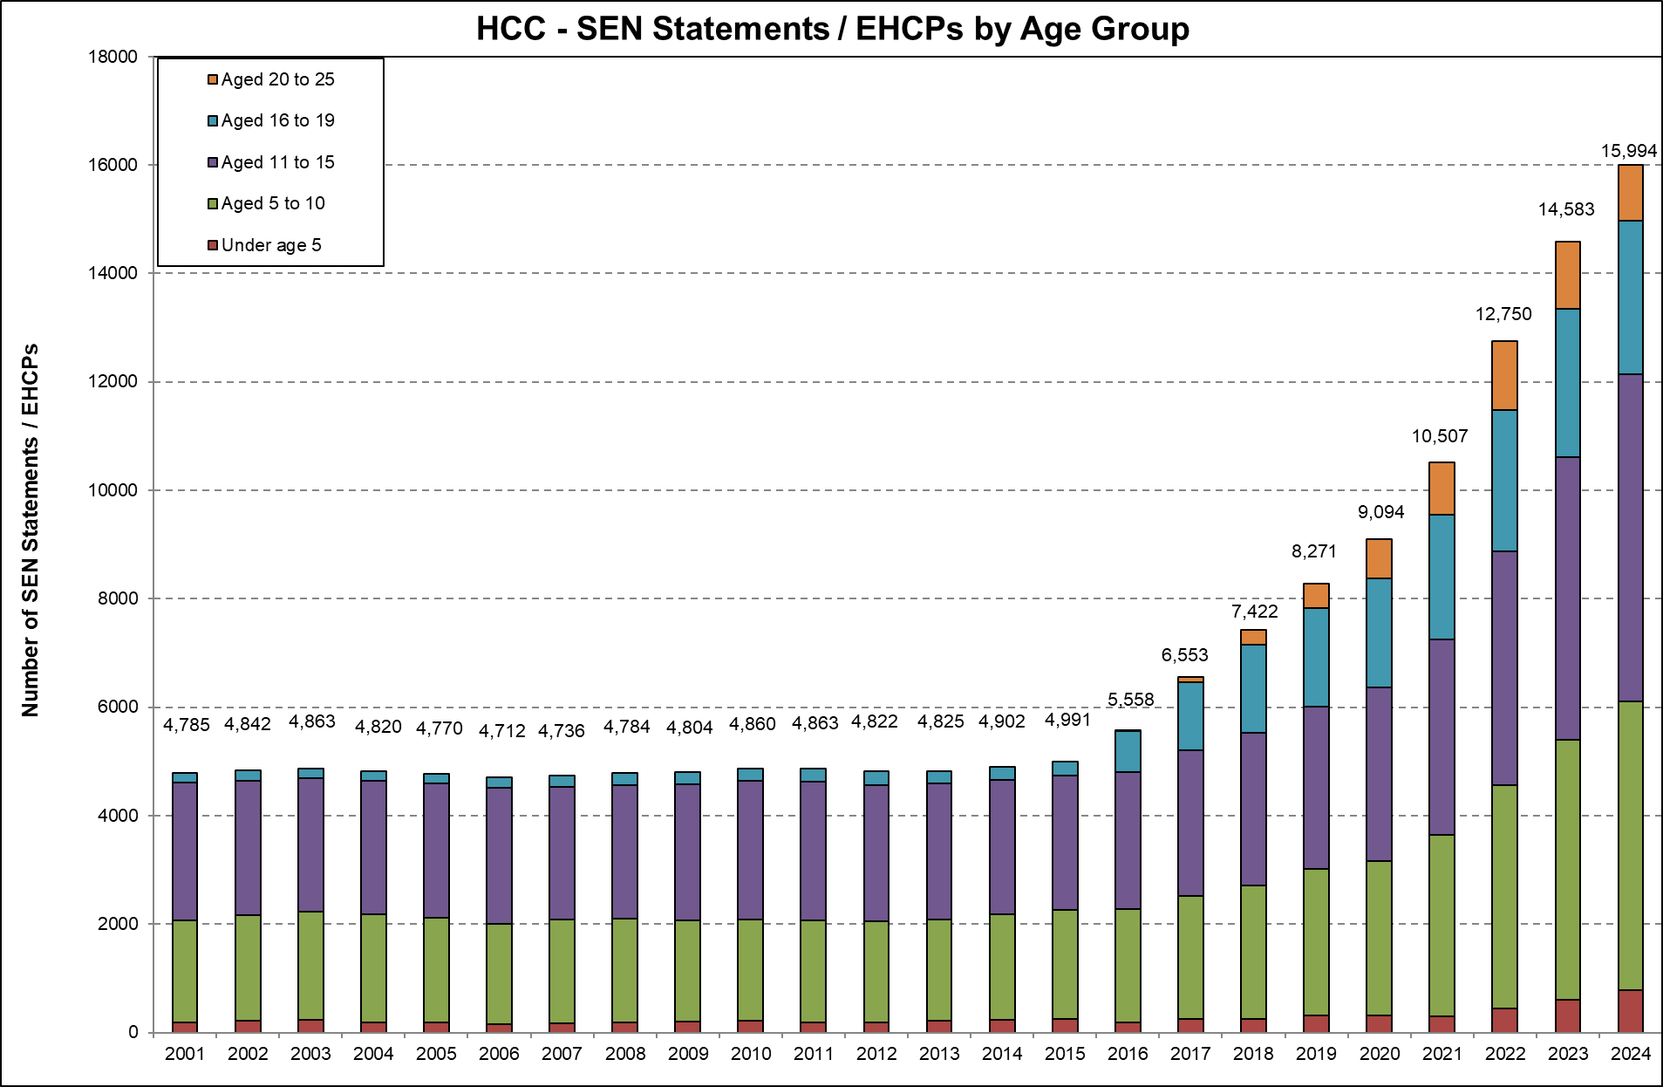
Maintained EHC Plans
Age groups* | May-23 | May-24 | % increase
Under 5s | 1,020 | 1204 | 18%
Aged 5-10 | 5,182 | 5656 | 9%
Aged 11-15 | 5,367 | 6183 | 15%
Aged 16-19 | 2,632 | 2734 | 4%
Aged 20+ | 1,075 | 849 | -21%
Grand Total | 15,276 | 16,626 | 9%
*Age at the start of each academic year
Between the reforms taking effect in 2015 and 2024 there has been a 220% increase in the number of EHC Plans being maintained, and a 10% increase from last year (as of January 2024).
Significant growth across school aged pupils.
Largest percentage increase in the under 5s group, +18% increase, +184 EHCPs.

Slide 13
Forecast EHC Plans
Forecasting models indicate that there could be 21,661 EHCPs maintained by Hampshire by 2029.
This would be a 35% growth from 2024.

Slide 14
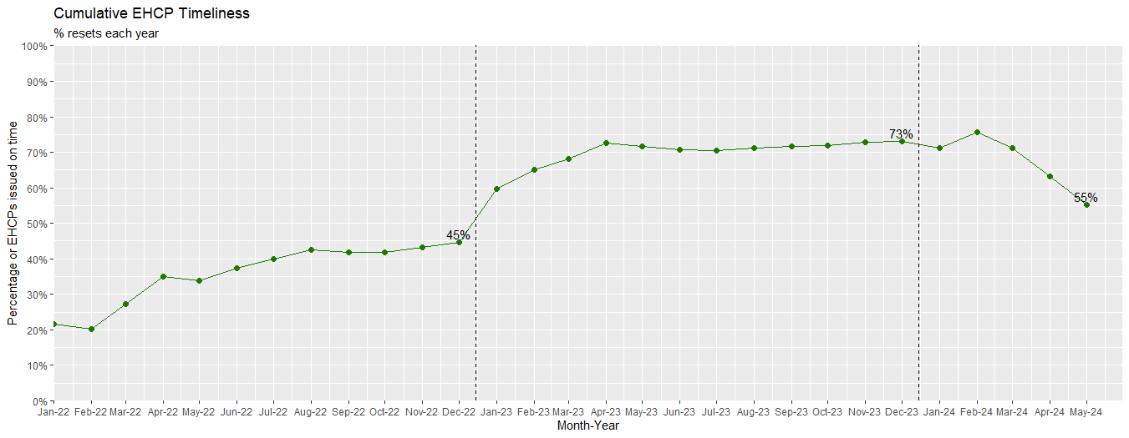
2023/24 Data
Requests for EHC Needs Assessments
Between September and May, the service received 2,913 requests, an average of 324 requests a month, and a 13% increase on the same period last year.
School requests have increased by 8.8% and parental requests have increased by 22.9%.
EHC Plans
The service has issued an average of 188 plans a month this academic year.
65% of these plans were issued on time, taking on average 21 weeks to issue an EHC Plan.
Source | 2022/23 (Sep-May) | 2023/24 (Sep-May) | Increase
School | 1,822 | 1,983 | +8.8%
Parent | 728 | 895 | +22.9%
Other | 28 | 35 | +25.0%
Total | 2,578 | 2,913 | +13.0%
The increased demand has caused delays in EHC Needs Assessments which has started to impact EHCP timeliness. The rate of plans issued within statutory timescales began to decline in April 2024 and is expected to fall further until the out of time assessments are cleared.
Locum Educational Psychologist support has been increased to support this.

Slide 15
High Needs Block Funding
The High Needs Block DSG allocation has increased significantly over the previous four years however there continues to be a pressure each year due to further increases in demand and complexity of needs and there was a reduction to the level of uplift in the current allocation.
The provisional allocation of High Needs Block funding for Hampshire for 2024/25 is £206.8m which equates to £1,165 per mainstream pupil.
The average level of funding per pupil in South East authorities is £1,358.
If Hampshire was funded at the South East local authorities' average level, we would receive an additional £34 million, significantly reducing the forecast in-year pressure.
Year | High Needs Allocation | Increase in Funding | In-year High Needs Pressure
2019/20 | £115.7m | £4.1m | £15.2m
2020/21 | £135.1m | £19.4m | £15.8m
2021/22 | £152.9m | £17.9m* | £27.7m
2022/23 | £176.2m | £23.3m** | £30.4m
2023/24 | £196.9m | £20.7m*** | £41.4m
2024/25 | £206.8m | £9.9m | £72.0m
* | Includes £2.5m for baselining of Teachers Pay and Pension Grants included in DSG allocations going forward.
** *** | Includes Supplementary Grant £2m included in DSG allocations going forward. Includes additional funding £7.7m announced in December 2022

Slide 16
DSG Medium Term Forecast
 | Mitigated Forecast by Financial Year (including the impact of savings / cost avoidance)
 | 2018/19 | 2019/20 | 2020/21 | 2021/22 | 2022/23 | 2023/24 | 2024/25 | 2025/26 | 2026/27 | 2027/28 | 2028/29 | 2029/30
Total expenditure | 937.8 | 967.8 | 1,029.8 | 1,131.5 | 1,187.3 | 1,277.2 | 1,430.0 | 1,453.3 | 1,480.0 | 1,504.9 | 1,532.3 | 1,560.7
Total income | 928.5 | 958.8 | 1,017.1 | 1,106.9 | 1,161.1 | 1,239.5 | 1,358.0 | 1,362.5 | 1,367.8 | 1,373.2 | 1,378.9 | 1,384.7
Net in-year position | 9.2 | 9.0 | 12.7 | 24.6 | 26.1 | 37.8 | 72.0 | 90.8 | 112.2 | 131.7 | 153.4 | 175.9
Of which
High Needs Block | 10.5 | 15.2 | 15.8 | 27.7 | 30.4 | 41.4 | 72.1 | 90.8 | 112.2 | 131.7 | 153.4 | 175.9
Other blocks | (1.3) | (6.2) | (3.1) | (3.1) | (4.3) | (3.6) | (0.1) | 0.0 | 0.0 | 0.0 | 0.0 | 0.0
Cumulative DSG Deficit Reserve | 13.7 | 22.8 | 35.4 | 60.0 | 86.1 | 123.9 | 195.9 | 286.7 | 398.9 | 530.6 | 684.0 | 860.0
Deficit as % of funding | 1.5% | 2.4% | 3.5% | 5.4% | 7.4% | 10.0% | 14.4% | 21.0% | 29.2% | 38.6% | 49.6% | 62.1%
Excluding the impact of savings
Net in-year position | 10.0 | 15.3 | 23.4 | 41.7 | 48.7 | 64.3 | 102.3 | 127.0 | 156.0 | 182.9 | 211.3 | 239.4
Cumulative DSG Deficit Reserve | 13.7 | 29.0 | 52.4 | 94.1 | 142.8 | 207.1 | 309.4 | 436.4 | 592.4 | 775.3 | 986.6 | 1,226.0
Deficit as % of funding | 1.5% | 3.0% | 5.2% | 8.5% | 12.3% | 16.7% | 22.8% | 32.0% | 43.3% | 56.5% | 71.6% | 88.5%
Savings / cost avoidance | 0.8 | 6.3 | 10.7 | 17.1 | 22.6 | 26.5 | 30.3 | 36.2 | 43.8 | 51.2 | 57.9 | 63.5
Note values above represent £m

Slide 17
High Needs Workstreams
 |  | Breakdown of savings / cost avoidance
Programme | Workstream | 2018/19 £000 | 2019/20 £000 | 2020/21 £000 | 2021/22 £000 | 2022/23 £000 | 2023/24 £000 | 2024/25 £000 | 2025/26 £000 | 2026/27 £000 | 2027/28 £000 | 2028/29 £000 | 2029/30 £000
Right Support, Right Time | In-house SALT therapies |  |  |  |  |  | -130 | -170 | -44
 | No to assess (PCP) pilot |  |  |  |  |  | -10 | -24 | -18 | -10 | 0 | 0 | 0
 | Transition to School pilot |  |  |  |  |  | 0 | -47 | -146 | -149 | -50 | 0 | 0
 | Access to Therapy Pilot |  |  |  |  |  | -29 | -15 | -73 | -71 | -21 | 0 | 0
 | SENCO helpline |  |  |  |  |  | 0 | -204 | -204 | -204 | -204 | -204 | -204
 | SEN Support Toolkit
 | Person Centred Planning Training |  |  |  |  |  | 0 | 0 | -21 | -62 | -62 | -62 | -62
Improve Outcomes, Control Costs | Preparing for adulthood |  |  | 86 | -276 | -895 | -1,143 | -2,356 | -4,404 | -6,739 | -9,397 | -11,902 | -13,974
 | Sufficiency Place Planning |  | -2,480 | -5,962 | -10,881 | -15,184 | -18,747 | -22,256 | -24,304 | -26,894 | -30,903 | -34,614 | -37,924
 | INMSS bring-backs | -669 | -1,479 | -1,840 | -2,546 | -2,839 | -2,894 | 0 | 0 | 0 | 0 | 0 | 0
 | Commissioning | 0 | -718 | -1,113 | -1,486 | -1,752 | -1,673 | -1,249 | -972 | -972 | -972 | -972 | -972
 | High needs top-up funding review |  | -1,203 | -1,133 | -1,175 | -1,175 | -1,100 | -1,100 | -1,100 | -1,100 | -1,100 | -1,100 | -1,100
 | Responsive Intervention Pilot |  |  |  |  |  |  | -1,534 | -2,734 | -3,885 | -3,885 | -3,885 | -3,885
 | Supporting complex SEND in Mainstream |  |  |  |  |  |  | -506 | -1,354 | -2,913 | -3,826 | -4,369 | -4,541
Pre TSEND Embeded Workstreams | Review of the Primary Behaviour Service |  |  | -159 | -159 | -159 | -159 | -159 | -159 | -159 | -159 | -159 | -159
 | Review of the Specialist Teacher Advisory Service | -113 | -403 | -552 | -552 | -609 | -650 | -650 | -650 | -650 | -650 | -650 | -650
Total Saving |  | -782 | -6,283 | -10,673 | -17,075 | -22,613 | -26,535 | -30,269 | -36,182 | -43,808 | -51,228 | -57,917 | -63,471

