Slide 1

Reforms to the schools National Funding Formula

Slide 2
Consultation
Background
Initial DfE consultation July to Sept 21 exploring further steps towards a hard national funding formula (NFF):
https://consult.education.gov.uk/funding-policy-unit/completing-our-reforms-to-the-nff/supporting_documents/Fair%20Funding%20For%20All%20Consultation.pdf
Government response to consultation published March 22
https://assets.publishing.service.gov.uk/government/uploads/system/uploads/attachment_data/file/1066146/Completing_the_reforms_to_the_National_Funding_Formula_-_government_consultation_response_.pdf
Further consultation on the detail of implementation launched 7 June with responses by 9 September
https://consult.education.gov.uk/funding-policy-unit/implementing-the-direct-national-funding-formula/

Slide 3
Principles
The DfE stated intent is that National Funding Formula will “replace the postcode lottery” of the current system whereby funding is allocated through 150 local formulae. This will further embed key principles, in the funding system:
Fairness – each mainstream school funded on a consistent basis, to reflect their needs and circumstances and give every child the same opportunities based on a consistent assessment of their needs.
Simplicity and transparency – every individual mainstream school’s funding calculated through one national formula and reflect the schools pupils and context. This should be transparent and easy to understand to all in the system.
Efficient and predictable – One national formula which matches funding to relative need, creating greater predictability in funding and ensuring resources are distributed and used across the system as efficiently as possible. It should also support school leaders to compare income, spending and outcomes helping them identify ways to improve.
59% of responses supported the aim of a direct formula, without further local adjustment. The DfE have confirmed their long term aim remains to allocate funding through a “hard” NFF.
Questions remain regarding whether the proposals and formula itself meet the stated aims.

Slide 4
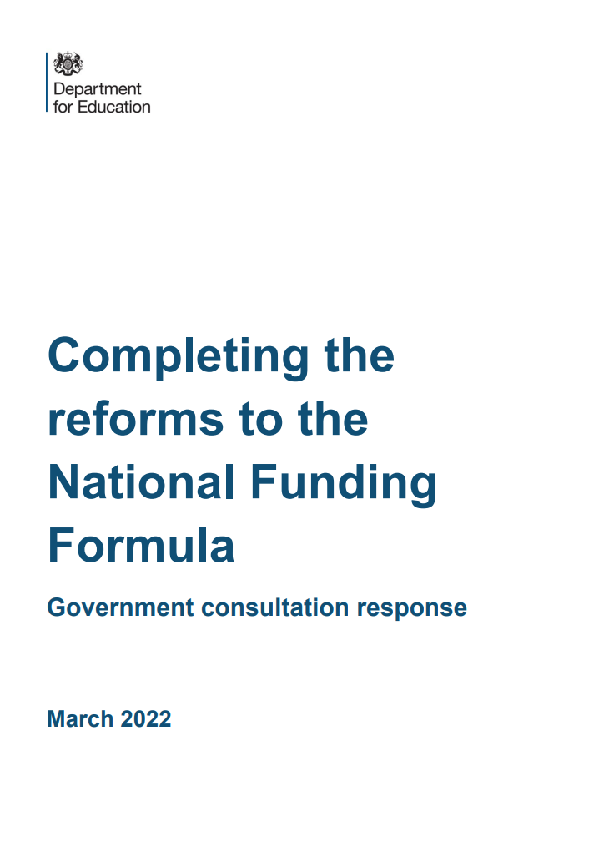
Growth funding
Initial proposals explored the potential of moving to national, standardised criteria to allocate all aspects of growth and falling rolls funding. Responses highlighted a wide range of views citing a wide range of concerns and practicalities.
DfE response committed to further improvements to existing approach to achieve greater simplicity, fairness and consistency but recognised the complexities and further consideration required.

Slide 5
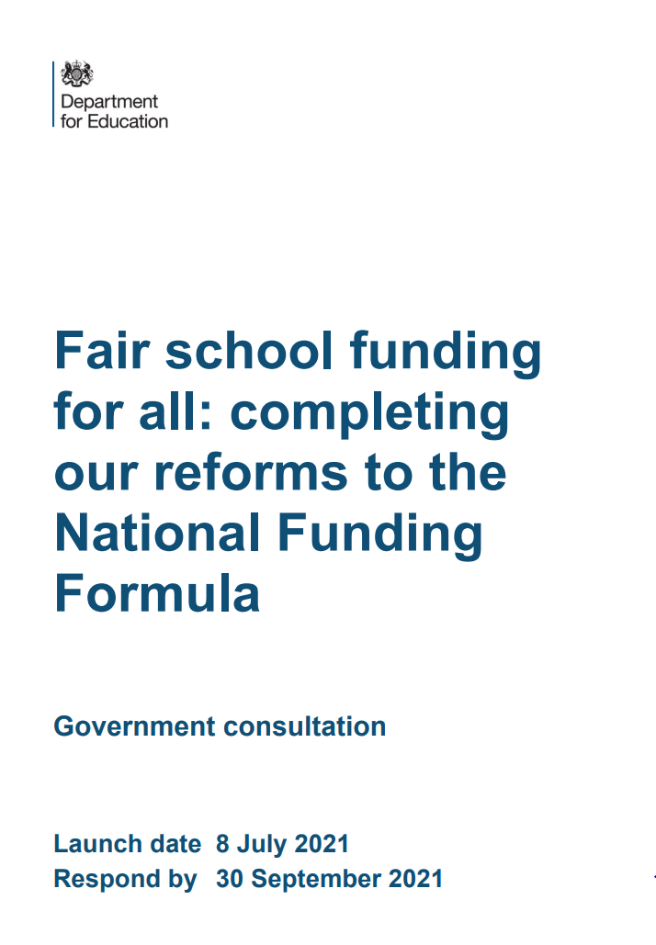
Growth funding
Current consultation seeks to explore two models:
  Limited local flexibility with LAs able to use funding using funding in a more consistent way on a defined set of scenarios which could include increased scope to support repurposing and removing space
  A fully standardised national system without local flexibility
DfE preference to adopt limited local approach which would allow implementation from 2024-25
Further consideration regarding extending popular growth funding to maintained schools on an application basis from the LA.
Questions remain regarding whether approach can reflect all local circumstances and also need for transitional protection.

Slide 6
Special Educational Needs
Special Educational Need not considered in detail as part of the initial consultation process due to the expected release of the Green Paper.
Following consideration of the responses to the Green Paper consultation, a further funding consultation will be released setting and refining proposals on changes to high needs funding.
The current consultation focuses on two elements:
Proposals on transfers of funding to the High Needs Block – The DfE is committed to retain this flexibility on the basis of strong evidence and are proposing to limit requests to a short “menu” of reasons. Following local consultation, transfers will be agreed by the Secretary of State which could include some discretion e.g. agree a multi-year transfer as pat of Safety Valve work. They envisage going forward reduced need for transfers as high needs systems become financially sustainable.
Use of the notional SEN budget through the NFF – The DfE propose to retain this indicator but nationalise the calculation of this notional figure to ensure consistency.
Questions remain regarding the value of the notional SEN budget given it simply earmarks existing funding as this can cause considerable confusion.

Slide 7
Formula change
A small number of proposals were put forward in the initial consultation:
Remove local flexibility regarding the eligibility criteria for funding for English as an additional language requiring pupils entering the school system in the last 3 years will attract funding in all cases.
Maintain limited local flexibility regarding sparsity funding for 23-24 with the intention to remove this in the long term.
The majority of responses received were in support of these proposals with the DfE therefore looking to implement changes from next year.

Slide 8
Formula change
The current consultation proposes changes to premises factors in order to begin to standardise this more complex are:
Split site – Develop a standard national approach based on a proportion of the lump sum taking into account both a basic amount and an element for distance
Exceptional circumstances – The DfE are proposing to further standardise policies and where possible automate payment for the relatively small number of circumstances that arise. They also intend to raise the minimum threshold value to be eligible from 1% of the schools budget up to at least 2.5%.
A further amendment is proposed to the minimum funding guarantee to address instances of potential over or under protection arising from changes to school-led funding which are more likely to arise in transitioning to a direct NFF.

Slide 9
Central Services
As part of the initial consultation, the DfE stated that a move to a direct NFF required a review of central services with the aim of bringing more consistency and towards a more school-based system that allows schools maximum control over their funding.
This considered local authorities’ ongoing responsibilities for all schools – both maintained and academies, de-delegated and top-sliced central functions and optional traded services for all schools paid out of individual school’s delegated budget share that are offered to schools to buy or not.
It also explored the potential merits of transferring funding for central services from the Dedicated Schools Grant to the LA General Fund.
Responses highlighted a range of challenges and competing pressure with the conclusion that the government will consider this further.
The current consultation does not make any further proposals regarding central services at this time however does intend to consult in the future in the context of the White Paper and further steps towards a direct NFF.

Slide 10
Transition and processes
The original consultation considered the proposal to change the funding year for maintained schools. Based on feedback and reflection, the DfE recognised the additional workload this would cause to schools and the LA therefore are not prioritising this area of investigation.
The recent consultation seeks to explore the timing and type of information that should be made available to schools. Proposals are similar to the existing arrangements with indicative figures made available in the autumn and final budgets provided in the spring (no later than existing deadlines)
Further details including timings to be discussed regarding data return requirements from the LA e.g. premises, growth, block transfers, de-delegation
It is intended to make some initial further steps towards a direct NFF in 24-25 focussing on areas discussed in the consultation
Further work, consultation and impact assessment will be undertaken during the transition period with the DfE aim to have moved to a direct NFF by 27-28 at the latest.
This work will also be impacted by changes as a result of the White and Green Papers which will also result in changes to the Central and High Needs blocks.

