Slide 1
Local Area Partnership Board
Summary strategy, governance and action areas.

Slide 2
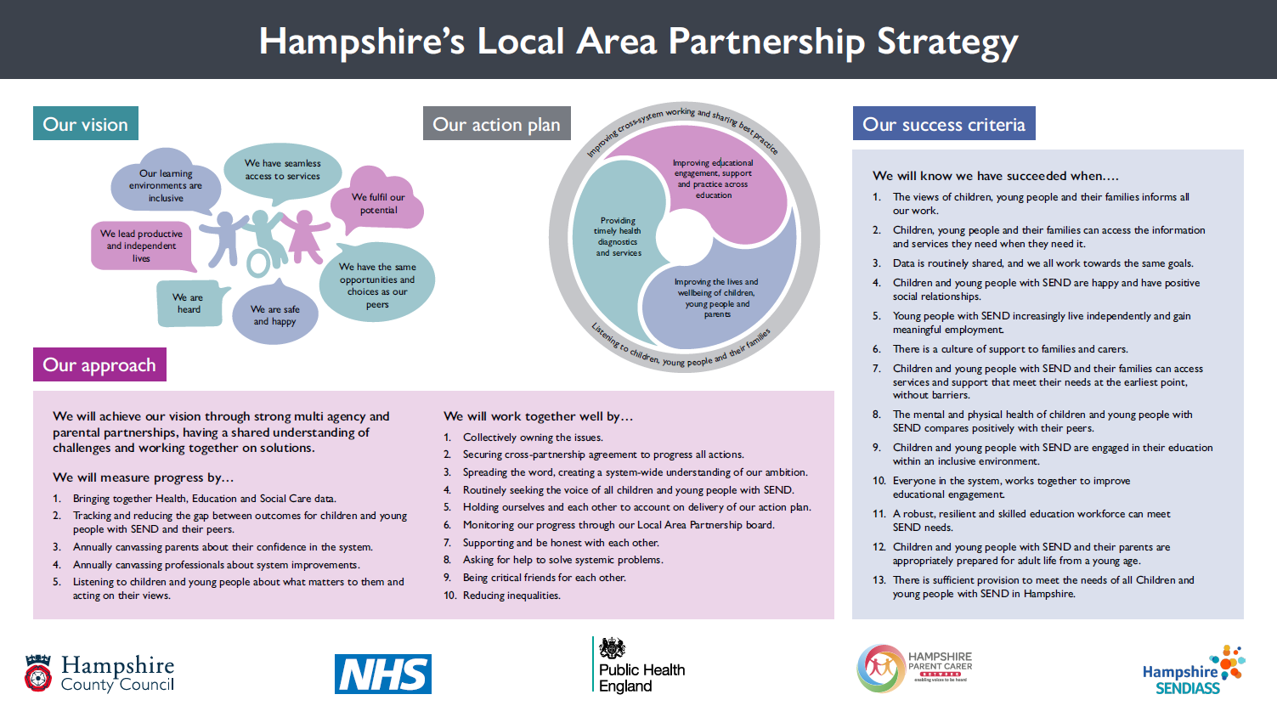

Slide 3
Strategic governance
SEND & AP
Local Area Partnership Board
We will ensure our priorities remain aligned with other strategic partnership boards across the county.
Strategic Partnership Boards
LAP Action Plan Delivery Boards
(TBC)
We will consult and inform partner led boards across the county about our action plans.
Partner-led Boards
Improving the lives and wellbeing of CYP and their families
Providing timely health diagnostics and services
Improving educational engagement, support and practice in Education
Transforming SEND Hampshire
LA led
CYP and family led
Health led
Giving children, young people and their families a voice.
improving cross system working.
Setting led

Slide 4
Improve educational engagement, support and practice across education settings
Summary of actions
Programme Lead: Caroline Marlborough

Slide 5
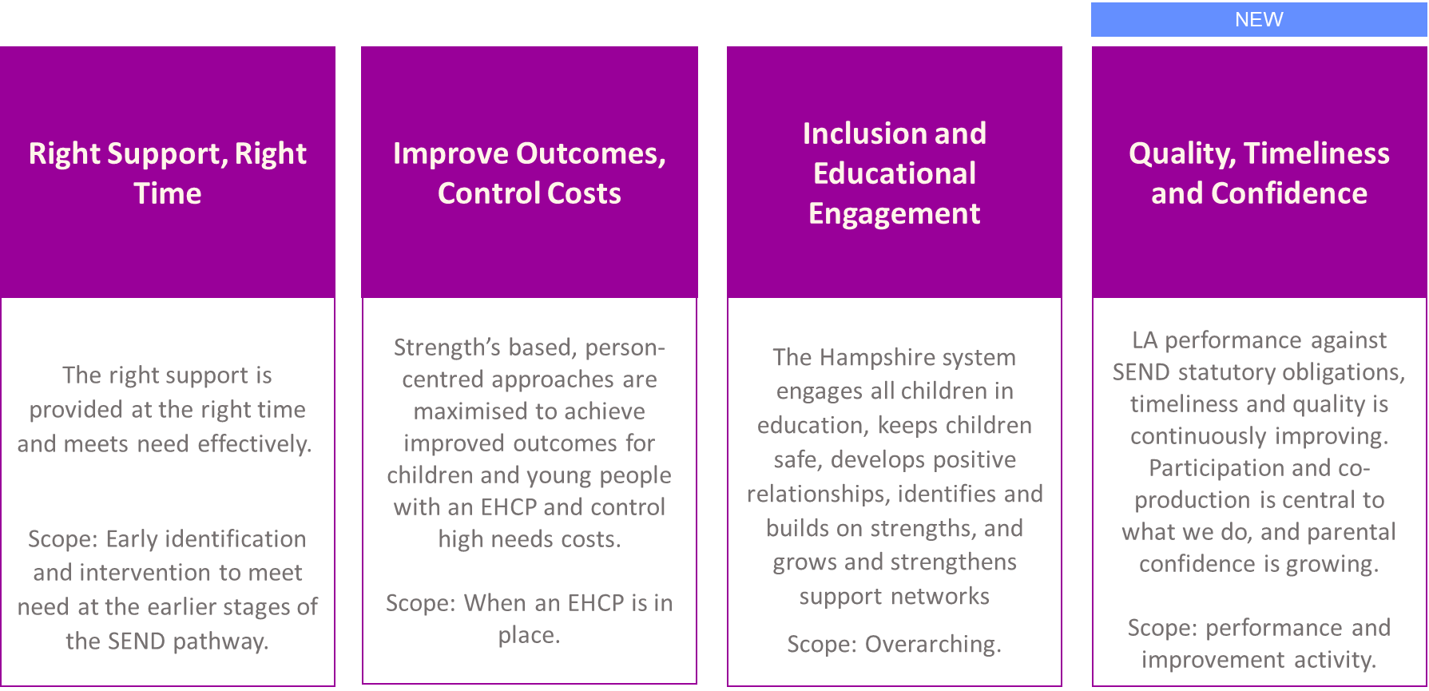
Transforming SEND
Transforming SEND is taking forward ‘Improving educational support and practice across education settings’.
The scope of the TSEND has expanded and workstreams have been extended to deliver Local Area actions.

Slide 6
Education and Inclusion led actions
47 actions have been aligned to 16 workstreams in TSEND, listed below.
Right Support, Right Time | Improve Outcomes, Control Costs | Inclusion and Educational Engagement | Quality, Timeliness and Confidence
Transition to School | Specialist Provision | The Hampshire Approach (Inclusive practice) | Improving data, accessibility, quality and timeliness
Person Centred Planning | Preparation for adulthood | Complex Admissions Panel | Improving timeliness of advice
 | Improve Outcomes and Attainment for CYP with SEND | Team around the School | Improving Therapy waiting times
 | Alternative Provision Action Plan | Needs-led training offer for schools and colleges | Improving Portage waiting times
 |  |  | Improving awareness and confidence
 |  |  | Participation and Co-production

Slide 7
Right Support, Right Time
TSEND workstream | Objective | Actions | Lead
Transition to School | To enable successful transitions from EY settings into Year R through extended portage support and advice to schools, jointly identifying and embedding approaches to avoid escalation of need. | TRANSITIONS: Improve cross system working to support effective transitions across all ages that avoid an escalation of need. | Sarah Hunt
Person Centred Planning | To provide PCP training and best practice that enables education professionals to identify the relevant SEN support available to CYP with SEND and increase parental confidence that their needs can be met. | PERSON CENTRED PLANNING: Make training available and spread best practice use of person-centred planning. | Becci Murphy

Slide 8
Improve Outcomes, Control Costs
TSEND workstream | Objective | Actions | Lead
Specialist Provision | To create high quality Specialist Provision that meets forecast need across the county. | LOCAL, SPECIALIST PLACEMENTS: renewed efforts to create in county specialist placements where they are most needed. INCLUSIVE RESOURCED PROVISIONS: Create Resource Provisions that promote inclusion in mainstream classrooms. | Helen Ley
Preparing for Adulthood | To improve PFA knowledge and embed best practice on PFA across the system. | PFA: Ensure effective cross system working to develop and implement strategies for PfA that meet the needs of CYP with SEND in their area, place children and young people and their families at the centre of their planning and provide accurate information about the options available to young people with SEND when they complete their education. PFA KNOWLEDGE: improve knowledge of PfA outcomes across professionals. | Toni Marie Leaf
Improve outcomes and attainment for CYP with SEND | To work across the partnership to identify children and young people with SEND who are not making expected progress and avoid escalation of need. | IDENTIFICATION AND INTERVENTION: Improve process for identifying CYP with an EHCP who are not making expected progress AVOIDING ESCALATION OF NEED: consider what more can be done across the LAP to prevent escalation of needs in the most common need types (SLCN, ASD, SEMH) IMPROVE ATTAINMENT: Improve attainment for CYP on SEN support IMPROVE OUTCOMES FOR CYP WITH SEMH NEEDS: Evidence more positive outcomes for CYP with SEMH needs | Laura Hamson (materials) HIAS (disseminate and embed in schools)

Slide 9
Improve Outcomes, Control Costs
TSEND workstream | Objective | Actions | Lead
Alternative Provision Action Plan | To improve the commissioning, oversight and quality of Alternative Provision. | 1. ALTERNATIVE PROVISION: Publish guidance covering the purpose of AP, when to use it, who to consult before commissioning, how to use it effectively in a time limited way, potential indicators of success, monitoring of outcomes and oversight responsibilities for unregistered AP. 2. AP FRAMEWORK: Improve the commissioning of AP and consider broadening the scope of the AP framework 3. AP QUALITY: Ensure Alternative Provision used is quality assured. 4. UNREGISTERED AP: Improved oversight and guidance for schools on children in unregistered AP 5. 3-TIER MODEL OF AP: Ensure that a three tired model for AP is in place in Hampshire, map existing AP against it and ensure that CYP can access appropriate AP when they need it. 6. AP OVERSIGHT: Improve the oversight of LA commissioned alternative provision for all children and young people who attend, not only those with SEND. Improve data collection to understand more about children accessing AP. 7. AP ROLES AND RESPONSIBILITIES: Ensure that roles and responsibilities for education, health and social care partners are clearly defined | Laura Hamson

Slide 10
Inclusion and Educational Engagement
TSEND workstream | Objective | Actions | Lead
The Hampshire Approach | To develop a collective approach to inclusion and educational engagement with schools and the wider system across Hampshire, that identifies and builds on best practice. | CULTURE: Create an inclusive environment for consistent effective practice and multi-agency working to flourish. | Michelle Nye
Complex Admissions Panel and resource | To establishment an effective multi-agency panel that identifies and responds effectively to hard-to-place children. | INTEGRATION SUPPORT Make integration support available for CYP with identified SEN who do not have a school place. REINTEGRATION SUPPORT Make reintegration support available for CYP with an EHCP who are out of school for a long time ELECTIVE HOME EDUCATION: Where families would prefer their children and young people with an EHCP to be educated at school, work with them to reintegrate them back into a school setting. | Pauline Martin-Ellis
Team around the School | To identify and establish comprehensive support for schools where a high number of children have complex SEND needs and/or are missing school. | REDUCED HOURS PROVISION: Work together across Education, Health and Care to improve attendance and reduce the prevalence of part time timetables for CYP with SEND. MEETING NEEDS OF COMPLEX LEARNERS: strengthen mainstream ability to meet the needs of complex CYP. (link to training) | Becci Murphy

Slide 11
Inclusion and Educational Engagement
TSEND workstream | Objective | Actions | Lead
Needs led training offer for schools and colleges | To use training needs analysis to identify and respond to the challenges associated with inclusion, educational engagement and SEND. | NEEDS-LED CPD: Create a needs-led SEND and Inclusion CPD offer for all education settings. SEN SELF-ASSESSMENTS introduce 'Self assessments’ for schools, to identify training needs, spaces and building changes required etc. NEWLY QUALIFIED TEACHERS Work with settings to upskill NQTs in SEND RIGHT SUPPORT, RIGHT TIME: Improve early identification of need and ensure CYP receive the right help and support at the right time OAP explore the options on improving the consistency and quality of OAP, including whether a quality standard is appropriate. SEN SUPPORT: Improve the quality, consistency and knowledge of OAP/SEN support across all Early years, schools and post 16 settings in Hampshire, particularly for children with the most common need types. Distinguish between a learning gap and a learning need, baseline SEN support in colleges. SENCOs: Develop SENCOs ability to identify and embed best practice. PARENTAL CONFIDENCE IN SEN SUPPORT: Increase parental confidence in SEN Support. MEETING NEEDS OF COMPLEX LEARNERS: strengthen mainstream ability to meet the needs of complex CYP. TRANSITIONS: Improve cross system working to support effective transitions across all ages that avoid an escalation of need. | Laura Hamson

Slide 12
Improve quality, timeliness and confidence
TSEND workstream | Objective | Actions | Lead
Improving data, accessibility, quality and timeliness | To improve The quality of data held on CYP with SEND The quality of EHCPs and annual reviews the accessibility of EHCPs and the timeliness of annual reviews | ACCURATE DATA RECORDING: Ensure records kept about CYP are up to date and accurate. OUTCOMES FOCUSSED, PERSON CENTRED EHCPs: Ensure that EHCPs are person-centred and outcomes focused (both at assessment and review stages) and ensure wider health and social care outcomes are included. EMBED PREPARATION FOR ADULTHOOD: Embed PfA goals in EHC plans and annual reviews, from year 9 at the latest. REVIEW TIMELINESS: Improve annual review processing timeliness. EHC HUB: Continue to work with the supplier, using feedback from users of the EHC hub to improve accessibility | Claire Campling
Improving timeliness of advice | To improve the timeliness of EP advice. | ASSESSMENT TIMELINESS: Improve the timeliness of EP advice and overall 20- week timeliness. | Becci Murphy
Improving Therapy waiting times | To improve waiting times for Therapy services. | WAITING TIMES FOR EDUCATION SERVICES: Reduce waiting times for services that support CYP with SEND and help to meet need effectively (Therapies) | Michelle Nye
Improving Portage waiting times | To improve waiting times for Portage services | WAITING TIMES FOR EDUCATION SERVICES: Reduce waiting times for services that support CYP with SEND and help to meet need effectively (Portage) | Sarah Hunt

Slide 13
Improve quality, timeliness and confidence
TSEND workstream | Objective | Actions | Lead
Improving awareness and confidence | To make the Local Offer responsive to feedback and accessible and ensure that it includes all relevant information for parents in a variety of formats. | LOCAL OFFER CONTENT: Ensure the Local Offer remains responsive to feedback, accessible and up to date. This should include: access to a published SEF, information about the Independent Futures Team, the options available to young people with SEND when they finish education, how their health and care needs can be met when they reach adulthood, transitions, information on ADHD, Anxiety and LGBTQ support. LOCAL OFFER PROCUREMENT: Consider future procurement options for the local offer, including possible integration of Adults Services directory, and the provision of virtual Community Hubs. FEEDBACK ON INFORMATION AND SERVICES: Use the Local Offer as a tool to gather feedback on services. Gather feedback more regularly across the partnership PATHWAYS: Set Health pathways out clearly in the Local Offer | Josh MacDonald
Participation and Co-production | To embed participation and co-production as a golden thread running through everything we do. | PARTICIPATION: Increase participation opportunities for children and young people to have a say in the service and support made available to them. CO-PRODUCTION: Improve co-production at a strategic level and throughout the system to practitioner level and ensure that evidence of co-production is held by the LAP | Toni Marie Leaf

Slide 14
Delivered workstreams
TSEND workstream | Objective | Actions | Lead | Justification for request to close
Multi Agency Audits | Develop a process for auditing across agencies, reporting into the LAPB | AUDITS: Carry out regular, multi agency audits and share the learning across the partnership | Laura Timms | An audit process is in place and regular reports to board are planned. Next report is in the Feb Board pack.
High quality annual reviews | Provide best practice Annual Review guidance | ANNUAL REVIEW QUALITY: Provide best practice guidance, targeted advice and support to education settings about Annual Reviews. | Becci Murphy | Annual review guidance has been developed and shared- a copy is provided with the February board papers.

Slide 15
Providing timely health diagnostics and services
Summary of Actions
Programme Lead: Anthony Harper

Slide 16
Health led actions
Health are leading on fifteen actions, covering:
  Primary Care (GP) services for young people preparing for adulthood.
  Waiting well.
  Improved capacity for healthy child programme checks.
  Statutory timeliness for continuing care assessments and health assessments for children in care.
  Consistent access to assessments and diagnostic services.
  The availability of musculo-skeletal and therapy services.
  Improving early identification of need and timeliness of response and reducing waiting lists for specialist mental health services.
  Supporting healthcare needs in schools.

Slide 17
Providing timely health diagnostics and services
Theme | Actions | Lead and progress
Primary Care Services | PRIMARY CARE - Primary Care (GPs) should make reasonable adjustments to ensure that children and young people with SEND can access services as part of developing their independence and their preparation for adulthood. (PfA Benchmarking)
Improve early identification of need, timeliness of response and reduce waiting lists. | WAITING LISTS: ensure LAPB partners are fully involved with the development of key pathways which a) ensure an effective ‘waiting well’ offer for those requiring formal assessment and b) improve the time children and young people wait for assessment where required. (Workshop 2024) HEALTH VISITOR CHECKS: Address capacity issues so that all 5 mandated healthy child programme checks can be undertaken. (Action Plan 2020) CONTINUING CARE ASSESSMENTS: Improve performance against statutory timescales for assessment of eligibility for children's continuing care. (Previous SEF) HEALTH ASSESSMENTS FOR CHILDREN IN CARE: Ensure initial and review health assessments for children in care are completed within statutory timescales (Action Plan 2020) | New In progress- Jo Lockhart In progress, Melanie Ellard Complete – monitor impact, Jeanette Keyte
Assessments and diagnostic services | TRANSITION: Develop effective transition protocols and practice that support young people to access adult service as and when required. (Action Plan 2020) AUTISM AND ATTENTION DEFICIT HYPERACTIVITY DISORDER: Develop a whole-system pathway which improves early identification of need, responds to need not diagnosis and which improves timeliness of assessment where children and young people require one. (workshop 2024) PUBLIC HEALTH NURSING: Public Health nursing to prioritise activity that enables an effective assessment of needs, provision of early support and appropriate onward referral to specialist services (Previous SEF) | New, Matt Powell ND pathway, Catherine Barnard New, Jo Lockhart

Slide 18
Providing timely health diagnostics and services
Theme | Actions | Lead and progress
Availability of services | MUSCULO-SKELETAL SERVICE: Improve consistency of MSK service offers across the county and their connectivity with other key services. (Action Plan 2020) ACCESS TO THERAPY SERVICES: Improve identification of need and support for children at the earliest stage. Ensure consistency of access to therapy services across the county (Action Plan 2020) | Matt Powell. In progress
Improve early identification of need, timeliness of response and reduce waiting lists for specialist mental health services | All actions identified in co-produced SEF 2024 1. ACCESS TO SERVICES: Improve access to universal emotional health and wellbeing services as part of a robust pathway. Ensure timely access to specialist services (e.g., CAMHS), particularly for identified vulnerable groups; children in care and those with care experience, those who are neurodiverse and those with eating disorders. Ensure that information on the waiting list for specialist services is clear and reported to the Board. 2. MHSTs: In line with further NHS England funding, roll out further waves of MHSTs across Hampshire schools and other settings and develop the evidence base of what works. 3. ALL PRACTITIONERS: Support practitioner working with children and young people to have a shared understanding of social, emotional and mental health and to promote resilience and emotional wellbeing in their work. | 1. Ongoing: 2. Early help and prevention, Jeanette Keyte 3. Specialist services, Jess Entwistle
Supporting healthcare needs in school | COMMISSIONING: Ensure micro and macro commissioning for children with complex healthcare needs provides safe, consistent access to school. (Action plan 2020) GOVERNANCE: Ensure that where schools support children with complex healthcare needs, that appropriate clinical governance and oversight is in place. | Jeanette Keyte

Slide 19
Improving the lives and wellbeing of children, young people and their parents
Summary of actions
Programme Lead: Katie Eason

Slide 20
Children Services led actions
Eight actions are being progressed by children services, covering:
Making information about advice and support available for families and young people not open to social care.
Information and guidance on accessing breaks from caring and the range of short breaks for CYP with a disability and their families.
The availability of personal transport budgets.
Wraparound care.
Opportunities for CYP with SEND to build relationships in the community.
Opportunities for evidence based, joint commissioning arrangements.
Social Care data availability.

Slide 21
Improving the lives and wellbeing of children, young people and their parents
Workstream | Objective | Actions | Lead
FISH Board | Ensure that appropriate family support and/ or advice is in place for families and young people who are not open to social care services | Support services are mapped and clearly set out in accessible formats and locations. Partner agencies are aware of support services available and able to signpost families and young people to accurate and appropriate sources of information. (Early Help and Prevention toolkit information, signpost to FISH, Healthier Together; Hampshire Healthy Families Portal and Hampshire CAMHS) | Katie Eason Josh McDonald
Short Breaks | Ensure the continued provision of a range of Short Breaks to support children and families with a disability, within available grant funding. | Commission a programme of community based Short Breaks Activity breaks for Gateway Card+ eligible children and young people. Ensure breaks continue to support identified priorities through engagement with parents & carers, CYP and HPCN. Ensure compliance to statutory duty to provide short breaks to eligible families open to Disabled Children's Teams via services such as care support, overnight respite and direct payments. | Sarah Cross (Belinda Stubbs) Andy Lund
Information and guidance on breaks from caring | Ensure information and guidance is accessible for parents/carers to access a range of opportunities to have a break from caring. | Publicise Short Breaks offer via Hantsweb pages and Short Breaks Service Statement. Providers to ensure entries maintained on FISH/Local Offer | Sarah Cross

Slide 22
Improving the lives and wellbeing of children, young people and their parents
Workstream | Objective | Actions | Lead
Personal Transport Budgets | Ensure personal transport budgets are maximised to allow children and families access to a wider range of opportunities to have a break from their caring responsibilities | Personal Transport Budget provision is an established workstream for the School Transport Service, providing eligible families with choices on how they transport their children to school. | Jon Bramley
Wraparound care | Children and families can access wraparound care appropriate for the needs of their child. | Ensure the Inclusion Setting Support Officer (ISSO) Service offers appropriate support and guidance on including children with additional needs in Hampshire’s Early Years education. Dedicated Wraparound Inclusion Officer has been funded to support providers now and create legacy support materials to support inclusion beyond the funded program. Survey mainstream providers to quantify current attendance of children with SEND in wraparound settings and to identify gaps Survey special schools to understand local barriers to Wraparound delivery and to identify good practice. Encourage wraparound provision to complete Quality Standards self-assessment. Target support for those providers with poor outcomes in inclusive culture and show case exemplar practice. Support network to be formed for the 14 schools chosen by the DfE for the Breakfast Clubs early adopter's test and learn phase. | Peter Cooper Rachel Johnson

Slide 23
Improving the lives and wellbeing of children, young people and their parents
Workstream | Objective | Actions | Lead
Community Opportunities | Children and families will have the opportunity to make friends, build supportive relationships and live happy and enjoyable lives | Strengthen opportunities to involve the voices of children and young people in shaping improvements to services and experiences. Review and collate accessible community offers. Review information and guidance available on The Local Offer and ensure that impartial information and advice is available about opportunities like: Community Buddy Scheme Hampshire Outdoors Hampshire Cultural Trust Hampshire Cultural Trust’s SEND Offer Accessible Ambassadors Scheme. | SEND Participation Officer Toni-Marie Leaf Karen Norwood / Andy Tickner
Joint commissioning | Joint commissioning arrangements will support best use of resources to improve outcomes and transition for adulthood for children and young people in the most efficient, effective, equitable and sustainable way | Review and refresh the current Joint Commissioning strategy in co-creation with partners. Review joint commissioning governance arrangements to ensure transparency in decision-making. Explore further opportunities to jointly commission services. | Jo Kent Sam Davenport

Slide 24
Improving the lives and wellbeing of children, young people and their parents
Workstream | Objective | Actions | Lead
Mosaic Programme Board/ CFMT | Accurate and accessible social care data will drive informed decision making and rigorous evaluation of services to support the best outcomes for families and young people. | Engage with the data governance and systems teams to align service requirements and system functionality to provide access to high quality data and reports Target improvement in data quality Engagement and learning opportunities for all professionals to increase their knowledge and expertise in data recording and monitoring | Steph How

Slide 25
Task and finish groups

Slide 26
Short term tasks
Task | Allocation and progress
Share data, create published shared KPIs and monitor them at Local Area level. | Heather Slocomb - underway.
Create a system-wide introductory video for the whole workforce on the wider SEND system. | Caroline Marlborough- underway
Invest in a Local Area Partnership Newsletter that is shared system-wide and has CYP at the centre. | Not started
Explore shared front door options | Not started
Create a place to collect and share best practice examples across the LAP and develop a richer picture of the difference that having an EHCP makes for a CYP with SEND in Hampshire. | Caroline Marlborough- underway. We are gathering examples of best practice – if you have any, please share them with Caroline.Marlborough@hants.gov.uk

Slide 27
How can Schools Forum members help?
Information sharing across all settings and partners about our strategy, and the work of TSEND.
Share information about the services and support available.

