Slide 1

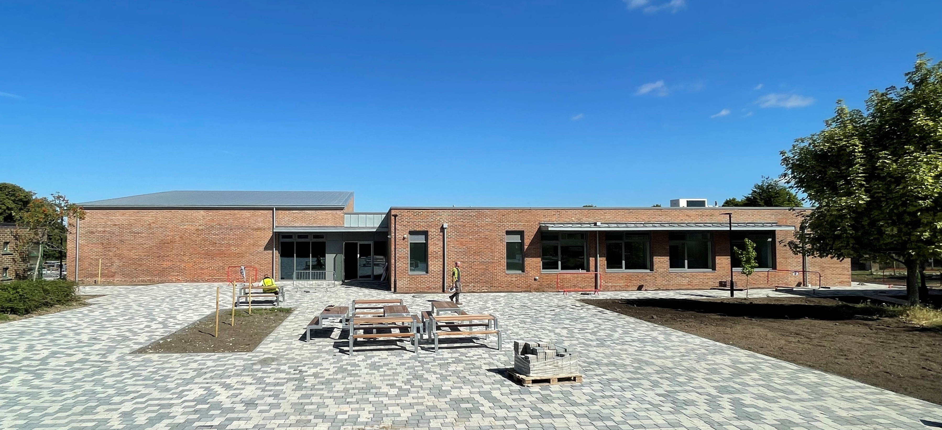
Children’s Services Capital Programme update
Richard Vaughan - Strategic Manager Capital Planning & Development
Team name (optional)

Slide 2
CSD Cap Prog update
Final 24/25 budget position £76m. Actual spend £60m (re-profiling of budgets) to 25/26 £16m Total value of three-year CSD Cap Prog £526m. Includes schemes currently underway and profiled spend beyond 2027/28. Programme now managed on an expenditure basis, starts basis previously. Schemes now profiled by financial years.

Slide 3
CSD Cap Prog update
3 new primary schools complete for September opening: Stanhope, Hounsome and Newlands.
2 new special schools due to start on site during 2025/26: Luminous Oak and Windmill.
Secondary: North Whiteley £50m

Slide 4
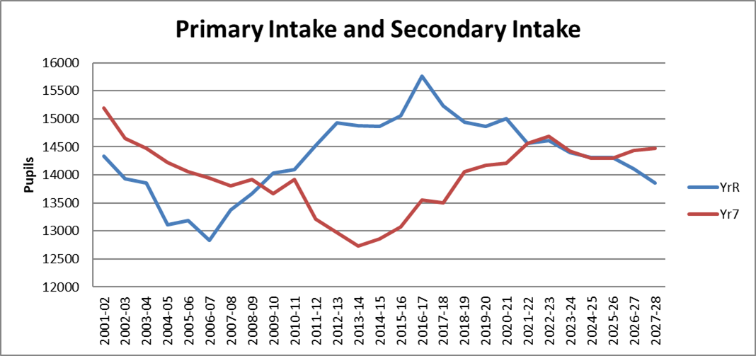
Primary numbers and movement into the secondary phase at Year 7

Slide 5
CSD Cap Prog update
No Basic Need allocation for 2026/27, but allocations expected from 2028/29. “025/26 allocation. 2025/26 allocation £22m.
High Needs Capital allocation of £23m for 2025/26. SEND pressures continue to grow in contrast to falling pupil numbers generally.
DFC and SCA grant allocation remain in line with expectations.

Slide 6
CSD Cap Prog update
Increasing numbers of complex social care schemes requiring an annual budget of £1.5m – unfunded going forward!
Developers slowing on housing building leading to delays with new schools and expansions.
Cost pressure on modular buildings represent decreasing value as a ‘cheaper’ solution.

