Slide 1

Laura Hamson – School Improvement Manager – SEND and Inclusion
Primary and Secondary Resource Committee – Resourced Provisions

Slide 2
Acronyms
ASC or AS – Autism
EFS – Education financial services
EHCP – Education, health and care plan
EPS – Education personnel services
FGB – Full governing body
HI – Hearing impairment
HIAS – Hampshire improvement and advisory service
LA – Local Authority
MLD – Moderate learning difficulty
PD – Physical disability
SDT – Strategic development team
SEMH – Social, emotional and mental health
SEN – Special Educational Needs
SENCo – Special educational needs coordinator
SIM – School Improvement Manager
SLA – Service level agreement
SLCN – Speech, language and communication need
SLD – Severe learning difficulty
SpLD – Specific learning difficulty
SRP or RP – Specialist resourced provisions
VI – Vision impairment

Slide 3

Resourced Provisions – Purpose and Vision
Local schools for local children
The Department for Education states:
Resourced provisions (SRP) and Designated Units (Units) provide additional specialist facilities on a mainstream school site for a small number of pupils, typically less than 30, who usually have EHC plans. SRP and Units tend to provide for a specific need such as speech, language, and communication needs (SLCN), hearing or visual impairment (HI/ VI) or autism (ASC). Less commonly they may provide for pupils with a physical disability (PD) or behavioural difficulty. RP and Units vary widely, often reflecting the local approach to inclusion.
There is a difference between RP and Units. In RP pupils spend most of their time (usually well over 50% of their timetable) in mainstream classes. They only attend the RP facilities for individual support, to learn a specific skill (for example braille for VI pupils), to receive medical or therapeutic support (for PD pupils) or to access specialist equipment. The facilities can be in a suite or dispersed throughout the school. Pupils in a Unit spend most of their time there, only attending mainstream classes for a few lessons, such as PE, for assembly or for lunch. Pupils in both settings are on the roll of the mainstream school.
Hampshire chooses to use resourced provisions because they aspire to the principles of inclusion rather than segregation
Admissions to resourced provisions are controlled by the LA SEN team
Different children will need different things from a resourced provision so this will affect the amount of time they spend in and out of the provision
The goal is always to strive for inclusion, however at times integration and segregation may be more appropriate in meeting needs
Integration? No, inclusion. (2020). https://amylawson9.wordpress.com/2020/03/24/integration-no-inclusion/.
Notes:
Deliberate choice to utilise RPs rather than units, because they more fully align to the Hampshire principles of inclusion.
Equally flexible in the delivery of them in order to ensure the right support at the right time for children but with a clear vision of them being as local to home as possible.
Resourced provision enable an aspiration more aligned to inclusion rather than segregation which is why they are the provision being utilised.
Situated as part of a mainstream school, however admissions are controlled by the SEN team in consultation with school.

Slide 4
Strategy
Forecasting methodology – modelling based on the assumption that existing patterns of EHCP growth will continue and taking into account birth rate trends.
Specialist Provision Action Plan 2025-2030 outlines additional 1000 specialist places (special school and resourced provisions) by 2030:
    Focus on AS/ASC and SEMH as highest areas of growth/need
    Decrease unfilled places (SpLD/PD)
    Look at designations, descriptors and consistency across the County
    Gaps of provision across the County
    Progression route – mapping where primary moves to secondary to ensure clear and available pathways
    Land and assets – falling rolls and repurposing of space where surplus to mainstream / other needs
Bi-monthly Specialist Provision board – Strategic development, County Education Manager and SEN Service Manager, Finance, Land, Assets and Buildings, School Improvement Team
Notes:
Clear forecasting methodology in place which is used to inform where strategic development is required.
Initial aim of 1000 places is on line to be met or exceeded. Places through RP and special school expansion / creation.
AS and SEMH are key areas for targeted growth as these are also able to support children with speech and language needs.
Unfilled places are being decreased (needs but also accessibility / AT / OAP is improving which means some areas are less needed than previously) but subsumed with alternative designations so number of places are not going to decrease.
Specialist Provision Board – in place for 1 year and provides a mechanism for ensuring a swifter response to requests and strategic needs. Also ensure that the focus is maintained on creating pathways and monitoring assets. All aspects from all specialists are reviewed prior to decision to pursue provision.

Slide 5
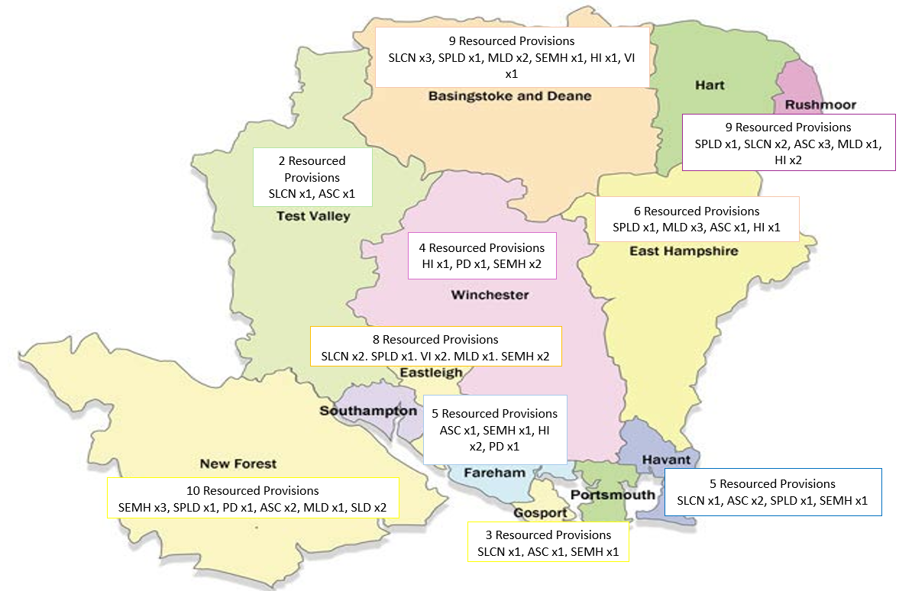
Resourced Provisions
Current summary - 61 Resourced Provisions providing 671 specialist places
Primary 37
Secondary 24
Date | Number of resourced provisions
September 2023 | 58 (651 places)
September 2024 | 60 (666 places)
September 2025 | 70 (13 new or expanded – 716 places)
September 2026 | 91?
Notes:
Overall designation summary
SLCN x10
AS x11
SEMH x11
SPld x6
PD x3
SLD x2
MLD x8
VI x3
HI x7
Sept 23 – 24 – +15 places
Sept 24 – 25 – +50 places
Sept 26 could be another +130 or more

Slide 6
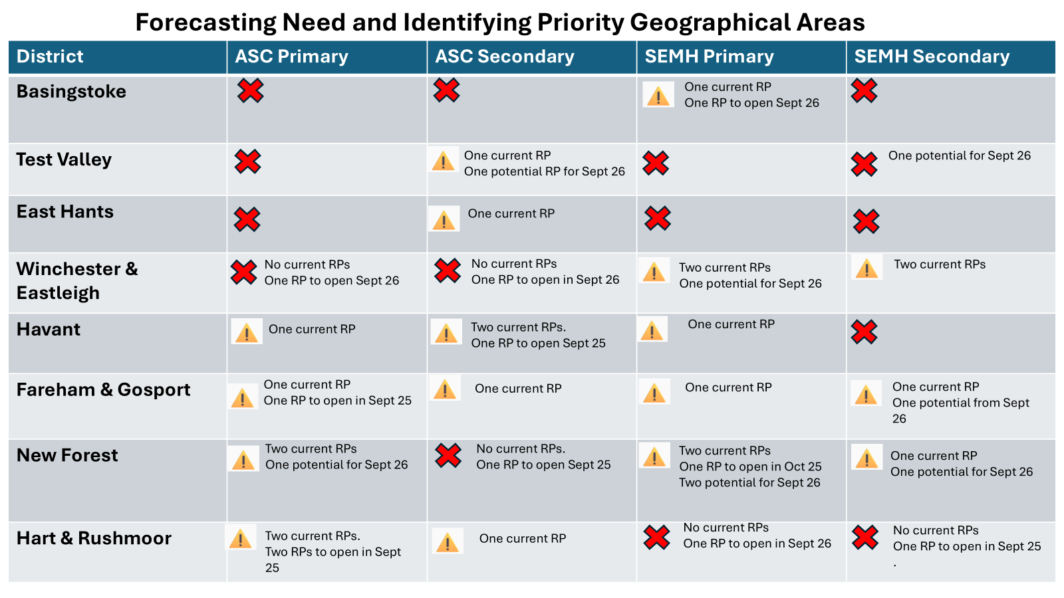
Notes:
X= currently no provision, so is a priority and most important to secure
! = is provision which needs to be identified as having a clear pathway

Slide 7
Placements and Funding
Placements
Consultations
Liaison with local SEN teams
Panels at phase transfer
Phased build up for new provisions
Funding
Capital – available to support development of internal and external spaces, equipment, IT
Revenue - Place funding from high needs, top up funding and mainstream pupil funding
Different funding amounts for different designations
SEMH provides a training element due to the ongoing costs of physical intervention training and refreshers
Starting to develop some staffing models for designations – currently in place for AS and SEMH
Can apply for one-off start up revenue funding for leadership time / resources
Notes:
Consultations – completed in the same manner as mainstream consultations for children with EHCPs. Look to work in collaboration with the school, however direction is still possible and does sometimes have to happen. Aim is for as many RPs as possible so wherever possible children are local. However this can mean that children outside of the catchment may attend, whilst provisions are being developed.
Phase transfer – physical panels undertaken for SEMH provision to ensure appropriate matching with future cohorts.
New provisions – phased opening and close working with the SEN team to ensure initial placements are appropriate. Opportunities to attend network meetings and any training in the lead up to opening to ensure preparation.
Funding – Reasonable capital investment available to ensure a provision to meet need and schools establishing new provision can apply for start up revenue for leadership time and resource. Ongoing revenue is allocated through place funding, top up and high needs funding. Some differences in funding to recognise the likely staff requirements for the provision dependent on designation. Currently an increased amount for SEMH which covers the expectation for physical intervention training and the ongoing cost of refresher training.
Not a money making venture but if use is aligned to principles then revenue is sufficient to cover costs. A lot of benefit for the mainstream of the school as practice should be shared and used for wider professional development.
Have developed 3 different financial modelling scenarios for both primary and secondary AS and SEMH for a provision of 12 which is fully occupied. All demonstrate how funding can be maximised for staffing purposes without recognising the benefits that the provision bring to and therefore value to the school as a whole. This is able to be used with new provisions to ensure that models established are viable and future proofed.

Slide 8
Developing Resourced Provisions
Approach from a School / FGB / Trust in establishing / expanding an RP – or direct approach to a School in priority location
Due diligence checks with EFS (budgets), SDT (accommodation/forecasts), HIAS (inclusion/capacity), EPS, SEN
Initial meeting with Headteacher, SENCo – outline of what an RP is, designations, funding, phasing, placements, opportunity to look at school accommodation and potential location for RP base
Headteacher/SENCo visit to established RPs
If still interested, presentation to FGB on potential programme, designation, funding
If approved by FGB, report to Executive Member Children’s Services, to gain authority to consult
Minimum of 4 week Statutory Consultation including drop-in
Feasibility designs / agreement of capital funding required to establish RP
Following consultation confirmation by LA and FGB still want to proceed
Report to Executive Member Children’s Services feedback on consultation and final approval to proceed including revenue and capital funding approvals
Guidance on placements, training, staff recruitment, capital works undertaken
SLA signed
Resourced Provision opens
Notes:
Strategic and deliberate with development. A significant number of factors are reviewed prior to moving forward with a request. Establishing a new provision requires quite an extensive process and therefore the first layer of due diligence is vital in ensuring that the provision is appropriate.

Slide 9
Support and Assurance
Support
Guidance for Governors/School Leadership in advance of committing to any new provision
Support for undertaking statutory consultations if establishing new, expanding or changing SEN provision
Appropriate capital funding to support establishment / expansion
Termly network meetings
Training offers – currently being trialled
Development of a best practice guide
Assurance
Quality assurance visits approx. every 2 years
Annual return of key data
Light touch review through Lead Learning Partner Review
Notes:
Support is provided through officer time and financially for those establishing new provisions.
Once established ongoing support is provided through the termly network meeting and potential training offers. We are also developing a best practice guidance for established and future provisions which will identify strategies for embedding the provision as part of the main school.
Assurance work is undertaken through a visit in the first 12 months of operating. This reviews the operation model as well as the quality of provision. Ongoing assurance is then undertaken through annual LLPR process and 2 years full assurance visits. Annual returns are also requested which provide the LA with data specific to the resourced provision to enable ongoing monitoring but also to prioritise earlier revisits.

