Slide 1

Delivering Better Value update
DBV diagnostic complete.
Our existing High Needs programme was validated.
Areas of further focus were identified through the diagnostic work which involved partners, parents and schools.
  Improving parental confidence.
  Promotion of inclusive practice in schools.
  Increasing awareness and understanding of the support available
  Annual reviews
£1m grant funding awarded following successful bid.

Slide 2
Transforming SEND Hampshire
Formal launch and promotion of the rebranded Transforming SEND Hampshire programme with schools through Autumn SEND conferences.
Transforming SEND programme encompasses new DBV workstreams;
  Three early intervention pilots to build SEN Support capacity in schools and improve parental confidence.
  A new SENCO Helpline for schools to raise awareness of LA services available and provide advice on SEN support
  A SEN Support Toolkit, building on our SEN Support guidance.
  Training for schools on supporting children and young people with complex needs to improve inclusivity.
  Training on running or participation in person centred planning meetings to improve parental confidence
  Improved Local Authority engagement in Annual Reviews to right size plans and focus on increasing independence.

Slide 3
Transforming SEND Hampshire
Right Support, Right Time
Improve Outcomes, Control Costs
Continuous Improvement
The right support at the right time to meet need effectively.
Scope: Early identification and intervention to meet need at the earlier stages of the SEND pathway.
Maximising strengths based, person centred approaches to achieve improved outcomes for children and young people with an EHCP and control high needs costs.
Scope: When an EHCP is in place.
Improve LA performance against SEND statutory obligations and quality of EHCPs / Annual Reviews and track the delivery of other transformation activity.
Scope: performance against statutory obligations and improvement activity.

Slide 4
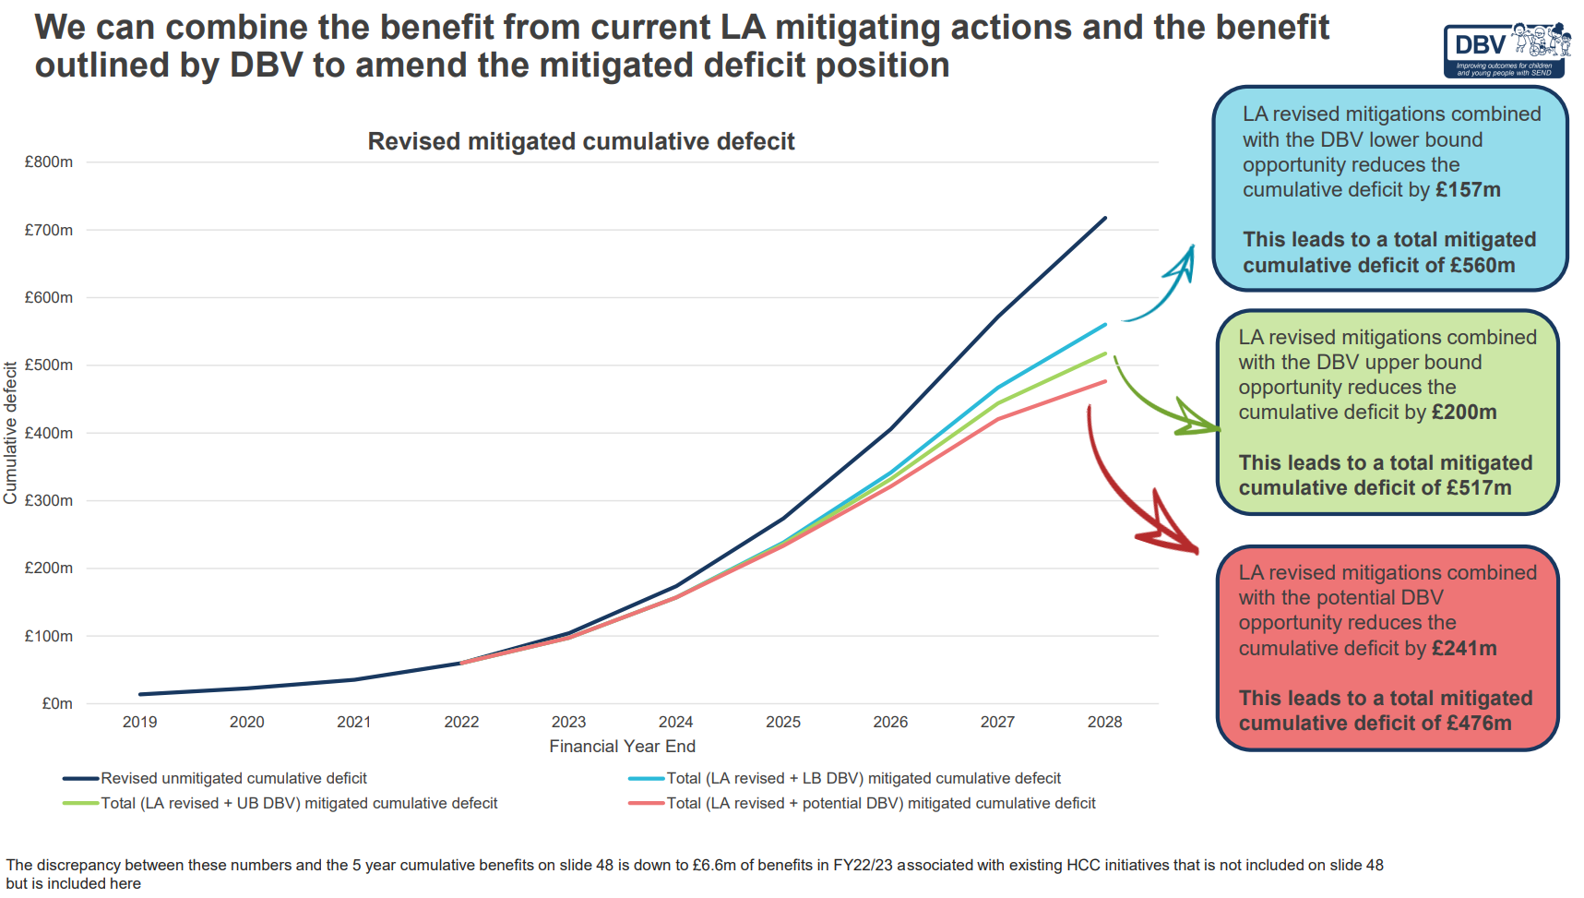
Newton Europe Graph
Black line - unmitigated forecast
Blue line - likely mitigated forecast
Green line – Optimistic forecast
Red line – if all was rolled out tomorrow (which isn’t possible within the funding envelope or current staffing)

