Slide 1
Dedicated Schools Grant Deficit Management Plan Update
June 2023
Natalie Smith
Assistant Director, Education & Inclusion

Slide 2
Overview
£86m Deficit for Hampshire Dedicated Schools Grant (DSG) at year end 2022/23. Represents 7.4% of total DSG and 49% of High Needs Block Funding.
Delivering Better Value (DBV) diagnostic completed in December 2022 and the LA’s rebranded Transforming SEND programme was validated.
Areas of further focus were identified and £1m grant funding awarded following successful bid.
The forecast cumulative DSG deficit at the end of 2023/24 has increased to £125.3m, 10.1% of total DSG and 64% of High Needs Block.
The estimated 2027/28 deficit is £382.4m using current funding assumptions and factoring in planned savings workstreams. This is significantly lower than the £476m best case deficit projected by Newton for 2027/28.
The Transforming SEND Hampshire programme is currently forecast to make circa £26.3m savings / cost avoidance in 2023/4.
Hampshire remains one of the lower funded local authorities through the High Needs National Funding Formula.
Between the reforms taking effect in 2015 and 2023 there has been a 192% increase in the number of EHC Plans being maintained (as of January 2023).
As of the end of May 2023 Hampshire maintains 15,276 EHC Plans, an increase of 13% since May 2022.
The age group with the largest percentage increase is the under 5s group, where the number of EHCPs has seen a 42% increase.
Between January and May 2023, the SEN Service received 1,484 requests for assessment, an average of 297 requests a month and a 9.4% increase on the same period last year.
The service has issued an average of 217 plans a month during 2023.
Hampshire bucks the national trend of decreasing EHCP Timeliness, improving by 30 percentage points in 2022, achieving 45.7% timeliness while clearing overdue cases. So far in 2023 72% of EHC Plans have been issued on time.
Forecasting models indicate that there could be 24,391 EHCPs maintained by Hampshire in 2029. This is a significant 68% growth from 2023.

Slide 3
Delivering Better Value (DBV) Diagnostic
Aim of the DBV programme is to support Local Authorities and their local area partners to improve the delivery of SEND services for children and young people (CYP) whilst working towards financial sustainability.
Diagnostic covered three phases:
Module 1
Baselining and Forecasting
To understand the volume and type of support CYP have received historically in Hampshire and forecast what this might look like going forward.
Data focussed
Module 2
Root Cause Diagnostic
To identify the highest impact changes that could be made to deliver better outcomes for CYP.
Surveys, case studies and interviews with schools, parents and partners
Module
Implementation planning
To build findings into effective implementation, identifying strengths, enablers and risks
Drawing together the evidence and agreeing the keys areas of focus for new workstreams.

Slide 4
Delivering Better Value (DBV) bid
DBV diagnostic completed December 2022.
The Local Authority’s rebranded Transforming SEND Programme was validated.
Areas of further focus were identified through the diagnostic phases.
  Improving parental confidence.
  Promotion of inclusive practice in schools.
  Increasing awareness and understanding of the support available from the LA and others.
  LA participation in annual reviews.
£1m grant funding was awarded following successful bid.
The DfE have indicated that further funding may be available and are looking into a process that is equitable across all LAs.

Slide 5
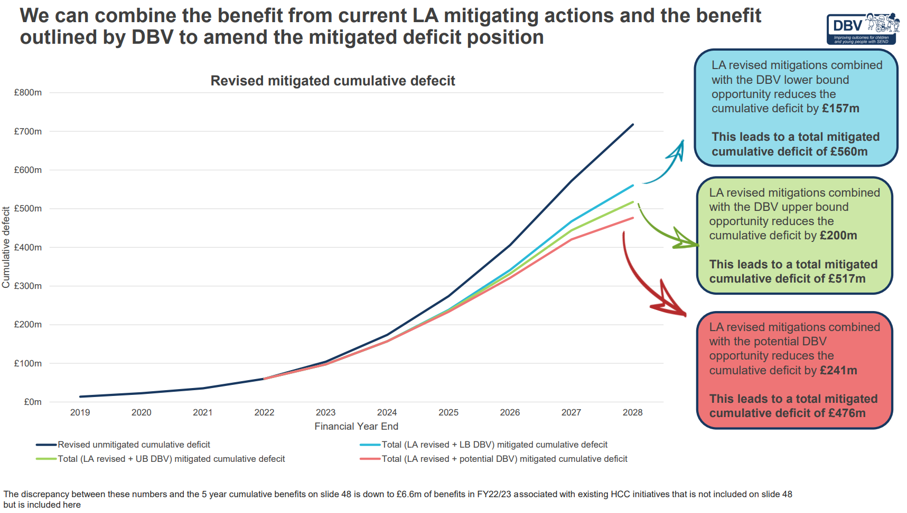
Delivering Better Value update
Newton Europe Graph
Black line - unmitigated forecast.
Blue line - likely mitigated forecast.
Green line – Optimistic forecast.
Red line – if all was rolled out tomorrow (which isn’t possible within the funding envelope or current staffing).
Our estimated 2027/28 deficit is £382.4m using current funding assumptions and factoring in planned savings workstreams. This is significantly lower than the £476m best case deficit projected by Newton for 2027/28.

Slide 6
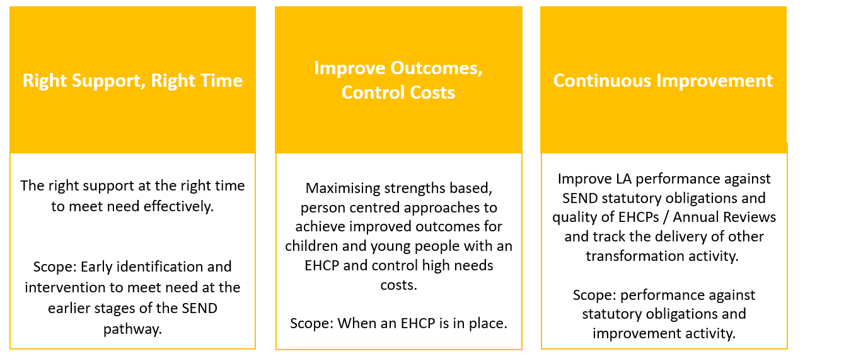
Transforming SEND Hampshire
Formal launch and promotion of the rebranded Transforming SEND Hampshire programme (replacing the High Needs, Performance & Oversight Programme) with schools through Autumn SEND conferences.

Slide 7
Transforming SEND Hampshire
Transforming SEND programme encompasses new DBV workstreams:
  Three early intervention pilots to build SEN Support capacity in schools and improve parental confidence.
  A new SENCO Helpline for schools to raise awareness of LA services available and provide advice on SEN support.
  A SEN Support Toolkit, building on our SEN Support guidance.
  Training for schools on supporting children and young people with complex needs to improve inclusivity.
  Training on running, or participation in, person centred planning meetings to improve parental confidence.
  Improved LA engagement in Annual Reviews to right size plans and focus on increasing independence.

Slide 8
Transforming SEND Hampshire
Right Support, Right Time
Improve Outcomes, Control Costs
Continuous Improvement
Building capacity in schools
Improved Outreach offer
In-house SALT therapies
Signposting to services
Early Years strategy
Preparing for Adulthood
Sufficiency Place Planning
Commissioning
INMSS
Special Schools Funding Review
SEN Panels Review
SEN Performance
HIEP Performance
Existing programme
Person Centred Planning pilot
Transition to School pilot
Access to Therapy Pilot
SENCO helpline
SEN Support Toolkit
Person Centred Planning training
Dynamic EHCP Support Pilot
Supporting complex SEND in mainstream training
Conference launch
SEN Capacity
Annual reviews
DBV funded

Slide 9
Transforming SEND Hampshire – plans in 2023
When | What | Aim | Progress
Summer term 2023 | EPs to run person centred planning meetings following a ‘No to assess’ decision. (proof of concept pilot). | Improve parental confidence. | Live – meetings are under way and the initial pilot cohort will be complete by end of July 2023 with evaluation over the summer. Initial feedback is positive.
Autumn term 2023 | Formal launch and promotion of Transforming SEND Hampshire with schools through November SEND conferences. Session on embedding a culture of inclusion. Introduction of a new SENCO Helpline for schools and a SEN Support Toolkit, building on our SEN Support guidance. Access to Communication and Interaction therapies without an EHCP (pilot in Eastleigh). | Increased awareness of the LA offer, launch new services and pilots. Promote inclusive practice in schools, raise awareness of LA services available and provide advice on SEN support. Improve access to LA services. | Venues and speakers have been confirmed and bookings will go live shortly. A working party has been set up with cross disciplinary representatives. First draft of the toolkit has been completed and refinements are being made. SEN Support Line staff have been recruited to start 1 September. On target for September 2023 start. A new Speech and Language Therapist has been recruited.

Slide 10
Transforming SEND Hampshire – plans in 2023/24
When | What | Aim | Progress update
Spring term 2024 | Extension of portage support into reception year (pilot in Havant). | Improve transition, promote inclusive practice and improve parental confidence. | On track with strong internal expressions of interest in new posts.
Autumn 2023 and 2024 | Training for schools on supporting children and young people with complex needs. Training on running, or participating in, person centred planning meetings. Improved Local Authority engagement in Annual Reviews. | Promote inclusive practice. Improve parental confidence. Clear overdue processing, right size plans and focus on increasing independence. | 5 online modules are being developed, supported by a ‘train the trainer’ and follow-up webinar. The training will be launched at the November conference. On target – training written, venues and trainers confirmed and booking to go live very shortly. Dynamic Support workstream due to commence in July.

Slide 11
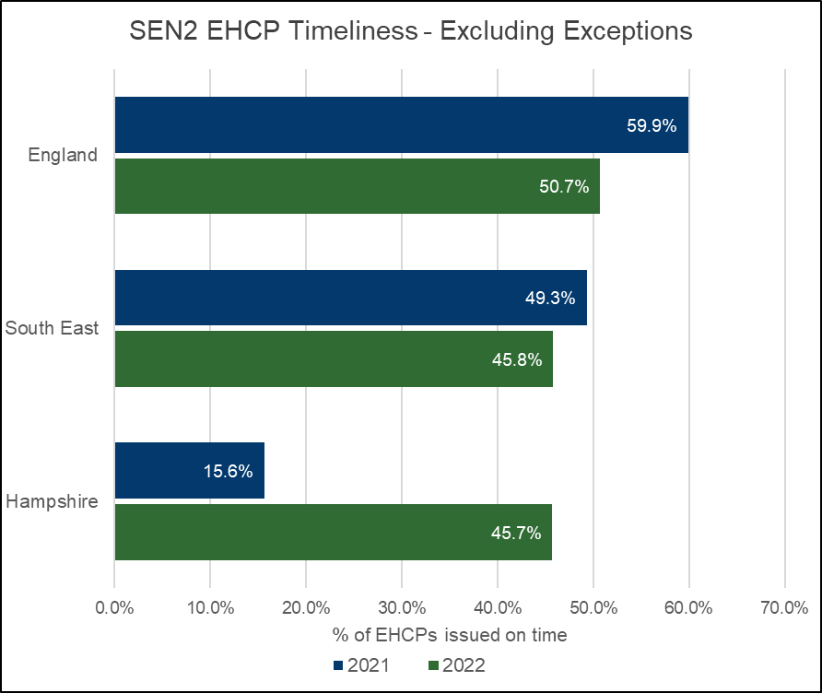
2023 SEN2 Headlines
 | Calendar Year | National | Hampshire
EHCP Timeliness | 2021 | 59.9% | 15.6%
 | 2022 | 50.7% | 45.7%
 | Difference | -9.2% | +30.1%
Total EHCPs | 2021 | 473,255 | 12,750
 | 2022 | 517,026 | 14,583
 | Difference | +9.2% | +14.4%
EHCNA Requests | 2021 | 93,302 | 2,379
 | 2022 | 114,457 | 3,156
 | % Increase | +22.7% | +32.7%
Nationally, the number of EHC Plans and requests for EHC Needs Assessments increased substantially, the percentage of plans issued within the 20-week statutory deadline fell by 9.2 percentage points.
Hampshire experienced a greater relative increase in requests for EHC Needs Assessments and a larger relative growth in EHC Plans. Hampshire bucks the national trend of decreasing EHCP timeliness, improving by 30 percentage points in 2022, achieving 45.7% timeliness, while clearing overdue cases.

Slide 12
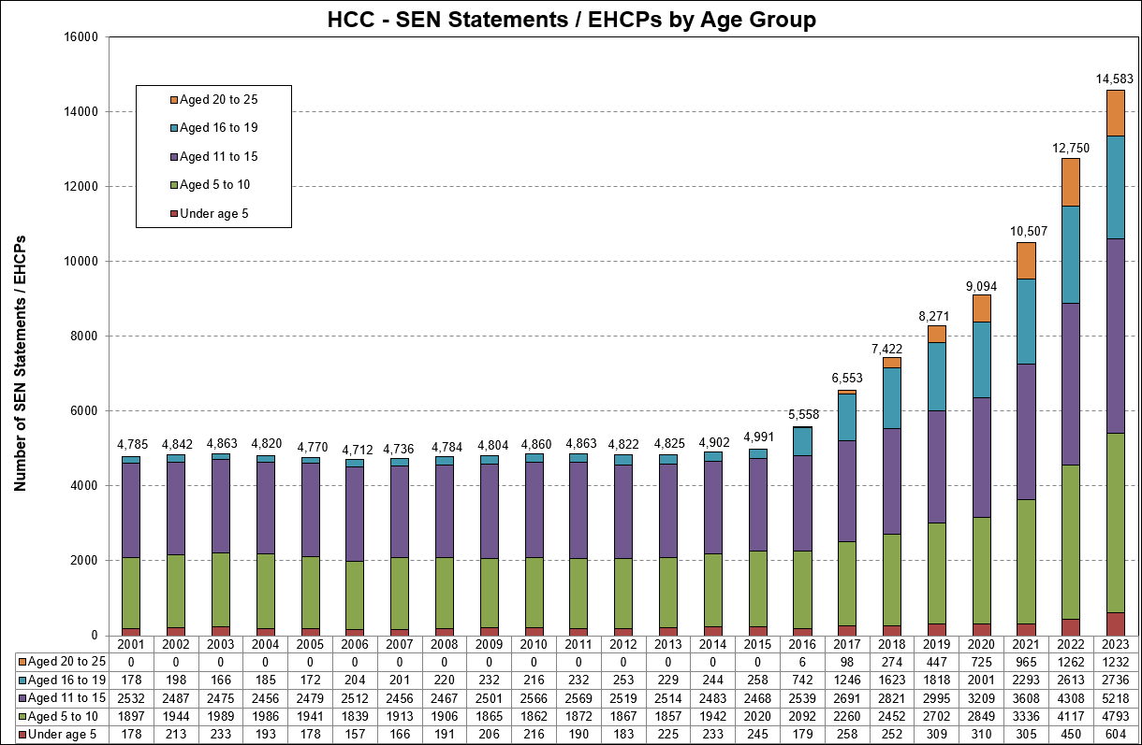
Maintained EHC Plans
Source: SEN2
This growth has continued to accelerate and as of the end of May 2023 Hampshire maintains 15,276 EHC Plans, an increase of 13% since May 2022.
Age groups* | May-22 | May-23 | % increase
Under 5s | 717 | 1,020 | 42%
Aged 5-10 | 4,575 | 5,182 | 13%
Aged 11-15 | 4,540 | 5,367 | 18%
Aged 16-19 | 2,578 | 2,632 | 2%
Aged 20+ | 1,118 | 1,075 | -4%
Grand Total | 13,528 | 15,276 | 13%
*Age at the start of each academic year
The age group with the largest percentage increase is the under 5s group, where the number of EHCPs has seen a 42% increase, +303 EHCPs.
Between the reforms taking effect in 2015 and 2023 there has been a 192% increase in the number of EHC Plans being maintained, and a 14% increase from last year (as of January 2023).

Slide 13
Forecast EHC Plans
Forecasting models indicate that there could be 24,391 EHCPs maintained by Hampshire by 2029.
This would be a 68% growth from 2023.
 | Total Forecast EHCPs by age group
As at January (3rd week) | 2018 | 2019 | 2020 | 2021 | 2022 | 2023 | 2024 | 2025 | 2026 | 2027 | 2028 | 2029
Under 5 | 252 | 309 | 310 | 305 | 450 | 604 | 689 | 754 | 819 | 883 | 948 | 1,013
Age 5 to 10 | 2,452 | 2,702 | 2,849 | 3,336 | 4,117 | 4,788 | 5,461 | 5,978 | 6,493 | 7,002 | 7,512 | 8,028
Age 11 to 15 | 2,821 | 2,995 | 3,209 | 3,608 | 4,308 | 5,210 | 5,942 | 6,505 | 7,065 | 7,619 | 8,175 | 8,735
Age 16 to 19 | 1,623 | 1,818 | 2,001 | 2,293 | 2,613 | 2,717 | 3,099 | 3,392 | 3,684 | 3,974 | 4,263 | 4,555
Age 20 to 25 | 274 | 447 | 725 | 965 | 1,262 | 1,229 | 1,402 | 1,534 | 1,667 | 1,797 | 1,928 | 2,061
Total | 7,422 | 8,271 | 9,094 | 10,507 | 12,750 | 14,548 | 16,592 | 18,163 | 19,728 | 21,276 | 22,826 | 24,391
Data extracted on the 19 of May 2023 – the slight variation between the 2023 figures above and the SEN2 figures is due to data cleansing within the SEN Service.

Slide 14
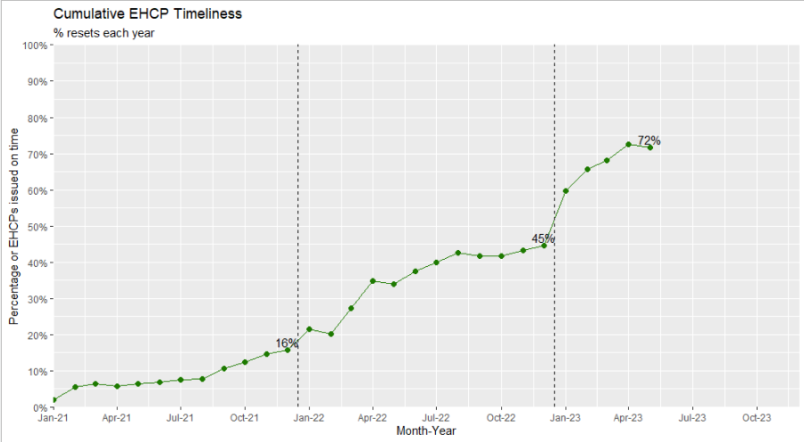
2023 Data
Requests for EHC Needs Assessments
Between January and May 2023, the service received 1,484 requests, an average of 297 requests a month, and a 9.4% increase on the same period last year.
School requests have increased by 10.2% and parental requests have increased by 8.7%.
EHC Plans
The service has issued an average of 217 plans a month in 2023.
72% of these plans were issued on time
On average it is taking 21 weeks to issue an EHC Plan
Source | Jan-May 2022 | Jan-May 2023 | Increase
School | 929 | 1,024 | 10.2%
Parent | 404 | 439 | 8.7%
Other | 24 | 21 | -12.5%
Total | 1,357 | 1,484 | 9.4%

Slide 15
High Needs Block Funding
The High Needs Block DSG allocation has increased significantly over the last four years however there continues to be a pressure each year due to further increases in demand and complexity of needs.
The provisional allocation of High Needs Block funding for Hampshire for 2023/24 is £196.8m which equates to £1,110 per mainstream pupil.
The average level of funding per pupil in South East authorities is £1,312.
If Hampshire was funded at the South East local authorities' average level, we would receive an additional £35.8 million, significantly reducing the forecast in-year pressure.
Year | High Needs Allocation | Increase in Funding | In-year High Needs Pressure
2019/20 | £115.7m | £4.1m | £15.2m
2020/21 | £135.1m | £19.4m | £15.8m
2021/22 | £152.9m | £17.9m* | £27.7m
2022/23 | £176.2m | £23.3m** | £30.4m
2023/24 | £196.8m | £20.6m*** | £39.5m
* | Includes £2.5m for baselining of Teachers Pay and Pension Grants included in DSG allocations going forward.
** *** | Includes Supplementary Grant £2m included in DSG allocations going forward. Includes additional funding £7.7m announced in December 2022
Notes:
Note provisional allocation for 23/24 is subject to change

Slide 16
DSG Medium Term Forecast
 | Mitigated (including the impact of savings / cost avoidance)
 | 2018/19 Outturn | 2019/20 Outturn | 2020/21 Outturn | 2021/22 Outturn | 2022/23 Outturn | 2023/24 Forecast | 2024/25 Forecast | 2025/26 Forecast | 2026/27 Forecast | 2027/28 Forecast | 2028/29 Forecast | 2029/30 Forecast
Total Expenditure | 937.8 | 967.8 | 1,029.8 | 1,131.5 | 1,187.3 | 1,274.9 | 1,279.7 | 1,300.1 | 1,321.8 | 1,345.2 | 1,357.2 | 1,368.8
Total Income | 928.5 | 958.8 | 1,017.1 | 1,106.9 | 1,161.1 | 1,235.8 | 1,239.8 | 1,244.8 | 1,249.9 | 1,255.3 | 1,260.8 | 1,266.5
Net In-year Position | 9.2 | 9.0 | 12.7 | 24.6 | 26.1 | 39.2 | 39.9 | 55.3 | 71.9 | 90.0 | 96.4 | 102.3
Of which
High Needs Block | 10.5 | 15.2 | 15.8 | 27.7 | 30.4 | 39.5 | 39.9 | 55.3 | 71.9 | 90.0 | 96.4 | 102.3
Other Blocks | -1.3 | -6.2 | -3.1 | -3.1 | -4.3 | -0.3 | 0.0 | 0.0 | 0.0 | 0.0 | 0.0 | 0.0
Cumulative DSG Reserve Balance | 13.7 | 22.8 | 35.4 | 60.0 | 86.1 | 125.3 | 165.3 | 220.6 | 292.5 | 382.4 | 478.8 | 581.1
Deficit as % of Funding | 1.5% | 2.4% | 3.5% | 5.4% | 7.4% | 10.1% | 13.3% | 17.7% | 23.4% | 30.5% | 38.0% | 45.9%
Excluding the Impact of Savings
Net In-year Position | 10.0 | 15.3 | 23.4 | 41.7 | 48.7 | 65.5 | 72.4 | 92.1 | 113.3 | 137.7 | 150.3 | 161.4
Cumulative DSG Reserve Balance | 13.7 | 29.0 | 52.4 | 94.1 | 142.7 | 208.2 | 280.6 | 372.8 | 486.1 | 623.8 | 774.1 | 935.5
Deficit as % of Funding | 1.5% | 3.0% | 5.2% | 8.5% | 12.3% | 16.8% | 22.6% | 29.9% | 38.9% | 49.7% | 61.4% | 73.9%
Savings/ Cost Avoidance | 0.8 | 6.3 | 10.7 | 17.1 | 22.5 | 26.3 | 32.5 | 36.8 | 41.4 | 47.8 | 53.8 | 59.1
Note values above represent £m

Slide 17
High Needs Workstreams
 |  | Breakdown of savings / cost avoidance
Programme | Workstream | 2018/19 £000 | 2019/20 £000 | 2020/21 £000 | 2021/22 £000 | 2022/23 £000 | 2023/24 £000 | 2024/25 £000 | 2025/26 £000 | 2026/27 £000 | 2027/28 £000 | 2028/29 £000 | 2029/30 £000
Improve Outcomes, Control Costs | Preparing for adulthood | 0 | 0 | 86 | -276 | -895 | -1,478 | -3,877 | -6,252 | -8,339 | -10,837 | -13,324 | -15,370
 | Sufficiency Place Planning |  | -2,480 | -5,962 | -10,881 | -15,184 | -18,358 | -21,973 | -23,932 | -26,438 | -30,316 | -33,904 | -37,105
 | INMSS | -669 | -1,479 | -1,840 | -2,546 | -2,839 | -2,894 | -3,060 | -3,097 | -3,072 | -3,072 | -3,072 | -3,072
 | Commissioning | 0 | -718 | -1,113 | -1,486 | -1,677 | -1,686 | -1,650 | -1,648 | -1,645 | -1,642 | -1,639 | -1,636
 | High needs top-up funding review | 0 | -1,203 | -1,133 | -1,175 | -1,175 | -1,100 | -1,100 | -1,100 | -1,100 | -1,100 | -1,100 | -1,100
Pre TSEND Workstreams | Banding change implementation | 0 | 0 | 0 | 0 | 0 | 0 | 0 | 0 | 0 | 0 | 0 | 0
 | Review of the Primary Behaviour Service |  |  | -159 | -159 | -159 | -159 | -159 | -159 | -159 | -159 | -159 | -159
 | Review of the Specialist Teacher Advisory Service | -113 | -403 | -552 | -552 | -609 | -650 | -650 | -650 | -650 | -650 | -650 | -650
Total Saving |  | -782 | -6,283 | -10,673 | -17,075 | -22,538 | -26,325 | -32,469 | -36,838 | -41,403 | -47,776 | -53,848 | -59,092
Saving/ cost avoidance tracking process being reviewed and developed in relation to both existing and DBV related workstreams
Projected DBV workstream savings are being developed against each workstream as part of the scoping and design phase.
Saving/ cost avoidance forecasts will be monitored throughout the year and added to the workstream breakdown as certainty improves.

