Slide 1
Dedicated Schools Grant Deficit Management Plan Update
December 2022
Brian Pope
Assistant Director, Education & Inclusion

Slide 2
Overview
£60m Deficit for Hampshire Dedicated Schools Grant (DSG) at year end 2021/22.
Represents 5.4% of total DSG and 39% of High Needs Block.
The forecast cumulative DSG deficit at the end of 2022/23 has increased to £89.2m 7.7% of total DSG and 51% of High Needs Block. However the cumulative deficit forecast for 2026/27 has reduced by £54m (20%).
Hampshire remains one of the lower funded local authorities through the High Needs National Funding Formula.
Between the reforms taking effect in 2015 and 2022 there has been a 155% increase in the number of EHC Plans being maintained (as at January 2022).
Between January and October 2022 there have been 2,486 requests for an EHC needs assessment, a 32% increase on the same period last year.
The growth in EHCPs maintained by the local authority continues to accelerate. At the end of October 2022 Hampshire maintains 14,435 EHCPs, an increase of 19% on the same period last year.
The age group with the biggest percentage increase is the under age 5 group, where the number of EHCPs has seen an increase from 333 to 522 (56.8%).
Forecasting models indicate that there could be 18,010 EHCPs maintained by Hampshire by 2025/26. This is a 41% growth from 2022.
Just over 10% of cases are out of time (they exceed 20 weeks) as at end October 2022. This has improved from just under 50% in October 2021.
The High Needs Performance and Oversight programme launched in January 2022 and is currently forecast to make circa £29m savings / cost avoidance in 2023/4.

Slide 3
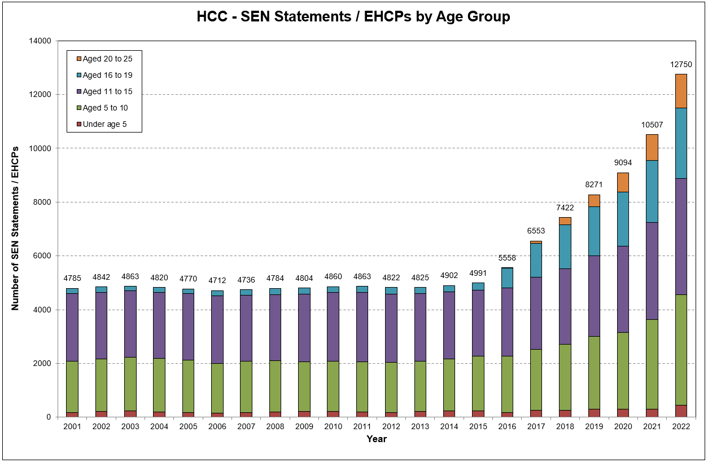
Maintained EHC Plans
This growth has continued to accelerate and as of the end of October 2022 Hampshire maintains 14,435 EHC Plans, an increase of 19% on the same period last year.
The age group with the biggest percentage increase is the under age 5 group, where the number of EHCPs has seen an increase from 333 to 522 (56.8%).
Between the reforms taking effect in 2015 and 2022 there has been a 155% increase in the number of EHC Plans being maintained (as at January 2022).

Slide 4
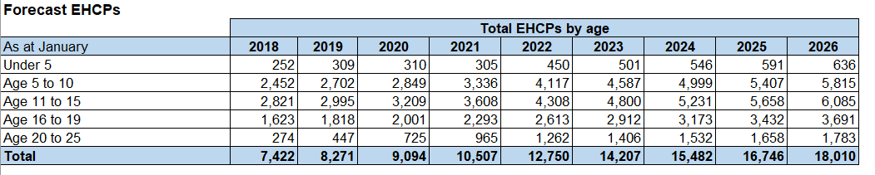
Forecast EHC Plans
Forecasting models indicate that there could be 18,010 EHCPs maintained by Hampshire by 2025/26. This is a 41% growth from 2022.

Slide 5
Requests for Assessment
In 2021 over 2,300 requests for EHC needs assessment were received, averaging 199 requests per month.
So far in 2022, 2,486 requests have been received, over 600 more than the highest previous total up to this point.
An average of 249 requests per month are being made

Slide 6
Issuing EHC Plans
Month | Number of Plans Issued | Average time (Days) | Month | Number of Plans Issued | Average time (Days)
Jan-21 | 99 | 342 | Jan-22 | 181 | 285
Feb-21 | 102 | 326 | Feb-22 | 173 | 274
Mar-21 | 152 | 356 | Mar-22 | 221 | 226
Apr-21 | 126 | 317 | Apr-22 | 208 | 190
May-21 | 132 | 316 | May-22 | 293 | 206
Jun-21 | 224 | 349 | Jun-22 | 288 | 187
Jul-21 | 267 | 318 | Jul-22 | 230 | 172
Aug-21 | 227 | 317 | Aug-22 | 191 | 169
Sep-21 | 236 | 276 | Sep-22 | 250 | 184
Oct-21 | 248 | 277 | Oct-22 | 190 | 175
Nov-21 | 301 | 269 | Nov-22
Dec-21 | 165 | 241 | Dec-22
In 2021, the Service issued 2,279 EHC Plans. So far in 2022, the Service has issued 2,225 EHC Plans.
From June 2021, the Service increased the volume of plans being issued and the average time to issue an EHCP has fallen.
Data from Capita – excludes exceptions and those not valid for SEN 2

Slide 7
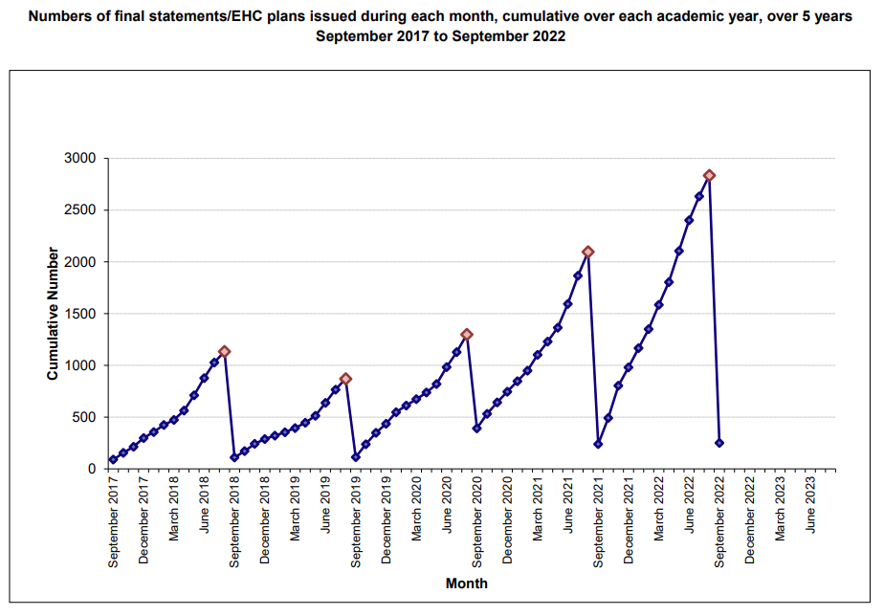
Issuing EHC Plans

Slide 8
EHC Plan Timeliness
Month | % EHCPs Issue Within Timescale | Cumulative %
Jan-22 | 21% | 21%
Feb-22 | 19% | 20%
Mar-22 | 40% | 27%
Apr-22 | 57% | 35%
May-22 | 32% | 34%
Jun-22 | 50% | 37%
Jul-22 | 55% | 40%
Aug-22 | 65% | 43%
Sep-22 | 35% | 42%
Oct-22 | 41% | 42%
The timeliness is improving in line with the recovery plan, with the aim of being in line with the national average by the end of this academic year.

Slide 9
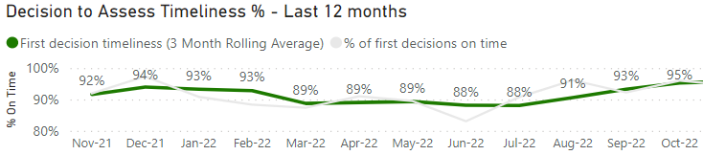
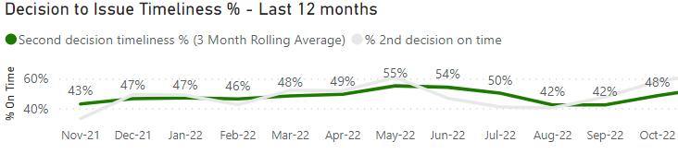
EHC Assessment Timeliness
‘Decision to Assess’ timeliness has remained at a high level over the last 11 months and is expected to steadily increase.
‘Decision to Issue’ an EHC Plan timeliness was steadily improving, then fell over the Summer due to a lack of available reports. Since the start of the academic year the timeliness is recovering and should continue to increase.

Slide 10
Work in progress and cases out of time
The long-term plan was re-evaluated due to increased demand levels. The principles remain the same - to reduce out of time cases and improve timeliness.
  31 October 2021 – 1,429
  31 October 2022 – 961
Just over 10% of cases are out of time (they exceed 20 weeks) as at end October 2022. This has improved from just under 50% in October 2021.

Slide 11
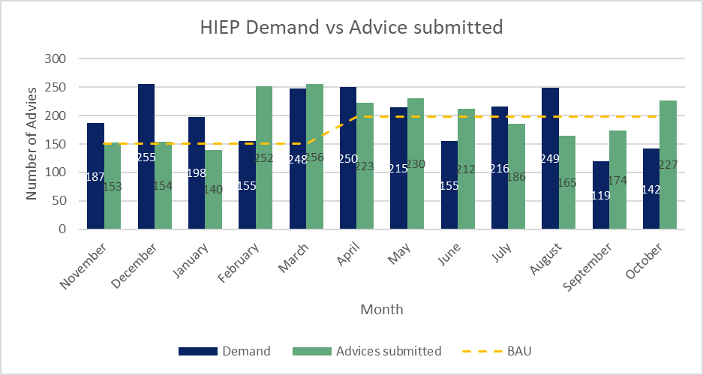
Educational Psychology Advice
BAU increased from 150 to 198 in April 2022. Actual demand in calendar year to end of Oct: 1,947 vs BAU of 1,836.
Output is being supported by bulk procurement of locums in the Autumn 22 term to allow full SLA delivery and facilitate a reduction in caseload to around 300.
Timeliness on a 6 week measure in October was 13%, and on a 12 week measure was 33%. It is expected that timeliness will improve as the caseload is brought down.

Slide 12
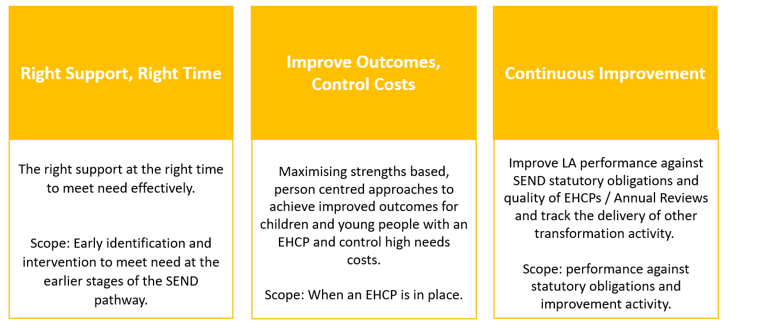
High Needs, Performance & Oversight Programme update
The High Needs, Performance and Oversight Board was launched in January 2022, with three programmes of work reporting into the Board. Each programme has a number of workstreams that seek to address incoming demand for EHCPs, alongside reducing the pressure on the high needs budget.

Slide 13
Workstream updates – Right Support, Right Time
Building Capacity – Sector Led SEN Improvement Projects
13 projects are now up and running in Hampshire County Council with initial financial allocations made
Build Capacity - SEN Support
Cross-branch work to embed the SEN Support guidance continues alongside professional development offers.
Outreach Review
Review of High Needs Block funded outreach services undertaken and recommendations presented to the High Needs Performance and Oversight Board in November. Decisions relating to future outreach strategy communicated to existing providers swiftly after.
Signposting
A project to review content and design of the Local Offer / Family Information and Services Hub is underway. Processes to ensure content is regularly reviewed are being developed. Launch of the new look and feel is scheduled for January 2023.

Slide 14
Workstream updates – Right Support, Right Time
Enhanced SaLT Provision
New support request process has been redesigned and is currently being automated to save management and admin time.
A cost savings tracker is being developed alongside Finance to track financial benefit from the investment in additional staffing.
A KPI dashboard including demand forecasting will be developed to incorporate both strategic and operational requirements.
Person Centred Approaches
A new workstream is being considered that focuses on the development of person centred approaches and their appropriate use to engage with families, CYP and professionals to improve outcomes.
Early Years SEN Strategy
A new workstream is being established to finalise an Early Years SEN Strategy and implement the action plan that underpins it.
Early Years Pilot
A new pilot is being considered to test the value of a Person Centred meeting following a decision to refuse an EHC assessment in early years or year R, alongside an extension of Portage support into Year R. Note that this is subject to a funding bid.

Slide 15
Workstream updates – Improve Outcomes, Control Costs
Preparing for Adulthood
Post-16 Employability hubs
  The Employability Hub model represents a 1+1+1 study programme, focused on employability and access to work placements, ending in an established pathway to employment, such as Supported Internships.
  There are currently 8 employability hubs across Hampshire. 2 new hubs opened in September 2022 (BCOT & Fareham). Brockenhurst College has withdrawn.
  56 learners are remaining active for 2022/23. 41% of active learners are in part-time employment alongside the course.
  73 new learners have been confirmed across 7 hubs (awaiting confirmation from 1 hub).
  9 primary outcomes have been achieved (paid employment / apprenticeship). 72% engagement in work experience.
  The highlights and link to the full end of Year 2 report can be found on slide 16.
  A full 3-year evaluation report will be presented to Schools Forum in 2023.
  Savings up to 2021/22 FY are £195k and a recent review of assumptions projects the cumulative saving to HNB of £9.783m by 2026/27.
Recommendation: to approve the continuation of the pilot for a further 2 years, funded from the High Needs Budget
Independence hubs
HSDC Alton opened in September 2022 with 4 learners.
3 additional hubs have been confirmed for 2023 openings (Farnborough College of Technology, Andover and Brockenhurst).
A recent review of assumptions projects the cumulative saving to HNB of £15.838m by 2026/27.

Slide 16
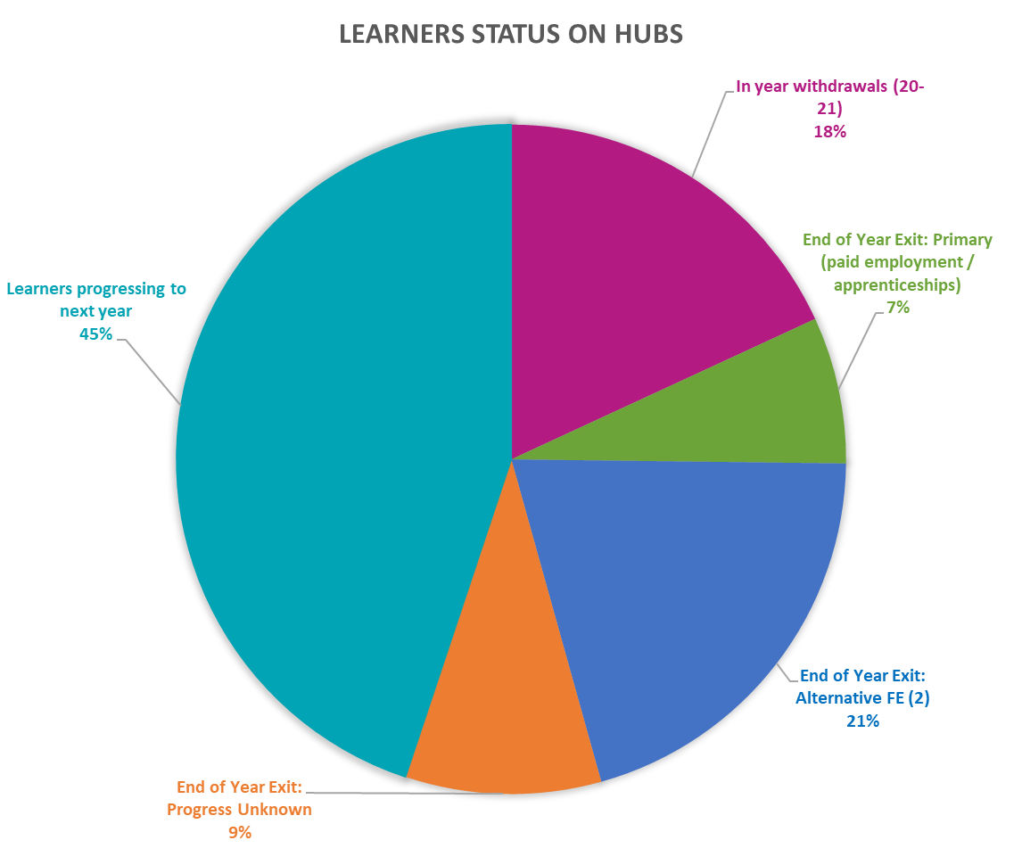
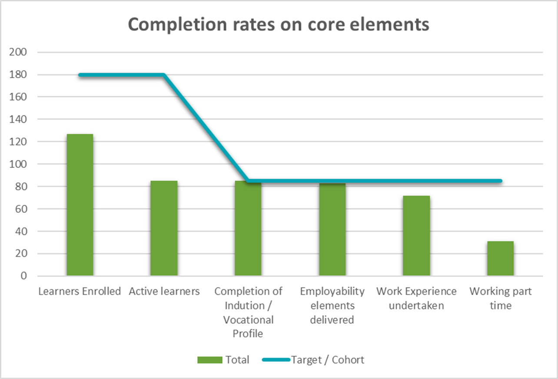
Preparing for Adulthood: End of Year Two Review
Headlines:
127 learners enrolled to date
85 learners active this year (2021-2022)
57 learners progressing to next year of hub (45%)
Expected intake 2022-23: 110 learners across 8 sites
47 closed learners:
In year withdrawal are mainly from year one (20-21) (18%)
Primary progressions (6 after 1 year on hub, 3 after 2 years) (7%)
Secondary progressions all moving to Alternative FE (within college and to alternative colleges) (21 after one year, 5 after 2 years) (21%)
Exit unknown progression (8 after one year, 4 after year two) (9%)
  Causes around anxiety, non-engagement, accessing STEP, left college with no progression noted)
This years active learners:
100% completed Vocational Profiles
98% completed employability
72% completed workplace engagements (as standalone WEX this is 65%)
36% are working part-time alongside their course.

Slide 17
Workstream updates – Improve Outcomes, Control Costs
Place Planning & Commissioning
The Hampshire SEN Sufficiency Strategy is being finalised to ensure the right types and number of places are available in the right location.
A capital investment plan is in place, providing an additional 276 places by September 2024.
2 x Free School bids have been submitted to the DfE with a decision due by January 2023:
  125 place school in the Fareham / Gosport area for pupils with Severe Learning Difficulties (SLD).
  90 place school in the Eastleigh area for pupils with Social, Emotional and Mental Health needs.
The new commissioning framework for Discretionary Payments went live in September 2022 and the Managed Educational Packages framework is expected to launch in September 2023.
Independent non-maintained special schools (INMSS) and Specialist post-16 institution (SPI) cost avoidance
The SEN Service prioritises annual reviews at INMSS & SPI placements and identifies students who would benefit from ceasing their education placement or moving to a more cost-effective in-house placement.
77 INMSS / SPI annual reviews were completed during the 2021/22 academic year giving a 2022/23 cost avoidance of £1,547,048.
17 placements and 5 SPI placements (22 in total) were identified as ceasing because of annual reviews.
333 children have been identified as a priority (for both INMSS and SPI) for review in the 2022/23 academic year (no reviews carried out to date).

Slide 18
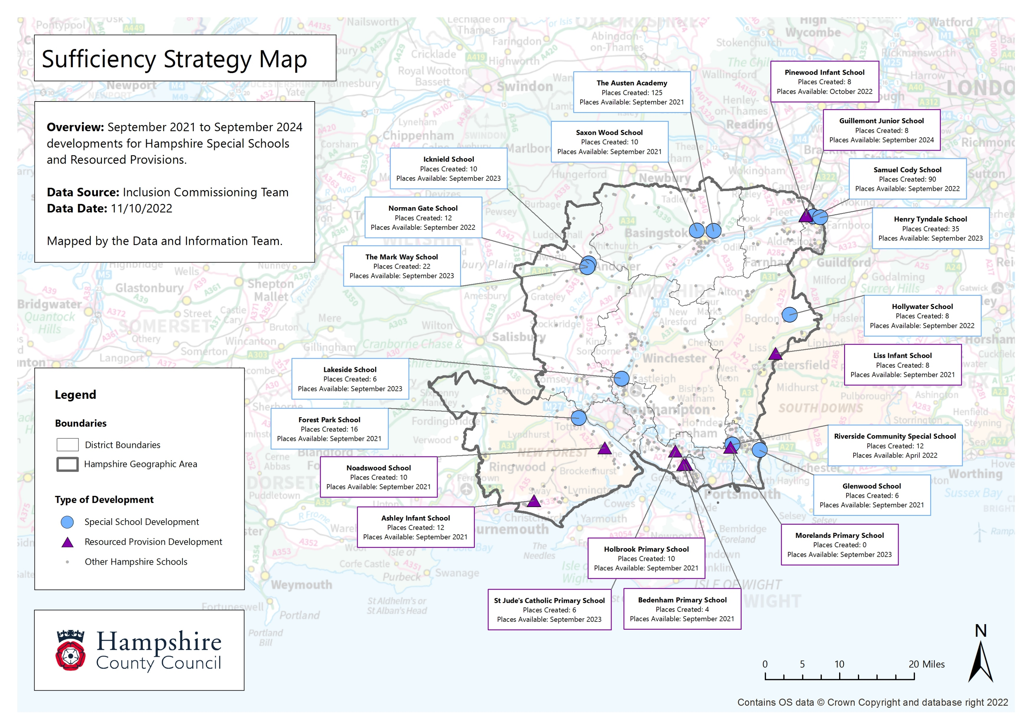

Slide 19
Workstream updates – Improve Outcomes, Control Costs
Dynamic ECHP Support
Diagnostic work has identified missed opportunities to intervene earlier in the process which can lead to a subsequent escalation of need, particularly in the run up to a phase transfer.
The Programme Board have agreed to pilot activity to identify opportunities to intervene earlier and track the impact of that intervention as part of the annual review process, using person-centred planning approaches and drawing on the expertise of HCC services.
The purpose of the pilot is to improve outcomes for children with an EHCP by ensuring that access to specialist advice is provided early on in the annual review process, supporting educational settings to intervene early and prevent escalation of need. This work is likely to be the subject of a Delivering Better Value funding bid.
Continuous Improvement – Annual Reviews
Alongside the Dynamic EHCP Support workstream, diagnostic work has also identified variation in the quality of annual reviews completed by settings, which can contribute to escalating needs and support costs.
An end-to-end review of the annual review process is required to accelerate the move away from paper-based processes and ensure all education settings and professionals are working to consistent guidance on conducting a high-quality annual review, in order to meet our statutory duties.
SEN Panels Review
The SEN Panels are being reviewed to ensure they are fit for purpose as decision panels to allocate places and fund SEN placements. Recommendations will be considered by the Board in January.

Slide 20
Workstream updates – Improve Outcomes, Control Costs
Special Schools Funding Review
Mid-way through review of the existing funding model(s) and the factors affecting the variation in funding across in special schools and resourced provisions.
​
Internal review of SEN Service decision-making and processes completed. Recommendations for a new process will be linked to the format of the new framework along with other decision-making quality assurance workstreams, such as panel development.
First round of special school visits and discussions completed summer term – key themes identified:
  recruitment and staff retainment challenges for schools
  existing step-funding system is based on pupil needs and not the resource required to deliver provision in EHCP
  consistency of step-funding form engagement and feedback
  rising requests for 1:1 support
  discretionary payments as way of problem-solving and plugging gaps in provision
Resource provision visits concluded autumn term – key themes identified:
  pressure on resources and wider school budgets due to complexity of pupil needs
  variation on integration (fully integrated or part integrated) leading to resource implications for some schools
  limited flexibility in the single top-up model resulting in increased discretionary payments to maintain placement
  discussion around banding/tiered funding as an alternative to the single top-up
Next steps
  financial information and provision-mapping requested from school to analyse provision against current step system
  model funding against current step system and alternative systems being considered
  wider consultation with school
  implementation planning

Slide 21
High Needs Block Funding
The High Needs Block DSG allocation has increased over the last three years however there continues to be a pressure each year due to increases in demand and complexity of needs.
The provisional allocation of High Needs Block funding for Hampshire for 2022/23 is £176.2m which equates to £999 per mainstream pupil
The average level of funding per pupil in South East authorities is £1,201
If Hampshire was funded at the South East local authorities average level, then we would receive an additional £35.5 million which would deliver a forecasted surplus budget.
It is recognised that Hampshire High Needs profile may not represent the average for the South East and if this is corrected for, we would be closer to a balanced funding position than a surplus.
Year | High Needs Allocation | Increase in Funding | In-year High Needs Pressure
2019/20 | £115.7m | £4.1m | £15.2m
2020/21 | £135.1m | £19.4m | £15.8m
2021/22 | £152.9m | £17.9m* | £27.7m
2022/23 | £176.2m | £23.3m** | £29.1m
2023/24 | £187.2m | £11.0m | £24.2m
* | Includes £2.5m for baselining of Teachers Pay and Pension Grants included in DSG allocations going forward.
** | Includes Supplementary Grant £2m included in DSG allocations going forward.
Notes:
Note provisional allocation for 23/24 is subject to change

Slide 22
Delivering Better Value
Hampshire’s is part of the first tranche of the DfE-sponsored Delivering Better Value Programme, aimed at securing sustainable management of local authorities’ high needs systems. A summary of the phases and timings is set out below.
Evaluation & Setup
Module 1:
Baselines and Forecasts
Module 2:
Root Cause Diagnostics
Module 3:
Implementation Planning
Grant Application
To 12/9
12/09 to 10/10
10/10 to 14/11
14/11 to 19/12
19/12 onwards
We have;
Provided data, workstream and forecasting information to the DBV consultants to support Module 1 development of a DBV approved baseline and forecast.
Supported data analysis, and attended cross-agency case reviews as part of the Module 2 root cause diagnostic.
Moved into more detailed Module 2 diagnostic work which involves ‘deep dives’ into some of the issues identified in the case reviews. The DBV programme is current surveying parents and schools as part of these deep dives, which are summarised below.
Deep Dive 1 : Pressure on Schools & lack of inclusive practice
Variational analysis of % of children with SEN support and % of children with EHCPs
Engagement with specific schools based on analysis
Deep Dive 2 : Parental Confidence (potential next steps)
Review existing reflections and feedback from parent and carers (e.g. parent/carer forum focus groups, complaints)
Review tribunal discussions/decisions
Further parental/professional engagement (e.g. survey/ focus groups)
Deep Dive 3: Quality/quantity of information available to assessor
Review of EHCP practice/activity
Engagement with assessment team
Module 3, which overlaps with Module 2 and covers implementation planning, started on 14 November 2022.

Slide 23
DSG Medium Term Forecast
 | Mitigated (including the impact of savings / cost avoidance)
 | 2018/19 Outturn | 2019/20 Outturn | 2020/21 Outturn | 2021/22 Outturn | 2022/23 Forecast | 2023/24 Forecast | 2024/25 Forecast | 2025/26 Forecast | 2026/27 Forecast
Total Expenditure | 937.8 | 967.8 | 1,029.8 | 1,131.5 | 1,191.0 | 1,232.4 | 1,250.1 | 1,268.1 | 1,288.8
Total Income | 928.5 | 958.8 | 1,017.1 | 1,106.9 | 1,161.9 | 1,208.2 | 1,212.7 | 1,217.4 | 1,222.3
Net In-year Position | 9.2 | 9.0 | 12.7 | 24.6 | 29.1 | 24.2 | 37.4 | 50.7 | 66.6
Of which
High Needs Block | 10.5 | 15.2 | 15.8 | 27.7 | 32.9 | 24.2 | 37.4 | 50.7 | 66.6
Other Blocks | -1.3 | -6.2 | -3.1 | -3.1 | -3.8 | -0.1 | -0.1 | -0.1 | -0.1
Cumulative DSG Reserve Balance | 13.7 | 22.8 | 35.4 | 60.0 | 89.2 | 113.3 | 150.7 | 201.3 | 267.9
Deficit as % of Funding | 1.5% | 2.4% | 3.5% | 5.4% | 7.7% | 9.4% | 12.4% | 16.5% | 21.9%
Excluding the Impact of Savings
Net In-year Position | 10.0 | 15.3 | 23.4 | 41.7 | 51.4 | 53.5 | 73.7 | 93.4 | 116.5
Cumulative DSG Reserve Balance | 13.7 | 29.0 | 52.4 | 94.1 | 145.5 | 198.9 | 272.6 | 366.0 | 482.6
Deficit as % of Funding | 1.5% | 3.0% | 5.2% | 8.5% | 12.5% | 16.5% | 22.5% | 30.1% | 39.5%
Savings/ Cost Avoidance | 0.8 | 6.3 | 10.7 | 17.1 | 22.3 | 29.3 | 36.3 | 42.8 | 49.9
Note values above represent £m

Slide 24
High Needs Workstreams
 |  | Breakdown of savings / cost avoidance
Workstream | Project | 2018/19 £000 | 2019/20 £000 | 2020/21 £000 | 2021/22 £000 | 2022/23 £000 | 2023/24 £000 | 2024/25 £000 | 2025/26 £000 | 2026/27 £000
Preparing for adulthood | SEND independence hubs |  |  |  | 5 | 106 | -1,296 | -3,127 | -4,913 | -6,613
 | SEND employability hubs |  |  | 86 | -281 | -738 | -1,172 | -1,824 | -2,455 | -3,313
Place planning and commissioning | Place planning / sufficiency |  | -2,480 | -5,962 | -10,881 | -15,207 | -20,254 | -24,688 | -28,675 | -33,316
 | Reducing reliance on out of county places through annual reviews | -669 | -1,479 | -1,840 | -2,546 | -2,839 | -2,894 | -3,060 | -3,097 | -3,072
 | Improved commissioning of independent places |  |  | -94 | -335 | -551 | -617 | -617 | -617 | -617
 | Review of funding for Deaf Instructors |  |  | -22 | -29 | -7 | 0 | 0 | 0 | 0
 | Review of places commissioned for education centres |  | -270 | -460 | -460 | -460 | -413 | -380 | -380 | -380
 | Commissioning SEMH places from education centres |  | -385 | -474 | -599 | -596 | -594 | -591 | -588 | -585
 | Review of funding for nurture groups |  | -63 | -63 | -63 | -63 | -63 | -63 | -63 | -63
High needs top-up funding review | Cease the SEN Support Agreement (SENSA) |  | -1,100 | -1,100 | -1,100 | -1,100 | -1,100 | -1,100 | -1,100 | -1,100
 | Reduce the notional SEN top-up |  | -103 | -33 | -75 | -75 | -75 | -75 | -75 | -75
Other | Review of the Primary Behavior Service |  |  | -159 | -159 | -159 | -159 | -159 | -159 | -159
 | Review of the Specialist Teacher Advisory Service | -113 | -403 | -552 | -552 | -609 | -650 | -650 | -650 | -650
 |  | -782 | -6,283 | -10,673 | -17,075 | -22,298 | -29,287 | -36,334 | -42,772 | -49,943
Saving forecasts reflect a reduction of £32.0m between 2022/23 and 2026/27 since the July update.
The majority of the reduction relates to the place planning and sufficiency workstream forecast reducing by £28.7m and SEND employability hubs forecast reducing by £3.2m.

Slide 25
Spend to save initiatives
Update
The £491k Spend to Save investment has provided increased capacity in the SEN team and the Inclusion Commissioning Team to enable the delivery of strategies to manage the DSG deficit.
77 INMSS / SPI annual reviews were completed during the 2021/22 academic year giving an annual cost avoidance of £1,547,048. This cost avoidance is included in the DSG management plan with effect from September 2022 (7/12ths in 2022/23 financial year) and in subsequent years until each place would have been expected to cease anyway.
The High Needs Performance and Oversight programme was established in January 2022, and draws together all of the LAs work on SEND and High Needs spend
The programme is currently forecast to make circa £29m savings / cost avoidance in 2023/4. The forecasting is currently being reviewed with the Delivering Better Value team, so this figure is an estimate and may be revised. We will report back to Schools Forum on any revised forecasts in the next update.
Recommendations
It is recommended that the Schools’ Forum agree to the continuation of the £491k investment in 2023/24, along with an increase of £88k to support the quality assurance of INMSS places and alternative provision.
The Local Authority is requesting a total spend to save investment of £579,000 for 2023/4.
It is recommended that the Spend to Save investment is allocated to the to the HNPO programme, so that it can be invested in activities that are forecast to generate the greatest savings to the High Needs block.
Details on the activities supported by this investment will be reported back to Schools Forum along with the impact and savings achieved

