Slide 1

Dedicated Schools Grant Deficit Management Plan Update
November 2024
Natalie Smith
Assistant Director, Education & Inclusion
Education and Inclusion

Slide 2
Overview
£123.9m Deficit for Hampshire Dedicated Schools Grant (DSG) at year end 2023/4.
Represents 10% of total DSG income for 2023/4 and 62.9% of the High Needs Block allocation.
The forecast cumulative DSG deficit at the end of 2024/5 has increased to £192.7m, 14.2% of total DSG funding for 2024/5 and 93.1% of the High Needs Block allocation.
Hampshire remains one of the lower funded local authorities through the High Needs National Funding Formula.
Between the reforms taking effect in 2015 and 2024 there has been a 220% increase in the number of EHC Plans being maintained (at January 2024).
In the 2023/24 academic year the service received over 3,800 requests for EHC needs assessments, a 16% increase on the previous academic year.
The number of EHCPs maintained by the local authority continues to grow. At the end of September 2024 Hampshire maintains 17,234 EHCPs, an increase of 10% on the same period last year.
The largest growth is in the 11-15 group which has increased by 705 EHCPs (+12.1%)
Forecasting models indicate that there could be over 24,000 EHCPs maintained by Hampshire by 2029/30 This is a 49.7% growth from 2024.
20% of cases (298) are out of time (exceed 20 weeks) as at end September 2024, compared to 4% (38) in September 2023
The Transforming SEND Hampshire programme launched internally in January 2022 and was formally launched with schools in November 2023. It delivered £26.5m savings in 2023/4 and is currently forecast to make circa £27.9m savings / cost avoidance in 2024/5.

Slide 3
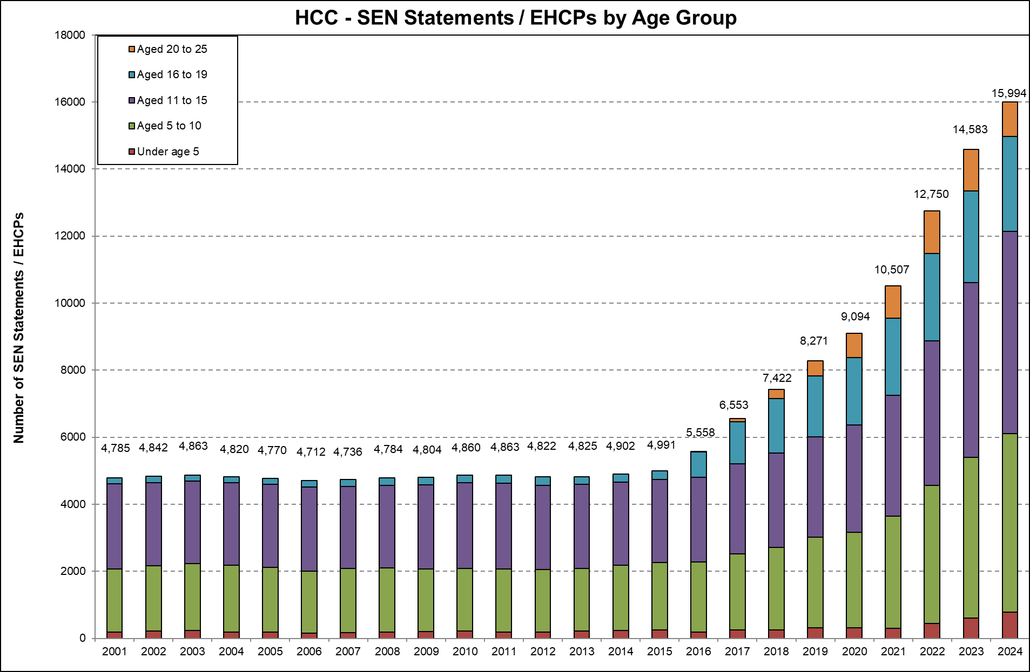
Maintained EHC Plans
Between the reforms taking effect in 2015 and 2024 there has been a 220% increase in the number of EHC Plans being maintained (as at January 2024).
This growth has continued and as of the end of September 2024 Hampshire maintains 17,237 EHC Plans, an increase of 10% on the same period last year.
Age groups* | Sep-23 | Sep-24 | % increase
Aged 20-25 | 1,231 | 1,099 | -10.7%
Aged 16-19 | 3,000 | 3,451 | 15.0%
Aged 11-15 | 5,847 | 6,552 | 12.1%
Aged 5-10 | 4,979 | 5,511 | 10.7%
Under 5 | 609 | 624 | +2.5%
Total | 15,666 | 17,237 | +10.0%
* Age as of snapshot date
The largest increase is in the 11-15 phase, +705 EHCPs.

Slide 4
Forecast EHC Plans
Forecasting models indicate that there could be over 24,000 EHCPs maintained by Hampshire by 2029/30, a 49.7% growth from 2024.
 | Total EHCPs by age group
As at January (3rd week) | 2018 | 2019 | 2020 | 2021 | 2022 | 2023 | 2024 | 2025 | 2026 | 2027 | 2028 | 2029 | 2030
Under 5 | 252 | 309 | 310 | 305 | 450 | 604 | 771 | 838 | 902 | 964 | 1,029 | 1,092 | 1,155
Age 5 to 10 | 2,452 | 2,702 | 2,849 | 3,336 | 4,117 | 4,788 | 5,312 | 5,776 | 6,214 | 6,641 | 7,089 | 7,524 | 7,956
Age 11 to 15 | 2,821 | 2,995 | 3,209 | 3,608 | 4,308 | 5,210 | 6,023 | 6,549 | 7,045 | 7,530 | 8,037 | 8,531 | 9,021
Age 16 to 19 | 1,623 | 1,818 | 2,001 | 2,293 | 2,613 | 2,717 | 2,867 | 3,117 | 3,354 | 3,584 | 3,826 | 4,061 | 4,294
Age 20 to 25 | 274 | 447 | 725 | 965 | 1,262 | 1,229 | 1,065 | 1,158 | 1,246 | 1,331 | 1,421 | 1,509 | 1,595
Total | 7,422 | 8,271 | 9,094 | 10,507 | 12,750 | 14,548 | 16,038 | 17,438 | 18,760 | 20,051 | 21,402 | 22,717 | 24,022

Slide 5
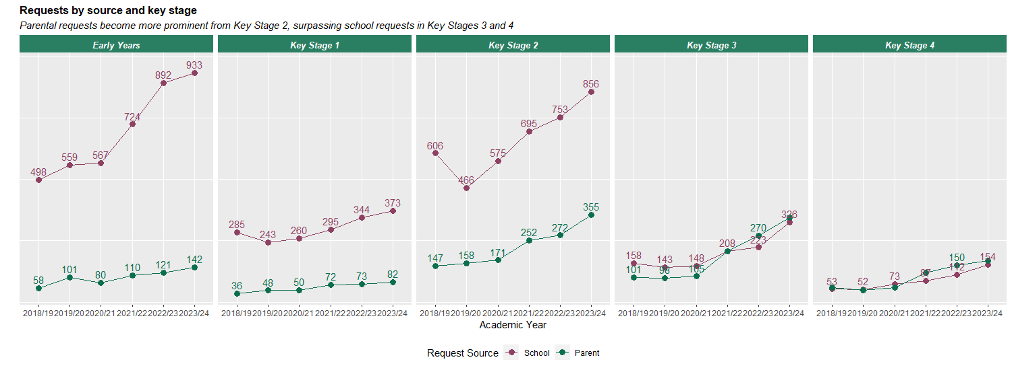
Requests for EHCPs
Over the last three academic years there have been drastic increases in requests for statutory EHC Needs Assessments.
Academic Year | School Requests | Percentage Increase | Parental Requests | Percentage Increase | Other Requests | Percentage Increase | Total | Percentage Increase
2018/19 | 1,625 | - | 440 | - | 24 | - | 2,089 | -
2019/20 | 1,481 | -8.9% | 472 | +7.3% | 18 | -25.0% | 1,971 | -5.6%
2020/21 | 1,627 | +9.9% | 492 | +4.2% | 34 | +88.9% | 2,153 | +9.2%
2021/22 | 2,024 | +24.4% | 800 | +62.6% | 31 | -8.8% | 2,855 | +32.6%
2022/23 | 2,340 | +15.6% | 926 | +15.8% | 37 | +19.4% | 3,303 | +15.7%
2023/24 | 2,654 | +13.4% | 1,142 | +23.3% | 38 | +2.7% | 3,834 | +16.1%

Slide 6
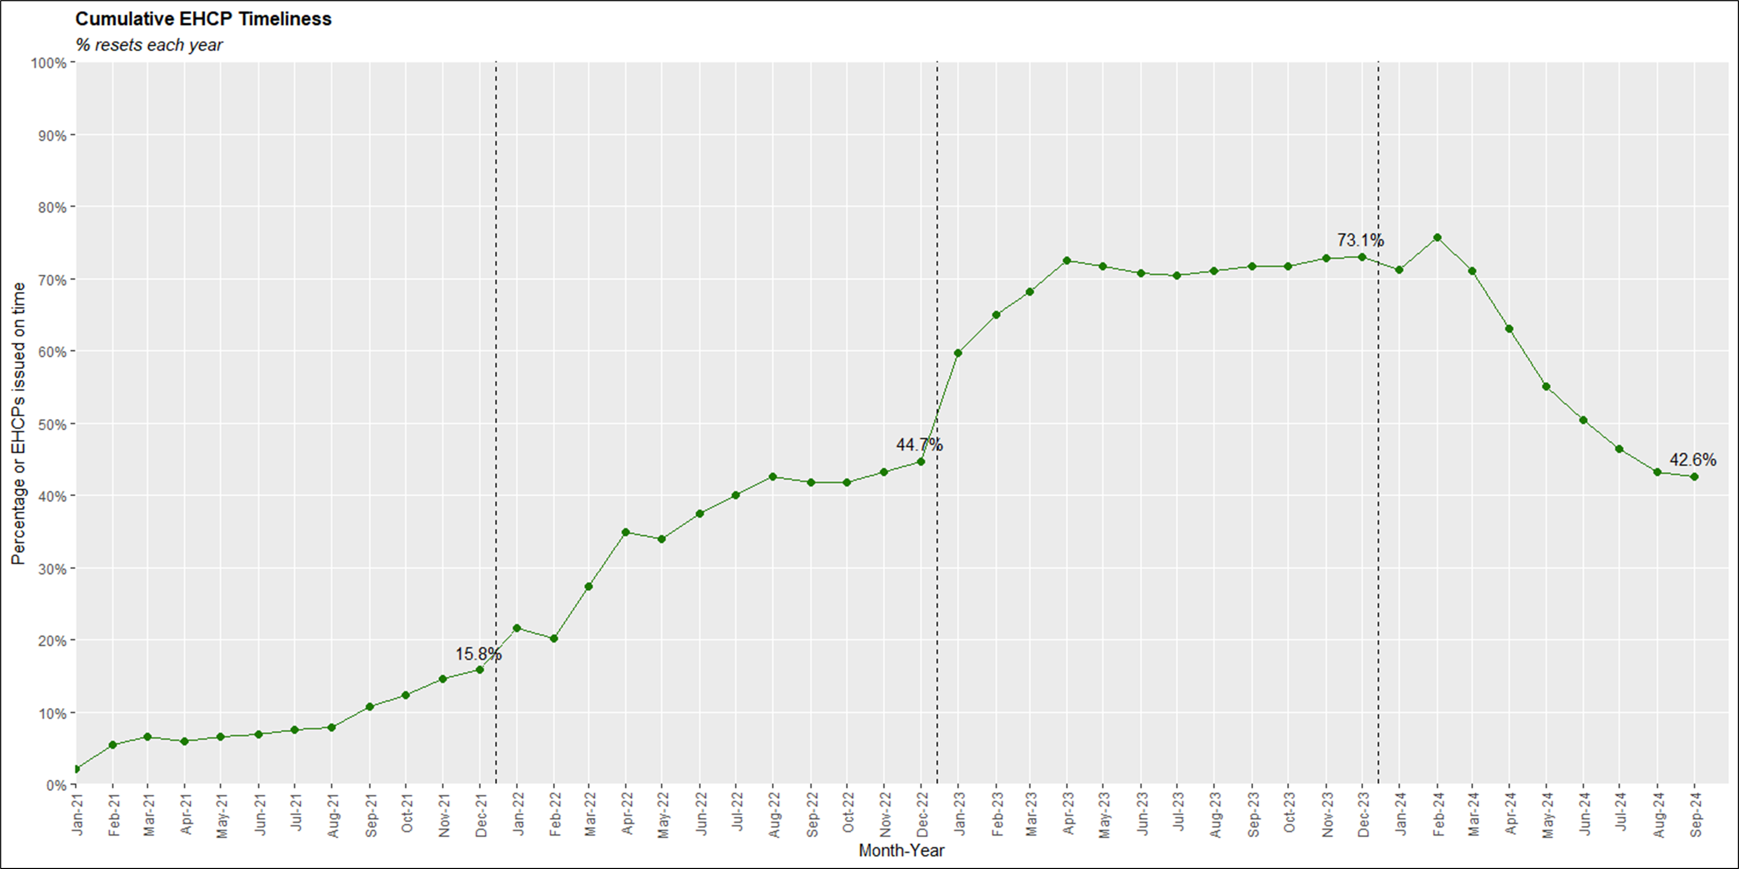
EHC Plan Timeliness
The percentage of EHC Plans issued within the statutory timescale has fallen below the 2023 national average of 50.3%.

Slide 7
EHC Plan Timeliness
Actions:
HEP: Additional funding agreed to increase capacity. Close liaison with HEP/SEN on prioritising cases and communication to schools and families.
SEN: Additional funding agreed to increase capacity reducing case-loads to 200. Reduced levels of agency staff due to rolling recruitment.
Decision to Assess and issue an EHCP: Weekly meetings so that decisions are made earlier than the 6-week time frame, giving the maximum amount of time for HEP to complete advice. Complex decisions go to weekly multi-agency panel. EHCCOs trained to write EHCPs as soon as they join the service. EHCCOs have planned points of EHCP drafting each week to ensure that as soon as advice is received, they can action.
Impact:
Some additional locums recruited but demand into the service is higher than forecast when additional resource was provided and continues to outstrip allocated capacity, leading to delays in the completion of advice.
Increase in EHCNA and failure demand work linked to delayed advice means caseloads for EHCCOs are higher than anticipated by the original modelling. Special school capacity means increased contact/complaints tribunals which has largely consumed the increased capacity in the SEN Team.
Efforts are made to make EHCNA decisions by week 3, but this is only possible if comprehensive information is provided by schools. Increasing level of parental requests are preventing timely decision making due to the delay in receiving school information. Draft plan production is broadly at the level of advice received from HEP.

Slide 8
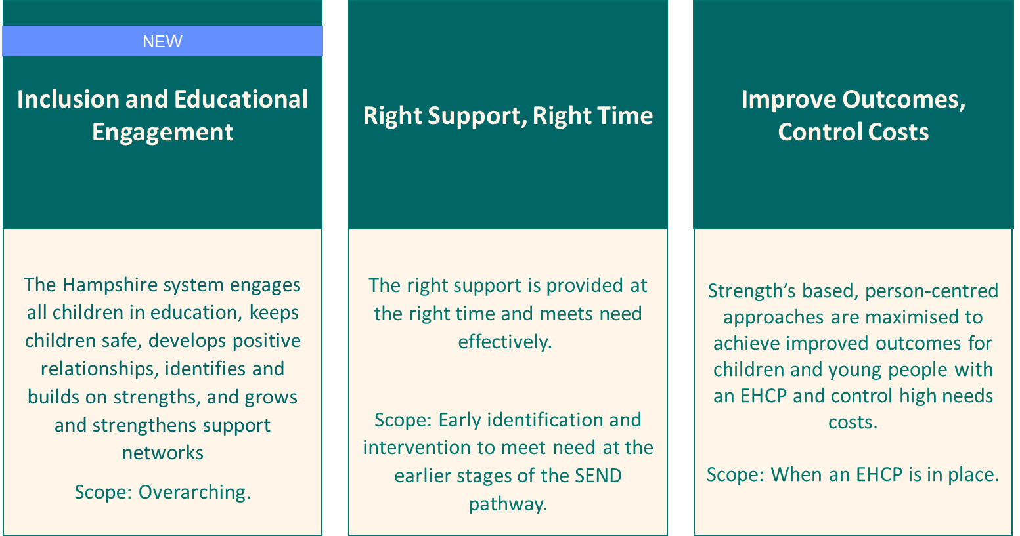
Transforming SEND Hampshire update
Transforming SEND Hampshire contains three programmes of work which report into the Programme Board.
Continuous Improvement (which used to be a programme in TSEND) transitioned to BAU in April 2024, and was replaced by a new programme, Inclusion and Educational Engagement.
The Local Area Partnership (LAP) Board has oversight of the delivery of Transforming SEND.
The LAP is currently in the process of agreeing its Local Area Strategy and Action Plan.
It is anticipated that Transforming SEND will become one of the delivery programmes for the action plan.

Slide 9
Delivering Better Value
DBV grant funding of £1m was allocated to the programme and used to deliver some of our workstreams.
The grant funding period has now ended, with all commitments under the DBV grant met.
Some workstreams are continuing, funded through high needs, spend to save where appropriate.
Work previously funded through the DBV is indicated over the next few slides.

Slide 10
Workstreams that are now BAU
Workstream
Summary of Results
2023/4 DBV funded
SENCO Helpline
Now an established service. From January 2024 - October 2024, 292 calls were received from 153 different schools.
62% of callers were SENCos
55% were in relation to children without an Education, Health and Care Plan.
Most calls related to social, emotional and mental health needs with communication and interaction being the second priority area.
On a rating of 1 to 5 (5 maximum) callers gave a satisfaction rating of 4.97.
91% of callers said that advice was given that they hadn't already considered.
2023/4 DBV funded
Now an established service.
The toolkit signposts to key documents and services.
Pages continue to be added, such as the Year R transition page.
SEN Support Toolkit
2023/4 DBV funded
Workshop completed and guidance produced. Shared with school staff and LA professionals. Completed and closed.
Annual Review guidance
PCP Training
A wide range of professionals across HCC are facilitating and participating in effective PCP meetings to meet the needs of children / young people and families.
We have trained 193 professionals from 143 schools as well as 113 other LA professionals to date.
Outcomes include increase in parental confidence in school staff ability to meet need.
Continues in 2025/6 with a further two cohorts.
2023/4 DBV funded

Slide 11
Workstreams that are now BAU
Workstream
Summary of Results
Annual Reviews
Funded through the DBV grant: Investigated over 5,800 overdue review cases, processed over 4,000 overdue annual reviews, identified 1,100 instances where neither the setting nor the Local Authority had conducted a review, and updated records for 700 pupils where either actions had occurred outside of a statutory process, or the pupil had moved out of the area.
Now business as usual: Each member of the team now holds a caseload of 30-70 CYP from vulnerable groups who do not have a registered education setting, including Electively Home Educated, Awaiting Placement and a large proportion of the Educated Other Than At School cohort. In addition, the team continue to work through overdue annual reviews, working one to two terms behind locality teams.
2023/4 DBV funded
2023/4 DBV funded
Training to support complex learners
Established funded training offer. A comprehensive training and support offer is now available to the education workforce, to develop the skills required to support complex learners in mainstream schools.
The training has been accessed 1604 times across 123 different schools.
Those who have completed report a confidence increase of over 80% and over 90% would recommend the training to a colleague.
Special Schools Funding Review
Completed and closed. New special school banding framework was implemented on 1 April 2024.
All special school pupils are now funded though the single framework and via a top-up band.
This sits alongside revised decision-making processes, updated scheme of delegation and termly moderation.
This has replaced all previous pupil-specific special school funding arrangements.

Slide 12
Inclusion and Educational Engagement
Workstream
Summary Progress
The Hampshire Approach across education
Virtual School purchased Attachment Research Community (ARC) membership for schools
Over 150 schools registered interest
Attachment and Trauma Aware Schools (ATAS) Training Cohort 11 starts November
ARC specific training about how to use tool in November will be recorded
Resource the Trainer training delivered by KCA in November, targeting ATAS schools and those with strong knowledge base
Review ARC end of November to see schools registered and submissions
Complex Admissions Panel and resource
14 pupils currently on Complex Admissions Panel (CAP) list, 12 of whom are not on school roll, 35 have been resolved/monitoring
Induction of two new members of the Reintegration Team, including Senior Reintegration Officer
Cost avoidance evaluation ongoing​ and evaluation metrics development planned​
Paper developed with options for interim remote education solutions, pilot for a small number of children
Light touch review of CAP to be shared with Panel members and feedback from 360 degree review incorporated
Exploring Suspensions
Havant & EH pilot started with good attendance
North County identified schools to start project before December
New Forest in liaison with Headteachers to establish best approach
Data collection on impact under way regarding suspensions
Resource includes venues and PBS capacity

Slide 13
Inclusion and Educational Engagement
Workstream
Summary Progress
Team around the school pilot
22 schools identified to take part in 2024/5.
Meetings being booked for this term to identify unique challenges of school.
Team of LA services will be put ‘around the school’ to
  Support individual CYP or groups of CYP.
  Carry out systemic work to improve educational engagement, improve SEN support practice, reducing inappropriate requests for an EHCP, reduce RHP, PEX, suspensions, non-attendance and escalation of need (including escalation into specialist provision).
EXTENDED IN 2025/6, to a further 20 schools.
Inclusion and Educational Engagement Hubs
12 District/Area Hubs have taken place in the autumn term, with 254 primary schools and 82 secondary schools attending
Initial feedback from schools has been positive. District Managers from social care and HIAS have attended the hubs
A “You said, We did” approach has been adopted, with key themes and outcomes identified for future work
Spring term hubs are now in the planning stage. Children and Families colleagues will present at these sessions. Schools will have opportunities to problem-solve and share best practice.
Needs-led training offer for schools and colleges
Co-development of package using a working group of school SENCos and cross section of services across Education and Inclusion.
SENCo cross phase termly briefings from Sept 24
T&L programme focused on ordinarily available provision from October 24
SENCo development programme starts Feb 25
SENCo toolkit under development
Inclusion best practice guidance and pod casts under development

Slide 14
Right Support, Right Time
Workstream
Summary Progress
Education Centre Review
Progressed to the financial modelling stage.
Revised set of proposals modelled for comparison, considering adjustments to pre-commissioned placements to build capacity.
Detailed data collection and reporting is in development.
Feedback on the modelling due mid-November 2024.
New outreach framework developed; applications have opened.
Framework due to go live January 2025.
2023/4 DBV funded
No to Assess, PCP pilot
Person Centred Planning (PCP) approaches offer the opportunity for parents, the child or young person and professionals to work in a collaborative and strengths-based way to ensure that needs and provision are appropriately identified and met.
12-month pilot of PCP meetings led by EPs for families of children in Early Years settings or Year R where a request for EHC needs assessment has been refused.
31 meetings have taken place, with 44 planned. 25 additional meetings will be planned before end March 25.
Phase 1 of the pilot resulted in improved confidence with 15 participants not progressing a further EHC assessment of appeal.
We are now gathering similar data for phase 2.
Positive feedback has been received from school staff, facilitators, parents and CYP.
A full evaluation is planned for the end of the workstream.
Continues in 2025/6 with 35 days set aside.

Slide 15
Right Support, Right Time
Workstream
Summary Progress
2023/4 DBV funded
Transition to School pilot
Portage Transition support ensures that high quality SEN Support is available to reception age children.
21 schools, 32 early years settings and 66 children.
Early feedback suggests improved confidence in effective transitions.
Schools and EY settings are building relationships and improving consistency of approach.
engagement with families strong, support group sessions provided to parent/carers in the Summer Holidays, on behaviours, sleep and creation of visuals to support their child.
Settings completed pre and post evaluation feedback for first Term.
92% declared that they have a ‘better understanding of supporting children at SEN Support level’.
To date, needs of children in cohort continue to be met at SEN Support following transition, with escalation avoided.
Extended and expanded in 2025/6 to Havant, Gosport and Basingstoke.
2023/4 DBV funded
Access to Therapy pilot
Provides access to Speech and Language Therapy when children are receiving SEN support.
Working with approx. 10 children per school at SEN Support. 60 children total pilot cohort.
Collaboration with teachers to develop High Quality Teaching (HQT) approaches for specific children with SLCN.
Improved whole school understanding of SLCN and how to support within the classroom, including resources.
22 training sessions completed across 7 schools on a range of topics, e.g. SLCN, Vocabulary, The Communication Chain, Attention and Listening.
SENCO feedback indicates intervention has improved confidence and quality of SEN Support for children with SLCN needs.
‘SaLT’s input has increased SENCo knowledge and confidence and has had a direct impact on our Ofsted result’ and ‘working with the individual children has had a whole school impact’.
11 EHCP applications were NOT made that would have been without pilot input. (18%).
Estimated 8% reduction (or delay) in EHCNAs in pilot schools compared to the rest of Hampshire.
Extended in 2025/6, covering 28 schools over two years

Slide 16
Improve Outcomes, Control Costs
Workstream
Summary Progress
External Commissioning- INMSS/AP
Initial market position statement drafted.
Work to better understand reasons for INMSS referrals made to CPG panels.
Creation of new additional INMSS places, mitigates the shortfall of maintained places.
8 new INMSS schools, in September '23 and '24 created 80 new places.
SEND Category Manager (started 1.10.24), enabling focussed work on Alternative Provision.
Initial planning for INMSS / AP provider event in March/April next year, to deliver Market Position Statement with specific focus on average fees for each SEN need type.
Focus on the second iteration of the SEND Open Framework for delivery in May ‘25 to go live in September '25.
Specialist Provision
Specialist Provision Strategy in draft for publication in Jan 2025 outlining plans to create an additional 1000 new specialist places in Special Schools and Resourced Provisions (RPs) by 2030.
Ambitious target but already working with a range of schools and sites.
Currently consulting on 5 new RPs for September 2025 and expansions at 6 other RPs.
Proposing expansions and increased pupil numbers at a range of special schools and new satellite provisions to provide additional specialist provision in next 3 years.
New SEMH School in Boorley Gardens, Eastleigh due to open September 2026 and new SLD Free School in Whiteley due to open September 2027.

Slide 17
Improve Outcomes, Control Costs
Workstream
Summary Progress
Early Years Action Plan
Following the Early Years SEN Review, the Action Plan encompasses key priorities;
data collection and reporting,
allocation processes,
consistency of SLA/Contracts,
LMSL approach and communications.
Responsible and accountable staff have been allocated to each action, actions have been prioritised and a timeframe agreed.
Work has bee
Post 16 sufficiency
Post 16 sector networking meeting held to commence the work of creating a sufficiency action plan.
Ideas include identifying additional learning environments, support for timely and appropriate transitions to post 16 offer and into adult outcomes.
Plan in development and resources being identified to deliver on outlined actions. Tools and resources required are in development.
Preparing for adulthood
New two stream-model approach to Employability Hubs being implemented across Hubs.
70 new learners across 6 Hubs this year, two hubs moving to a 'Business as usual' approach to delivery.
Total of 306 learners engaged to date with 26% 'primary-tier' progress to paid employment within 3 years.
Three Independence Hubs delivering programmes for 31 SLD and complex needs learners in mainstream settings. We are continuing to working to support accessibility works across college sites.
The SEN Support Supported Internship Programme commenced in January 2024 currently supports 53 SEN Support (Non-EHC plan) learners across 4 sites to access employment outcomes.
Primarily funded via a DfE grant, gap funding is required to support learners accessing from September 2024 to complete the academic year.

Slide 18
High Needs Block Funding
The allocation for 2025/26 has not yet been formally disclosed however reviewing the recent government policy note we have modelled our assumed funding allocation.
Part of the government's recent announcement related to a separate allocation designed to support teacher’s pay and pension uplifts, we are not expecting this to form part of the main High Needs Block allocation in 2025/26.
Our modelled position continues to show a significant funding shortfall between the allocation and forecast expenditure
We are awaiting updates from the DfE in relation to the methodology for the allocation and distribution and will keep schools forum updated further to details being confirmed.
Year | High Needs Allocation | Increase in Funding | In-year High Needs Pressure
2019/20 | £115.7m | £4.1m | £15.2m
2020/21 | £135.1m | £19.4m | £15.8m
2021/22 | £152.9m | £17.8m* | £27.7m
2022/23 | £176.2m | £23.3m** | £30.4m
2023/24 | £196.9m | £20.7m*** | £41.4m
2024/25 | £207.1m | £10.2m | £71.7m
2025/26 | £216.7m**** | £9.6m | £88.8m
* | Includes £2.5m for baselining of Teachers Pay and Pension Grants included in DSG allocations going forward.
** *** | Includes Supplementary Grant £2m included in DSG allocations going forwards. Includes High Needs Additional Grant £8m included in DSG allocations going forwards.
**** | Support for recent Teacher Pay and Pension Contribution uplifts are provided as additional grants rather than HNB funding

Slide 19
DSG Medium Term Forecast – In Year
 | In Year HNB Expenditure (£'000)
 | 2018/19 | 2019/20 | 2020/21 | 2021/22 | 2022/23 | 2023/24 | 2024/25 | 2025/26 | 2026/27 | 2027/28
HNB Funding Allocation​ | 115,264 | 119,452 | 135,053 | 152,818 | 176,224 | 196,885 | 207,065 | 216,659 | 221,948 | 227,572
HNB Mitigated Expenditure LA - Current Projection | 125,767 | 134,614 | 150,876 | 180,539 | 206,644 | 238,298 | 278,755 | 305,322 | 332,273 | 357,872
HNB Mitigated Target Expenditure Newton | 125,767 | 134,614 | 150,876 | 180,539 | 213,849 | 257,501 | 294,332 | 324,406 | 349,250 | 370,835
HNB Mitigated Stretch Target Expenditure Newton | 125,767 | 134,614 | 150,876 | 180,539 | 213,849 | 257,501 | 293,500 | 317,513 | 333,762 | 345,920
HNB Unmitigated Expenditure Newton | 125,767 | 134,614 | 150,876 | 180,539 | 220,448 | 266,462 | 306,959 | 348,503 | 387,987 | 424,969
In Year Deficit - LA Current Projection | 10,503 | 15,162 | 15,823 | 27,721 | 30,420 | 41,413 | 71,690 | 88,813 | 110,325 | 130,300

Slide 20
DSG Medium Term Forecast – Cumulative
 | Cumulative DSG Deficit (£’000)
 | 2018/19 | 2019/20 | 2020/21 | 2021/22 | 2022/23 | 2023/24 | 2024/25 | 2025/26 | 2026/27 | 2027/28
HNB Mitigated Expenditure LA - Current Projection | 13,746 | 22,754 | 35,445 | 60,022 | 86,149 | 123,920 | 192,697 | 278,797 | 386,408 | 513,995
HNB Mitigated Expenditure Newton - Target | 13,746 | 22,754 | 35,445 | 69,209 | 106,834 | 167,450 | 254,716 | 362,614 | 489,916 | 633,179
HNB Mitigated Expenditure Newton - Stretch Target | 13,746 | 22,754 | 35,445 | 69,209 | 106,834 | 167,450 | 253,885 | 354,889 | 466,703 | 585,051
HNB Unmitigated Expenditure Newton - Baseline | 13,746 | 22,754 | 35,445 | 69,209 | 113,433 | 183,010 | 282,904 | 414,898 | 580,937 | 778,334
Current LA Mitigated Forecast to Newton Unmitigated Baseline Variance | 0 | 0 | 0 | 9,187 | 27,284 | 59,090 | 90,207 | 136,102 | 194,529 | 264,339

Slide 21
Benefits to CYP with SEND and families
NEW
Inclusion and Educational
Engagement
Schools can access an intensive and effective package of support where a high number of children have SEND and/or are missing school, improving support to CYP and their families.
Improved multi-disciplinary working, improving support to CYP and their families
Improved attendance
Reduction in permanent exclusions
Reduced number of suspensions
Fewer requests for Reduced Hours Provision
Established
Right Support Right Time
Improved practice at SEN support, with high quality advice and best practice spread across settings.
Needs met at SEN support.
Improved parental confidence in ability of schools to meet need at SEN Support.
Improved setting and family confidence in transition to school.
Speech and language needs met at SEN Support.
Established
Improve Outcomes Control Costs
More CYP with highest needs have access to a specialist placement close to home.
Increasing confidence to support complex leaners in mainstream.
Increased confidence in, and supported timely transitions to Post-16 education for SEND learners leaving Special Schools
Improved transitions between Special Schools and GFE for CYP through greater awareness and support for colleges regarding the needs of young people coming through
Increased number of young people accessing employment within 3 years of entering post 16 education
Independence Hub learners effectively transitioning to adult support within 5-7 years,
Improved employment outcomes

Slide 22
Return on cost avoidance investment
£686k of High Needs funding was allocated to Transforming SEND cost avoidance activity in 2024/5.
Transforming SEND delivered £26.5m cost avoidance in 2023/4 and is forecast to deliver c.£28m cost avoidance against the high needs budget.
Workstreams delivering cost avoidance
SENCO helpline and toolkit
Independence and employability hubs
Sufficiency place planning
Mainstream training to supporting complex learners
Pilots delivering cost avoidance
Person Centred Planning training and meetings
Transition to School Service (portage support in year- Havant only in 2024/5, but proposing expansion to Gosport and Basingstoke from April 2025.)
Access to therapy (currently in Winchester and Eastleigh in 2024/5 but proposing extension to a total of 28 schools in 2025/6)

Slide 23
High Needs Workstreams
 |  | Breakdown of savings / cost avoidance
Programme | Workstream | 2018/19 £000 | 2019/20 £000 | 2020/21 £000 | 2021/22 £000 | 2022/23 £000 | 2023/24 £000 | 2024/25 £000 | 2025/26 £000 | 2026/27 £000 | 2027/28 £000 | 2028/29 £000 | 2029/30 £000
Right Support, Right Time | In-house SALT therapies | 0 | 0 | 0 | 0 | 0 | -130 | -170 | -44 | 0 | 0 | 0 | 0
 | No to assess (PCP) pilot | 0 | 0 | 0 | 0 | 0 | -11 | -46 | -43 | 0 | 0 | 0 | 0
 | Transition to School pilot | 0 | 0 | 0 | 0 | 0 | 0 | -32 | -144 | -360 | -430 | -455 | -152
 | Access to Therapy Pilot | 0 | 0 | 0 | 0 | 0 | -32 | 10 | -50 | -141 | -253 | -191 | -64
 | SENCO helpline | 0 | 0 | 0 | 0 | 0 | 0 | -206 | -206 | -206 | -206 | -206 | -206
 | SEN Support Toolkit | 0 | 0 | 0 | 0 | 0 | 0 | 0 | 0 | 0 | 0 | 0 | 0
 | Person Centred Planning Training | 0 | 0 | 0 | 0 | 0 | 0 | -43 | 0 | 0 | 0 | 0 | 0
Improve Outcomes, Control Costs | Preparing for adulthood | 0 | 0 | 86 | -276 | -895 | -1,143 | -1,523 | -3,154 | -5,054 | -6,769 | -8,186 | -9,143
 | Sufficiency Place Planning | 0 | -2,480 | -5,962 | -10,881 | -15,184 | -18,747 | -22,481 | -32,037 | -49,333 | -76,143 | -114,978 | -165,531
 | INMSS bring-backs | -669 | -1,479 | -1,840 | -2,546 | -2,839 | -2,894 | 0 | 0 | 0 | 0 | 0 | 0
 | Commissioning | 0 | -718 | -1,113 | -1,486 | -1,752 | -1,673 | -1,021 | -634 | -634 | -634 | -634 | -634
 | High needs top-up funding review | 0 | -1,203 | -1,133 | -1,175 | -1,175 | -1,100 | -1,100 | -1,100 | -1,100 | -1,100 | -1,100 | -1,100
Inclusion & Educational Engagement | Team Around the school | 0 | 0 | 0 | 0 | 0 | 0 | -32 | -32 | -32 | -32 | -32 | -32
 | Supporting complex SEND in Mainstream | 0 | 0 | 0 | 0 | 0 | 0 | -506 | -1,359 | -2,914 | -3,824 | -4,363 | -4,532
Pre TSEND Embeded Workstreams | Review of the Primary Behaviour Service | 0 | 0 | -159 | -159 | -159 | -159 | -159 | -159 | -159 | -159 | -159 | -159
 | Review of the Specialist Teacher Advisory Service | -113 | -403 | -552 | -552 | -609 | -650 | -650 | -650 | -650 | -650 | -650 | -650
Total Saving |  | -782 | -6,283 | -10,673 | -17,075 | -22,613 | -26,539 | -27,958 | -39,610 | -60,583 | -90,200 | -130,954 | -182,204
Saving forecasts show a cumulative saving of £615.5m between 2018/19 and 2029/30

Slide 24
Priorities for 2024/5 and 2025/6
2024/5
Further development of new workstreams that are supporting improved Inclusion and Educational Engagement.
Establishing our Team around the School model, evidencing what works and expanding approach to a further c.20 schools.
Concluding and evaluating pilots and expanding successful approaches across Hampshire schools.
2025/6
Programme workstreams and priorities aligned to upcoming Local Area Partnership Strategy and action plan.
Draft outline strategy is set out on the next slide.
TSEND will be a delivery programme for the strategy, delivering on the action plan.

Slide 25


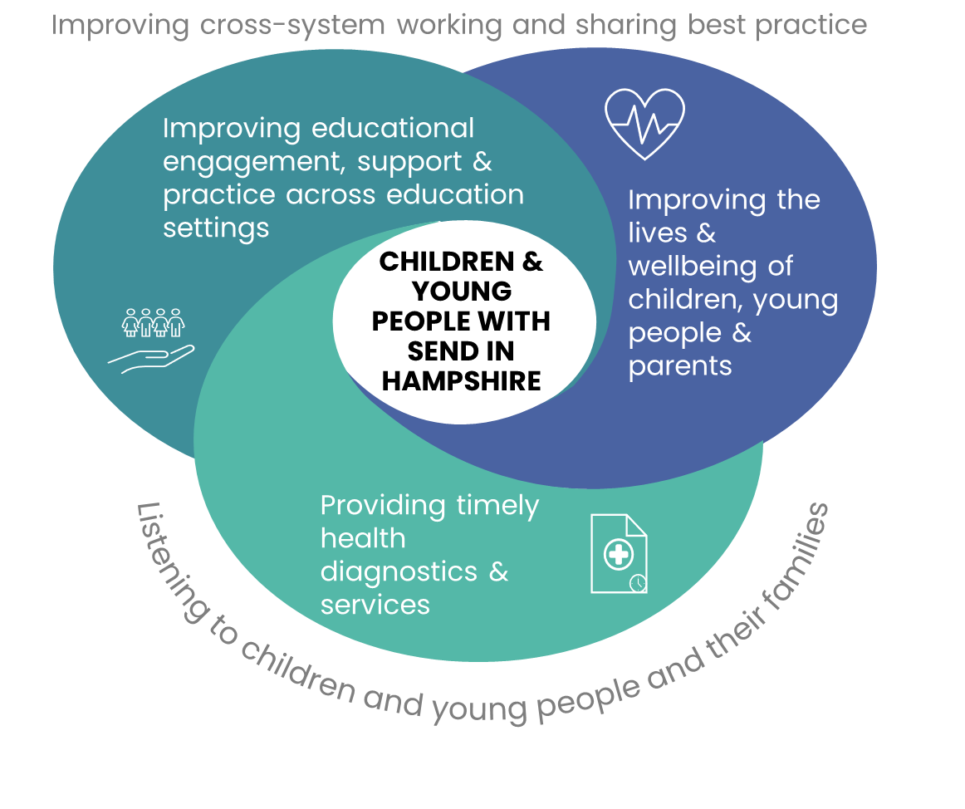





HAMPSHIRE’S LOCAL AREA PARTNERSHIP STRATEGY
Our Approach
Our Vision
Our Success Criteria
We will achieve our vision through strong multi agency and parental partnerships, having a shared understanding of challenges and working together on solutions.
We will know we have succeeded when….
The views of children, young people and their families informs all our work.
Children , young people and their families can access the information and services they need when they need it.
Data is routinely shared, and we all work towards the same goals.
Children and young people with SEND are happy and have positive social relationships.
Young people with SEND increasingly live independently and gain meaningful employment.
There is a culture of support to families and carers.
Children and young people with SEND and their families can access services and support that meet their needs at the earliest point, without barriers.
The mental and physical health of CYP with SEND compares positively with their peers.
CYP with SEND are engaged in their education within an inclusive environment.
Everyone in the system, works together to improve educational engagement.
A robust, resilient and skilled education workforce can meet SEND needs.
CYP with SEND and their parents are appropriately prepared for adult life from a young age.
There is sufficient provision to meet the needs of all CYP with SEND in Hampshire.
We will measure progress by…
Bringing together Health, Education and Social Care dashboards.
Tracking and reducing the gap between outcomes for children and young people with SEND and their peers.
Annually canvassing parents about their confidence in the system.
Annually canvassing professionals about system improvements.
Listening to children and young people about what matters to them and acting on their views.
We will work together well by…
Collectively owning the issues.
Securing cross- partnership agreement to progress all actions.
Spreading the word, creating a system-wide understanding of our ambition.
Routinely seeking the voice of all children and young people with SEND.
Holding ourselves and each other to account on delivery of our action plan.
Monitoring our progress through our Local Area Partnership board.
Supporting and be honest with each other.
Asking for help to solve systemic problems.
Being critical friends for each other.
Reducing inequalities.
Our action plans relentlessly focus on…

Slide 26
Request for spend to save investment
Transforming Send is an established programme, which is now formally reporting into the Local Area Partnership Board. To ensure that the programme continues to deliver against its aims we are requesting spend to save funding as follows;
For 2025/6, a total of £762k, comprised of:
£432k to deliver workstreams that embed early interventions, preventing escalation of need to an EHCP and improving confidence in SEN support.
£49k to deliver workstreams that improve post 16 outcomes.
£280k to deliver workstreams that improve educational engagement and inclusion in mainstream schools.
Ongoing funding
£279k of ongoing funding to support the following long-term work;
To promote a culture of inclusion across Hampshire education settings and with our partners.
To increase our efforts to collaborate with schools to embed inclusive practice.
To support the development and delivery of high-quality SEN support provision.

