Slide 1

Dedicated Schools Grant Deficit Management Plan Update
December 2023
Natalie Smith
Assistant Director, Education & Inclusion
Education and Inclusion

Slide 2
Overview
£86.1m Deficit for Hampshire Dedicated Schools Grant (DSG) at year end 2022/23.
Represents 7% of total DSG income for 2022/23 and 49% of the High Needs Block allocation.
The forecast cumulative DSG deficit at the end of 2023/24 has increased to £129.7m 11% of total DSG funding for 2023/24 and 66% of the High Needs Block allocation.
Hampshire remains one of the lower funded local authorities through the High Needs National Funding Formula.
Between the reforms taking effect in 2015 and 2023 there has been a 192% increase in the number of EHC Plans being maintained (as at January 2023).
In the 2022/23 academic year the service received over 3,500 requests for EHC needs assessments, an 18% increase on the previous academic year.
The number of EHCPs maintained by the local authority continues to grow. At the end of October 2023 Hampshire maintains 15,886 EHCPs, an increase of 10% on the same period last year.
The largest growth is in the Aged 11-15 group which has increased by almost 900 EHCPs, while the Under 5s group has experienced the largest percentage increase.
Forecasting models indicate that there could be 19,728 EHCPs maintained by Hampshire by 2025/26. This is a 55% growth from 2022.
Less than 3% of cases are out of time (they exceed 20 weeks) as at end October 2023. This has improved from just over 10% in 2022 and just over 45% in October 2021.
The Transforming SEND Hampshire programme launched internally in January 2022, and was formally launched with schools in November. It is currently forecast to make circa £26.1m savings / cost avoidance in 2023/4.

Slide 3
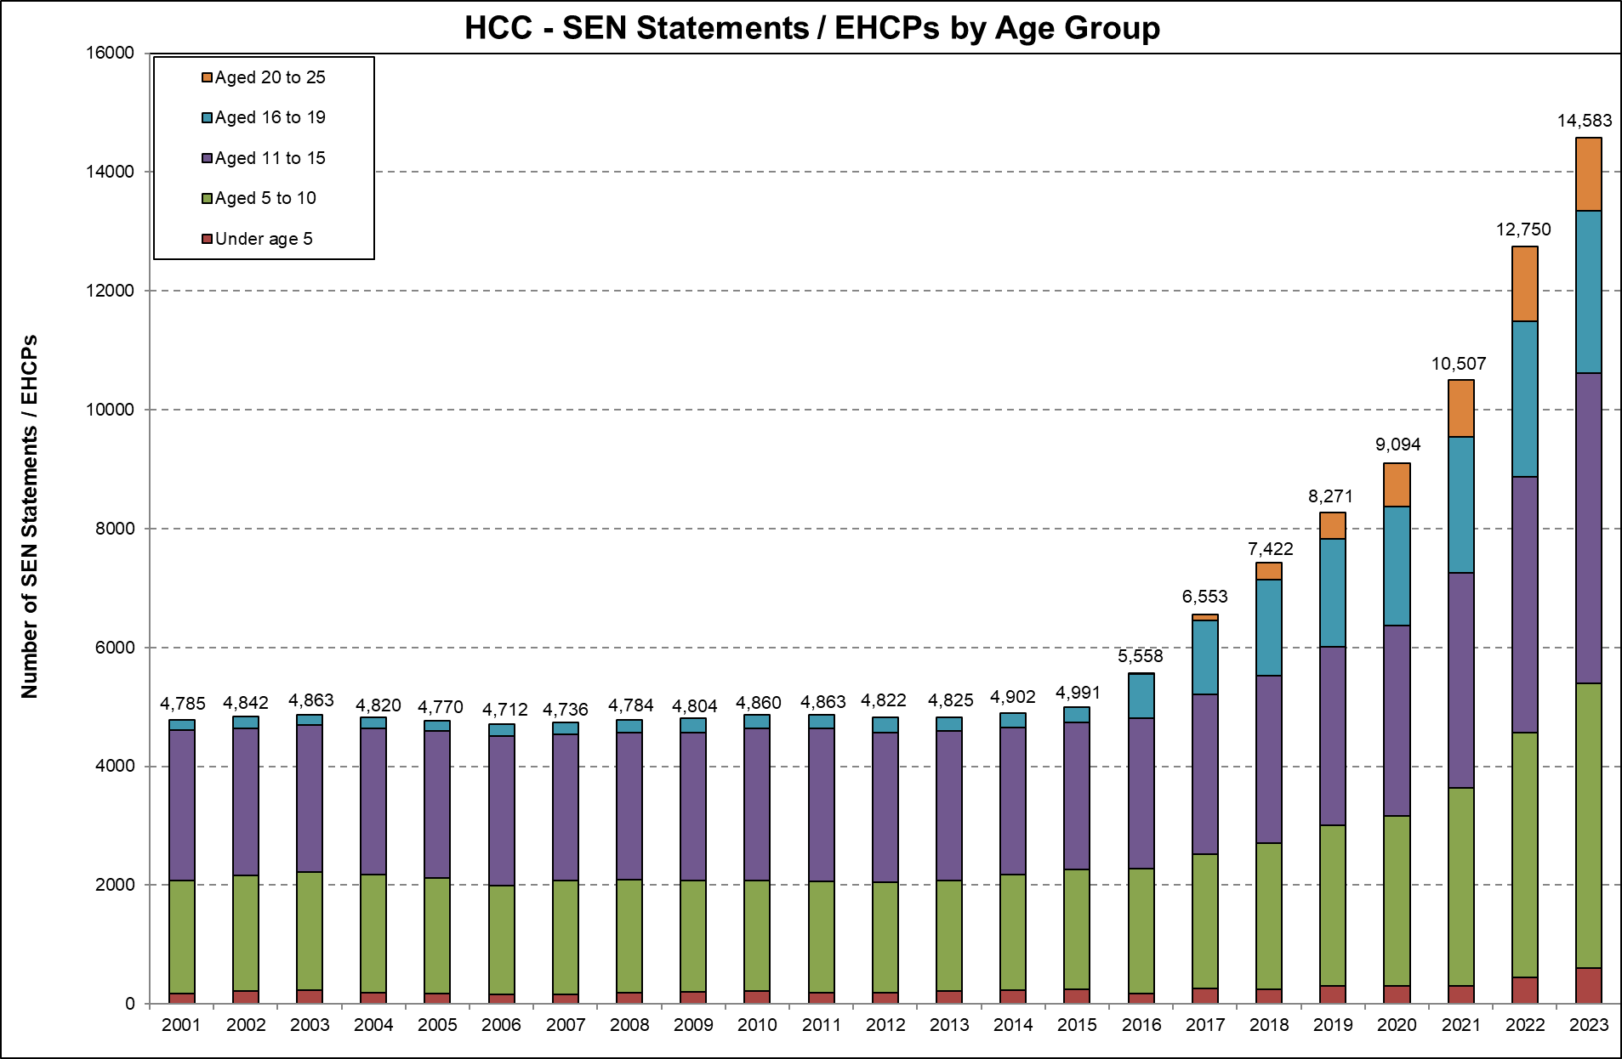
Maintained EHC Plans
Between the reforms taking effect in 2015 and 2023 there has been a 192% increase in the number of EHC Plans being maintained (as at January 2023).
This growth has continued and as of the end of October 2023 Hampshire maintains 15,886 EHC Plans, an increase of 10% on the same period last year.
Age groups* | Oct-22 | Oct-23 | % increase
Aged 20+ | 1,440 | 1,205 | -16%
Aged 16-19 | 2,851 | 2,930 | 3%
Aged 11-15 | 5,083 | 5,936 | 17%
Aged 5-10 | 4,539 | 5,106 | 12%
Under 5s | 522 | 689 | 32%
Total | 14,435 | 15,866 | 10%
* Age as at the start of each academic year
The largest growth is in the Aged 11-15 group which has increased by almost 900 EHCPs, while the Under 5s group has experienced the largest percentage increase.

Slide 4
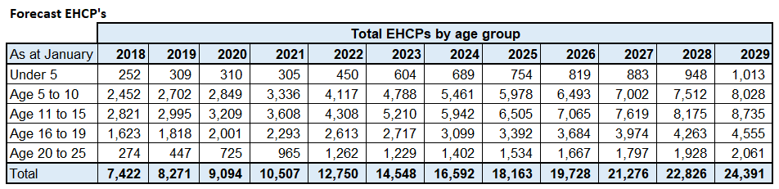
Forecast EHC Plans
Forecasting models indicate that there could be 19,728 EHCPs maintained by Hampshire by 2025/26. This is a 55% growth from 2022.

Slide 5
Requests for Assessment
Over the past two academic years there has been a drastic increase in requests for statutory EHC Needs Assessments:
  School requests increased by 25% in 2021/22 and a further 18% in 2022/23
  Parental requests increased by 63% in 2021/22 and a further 22% in 2022/23
Early 2023/24 data show further significant increases in both school and parental requests over the same period in previous years, +17% increase in school requests, and +26% increase in parental requests.

Slide 6
Issuing EHC Plans
In early 2021 the service increased its productivity with the plan to clear overdue cases and reduce the time taken to issue EHC
Plans.
Over the past two academic years, the service has issued over 5,300 EHC
Plans - 2,771 EHC Plans in 2021/22 and 2,588 plans in 2022/23.
Within this period the service has cleared the overdue cases and greatly reduced the average time taken to issue an EHC Plan.
Data from Capita – excludes exceptions and those not valid for SEN 2

Slide 7
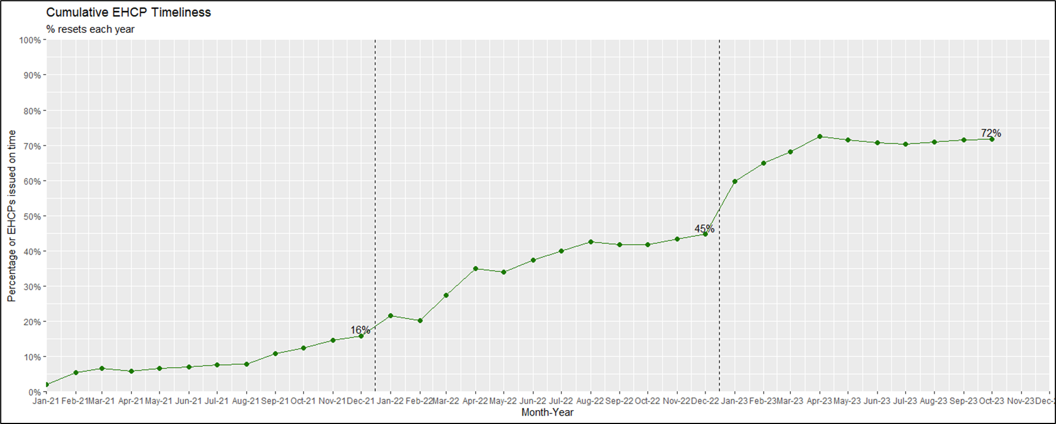
EHC Plan Timeliness
The percentage of EHC Plans issued within the statutory timescale has continued to climb and is being maintained well above the 2022 national average of 50.7%.

Slide 8
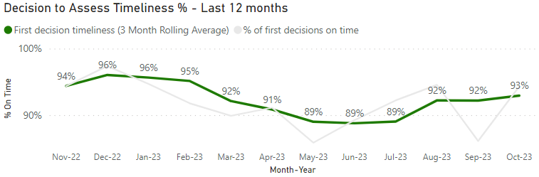
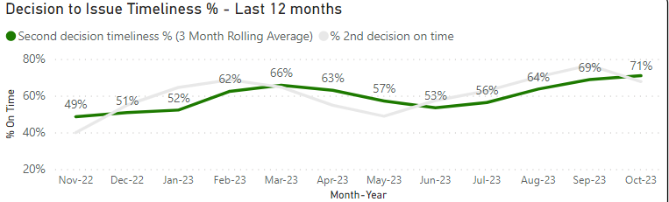
EHC Assessment Timeliness
Decision to Assess timeliness has remained at a high level over the last 12 months and is expected to be maintained.
The high level of parental requests may have a negative effect on this as it is generally more difficult to source evidence for parental requests.
Decision to Issue an EHC Plan timeliness has steadily improved over the last 12 months, with a slight dip around Easter due to a lack of available reports.

Slide 9
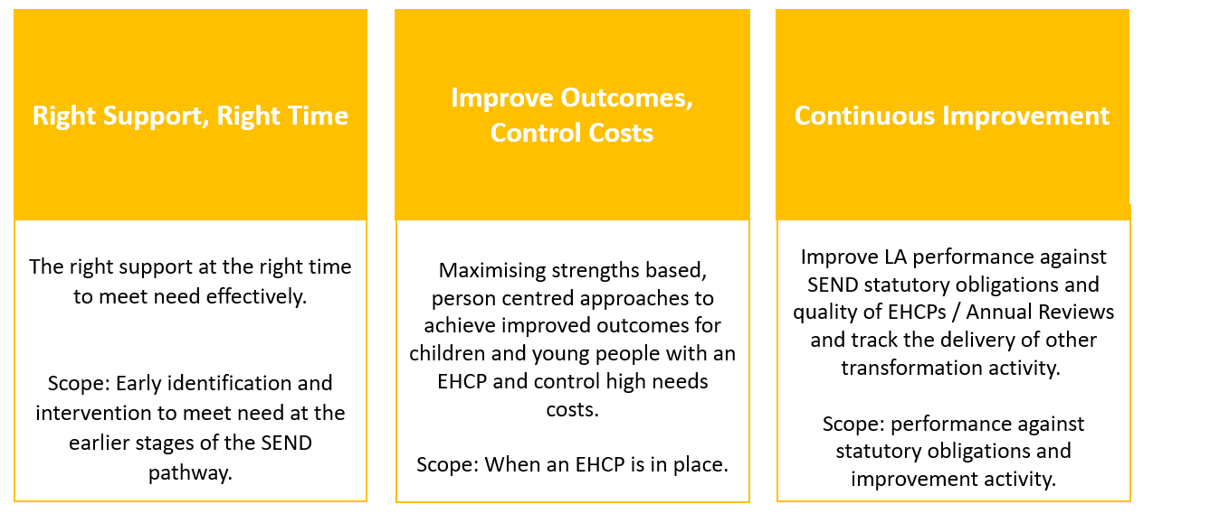
Transforming SEND Hampshire update
Transforming SEND Hampshire was launched internally in January 2022, and has been formally launched with schools in November 2023. Three programmes of work reporting into the Programme Board.
The Local Area Partnership Board is the programme reference group.

Slide 10

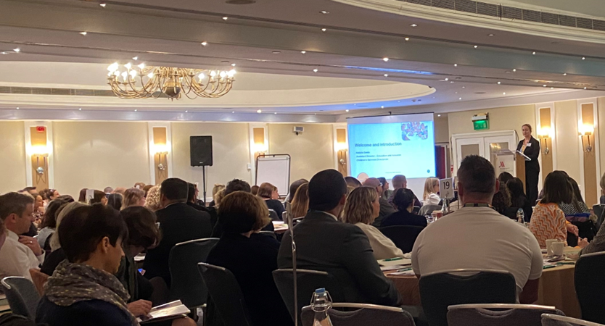
Conference launch and training
Conferences to launch the TSEND Programme with schools have taken place.
Feedback is strong, with heads broadly supportive of the TSEND work presented to them, including;
New, fully funded training to help school staff supported children with complex SEND in mainstream settings.
A new SENCO Helpline and SEN Support Toolkit.
Important to maintain momentum now that we have formally launched.

Slide 11
Workstream updates – Right Support, Right Time
Building Capacity – Sector Led SEN Improvement Projects
The 13 selected projects are running, progress reports have been received and reviewed and the second tranche of funding released.
Build Capacity - SEN Support
Cross-branch work to embed the SEN Support guidance continues alongside professional development offers.
Four new SEN Advisors have been employed and are working alongside schools.
Outreach Review
Review of High Needs Block funded outreach services undertaken and recommendations presented to the High Needs Performance and Oversight Board in November. Decisions relating to future outreach strategy communicated to existing providers swiftly after.
Signposting / Building Confidence
The new look and feel, and refreshed content of the Local Offer / Family Information Services Hub launched in July 23.
Work has commenced on developing the internal Education and Inclusion pages and a review of the externally available web content
Early Years Pilot
Planning for a pilot to extend Portage support into Year R has continued with successful internal recruitment. This will launch in April 24.

Slide 12
Workstream updates – Right Support, Right Time
Enhanced SaLT Provision
This workstream is complete, with a KPI dashboard, a cost avoidance tracker and an improved allocation process in place. The workstream is now closed.
Person Centred Approaches
Free to access 2-day training in person centred approaches is running across Hampshire until March 24 with good uptake on places.
A pilot of PCP meetings led by Educational Psychologists following a decision to refuse an EHC assessment in Early Years or Year R has shown improved confidence of settings and parents. Longer term outcomes are being monitored and consideration is being given to how best to extend the pilot.
Early Years SEN Strategy
A review of SEN Inclusion Fund processes and budget is nearing completion and will be followed by a wider review of EY SEN provision.
New Early Years SEN Support Guidance is complete and will be launched to settings in January 24.
SEN Support Line & Toolkit
These new services launched in September 23 and offer additional support to schools in exploring and implementing SEN Support.
Feedback has been exceptionally positive, and 72 enquiries have been resolved.

Slide 13
Workstream updates – Improve Outcomes, Control Costs
Preparing for Adulthood
Post-16 Employability hubs
  The Employability Hub model represents a 1+1+1 study programme, focused on employability and access to work placements, ending in an established pathway to employment, such as Supported Internships.
  There are currently 8 employability hubs across Hampshire. 132 active learners are currently engaged with hubs (64 new learners, 68 continuing learners)
  Three-year evaluation currently in draft (see slide 17 for details):
    18% of all learners engaged (181) have positive progressions to paid employment, all progressing to employment have higher engagement with the core elements of the programme (WEX, PfA delivery and Vocational Profiling).
    For learners who have completed 3 years (September 2020 intake): 31% have progressed to paid employment. 73% have EHC plans that are ceased or due to cease (includes those that exited during the programme to other courses)
    Consultation currently underway with Hubs and learners to determine model of the programme moving forward.
  Savings up to 2022/23 FY are £1.026m and a recent review of assumptions projects the cumulative saving to HNB of £8.132m by 2026/27.

Slide 14
Preparing for Adulthood (EH): End of Three-Year Pilot
Headlines:
181 learners enrolled over the three-year pilot (lower than expected – 360).
100 have progressed from the hub or withdrawn to date.
68 learners continued into the next hub year (13 withdrew between end of July 'fixed data point' for evaluation and commencement of next AY)
Intake for 2023-24 year was 64 new learners
Core Delivery Element | Work Experience / Inductions | PfA Delivered | Vocational Profiles
Positive Progression (18%) | 83% | 100% | 89%
Alternative FE (44%) | 57% | 91% | 86%
Exit (32%) | 53% | 78% | 97%
Findings:
18% have progressed to paid employment / apprenticeships.
Of those engaged in year one (2020) 73% have now had or are due to have their EHC plans ceased. 31% progressed to paid employment / apprenticeships directly from the Hub.
Engagement in core element have been high for learners making positive progressions (remaining 6% progressed to ‘other; related to logistical reasons for exit (heading to University, left the country))
The cost avoidance from 2022/23 on completion of the three-year pilot with Cohort one learners is £456,000 with forecasting suggesting in-year savings to continue until 2028/29.
Proposals
Continue to deliver the current model, engaging new post 16 providers to deliver.
Amend the model to deliver a site wide PfA focused foundation offer, and a 'bolt on' 2-year programme (from Year 13) for all mainstream EHCP learners on employment pathways.
Consultation currently underway with Employability Hub staff and learners to determine the way forward.

Slide 15
Workstream updates – Improve Outcomes, Control Costs
Preparing for Adulthood
Independence hubs
HSDC Alton, Brockenhurst College and Sparsholt Group (Andover) are now open. Andover and Alton have opened post 19 offers alongside 16+ offer.
14 learners are engaged across 3 sites (9 x 16–18-year-olds and 5 x 19+)
Savings up to 2022/23 FY are £59k and a recent review of assumptions projects the cumulative saving to HNB of £11.073m by 2026/27

Slide 16
Workstream updates – Improve Outcomes, Control Costs
Place Planning & Commissioning
This workstream has been separated out into three main areas:
Sufficiency Place Planning
The Hampshire SEN Sufficiency Strategy data was presented to CSDMT 19th October. The streatgy, when finalised, will extend to 2030.
A capital investment plan is in place, providing an additional 276 places by September 2024.
Additional capacity to be created with satellite provisions for Riverside & Henry Tyndale Schools
New proposals for additional places at Shepherds Down School and Samuel Cody in Sept 2024 at feasibility stage – revenue and capital funding to be agreed
Academy sponsors for two new free schools located in Eastleigh and Whiteley (125 SLD/ 90 SEMH) interviewed and scored. Responses to be submitted to the DfE with a decision due by January 2024

Slide 17
Workstream updates – Improve Outcomes, Control Costs
2. External Commissioning
Independent non-maintained special schools (INMSS) and Specialist post-16 institution (SPI) cost avoidance
Block Contracts / Volume Discounts in the AY 22/23 (Sept 22 – Aug 23)
  £1.309m savings/cost avoidance against the high needs budget, including INMSS: £163,946, savings through block contract unit cost reductions £1.145m
New Hampshire INMSS.
  Light Years – Fareham Primary ASC / SEMH – 10 places
  Napier (Outcome First Learning Group OFGL) - Farnborough SLD Primary 24 places (6 more over October half-term)
  Dibden Park (OFGL) - New Forest SEMH Secondary 20 places
  Elysian – Liss Secondary SEMH / Anxiety / ASC – 20 places + 10 January 2024
Commissioning AP
  Framework working well with 47 approved providers passing evaluations. Evaluations panels are weekly . 54 separate LOTs have been approved (42% pass rate) Supplier engagement continues
  Managed Packages and suitable Framework options are being scoped
3. Specially Resourced Provisions
  RP process defined. Identification of highest locality areas of need
  Planning meetings in and have already started
  APN data collection completed and DfE returns sent 10th November 2023

Slide 18
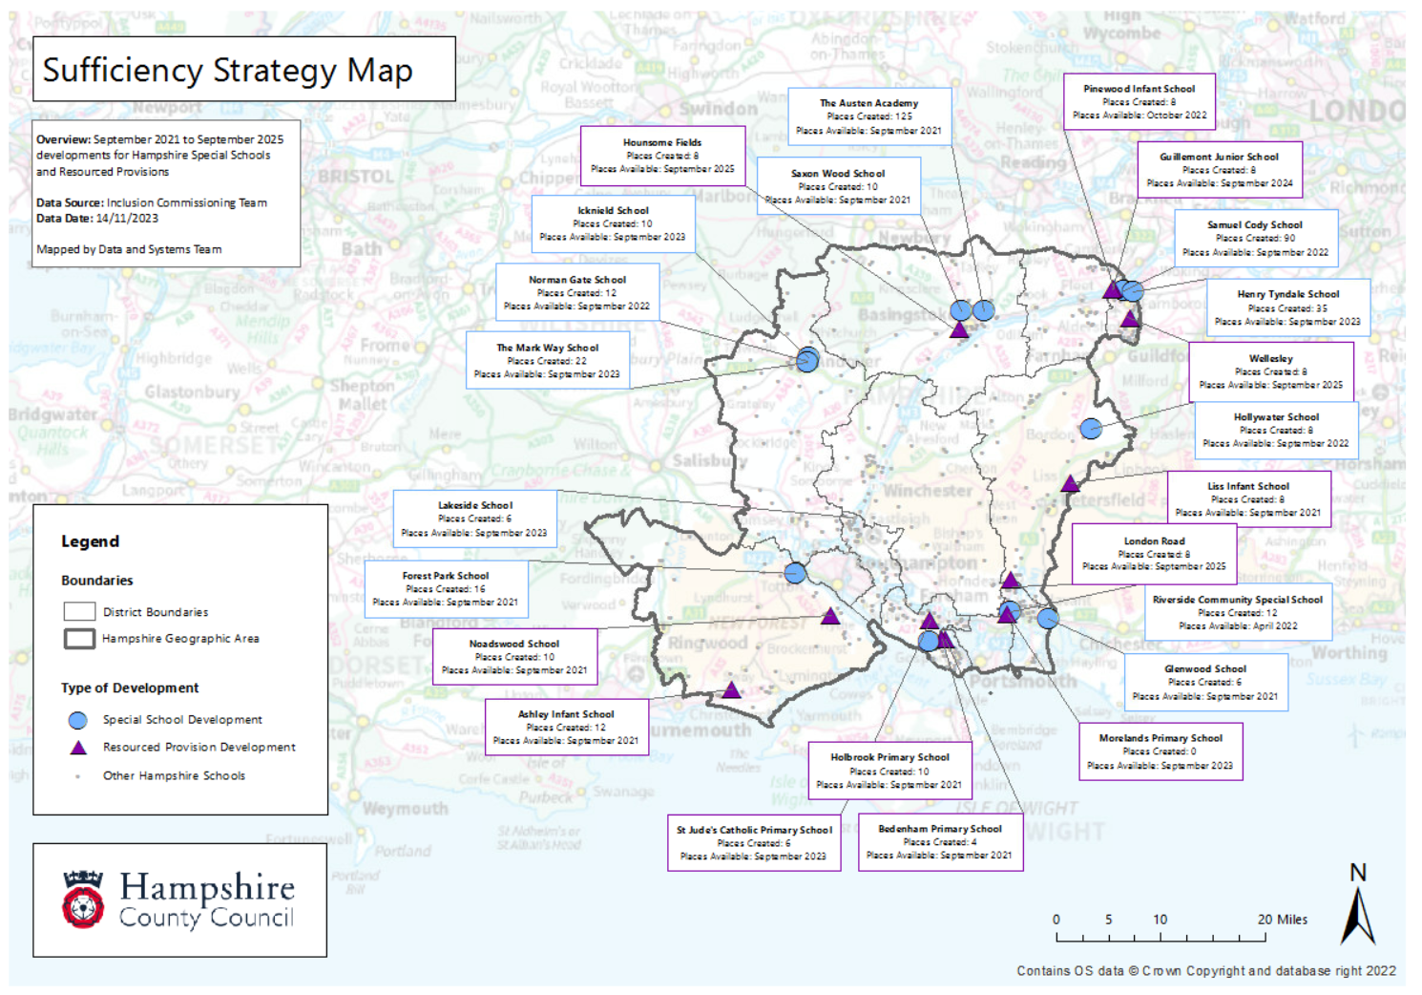

Slide 19
Workstream updates – Improve Outcomes, Control Costs
Special Schools Funding Review
The review is completed, and recommendations have been accepted by the Transforming SEND Board.
A proposed standardised funding framework which incorporates the majority of discretionary spend will be made available to special schools.
The framework is scheduled for implementation on 1 April 2024.
There is a separate agenda item on this, later in the meeting.

Slide 20
Workstream updates – Improve Outcomes, Control Costs
Responsive Intervention Pilot
DBV diagnostic work identified missed opportunities to intervene earlier in the process which can lead to a subsequent escalation of need, particularly in the run up to a phase transfer.
Our DBV bid included pilot activity to identify opportunities to intervene earlier and track the impact of that intervention as part of the annual review process, using person-centred planning approaches and drawing on the expertise of HCC services.
The aim is to improve outcomes for children with an EHCP by ensuring that access to specialist advice is provided as part of the annual review process, supporting educational settings to intervene early and prevent escalation of need
DBV funding didn’t cover the cost of this in 2023/4, so the pilot has been deferred to 2024/5.

Slide 21
Workstream updates – Continuous Improvement
Continuous Improvement – Annual Reviews
Annual review guidance has been developed and distributed to support high quality annual reviews. It included person centred planning to support improved outcomes for children and young people.
A new annual review team is in place to clear overdue processing of annual reviews. To date they have reviewed 1,162 cases.
SEN Panels Review
The SEN Panels are being reviewed to ensure they are fit for purpose as decision panels to allocate places and fund SEN placements. Recommendations will be considered by the Board in January.
SEN hub
A review of the SEN hub is being undertaken to understand requirements for the system and whether the current system is fit for purpose.
Automation
Opportunities are being explored to understand where automation can improve the services processes.

Slide 22
High Needs Block Funding
The High Needs Block DSG allocation has increased significantly year on year between 2020/21 and 2023/24, the level of increase has reduced significantly between 2023/24 and 2024/25 however our forecasts continue to predict significant growth in expenditure due to continued increases in demand and complexity of needs.
The provisional allocation of High Needs Block funding for Hampshire for 2024/25 is £205.6m which equates to £1,159 per mainstream pupil.
The average level of funding per pupil in South East authorities is £1,364.
If Hampshire was funded at the South East local authorities average level, then we would receive an additional £36.3 million which would significantly reduce the forecast in year high needs pressure in 2024/25.
Year | High Needs Allocation | Increase in Funding | In-year High Needs Pressure
2019/20 | £115.7m | £4.1m | £15.2m
2020/21 | £135.1m | £19.4m | £15.8m
2021/22 | £152.9m | £17.9m* | £27.7m
2022/23 | £176.2m | £23.3m** | £29.1m
2023/24 | £196.9m | £20.7m*** | £45.5m
2024/25 | £205.6m | £8.7m | £61.0m
* | Includes £2.5m for baselining of Teachers Pay and Pension Grants included in DSG allocations going forward.
** *** | Includes Supplementary Grant £2m included in DSG allocations going forwards. Includes High Needs Additional Grant £8m included in DSG allocations going forwards.
Notes:
Note provisional allocation for 23/24 is subject to change

Slide 23
Delivering Better Value
Right Support, Right Time
Improve Outcomes, Control Costs
Continuous Improvement
Building capacity in schools
Improved Outreach offer
In-house SALT therapies
Signposting to services
Early Years strategy
Preparing for Adulthood
Place Planning & commissioning
Special Schools Funding Review
SEN Panels Review
Responsive Intervention Pilot
SEN Service Capacity & performance
HIEP Capacity & Performance
Existing programme
Person Centred Planning pilot
Transition to School pilot
Access to Therapy Pilot
SENCO helpline
SEN Support Toolkit
Supporting complex SEND in mainstream training
Person Centred Planning training
Conference Launch
SEN Structure and Design
Annual Review process redesign
Clear Overdue Annual Reviews
Annual review external guidance
DBV funded

Slide 24
DSG Medium Term Forecast – In Year
 | 2018/19 £'000 | 2019/20 £'000 | 2020/21 £'000 | 2021/22 £'000 | 2022/23 £'000 | 2023/24 £'000 | 2024/25 £'000 | 2025/26 £'000 | 2026/27 £'000
HNB Funding Allocation​ | 115,264 | 119,452 | 135,053 | 152,818 | 176,224 | 196,940 | 205,553 | 210,000 | 215,218
HNB Mitigated Expenditure LA - Baseline Projection | 125,767 | 134,614 | 150,876 | 180,539 | 212,534 | 217,880 | 238,071 | 257,781 | 278,412
HNB Mitigated Expenditure LA - Current Projection | 125,767 | 134,614 | 150,876 | 180,539 | 206,642 | 242,459 | 266,554 | 290,309 | 314,875
HNB Mitigated Target Expenditure Newton | 125,767 | 134,614 | 150,876 | 180,539 | 220,149 | 245,021 | 268,689 | 287,063 | 296,286
HNB Unmitigated Expenditure Newton | 125,767 | 134,614 | 150,876 | 180,539 | 226,749 | 251,621 | 277,589 | 299,663 | 320,286
In Year Deficit - LA Current Projection | 10,503 | 15,162 | 15,823 | 27,721 | 30,418 | 45,519 | 61,002 | 80,309 | 99,657

Slide 25
DSG Medium Term Forecast – Cumulative
 | 2018/19 £'000 | 2019/20 £'000 | 2020/21 £'000 | 2021/22 £'000 | 2022/23 £'000 | 2023/24 £'000 | 2024/25 £'000 | 2025/26 £'000 | 2026/27 £'000 | 2027/28 £'000
HNB Mitigated Expenditure LA - Baseline Projection | 13,746 | 22,754 | 35,445 | 60,022 | 89,200 | 113,300 | 150,700 | 201,300 | 267,900 | n/a
HNB Mitigated Expenditure LA - Current Projection | 13,746 | 22,754 | 35,445 | 60,022 | 86,149 | 129,721 | 190,723 | 271,032 | 370,689 | 489,536
HNB Mitigated Expenditure Newton - Target | 13,746 | 22,754 | 35,445 | 69,209 | 106,834 | 167,450 | 254,716 | 362,614 | 489,916 | 633,179
HNB Unmitigated Expenditure Newton - Baseline | 13,746 | 22,754 | 35,445 | 69,209 | 113,433 | 183,010 | 282,904 | 414,898 | 580,937 | 778,334

Slide 26
High Needs Workstreams
 |  | Breakdown of savings / cost avoidance
Workstream | Project | 2018/19 £000 | 2019/20 £000 | 2020/21 £000 | 2021/22 £000 | 2022/23 £000 | 2023/24 Forecast | 2024/25 Forecast | 2025/26 Forecast | 2026/27 Forecast | 2027/28 Forecast | 2028/29 Forecast | 2029/30 Forecast
Preparing for Adulthood | SEND independence hubs |  |  |  | 5 | -64 | -188 | -1,798 | -3,600 | -5,428 | -6,906 | -8,233 | -9,194
 | SEND employability hubs |  |  | 86 | -281 | -831 | -825 | -1,383 | -2,026 | -2,872 | -4,145 | -5,367 | -6,491
Sufficiency Place Planning | Place planning / sufficiency |  | -2,480 | -5,962 | -10,881 | -15,184 | -18,598 | -22,415 | -24,396 | -26,903 | -30,779 | -34,368 | -37,570
INMSS review | Reducing out of county places through annual reviews | -669 | -1,479 | -1,840 | -2,546 | -2,839 | -2,894 | -3,060 | -3,097 | -3,072 | -3,072 | -3,072 | -3,072
External Commissioning | Improved commissioning of independent places |  |  | -94 | -335 | -551 | -617 | -617 | -617 | -617 | -617 | -617 | -617
 | Review of funding for Deaf Instructors |  |  | -22 | -29 | -7 | 0 | 0 | 0 | 0 | 0 | 0 | 0
 | Review of places commissioned for education centres |  | -270 | -460 | -460 | -460 | -413 | -380 | -380 | -380 | -380 | -380 | -380
 | Commissioning SEMH places from education centres |  | -385 | -474 | -599 | -671 | -668 | -665 | -663 | -660 | -657 | -654 | -651
 | Review of funding for nurture groups |  | -63 | -63 | -63 | -63 | -63 | -63 | -63 | -63 | -63 | -63 | -63
High Needs Top-up Funding Review | Cease the SEN Support Agreement (SENSA) |  | -1,100 | -1,100 | -1,100 | -1,100 | -1,100 | -1,100 | -1,100 | -1,100 | -1,100 | -1,100 | -1,100
 | Reduce the notional SEN top-up |  | -103 | -33 | -75 | -75 | 0 | 0 | 0 | 0 | 0 | 0 | 0
Review of Support Services | Review of the Primary Behaviour Service |  |  | -159 | -159 | -159 | -159 | -159 | -159 | -159 | -159 | -159 | -159
 | Review of the Specialist Teacher Advisory Service | -113 | -403 | -552 | -552 | -609 | -650 | -650 | -650 | -650 | -650 | -650 | -650
 |  | -782 | -6,283 | -10,673 | -17,075 | -22,613 | -26,175 | -32,290 | -36,751 | -41,904 | -48,528 | -54,663 | -59,947
Saving forecasts show a cumulative saving of £357.7m between 2018/19 and 2029/30
Further savings are expected in relation to the current sufficiency strategy and Transforming SEND pilots and workstreams, further details on projected savings will be available in 2024.

Slide 27
2023/4 High Needs investment in cost avoidance activity.
£88k was allocated to HIAS for work that goes beyond the statutory expectations on a Local Authority in commissioning INMSS and AP. This work ensures that appropriate high-quality provision is provided for CYP in the right location, to reduce travel time for children and young people, improving the quality of the offer while controlling the price.
£491k of High needs funding was allocated to the Local Authority in 2023/4 for cost avoidance activity. This investment resulted in £1.309m savings/cost avoidance against the high needs budget, including
INMSS: £163,946
Savings through block contract unit cost reductions £1.145m

Slide 28
2024/5 Transforming SEND Hampshire work
High needs cost avoidance is a forecast consequence of the early intervention work introduced following the DBV work.
New ‘Transforming SEND Hampshire’ workstreams were funded through a DBV grant in 2023/4, on the understanding that, moving forwards they will be funded through a high needs ‘spend to save’ investment.
Cost avoidance is a key priority for the TSEND Hampshire, which has launched to all schools in Hampshire this month. We would like to fund;
  Ongoing pilot activity (funded through the DBV grant in 2023/4)
  Other workstreams that have a direct link to cost avoidance
We will come back to school's forum in 2024/5 year as pilots come to an end, with evaluation findings and recommendations for the future.
We propose that High Needs funding is used on an ongoing basis for
  A contribution towards funding the new SENCO Helpline service and ongoing maintenance of the SEN Support toolkit.
  Other established spend to save activity.
Total proposed High Needs funding required: £1,356,923 comprised of;
  £685,853 TSEND spend to save investment for pilots, training and workstream activity.
  £671,070 on ongoing high needs funded services and activity.
A breakdown of these activities are summarised over the following slides.

Slide 29
New proposed investment
(DBV funded in 2023/4)
Workstream name | Description | 2024/5 cost
Transition to school PILOT | Continuation of a pilot to test the impact of extending portage support into year R. Intended impact is to avoid escalation of need to an EHCP during the transition phase. | £ 92,868
Access to therapy PILOT | Continuation of a pilot to test the impact of providing greater access to therapy without the need for an EHC plan. Intended impact is to provide a short-term intervention that avoids the need for an EHC plan. | £ 63,728
PCP training | Funding PCP training for 150 delegates in schools in 2024/5 to support increased parental confidence in SEN support. Avoiding EHC requests for assessment by parents. | £ 20,850
Responsive Intervention PILOT | A new pilot (paused in 2023/4) for a multidisciplinary team to engage in key annual reviews at the outset, using LA strengths-based expertise to step down plans where CYP are making progress. | £ 333,282
Culture, comms and stakeholder engagement | A workstream to embed an inclusive culture across all schools, the LA and stakeholders. | £ 77,265
Other costs | Management of cost avoidance activity and work to streamline services funded through high needs. | £ 97,860
Total High Needs spend to save |  | £ 685,853

Slide 30
2024/5 Ongoing investment
The following areas are well-established and spend to save evidence is available (including from the DfE and other LAs). We propose to continue to fund them through high needs on an ongoing basis;

