Slide 1
Dedicated Schools Grant Deficit Management Plan Update
July 2022
Brian Pope
Assistant Director, Education & Inclusion

Slide 2
Overview
£60m Deficit for Hampshire Dedicated Schools Grant (DSG) at year end 2021/22.
Represents 5.4% of total DSG and 39% of High Needs Block.
Hampshire remains one of the lower funded local authorities through the High Needs National Funding Formula.
Between 1 September 2021 and 31 May 2022, there have been 2,213 requests for an EHC needs assessment, a 35.6% increase on the same period last year.
There has been a steady rise in the number of EHCPs maintained within the local authority, with an increase of 23% between May 2021 and May 2022.
Forecasting models indicate that there could be 18,010 EHCPs maintained by Hampshire by 2025/26. This is a 41% growth from 2022.
The age group with the biggest percentage increase is the under age 5 group, where the number of EHCPs has seen an increase from 474 to 716 (51.1%).
EHCPs have increased by 155% between January 2015 and January 2022. The national growth is 97%.
A significant increase in Post 19 places additional pressure on the high needs budget and increased pressure for the SEN Service.

Slide 3
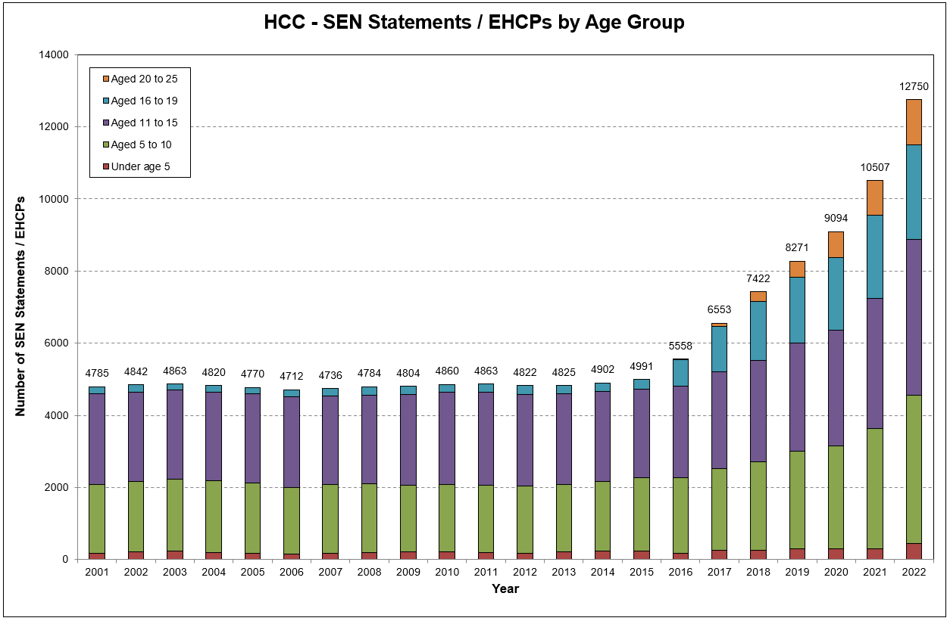
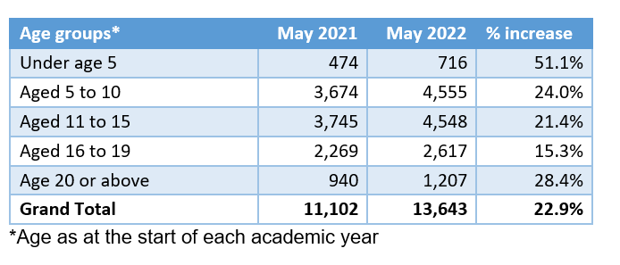
Maintained EHC Plans
This growth has continued to accelerate and as of the end of May 2022 Hampshire maintains 13,643 EHC Plans, an increase of 23% on the same period last year.
The age group with the biggest percentage increase is the under age 5 group, where the number of EHCPs has seen an increase from 474 to 716 (51.1%).
Between the reforms taking effect in 2015 and 2022 there has been a 155% increase in the number of EHC Plans being maintained (as at January 2022).

Slide 4
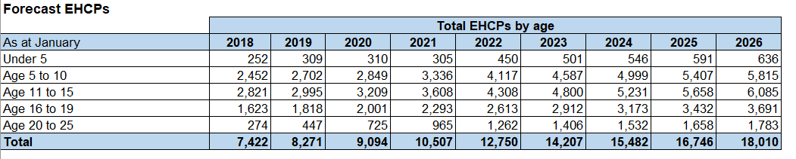
Forecast EHC Plans
Forecasting models indicate that there could be 18,010 EHCPs maintained by Hampshire by 2025/26. This is a 41% growth from 2022.

Slide 5
Requests for Assessment
In 2021 over 2,300 requests for EHC needs assessment were received, averaging 199 requests per month.
So far in 2022, over 1,300 requests have been received - averaging 266 requests per month.

Slide 6
Issuing EHC Plans
Month | Number of Plans Issued | Average time (Days) | Month | Number of Plans Issued | Average time (Days)
Jan-21 | 99 | 342 | Jan-22 | 181 | 285
Feb-21 | 102 | 326 | Feb-22 | 173 | 274
Mar-21 | 152 | 356 | Mar-22 | 221 | 226
Apr-21 | 126 | 317 | Apr-22 | 208 | 190
May-21 | 132 | 316 | May-22 | 293 | 206
Jun-21 | 224 | 349 | Jun-22
Jul-21 | 267 | 318 | Jul-22
Aug-21 | 227 | 317 | Aug-22
Sep-21 | 236 | 276 | Sep-22
Oct-21 | 248 | 277 | Oct-22
Nov-21 | 301 | 269 | Nov-22
Dec-21 | 165 | 241 | Dec-22
In 2021, the Service issued 2,279 EHC Plans. So far in 2022, the Service has issued 1,076 EHC Plans.
From June 2021, the Service increased the volume of plans being issued and the average time to issue an EHCP has fallen.
Data from Capita – excludes exceptions and those not valid for SEN 2

Slide 7
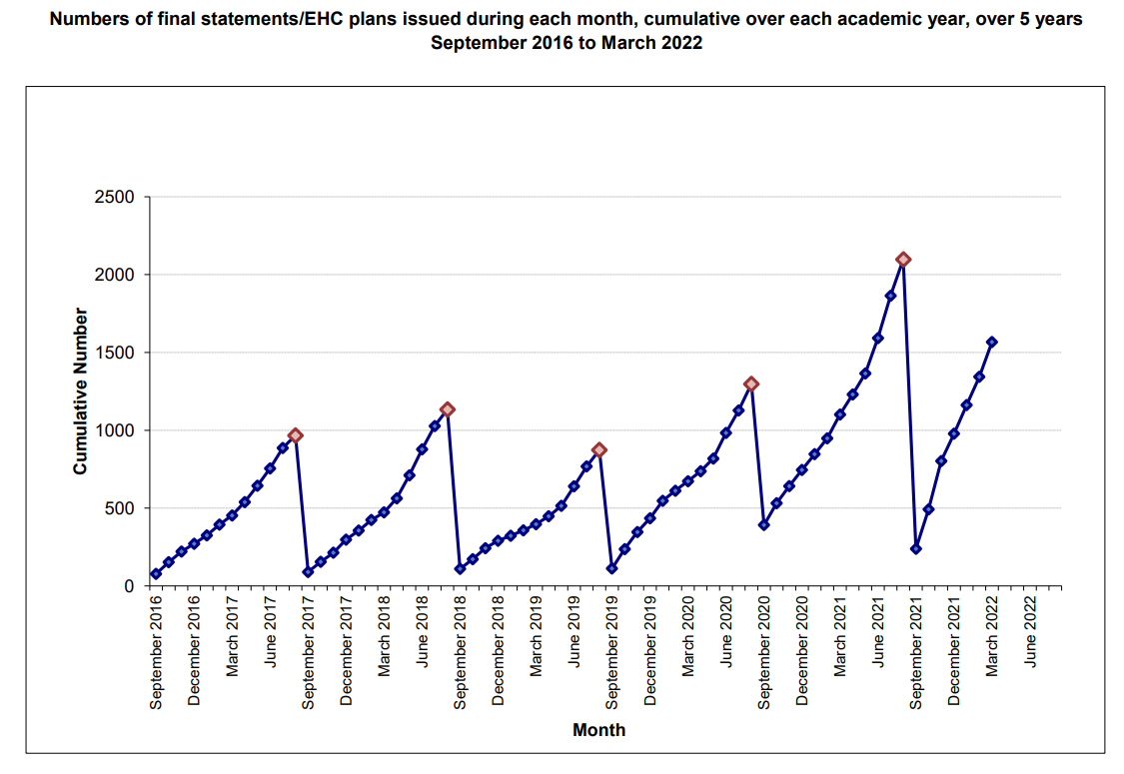
Issuing EHC Plans

Slide 8
EHC Plan Timeliness
The timeliness is improving in line with the recovery plan, with the aim of being in line with the national average by the end of this academic year.
Month | % EHCPs Issue Within Timescale | Cumulative %
Jan-22 | 21% | 21%
Feb-22 | 19% | 20%
Mar-22 | 40% | 27%
Apr-22 | 57% | 35%
May-22 | 32% | 34%

Slide 9
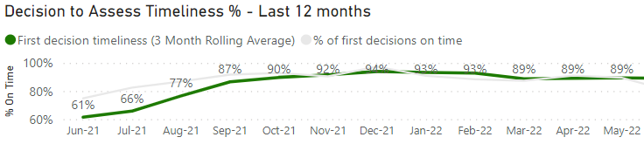
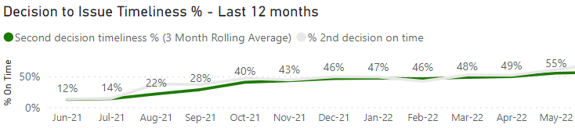
EHC Assessment Timeliness
‘Decision to Assess’ timeliness has increased by around 30 percentage points since last June and has remained between 89-94% over the last 8 months.
‘Decision to Issue’ an EHC Plan timeliness has increased by over 40 percentage points since last June and has been steadily increasing since October 2021.

Slide 10
Work in progress and cases out of time
The long-term plan was re-evaluated due to increased demand levels. The principles remain the same - to reduce out of time cases and improve timeliness.
  31 October 2021 – 1,429
  31 May 2022 – 1,368
Just over 20% of cases are out of time (they exceed 20 weeks) as at end May 2022. This has improved from just under 50% in October 2021.

Slide 11
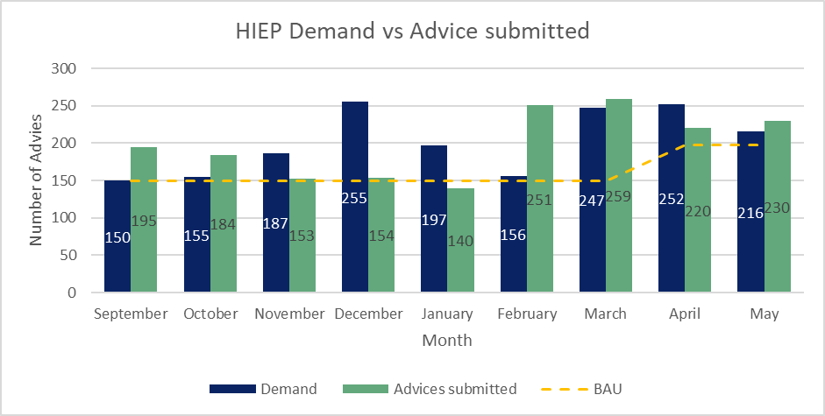
Educational Psychology Advice
Demand in to HIEP for statutory needs assessments continues to increase. This resulted in a monthly BAU figure of 150 in Sept. 21, which later increased to 198 in April 22.
With adjustments to the schools' SLA, HIEP have been submitting 220-260 advice each month between Feb. 22 and June 22.
It is anticipated HIEP will complete approx. 2,300 for the academic year 21/22.

Slide 12
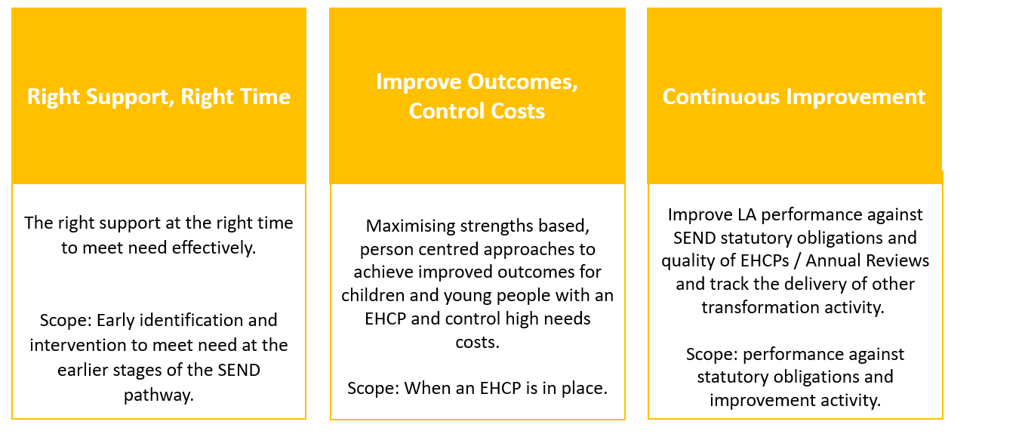
High Needs, Performance & Oversight Programme update
The High Needs, Performance and Oversight Board was launched in January 2022, with three programmes of work reporting into the Board. Each programme has a number of workstreams that seek to address incoming demand for EHCPs, alongside reducing the pressure on the high needs budget.

Slide 13
Workstream updates
Building Capacity – Sector Led SEN Improvement
Adding strength to the overall work to improve SEN support across the system.
26 Hampshire groups submitted an Expression of Interest, 13 of which were successful following scrutiny by the panel of LA officers and HT reps.
Funded through the High Needs Block; a total on this initiative of £412k.
Projects will start September 2022 and run through to end March 2024.
Build Capacity - SEN Support
District and phase projects co-ordinated through School Improvement Managers continue; some are on-going from the previous financial year with ‘build-ons’, others are new, the majority of these are offered to all schools in the district/phase fully funded, some have target groups.
Various networking and collaborative opportunities continue, for example SENCo networks and resourced provision networks/offers of support and advice.
Embedding the SEN Support Guidance remains a priority.
The LLPR process has a continued focus on this area and wider inclusion.

Slide 14
Workstream updates
Preparing for Adulthood
Post-16 Employability hubs
  The Employability Hub model represents a 1+1+1 study programme, focused on employability and access to work placements, ending in an established pathway to employment, such as Supported Internships.
  There are currently 7 employability hubs. 84 learners currently active. 5 primary outcomes have been achieved (4 paid employment outcomes and 1 apprenticeship). 81% engagement in work experience.
  2 additional employability hubs are joining in 2022 (BCOT & Fareham), bringing the total Employability hubs up to 9 across Hampshire.
Independence hubs
HSDC Alton opens in September 2022 with 8 spaces.
3 additional hubs have been confirmed for 2023 openings (Farnborough College of Technology, Andover and Brockenhurst).

Slide 15
Workstream updates
Place Planning & Commissioning
Place Planning strategy is being refreshed, for implementation from January 2023.
Proposal is being progressed to build a new all-through PD/SLD schools for 125 places, in a location along the M27/M3 corridor.
Additional places are being developed at Henry Tyndale, Norman Gate and Pinewood Schools for September 2022.
Commissioning frameworks for Discretionary Payments (September 2022) and Managed Educational Packages (September 2023) and underway and on track for planned go live dates.
Approval has been granted to develop an in-house SaLT resource, in response to demand and to reduce discretionary spend. It will be implemented from September 2022.
Bring-back cost avoidance
Hampshire: 389 children identified as a priority for both INMSS and SPI for review (increase of 14 from last month). 69 INMSS / SPI annual reviews have been completed to date (increase of 1 from last month) giving a 2022/23 cost avoidance of £1,236,722 (no change from last month). 18 placements have been identified as ceasing as a result of annual reviews.

Slide 16
Workstream updates
Dynamic ECHP Support
This initiative will increase the number of annual reviews that the local authority are involved with.
The focus will on more dynamic support and placement choices that meet the changing needs of children and young people
The aim is for children and young people to achieve improved outcomes and build their resilience to thrive in a mainstream environment.
A sign of success will be more plans stepped down or ceased as EHCPs focus on increasing independence with aligned support.
Work has been undertaken to review the current annual review position – next step is to agree which annual reviews to prioritise, before looking at the process and framework that sits around this.

Slide 17
Workstream updates
Special Schools Funding Review
A review is underway of the existing funding model(s) and the factors affecting the variation in funding across in special schools and resourced provisions.
​
The workstream will propose a standardised special school and resource provision funding framework to be implemented during 2023.
The timeline is:
  Review period April 2022 – October 2022​
  ​
  Framework development and testing October 2022 – August 2023​
  ​
  Implementation September 2023
Virtual information sessions have been held for all special schools and resource provisions.
More in-depth interviews are scheduled with schools over the summer.
Review of outreach services
A review of outreach services provided by special schools and Education is currently underway.
Timeline: April – October 2022
Analysis of existing data is ongoing and interviews have been held with a wide range of provider Headteachers and Outreach Workers.
Questionnaire for mainstream schools is being finalised and will go out shortly via HIAS.

Slide 18
High Needs Block Funding
The High Needs Block DSG allocation has increased over the last three years however there continues to be a pressure each year due to increases in demand and complexity of needs.
The provisional allocation of High Needs Block funding for Hampshire for 2022/23 is £176.1m which equates to £999 per mainstream pupil
The average level of funding per pupil in South East authorities is £1,201
If Hampshire was funded at the South East local authorities average level, then we would receive an additional £35.5 million which would deliver a forecasted surplus budget.
It is recognised that Hampshire High Needs profile may not represent the average for the South East and if this is corrected for, we would be closer to a balanced funding position than a surplus.
Year | High Needs Allocation | Increase in Funding | In-year High Needs Pressure
2019/20 | £115.7m | £4.1m | £15.2m
2020/21 | £135.1m | £19.4m | £15.8m
2021/22 | £152.9m | £17.9m* | £27.7m
2022/23 | £176.1m | £23.2m** | £28.3m
* | Includes £2.5m for baselining of Teachers Pay and Pension Grants included in DSG allocations going forwards
** | Includes Supplementary Grant £2m

Slide 19
Delivering Better Value
Hampshire’s DSG deficit has been identified as less severe than Local Authorities included within the Safety Valve Programme but still substantial.
Invited to take part in the first of of three tranches of the Delivering Better Value (DBV) programme, aimed at securing sustainable management of local authorities’ high needs systems.
The DBV programme consists of two phases with phase one commencing June 2022:
Phase 1: 6 months
Local area stocktake (assessment of existing processes, plans, capability, relationships, etc.).
Facilitation of key stakeholder engagement for each authority
Data analysis and assurance.
Identification of root cause/underlying cost drivers and mitigating solutions/reforms.
Improvement plan including reform implementation critical path
A quality assured DSG management plan.
DfE will provide a small grant to support data analysis and assurance
DfE will agree with each LA critical elements of its action plan to be funded at the end of phase 1.
Phase 2: 18 months
Implementation of action plans produced in phase 1, with critical elements funded through Section 14 grants.

Slide 20
DSG Medium Term Forecast
 | 2018/19 | 2019/20 | 2020/21 | 2021/22 | 2022/23 | 2023/24 | 2024/25 | 2025/26 | 2026/27
 | Actuals | Actuals | Actuals | Forecast | Forecast | Forecast | Forecast | Forecast | Forecast
Total Expenditure | 937.8 | 967.8 | 1,029.8 | 1,131.5 | 1,188.1 | 1,228.3 | 1,247.1 | 1,266.4 | 1,287.2
Total Income | 928.5 | 958.8 | 1,017.1 | 1,106.9 | 1,159.8 | 1,192.2 | 1,196.5 | 1,201.1 | 1,205.8
Net In-year Position | 9.2 | 9.0 | 12.7 | 24.6 | 28.3 | 36.1 | 50.6 | 65.4 | 81.5
Of which:
High Needs Block | 10.5 | 15.2 | 15.8 | 27.7 | 28.3 | 36.1 | 50.6 | 65.4 | 81.5
Other Blocks | - 1.3 | - 6.2 | - 3.1 | - 3.1 | - | - | - | - | -
Cumulative DSG Deficit Reserve | 13.7 | 22.8 | 35.4 | 60.0 | 88.3 | 124.5 | 175.0 | 240.4 | 321.9
Deficit as % of Funding | 1.5% | 2.4% | 3.5% | 5.4% | 7.6% | 10.4% | 14.6% | 20.0% | 26.7%
Excluding the Impact of Savings
Net In-year Position | 10.0 | 15.3 | 23.4 | 41.7 | 50.3 | 69.1 | 90.7 | 108.2 | 124.1
Cumulative DSG Deficit Reserve | 13.7 | 29.0 | 52.4 | 94.1 | 144.3 | 213.4 | 304.1 | 412.3 | 536.5
Deficit as % of Funding | 1.5% | 3.0% | 5.2% | 8.5% | 12.4% | 17.9% | 25.4% | 34.3% | 44.5%
Savings / Cost Avoidance | 0.8 | 6.3 | 10.7 | 17.1 | 21.9 | 33.0 | 40.1 | 42.9 | 42.7
Note: Figures above represent £m

Slide 21
High Needs Workstreams
 |  | Breakdown of Savings (-) / Additional Costs (+)
Workstream | Projects Within the Workstream | 2018/19 £'000 | 2019/20 £'000 | 2020/21 £'000 | 2021/22 £'000 | 2022/23 £'000 | 2023/24 £'000 | 2024/25 £'000 | 2025/26 £’000 | 2026/27 £'000
Preparing for Adulthood | SEND independence hubs | 0 | 0 | 0 | 5 | -93 | -1,593 | -3,362 | -4,961 | -4,961
 | Post-16 Employability Hubs | 0 | 0 | 86 | -281 | -823 | -1,995 | -3,304 | -3,304 | -3,304
Place Planning and Commissioning | Sufficiency strategy, including place planning | 0 | -2,480 | -5,962 | -10,881 | -20,444 | -28,755 | -33,009 | -34,332 | -34,332
 | Reduce reliance on out of county placements through annual reviews | -669 | -1,479 | -1,840 | -2,546 | -3,022 | -3,157 | -3,138 | -3,122 | -3,130
 | Improved procurement of independent placements | 0 | 0 | -94 | -335 | -551 | -617 | -617 | -617 | -617
 | Commission SEMH places from education centres |  | -385 | -474 | -599 | -596 | -594 | -591 | -588 | -585
 | Review of funding for Deaf Instructors |  |  | -22 | -29 | -7 | 0 | 0 | 0 | 0
 | Review of places commissioned for education centres |  | -270 | -460 | -460 | -460 | -460 | -460 | -460 | -460
 | Review of funding for nurture groups |  | -63 | -63 | -63 | -63 | -63 | -63 | -63 | -63
High Needs Top-up Funding Review | Cease the SEN support agreement (SENSA) |  | -1,100 | -1,100 | -1,100 | -1,100 | -1,100 | -1,100 | -1,100 | -1,100
 | Reduce Notional SEN top-up |  | -103 | -33 | -75 | -75 | -75 | -75 | -75 | -75
Other | Review of Primary Behaviour Service |  |  | -159 | -159 | -159 | -159 | -159 | -159 | -159
 | Review of Specialist Teacher Advisory Service | -113 | -403 | -552 | -552 | -609 | -650 | -650 | -650 | -650
 |  | -782 | -6,283 | -10,673 | -17,075 | -28,003 | -39,218 | -46,528 | -49,431 | 49,436

