Slide 1

Schools Budget 2026/27
14 October 2026
Andrew Minall
Team name (optional)

Slide 2
2026/27 Schools Budget
Report sets out the forecast position as of 31 August 2026:
Forecast position on the DSG Deficit Reserve as at end of 2026/27
We have now received positive feedback from government on our SEN Reform plan which will provide additional one-off funding of up to 90% of the cumulative DSG deficit at 31 March 2026. We will continue to monitor and develop this plan and an update will be provided at the next meeting.
Block | Current budget | Forecast outturn | Forecast variance
 | £000 | £000 | £000 | %
Early Years | 253,559 | 253,771 | 212 | 0.1
Schools | 764,062 | 763,619 | (443) | (0.1)
High Needs | 223,013 | 432,817 | 209,804 | 94.1
Central School Services | 10,429 | 10,383 | (46) | (0.4)
Dedicated Schools Grant | 1,254,063 | 1,460,590 | 209,527 | 16.7%
Other school grants | 81,110 | 81,110 | 0 | 0.0
Total Schools Budget | 1,332,173 | 1,541,700 | 209,527 | 15.7%
 | £000
Balance brought forward from 2025/26 | (345,788)
2026/27 forecast overspend | (209,527)
DSG reserve as at 31.03.27 | (555,315)

Slide 3
2026/27 Schools Budget
Inclusive mainstream fund
The DfE have introduced the inclusive mainstream fund for mainstream schools as part of the wider SEN reform programme.
It’s provided to support schools to move towards practices that are inclusive by design, providing early support directly to children without the need for diagnosis or statutory process.
The funding announced is for the duration of the three-year spending period and will not initially be incorporated into core budget allocations.
Mainstream schools must publish an annual inclusion strategy on their website by 31 December 2026 and account for the grant.
Expectations of efficiency savings to fund pay award
The Education Secretary wrote to the NEU confirming that the government does not intend to claw back savings resulting from Local Government Pension Scheme (LGPS) revaluations (average reduction of 4.9%).
The government has presented this as providing an additional £500m for schools to help fund the 3.5% teachers' pay award from September 2026.
Hampshire maintained school employer contribution rates reduced from 17.8% to 15.1% and reflected in budget plans from April 2026.

Slide 4
2026/27 Schools Budget variances
Early Years Block
£0.2m overspend mostly relating to higher take up of SEN inclusion funding.
There will be further updates to take-up and funding allocations during the year therefore the position remains both volatile and subject to change.
Schools Block
£0.4m net underspend consisting of:
  £0.2m overspend on maintained, mainstream school de-delegation due to increased cost and activity relating to staff suspensions.
  £0.6m underspend on the growth fund relating to a reduction in the use of modular buildings.

Slide 5
2026/27 Schools Budget variances
High Needs Block
£209.8m overspend forecast as a result of growth in EHCPs, increased complexity in SEND provision requirements.
SEN2 reporting each January highlights the annual growth in EHCPs:
Significant pressures on top-up budgets with a forecast overspend of £9.1m as a result of increased numbers and unit costs
Discretionary payment budget also forecasting an overspend of £3.14m reflecting growth in numbers of EHCPs and increased need for bespoke packages. This budget reduces the escalation of costs to higher cost provision and supports greater placement stability.
No budget variance identified to date but note ongoing increases in the number and cost of independent placements (in line with forecast)
Note budget includes a projected deficit budget to allow for more meaningful reporting on other budgets
 | 2022 | 2023 | 2024 | 2025 | 2026
Total EHCPs | 12,750 | 14,583 | 15,994 | 17,784 | 20,499
Growth on Prior Year % | 21% | 14% | 10% | 11% | 15%

Slide 6
2027/28 Schools Budget
Core financial information delayed therefore no indications of next years funding at this time. Further information likely to be published some time after the autumn budget due 28 October
Schools Budget Support Grant in 2025/26 will be rolled into the national funding formula at full year values (rates already published).
Significant reduction in funding through NFF to reflect reduced teachers pension employer costs.
Free school meal expansion cost funding provided from September 2026 will be rolled into core school funding and NFF the year after.
In preparation for the coming year and to meet DfE timescales, a number of disapplication's to the regulations need to be agreed by Forum for:
  Exceptional circumstances – To maintain long standing funding support for a small number of schools faced with exceptional costs. It is proposed to continue support in recognition of the unavoidable costs incurred in delivering core education activities
  Amalgamating schools – To provide tapered lump sum transition funding for an amalgamating school. It is proposed to support this protection as in previous cases to enable a successful transition.
  Special school funding alignment – To allow funding for two schools to be aligned with the standard rate as part of the end of a mutually agreed transitional arrangement.

Slide 7
DfE funding consultations
Local SEND inclusion formula
Ahead of statutory changes, DfE seeking views on temporary arrangements to allow LAs to increase the funding mainstream schools receive to support pupils with SEND.
Response gives broad support of the long-term objective of strengthening mainstream inclusion but does not support implementation at this time due to significant risks and wider system challenges.
As the current SEND system remains under significant pressure, with a continuing mismatch between notional SEN funding and the actual costs of supporting pupils. The response considers this proposal now is premature and risks creating further financial pressures for schools and local authorities.
It suggests whilst the principal of providing more upfront funding to mainstream schools is welcomed, this should be considered once wider SEND reforms are more established and there is greater clarity on the future operating model for SEND support.

Slide 8
DfE funding consultations
Early Years: Proposed Changes to the Entitlements Funding System
Proposals explore potential changes to how the DfE distribute funding to support the aim of ensuring every child has the best start in life considering factors such as disadvantage; SEN; Best Start in Life expectations and overall effectiveness.
Response gives broad support for the ambition to improve fairness, inclusion and effectiveness within the Early Years funding system.
However, response states this should be evidence-based, sufficiently funded, and retain local flexibility to reflect varying local circumstances and provider markets.

Slide 9
Recommendations
It is recommended that Schools Forum:
6.1 notes the update on the 2026/27 budget.
6.2 notes the update on the 2027/28 funding for schools.
6.3 support the proposal to disapply the regulations in relation to exceptional premises costs for a small number of schools as outlined in 4.7.
6.4 support the proposal to apply for second year of lump sum protection for one school as outlined in 4.8.
6.5 support the proposal to disapply the regulations in relation to MFG as part of an agreed transition to standard funding arrangements in academic year 2027/28 as outlined in 4.9.

Slide 10

Campaigning for reform and increased, fairer funding in education and SEND

Slide 11

f40 activities during 2026
Hosted MPs around need for major change in SEND reforms
Campaign week with f40 members - coverage on national BBC and in regions
Encouraged MPs to submit questions to the Education debate
Submitted response to the SEND reforms
Wrote to Ed Sec Bridget Phillipson and Schools Minister Georgia Gould
Wrote to new Education Secretary Lucy Powell MP

Slide 12
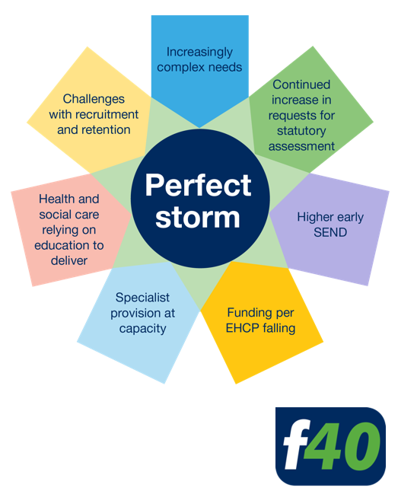
f40 activities during 2026
Met with DfE Director of SEND Claire Burton – due to meet again
Meeting with members of Collaboration Group to discuss joint campaign
Hosting MPs in November to discuss need for major review of funding policy to match reforms
Speaking on panel at planned meeting of the SEND APPG (All Party Parliamentary Group) in Westminster in October / November
Producing a new f40 suggested funding formula – for presentation to the DfE

Slide 13
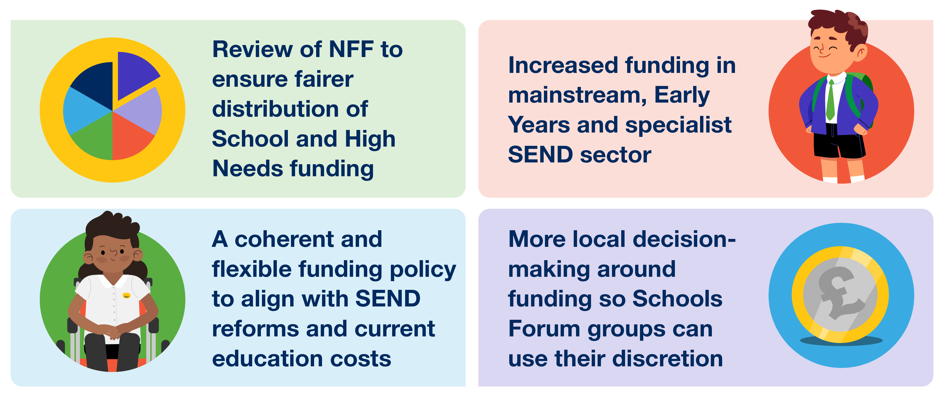

Campaign objectives and key asks

Slide 14
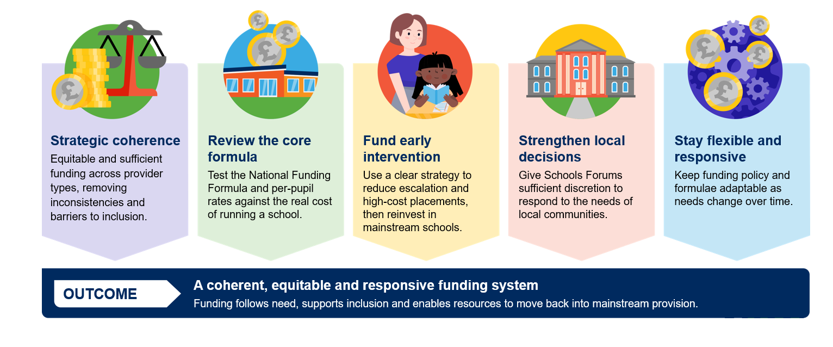
Need for a coherent funding system

Slide 15
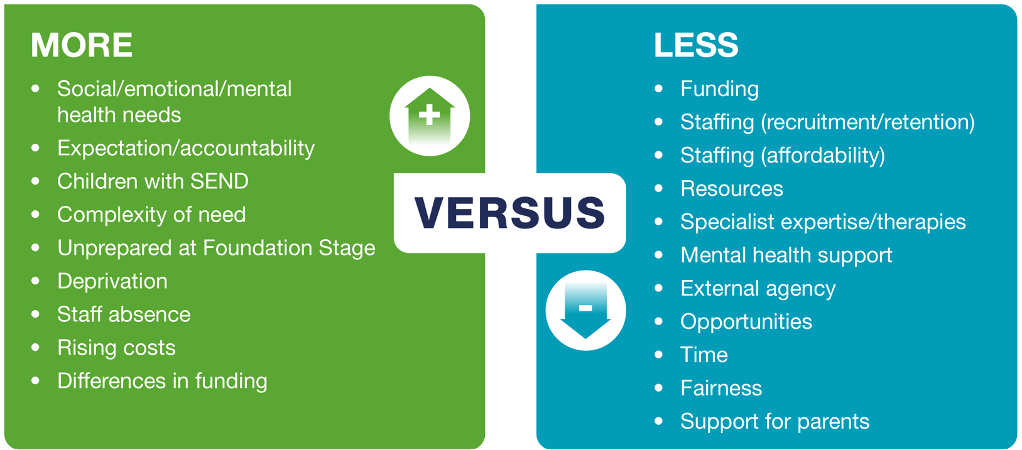
Doing more with less…

