Slide 1

Statutory Performance Measures
EAP
5th October 2016

Slide 2
Reforms to Assessment
Statutory Assessment
  EYFS baseline assessments introduced and abandoned following comparability study
  EYFS Profile abandoned for 2017, now re-instated
  KS1 and KS2 new national curriculum tests with outcomes in the form of scaled scores
  Teacher assessment at KS1 and KS2 using the interim frameworks for teacher assessment, repeatedly changed
  Resits in Year 7 for pupils who don’t achieve the expected standard at the end of KS2, now postponed (Dec 2017?)
  Review of assessment for pupils working below the standard of the tests, delayed
  Phonics screening check: trial for Year 3
Classroom Assessment
  Determined by the school in line with their curriculum

Slide 3
EYFS statutory performance 2016 (checked but unvalidated)
Assessed using EYFS profile (as previously)
GLD - Good Level of Development | A further 2% increase on 2016 to 75%.
GLD - FSM | A 4% increase on 2016 to 53%
Gap for lowest attaining 20% | The gap has reduced year on year for this group of children and is 23% for 2016, down from 24.8% in 2015
Gap for pupils living at in the 30% most deprived LSOAs nationally | Achievement has increased in 2016 in both Average Point Score (32.9 compared with 32.6 in 2015) and GLD (62.9% compared with 60.2% in 2015) for the most deprived group of children by home address.

Slide 4

The Interim baseline for progress: Interim Frameworks for Teacher Assessment
For English reading, writing and mathematics at KS1 and for writing at KS2, there are 3 standards:
  Working towards the expected standard
  Working at the expected standard
  Working at greater depth within the expected standard
For English reading and mathematics at KS2 and for science, there is one standard (working at the expected standard)
Each of the 3 standards within the framework contains a number of ‘pupil can’ statements
Teachers will need to have evidence that a pupil demonstrates attainment of all of the statements within that standard and all the statements in the preceding standard(s).

Slide 5
KS1 attainment
2015 RWM 2C+ | 2015 RWM 2B+ | 2016 RWM EXP
89.8% | 74.9% | 65.8% | No comparison with either previous or predicted expectations
2015 RWM 3+ | 2016 RWM GDS
15.2% | 9.4% | Little correlation
EXP | Reading | Writing | Mathematics | Science
Hampshire | 80% | 70% | 77% | 88%
National | 74% | 65% | 73% | 82%
Difference | +6 | +5 | +4 | +6
GDS | Reading | Writing | Mathematics
Hampshire | 29% | 14% | 18%
National | 24% | 14% | 18%
Difference | +5 | = | =

Slide 6
KS2 attainment (provisional)
Expected | 2015 RWM 4C+ | 2015 RWM 4B+ | 2016 RWM EXP
National Hampshire | 80% 83% (+3) | 69 73 (+4) | 52% 57% (+5) | No comparison with either previous or predicted expectations
Deeper | 2015 RWM 5+ | 2016 RWM GDS
National Hampshire | 24 27 (+3) | 5% 7% (+2) | Little correlation
EXP | Reading | Writing | Mathematics | GPS
Hampshire | 71% | 78% | 71% | 74% (23% GDS)
National | 66% | 73% | 70% | 72% (22% GDS)
Difference | +5 | +5 | +1 | +2 +1
GDS | Reading | Writing | Mathematics
Hampshire | 23% | 20% | 17%
National | 19% | 14% | 17%
Difference | +4 | +6 | =

Slide 7
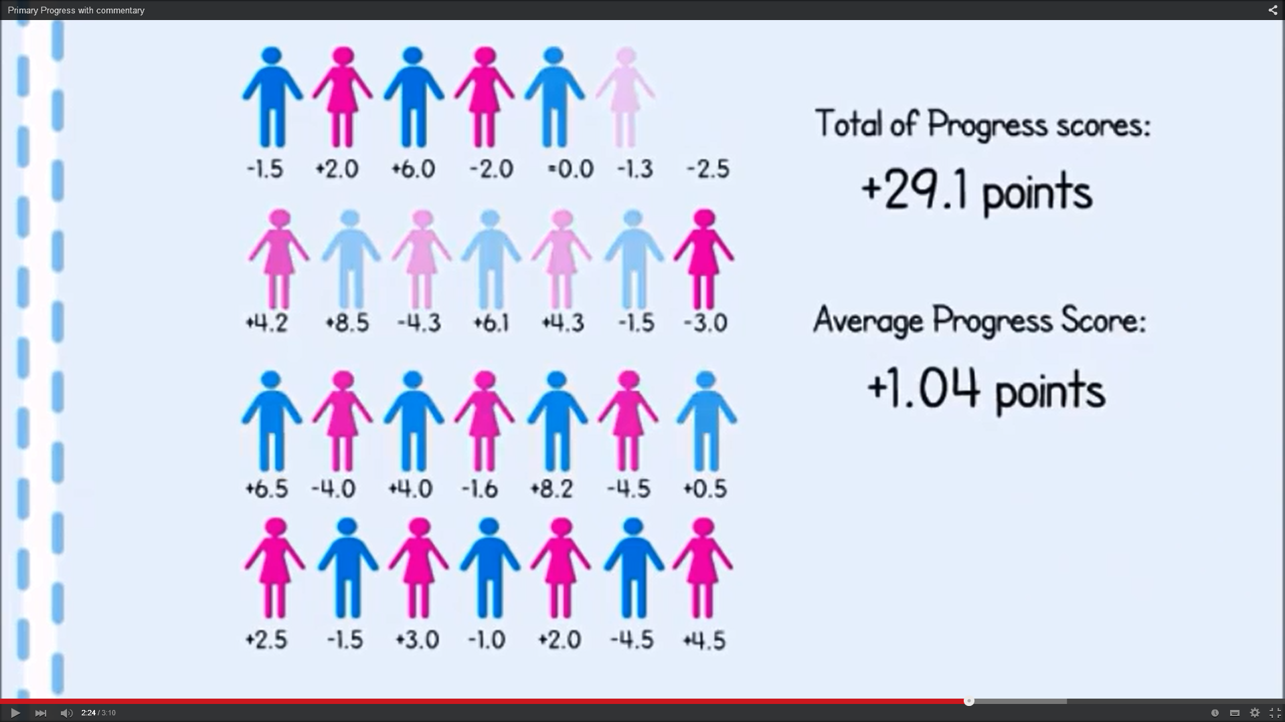
National Tests: KS2 summative progress measure
https://www.youtube.com/watch?v=AlaN-KH1Pcg

Slide 8
Floor standards / Coasting schools (Primary)
2015 FLOOR STANDARD
Less than 65% L4+ RWM & less than median progress in ALL subjects
2016 FLOOR STANDARD
Less than 65% ‘national standard’
& less than progress measure in ONE subject
COASTING
Less than 85% in 2014 and 2015 & less than ‘average’ progress plus below ‘coasting level ‘ in 2016
2017 FLOOR STANDARD
Not published
COASTING
Less than 85% in 2015 & less than ‘average’ progress plus below ‘coasting level ‘ in 2016 and 2017
2018 FLOOR STANDARD
Not published
COASTING
Below ‘coasting level ‘ in 2016, 2017 and 2018

Slide 9
KS2 Floor standards definition
In Key Stage 2 tests in 2016, primary schools will be above the floor standard if:
at least 65% of pupils meet the expected standard in English reading, English writing and mathematics or
the school achieves sufficient progress scores in all three subjects. At least -5 in English reading, -5 in mathematics and -7 in English writing.
To be above the floor, the school needs to meet either the attainment or all of the progress element.
NB If the school has one progress score that is less than sufficient in one subject, the school will only be below the floor if the progress score for that subject is significantly below average – e.g. the upper band of its confidence interval is below zero.
EXP | Reading | Writing | Mathematics | RWM attainment
Hampshire | +0.03 | +0.52 | -0.75 | 57%
National | 0? | 0? | 0? | 52%
Floor target 2016 | -5.0 | -7.0 | -5.0 | 65%
Coasting target 2016 | Less than 85% in 2014 and 2015 & less than ‘average’ progress plus below ‘coasting level ‘ in 2016

Slide 10

Secondary – Year on year
2015 (Year 12)
KS2 levels
Current KS4 5 A*-C EM
2016 (Year 11)
KS2 levels
Current KS4 Progress 8
2017 (Year 10)
KS2 levels
New E&M Progress 8
2018 (Year 9)
KS2 levels
More new GCSEs Progress 8
2019-20 (Year 7/8)
KS2 levels
Final new GCSEs Progress 8
2021 (Year 6)
New KS2 Std. Score
Final new GCSEs Progress 8

Slide 11
An approximate translation of old to new grades:
NEW GRADES | OLD GRADES
Grade 9 | A*a/A*b
Grade 8 | A*c/Aa
Grade 7 | Ab/Ac
Grade 6 | Ba/Bb
Grade 5 | Bc/Ca
Grade 4 | Cb/Cc
Grade 3 | Da/Db/Dc/Ea/Eb
Grade 2 | Ec/Fa/Fb/Fc
Grade 1 | Ga/Gb/Gc
Grade 0 | U
Working towards

Slide 12

New DfE headline accountability measures
.
Progress across a modified best 8 subjects
Attainment across the same 8 subjects
Percentage of pupils achieving a C grade in English and mathematics
The EBacc

Slide 13
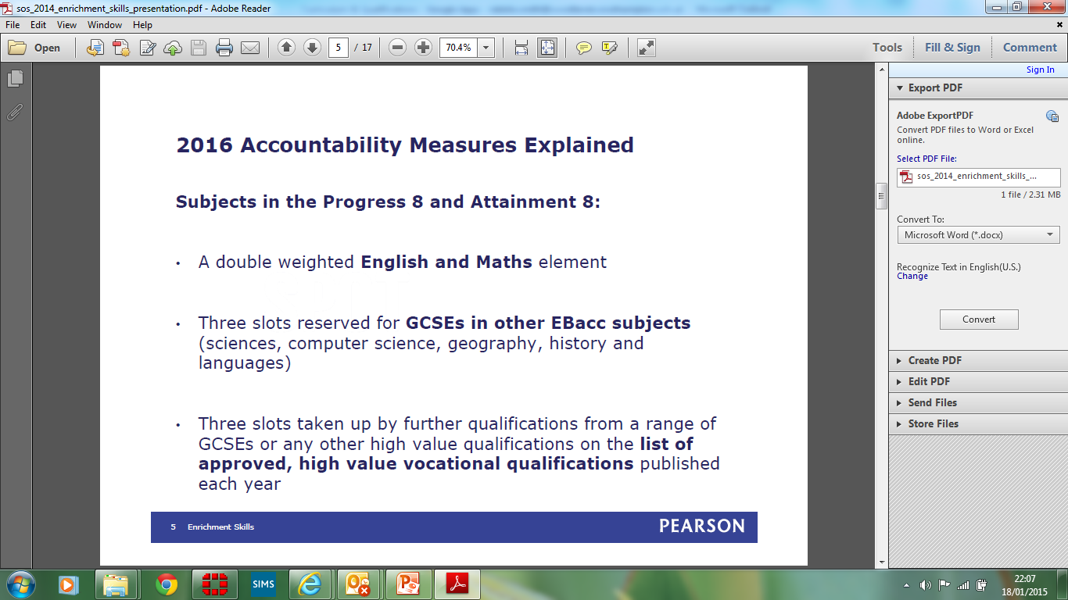

Slide 14
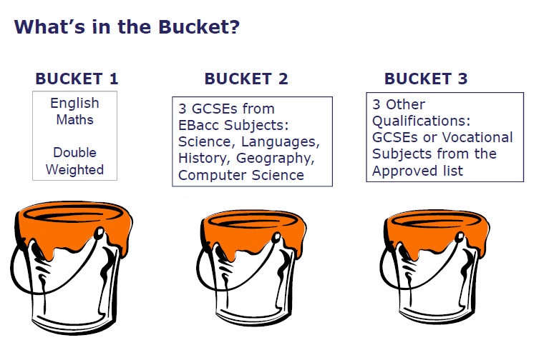

Slide 15
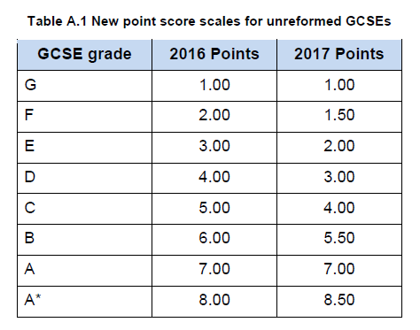
Attainment 8:

Slide 16
Estimated Attainment 8 scores
The minimum grades each pupil requires to achieve a positive Progress 8 score (also known as their ‘estimated grade’) will not be known in advance.
This is because each pupil’s results are compared to other pupils with the same prior attainment within the same cohort.

Slide 17
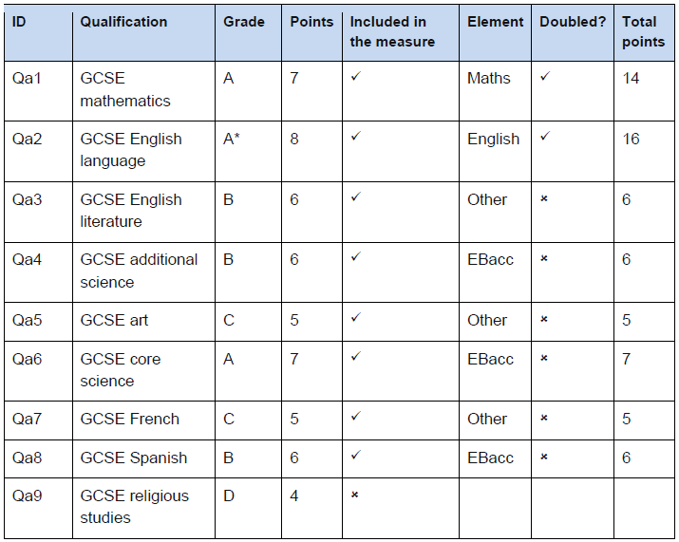
Results for Gillian

Slide 18
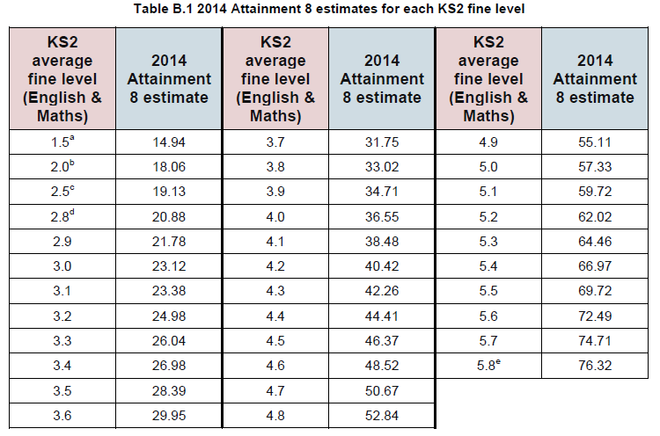
Progress 8: What is it?
Remember Gillian?
Attainment 8 = 65 KS2 fine level = 5.1

Slide 19
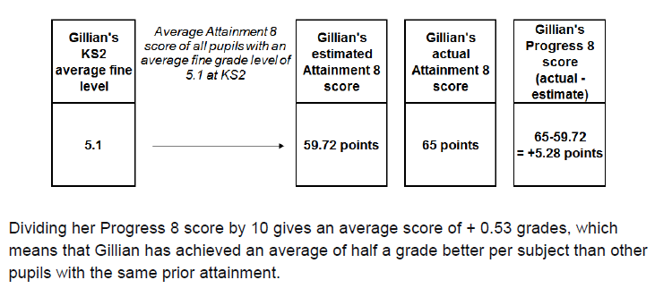
Remember Gillian?
Attainment 8 = 65 KS2 fine level = 5.1

Slide 20

DFE “a fairer measure” of school’s performance
https://www.youtube.com/watch?v=4IAEgFMSGDY

Slide 21
RAISE Progress 8 2015 example
(cohort numbers removed to preserve anonymity)
 |  |  | Progress 8 |  | English element |  | Mathematics element |  | EBacc element |  | Open element
 | Cohort
all pupils |  |  | -0.34 |  | -0.46 |  | -0.18 |  | -0.37 |  | -0.32
male |  |  | -0.35 |  | -0.59 |  | 0.04 |  | -0.30 |  | -0.51
female |  |  | -0.32 |  | -0.35 |  | -0.38 |  | -0.43 |  | -0.15
disadvantaged |  |  | -0.78 |  | -0.87 |  | -0.39 |  | -1.02 |  | -0.76
other |  |  | -0.18 |  | -0.31 |  | -0.11 |  | -0.14 |  | -0.16
Free School Meals |  |  | -0.70 |  | -0.83 |  | -0.31 |  | -0.92 |  | -0.67
Children Looked After |  |  | -1.25 |  | -0.83 |  | -1.47 |  | -1.64 |  | -0.99
SEN with statement or EHC plan |  |  | 0.92 |  | 1.66 |  | 0.76 |  | 0.51 |  | 0.95
SEN support |  |  | -0.03 |  | -0.18 |  | 0.39 |  | -0.29 |  | 0.05
no SEN |  |  | -0.40 |  | -0.53 |  | -0.29 |  | -0.39 |  | -0.39
on roll in years 10 & 11 |  |  | -0.33 |  | -0.47 |  | -0.19 |  | -0.35 |  | -0.30
English first language |  |  | -0.44 |  | -0.54 |  | -0.26 |  | -0.53 |  | -0.41
English additional language |  |  | 0.72 |  | 0.32 |  | 0.55 |  | 1.22 |  | 0.61
Prior Attainment
low overall |  |  | -0.17 |  | -0.24 |  | 0.25 |  | -0.26 |  | -0.32
middle overall |  |  | -0.41 |  | -0.54 |  | -0.45 |  | -0.30 |  | -0.41
high overall |  |  | -0.35 |  | -0.50 |  | -0.10 |  | -0.56 |  | -0.19
English low |  |  | -0.35 |  | -0.39 |  | 0.18 |  | -0.53 |  | -0.52
English middle |  |  | -0.21 |  | -0.41 |  | -0.20 |  | 0.02 |  | -0.30
English high |  |  | -0.46 |  | -0.55 |  | -0.37 |  | -0.70 |  | -0.24
mathematics low |  |  | -0.18 |  | -0.13 |  | -0.12 |  | 0.03 |  | -0.46
mathematics middle |  |  | -0.36 |  | -0.51 |  | -0.30 |  | -0.37 |  | -0.29
mathematics high |  |  | -0.39 |  | -0.58 |  | -0.02 |  | -0.61 |  | -0.29

Slide 22
Volatility in progress 8 “estimate”
Key stage 2 fine level | 2015 A8 estimates | 2016 Attainment 8 estimate | Difference
1.5 | 13.2 | 14.3 | 1.1
2 | 17.79 | 19.87 | 2.08
2.5 | 19.39 | 21.05 | 1.66
2.8 | 20.38 | 22.31 | 1.93
2.9 | 21.88 | 24.39 | 2.51
3 | 23.37 | 25.2 | 1.83
3.1 | 23.91 | 26.21 | 2.3
3.2 | 24.42 | 27.46 | 3.04
3.3 | 26.15 | 29.08 | 2.93
3.4 | 27.71 | 29.95 | 2.24
3.5 | 28.58 | 31.29 | 2.71
3.6 | 30.24 | 32.96 | 2.72
3.7 | 32.11 | 34.39 | 2.28
3.8 | 33.63 | 35.91 | 2.28
3.9 | 35.27 | 37.8 | 2.53
4 | 36.48 | 39.15 | 2.67
4.1 | 38.8 | 40.78 | 1.98
4.2 | 40.62 | 42.52 | 1.9
4.3 | 42.55 | 44.31 | 1.76
4.4 | 44.49 | 46.07 | 1.58
4.5 | 45.87 | 47.7 | 1.83
4.6 | 48.5 | 49.82 | 1.32
4.7 | 50.71 | 51.71 | 1
4.8 | 52.76 | 53.78 | 1.02
4.9 | 55.03 | 55.72 | 0.69
5 | 56.16 | 57.56 | 1.4
5.1 | 59.32 | 59.8 | 0.48
5.2 | 61.51 | 61.9 | 0.39
5.3 | 63.92 | 64.02 | 0.1
5.4 | 66.31 | 66.4 | 0.09
5.5 | 65.67 | 68.67 | 3
5.6 | 71.61 | 71.37 | -0.24
5.7 | 74.18 | 73.75 | -0.43
5.8 | 76.28 | 75.95 | -0.33
26th September secondary schools data checking exercise included 2016 progress & attainment 8 scores.
P8 scores have shifted a lot
Many schools that published P8 figures without the caveat that they were against 2015 figures, will now show lower P8 figures
Comparisons of the 2015 and 2016 show biggest changes have been with the pupils whose ks2 fine point score was between L3 & L4 with very little change at L5+
4 | 36.48 | 39.15 | 2.67

Slide 23
KS4 floor standards
In 2016, a school or college will be below the secondary floor standard if its Progress 8 score is below -0.5, unless the confidence interval suggests that the school’s underlying performance may not be below average (the upper band of its confidence interval is above 0).
A progress 8 score of -0.5 indicates that the average achievement of a school’s pupils is half a grade worse per subject than other pupils with the same prior attainment.
Progress & attainment 8 data for schools will be released this October.

