Slide 1

SHBOA
PROJECT DELIVERY

Slide 2
Phil Stockley
MD Black Velvet Travel
Andrew Wickham
MD Go South Coast

Slide 3
Project Delivery Update
Project Component | Planned Delivery | Committed Delivery to Date | Delivery to Date
Wi-Fi | 500 Buses | 571 Buses | 461 Buses
Bus Refurbishment | 141 Buses | 137 Buses | 10 Buses
Next Stop Audio-Visual Announcement | 500 Buses | 138 Buses | 18 Buses
Internal LED Lighting | 500 Buses | 481 Buses | 88 Buses
Apprenticeships | At least 16 | - | 9
Marketing | Solent Travel Card Marketing of “The Bus” | - | Refresh of Solent Travel Card Literature and Website
Customer Service Charter | 2013 | - | Drafted by First for comment by other operators
Brockhurst Roundabout | 2012-2014 | 2013-2014 | -

Slide 4
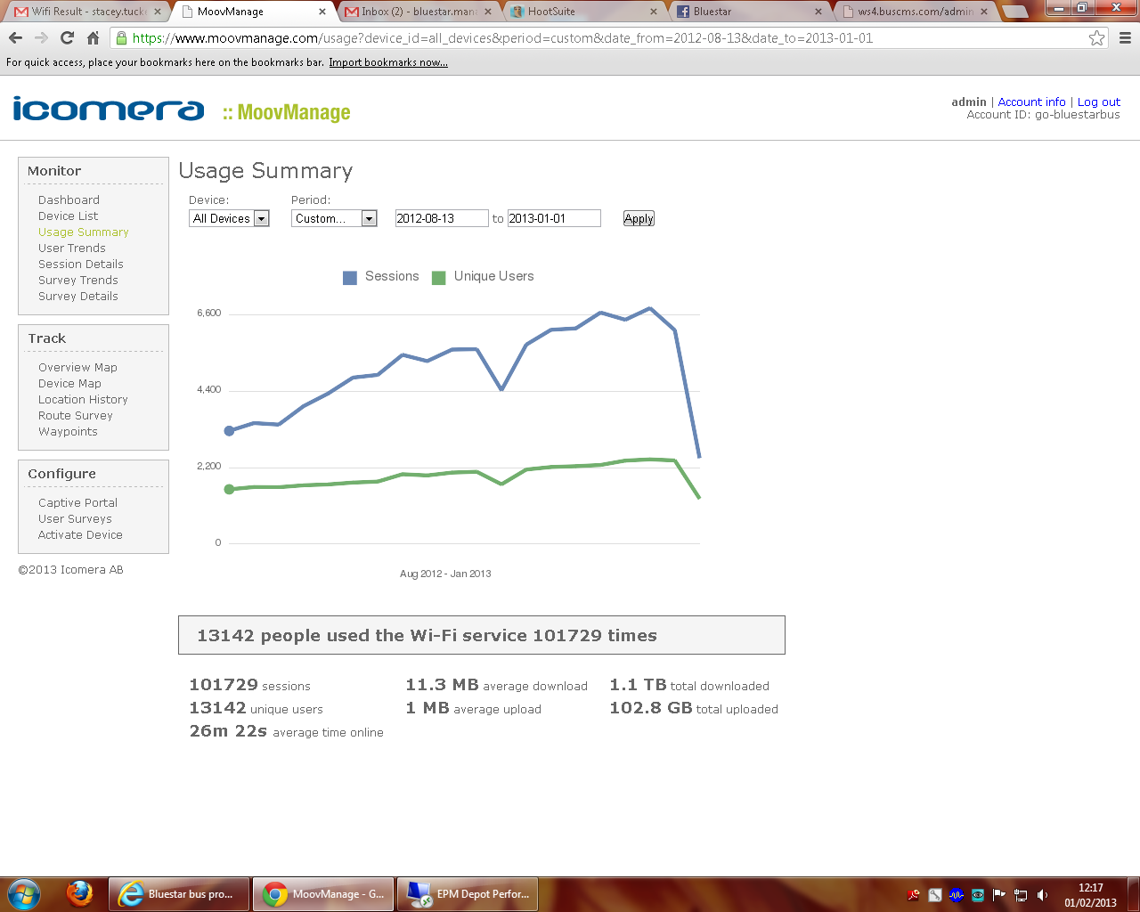
WiFi

Slide 5
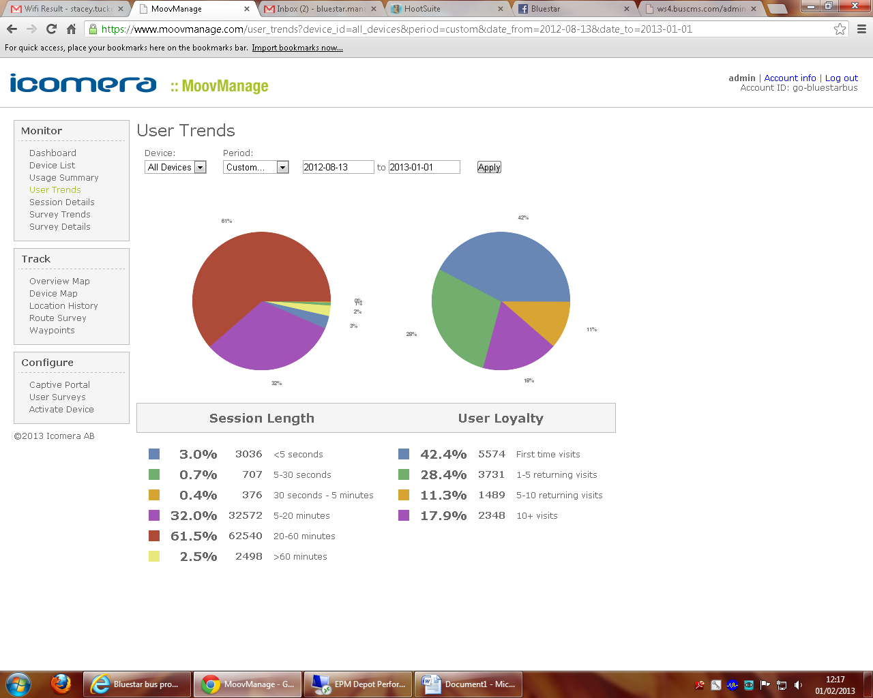
WiFi cont.

Slide 6
Next Stop Audio-Visual
  Accomplishments
  18 buses fitted
  Velvet the first company outside London to be 100% fitted
  Capital cost of £48k
  Routes being “switched on” progressively as the quality of stop data permits
  Positives
  Feedback positive
  Unprompted positive comments from customers secure in the knowledge they will not miss their stop
  Drivers initial scepticism has been overturned as it is hardly noticeable in the background

Slide 7
Next Stop Audio-Visual cont.
  Drawbacks
  Technology still at the early stage and underdeveloped
  Considerable man hours have been spent on the system at the detriment of other projects
  Even thou all the stops are theoretically geo-coded, the quality of the stop data is not as it could be

Slide 8
Smart Card Progress

Slide 9
Smart Card Progress cont.

Slide 10
New Buses
  24 new buses in 2012 and 32 ordered for rollout in 2013

Slide 11
New Jobs
Drivers 53
Engineers 6
Other Various 7

