Slide 1

Local Government Reorganisation
Representative Sample Survey Insight Report
August 2025

Slide 2
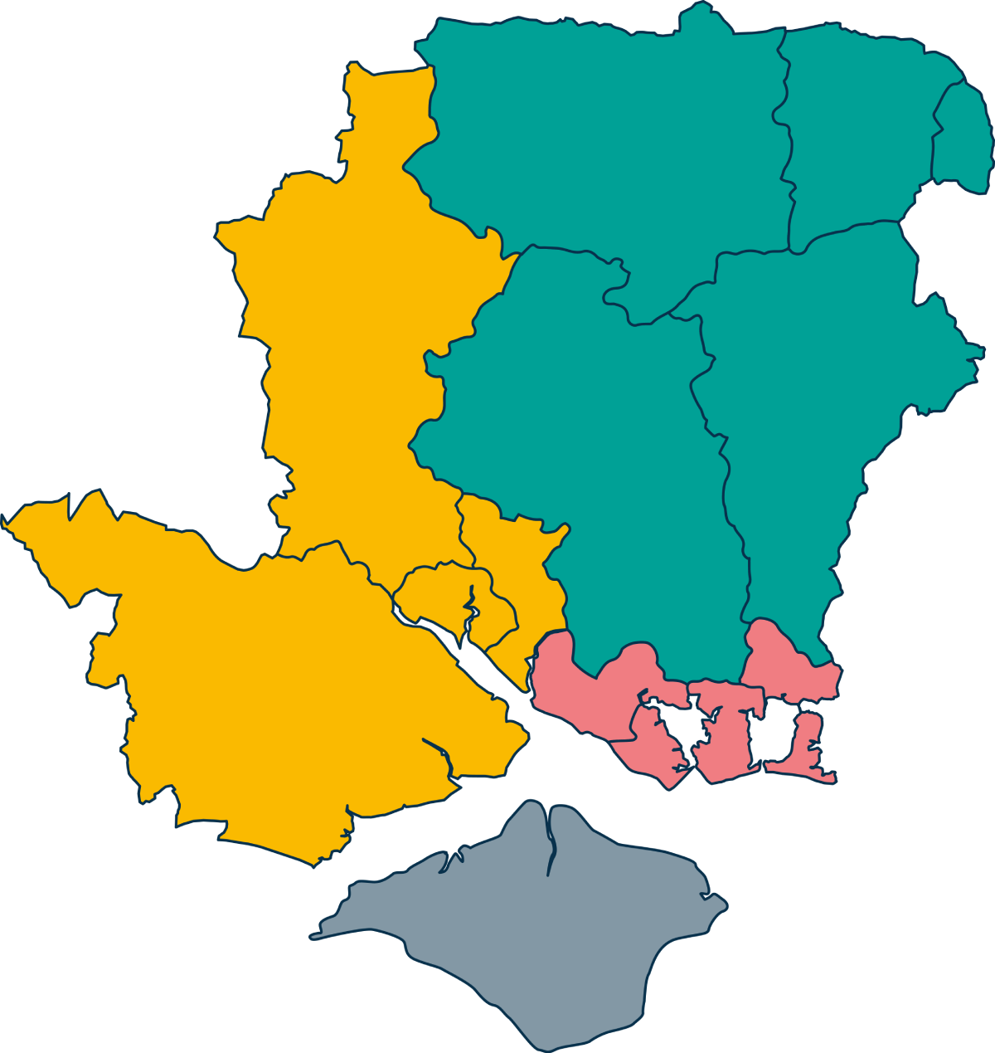
Background
In Summer 2025 Hampshire County Council undertook stakeholder engagement to inform proposals for Local Government Reorganisation (LGR) across Hampshire, Portsmouth, Southampton and the Isle of Wight (described as “Hampshire and the Solent area” in this report).
Hampshire County Council and East Hampshire District Council have proposed that Hampshire and the Solent area has four councils: three councils on the Hampshire and Solent area mainland, and a standalone Isle of Wight council, as shown on the right.
Hampshire County Council commissioned a polling company, findoutnow, to survey a representative sample of residents living within the Hampshire and the Solent area to ask about:
Their awareness of plans for LGR in their area
Any perceived potential benefits or risks of the proposed restructure
The importance of different criteria when designing a new council
Views on how the new councils should be named
The survey ran between 23 July and 29 July 2025. It received a total of 1,129 responses. The sample was built using quotas based on the age, gender, and geographical characteristics to provide a representative sample for the Hampshire and the Solent area.
North and Mid council
South-West council
South-East council
Isle of Wight

Slide 3
Headline findings
Awareness of Local Government Reorganisation in Hampshire and the Solent area
  72% of respondents were aware, and 28% unaware, of plans for LGR in Hampshire and the Solent area before taking the survey
  Awareness was higher amongst respondents who were older, male, or residents of Winchester or East Hampshire
Potential benefits of the proposed structure
  A quarter of respondents felt there would be no benefits of the proposed structure of four councils in Hampshire and the Solent area
  Where respondents suggested benefits, these most commonly related to financial benefits for the councils, improved local identity and engagement, and improved service delivery
Potential risks of the proposed structure
  Respondents’ concerns with the proposed local authority structure most commonly related to local council finances, geographical and boundary issues, and a potential loss of identity or representation
Important considerations when designing a new council
  All the criteria set by the Government were seen as important, with the greatest importance placed on financial elements such as value for money and financial stability, as well as councils’ understanding of local needs and service quality
Important criteria when naming a new council
  A majority of respondents from each of the proposed council areas felt that the names of councils should reflect the geography of the area, with history and the area’s prominent town or city also seen as relatively important

Slide 4
Awareness of LGR – The majority were aware of LGR, with respondents who were older, male, or living in Winchester or East Hampshire the most likely to be aware of the planned changes. However, only a third felt that they had a good understanding of what LGR was all about.
Overall, 72% were aware of the Government’s plans for LGR in Hampshire and the Solent area, with the following demographic splits:
Older respondents were more likely to be aware (85% amongst those aged 65 or over) than younger respondents (56% of those aged under 35)
78% of males were aware of LGR before taking the survey; this was lower (68%) for female respondents
The chart below shows the spread of awareness across Hampshire and the Solent area, which ranged from 61% in Hart and 62% in Southampton, up to 79% in Winchester and East Hampshire:

Slide 5
Potential benefits of the proposed structure – While a quarter of comments suggested that there would be no benefits from the proposed change, most respondents recognised some benefit - such as the potential for efficiency and cost savings, better local identity and engagement, and improvements in service delivery
These comments most commonly related to opportunities to reduce costs (10%), run services more efficiently (7%), and reduce administration and management budgets (5%), as well as reduced duplication (3%) and finding a fairer way to distribute resources than the current model offers (2%)
Comments around local identity and engagement mainly reflected a hope that new councils would be more responsive and accountable to local needs (10%), maintain and enhance local identities (4%) and improve community engagement (1%). The relatively equal population size across the unitaries was also noted (1%)
Where respondents mentioned improved service delivery in detail they described services that would be more joined up than under the current two-tier model (7%), with a focus on local needs (5%), and equal access (1%)
Simplification and clarity related to it being easier for the public to understand which authority provides which service (4%), and that having a single provider would mean that everything can be accessed in one place (3%)
Comments which described strategic planning and governance related to opportunities for long-term planning (1%), such as via partnerships (1%)
‘Other comments’ made points unrelated to LGR, such as the respondents’ views on council services, the principles of LGR, and views on UK politics

Slide 6
Perceived potential benefits of the proposed structure – examples of comments provided
Efficiency and cost savings
Local identity and engagement
Improved service delivery
“I should imagine that the councils would save a lot of money if this were to happen”
“Streamlining of staff meaning less costs, which can then be spent on services required”
“Issues within the local area being dealt with by local councillors who are better aware of the needs”
“…each council can focus more exclusively on issues that affect local people more directly, rather than having to adopt a policy across a wider area”
“People running those districts would hopefully have more local knowledge about how best to spend money”
“Simpler to get things sorted as don't have to deal with multiple departments of multiple councils”
“Should hopefully save money and be more efficient”
“More local services can be more responsive to local need”
“Opportunities to replicate good practice and closer working relationships”
“Less duplication so hopefully some things are cheaper”
Simplification and clarity
Strategic planning and governance
“It will be easier to contact the right people about local issues as you'll know whose responsible”
“Residents would have clearer understanding of who was responsible for local services, increasing accountability”
“More integrated public transport. Opportunities for quicker delivery of new housing projects”
“More power to enforce effective change i.e. transport. With joined up thinking for a combined authority of circa 1 million people Southampton and Portsmouth may just see a light rail system implemented”
“Easier to access services or report any issues, as currently can be unsure as to who to contact regarding different things”
“A more holistic approach to efforts on climate change and the environment”

Slide 7
Potential benefits of proposed structure – Respondents in the proposed North and Mid and South-West council areas were more likely than average to see the proposed change as delivering cost and efficiency benefits, while those on the Isle of Wight (where no change is proposed) more commonly saw the proposal as delivering local identity and engagement benefits
Respondents living within. . .

Slide 8
Other demographic observations on the perceived potential benefits of the proposed structure
Potential benefit reported by respondents | Proportion of respondents that reported this benefit | Groups more likely than average to report this benefit*
Efficiency and cost savings | 23% | Residents of Eastleigh (39%), Winchester (34%), and East Hampshire (33%)
Local identity and engagement | 15% | Respondents from ethnic minority backgrounds (35%), respondents aged 25 to 34 (35%) or 16 to 34 (22%), residents of the Isle of Wight (28%)
Improved Service delivery | 15% | Households earning £80,001 to £100,000 per year (24%), respondents aged 25 to 34 (22%)
Simplification and Clarity | 7% | Residents of Basingstoke and Deane (13%)
Strategic Planning and Governance | 3% | Respondents aged 16 to 24 (9%) and 35 to 44 (7%), Residents of Rushmoor (7%), and Eastleigh (6%), respondents with children or young people aged under 25 in their home (5%)
Employment and Workforce | 0.3% | Residents of Test Valley (2%), respondents aged 25 to 34 (2%)
No benefit | 25% | Residents of the New Forest (34%), respondents aged 65 or over (34%), males (29%)
*Black font indicates significance at the 95% confidence interval, grey font at the 90% confidence interval

Slide 9
Potential concerns with the proposed structure – Respondents most frequently mentioned concerns about the finances of the proposed councils, issues relating to their geographical locations and areas, and that the proposed councils could lose the local connection that the existing councils currently have
Financial concerns most commonly related to unequal funding across areas (6%), potential budget reductions (5%), costs of LGR implementation (4%) and debt inheritance (3%)
Comments about geographical and boundary concerns suggested views that the proposed areas are too large (9%), too varied (4%), and would mix rural and urban areas (3%)
Respondents mentioning loss of local identity and representation referred to a loss of local voices in larger authorities (10%) and of local knowledge in decision making (6%), as well as overrepresentation of urban areas compared with rural areas (2%)
Concerns around service delivery and quality mainly indicated concerns about worsening services (4%), which would be harder to access (2%), and less consistent across the area (1%) with less of a focus on local needs (1%)
Details on concerns about public trust mentioned scepticism about the purported benefits of LGR (4%), the timescales and budget for the programme’s delivery (2%), and the fairness of any resource allocation (2%)
Comments about governance and decision-making suggested concerns about who would take decisions under the new structure (3%), views that councils would reduce local engagement with a top-down approach (2%) and that councils may not communicate adequately with residents (1%)
Comments about employment and workforce mentioned potential redundancies due to LGR (2%), higher workloads for council staff (1%) and changes to their working conditions (1%)
Impacts on residents mainly related to their ability to deal with any service changes (1%)
Planning impacts primarily related to unequal housing targets across the proposed councils (<1%)
‘Other comments’ made points unrelated to LGR, such as the respondents’ views on council services, the principles of LGR, and views on UK politics

Slide 10
Perceived potential concerns with the proposed structure – examples of comments provided
Financial concerns
Geographical and boundary concerns
Loss of local identity and representation
“Not enough government money to support the increased lower level responsibilities”
“Hampshire being spilt and finances not being evenly distributed”
“The New Forest has very little in common with Southampton. It seems ridiculous to lump them together”
“Unsure as to why the areas outside the Isle of Wight aren’t more evenly divided, population-wise”
“Having a larger area loses the more locally focussed elements and knowledge. Even in the similar area, different areas may have very different needs”
“Councils becoming too big and not in touch with the local community. I feel Southampton is already like this. I feel places like Eastleigh etc benefit from a smaller council”
“Decentralisation can lead to inequality in investment and spending”
“Funding cuts could be hidden in the restructuring”
“Too big an area, what works in the city won't work in rural areas”
“People on the borders may get confused as to who looks after them”
“North and Mid Hampshire have no real relationship”
“Costly to implement and could mean higher council tax bills”
“Less funding for smaller areas”
Service delivery and quality
Public trust and confidence
Governance and decision-making
“If staffing numbers are reduced, services will suffer, making it more difficult to contact departments”
“It might cost a lot of money and involve lots of extra paperwork for only minimal gain”
“Small parishes will be forgotten about”
“Where new houses get allocated - due to the South Downs national park, houses in east Hampshire are not fairly allocated”
“That services may be reduced or harder to access going forward”
“The cost of implementing these changes and the time it will take to merge councils”
“It’s going to cost a lot of money and make no difference”
“Poorer areas overlooked in favour of more affluent areas”
“I would be concerned that the reduced number of councils having to look after more people may deliver poorer services”
“…departments will have extra work loads with less staff”
“Negatively being affected by decisions that aren't suitable for my area”
“Restructuring always costs money, which this is supposed to save, and leads to job losses, so more benefits going out, and less income tax coming in”
“Too much power in one place”

Slide 11
Potential concerns with proposed structure – Geography and boundaries were the most prominent concern amongst respondents in the proposed Isle of Wight* and South-West areas. Respondents in the proposed North and Mid area were most concerned about loss of local identity and representation, whilst those in the South-East area were particularly concerned about finances.
Respondents living within. . .
*Comments about the unchanged geography/boundaries on the IOW tended to relate to concerns about the viability of IOW as a standalone authority and whether, as a smaller authority, it would become forgotten and/or receive unequal funding

Slide 12
Other demographic observations on the perceived potential concerns with the proposed structure
Potential concern reported by respondents | Proportion of respondents that reported this concern | Groups more likely than average to report this concern
Financial concerns | 22% | Residents of Portsmouth (34%)
Geographical and boundary concerns | 21% | Residents of New Forest (32%)
Loss of local identity and representation | 19% | Residents of Eastleigh (27%),
Service delivery and quality | 10% | Respondents from ethnic minority backgrounds (22%), households earning over £100,000 per year (20%), residents of Basingstoke and Deane (17%),
Public trust and confidence | 9% | Residents of Hart (23%) and Gosport (17%), respondents from ethnic minority backgrounds (22%)
Governance and decision-making | 8% | No notable variances from the average
Employment and workforce | 4% | Residents of Winchester (15%)
Impact on residents | 2% | Respondents aged 16 to 24 (13%), respondents from ethnic minority backgrounds (9%), residents of Winchester (7%) and Southampton (7%)
Planning, housing, and infrastructure | 1% | Respondents aged 16 to 24 (9%), respondents from ethnic minority backgrounds (4%), residents of East Hampshire (3%) and Fareham (2%)
No concerns | 16% | No notable variances from the average
*Black font indicates significance at the 95% confidence interval, grey font at the 90% confidence interval

Slide 13
Criteria when designing new councils – Each of the Government’s criteria for LGR were seen as important, but ongoing finance elements such as value for money and financial stability were seen as the most critical, and the councils’ understanding of local needs and service quality also scored particularly highly in relation to the other criteria

Slide 14
Naming new councils – A majority of respondents, including a majority in each of the proposed council areas, felt that a council’s name should reflect its geography, with other factors seen as less important
 | Observations
 | Higher for those living in the proposed South-West council area (63%), and North and Mid council area (58%), than those in the proposed South-East council area (52%)
 | Higher for those living in Southampton (40%), Rushmoor (40%), and Portsmouth (39%), compared with Hart (16%), Eastleigh (21%), and the New Forest (23%)
 | Higher amongst those in urban areas (36%) than amongst rural residents (18%)
 | Higher amongst those in rural areas (27%) than amongst urban residents (17%)
 | Higher amongst males (14%) than amongst females (10%) Higher amongst residents of Gosport (17%) and Winchester (16%) than those living in Eastleigh (6%) and Basingstoke and Deane (7%)
 | Some of those who selected ‘something else’ suggested using local river names and the diversity of an area when selecting an authority’s name, but the majority of comments provided here indicated apathy regarding the name or disagreement with the LGR process

