Slide 1

School Funding
Getting to the Local Formula
Felicity Roe
Assistant Director
Children’s Services

Slide 2
School Funding
Forecast year end 2017/18
National Funding Formula
Local impact
Options and proposals

Slide 3
Forecast year end 2017/18

Slide 4
Dedicated Schools Grant 2017/18 | Amount £000
Schools Block | 720,154
Early Years Block | 70,753
High Needs Block | 102,681
Total DSG | 893,588

Slide 5
DSG Reserves |  | £000 | £000
Balance b/f |  |  | 6,599
2017/18 funded items | Early Years - SfYC | 1,246
 | SENSA | 1,500
Other committed items | Early Years CERA | 533
Uncommitted balance |  |  | 3,320
2017/18 pressures | Forecast overspend | 8,146
Forecast DSG reserve as at 31.03.18 |  |  | 4,826

Slide 6
17/18 Projected Overspend | Current budget | Forecast outturn | Forecast variance
 | £000 | £000 | £000 | %
Schools | 547,956 | 548,002 | 46 | -
Early Years | 70,743 | 72,809 | 2,066 | 2.9
High Needs | 99,253 | 105,183 | 5,930 | 6.0
Central | 4,091 | 4,195 | 104 | 2.5
Total DSG | 722,043 | 730,189 | 8,146 | 1.1

Slide 7
Allows for pupil number change
Early Years Block funding basis
7/12ths: Jan 2018 census
5/12ths: Jan 2017 census

Slide 8
LA will fund £533k EY capital
Early years capital
Relieves DSG reserve
Funding can be used to offset the DSG pressures

Slide 9
High Needs pressures
Increasing demand and costs
Complexity of need
Capacity issues
Market forces
Inflation driving charges
EHCPs increasing
Increase in high cost placements

Slide 10
13% growth in EHCPs Feb16 to Feb17 (1,625 to 1,839)
11% increase in weekly LSA hours required
Top up Funding for Mainstream Schools
£2.135m overspend
19% of the budget

Slide 11
SENSA
£700k overspend
47% of budget
Pilot: £1.5m funded from DSG reserves 2017/18
Spend already over £900k
Forecast to be £2.2m

Slide 12
SEN top-up
£650k overspend
290% of budget
Threshold currently 3.75% of a school’s budget
Budget allocation £350k
Total forecast spend £1m
Disproportionate SEN spend

Slide 13
Top up Funding for Special Schools
£694k overspend
4% of the budget
Number of pupils in special schools up 2%
Increased levels of assessed needs
More pupils on a higher ‘Step’
Additional post-16 places needed

Slide 14
Top up Funding for Other LA Schools
£249k overspend
8% of the budget
Additional placements made in other Local Authority schools, some of which are high cost, residential placements

Slide 15
SEN Discretionary Payments
£484k overspend
23% of budget
Continuation of 2016/17 pressure
Bespoke packages for pupils in mainstream schools
Tighter controls but legacy
Increase in EHCPs = additional pressure on this budget.

Slide 16
Independent and Non-maintained Special Schools
£2.66m overspend
18% of the budget
Increased number of pupils placed in out of county SEN provisions
continuation of the growth
average cost of £49k for SEN only placements and
£82k for the joint funded placements

Slide 17
High Needs pressures
Actions
Improved procurement to reduce placement costs
Efficiency reviews of central services to reduce costs
Increased funding through national funding formula over next 3 years

Slide 18
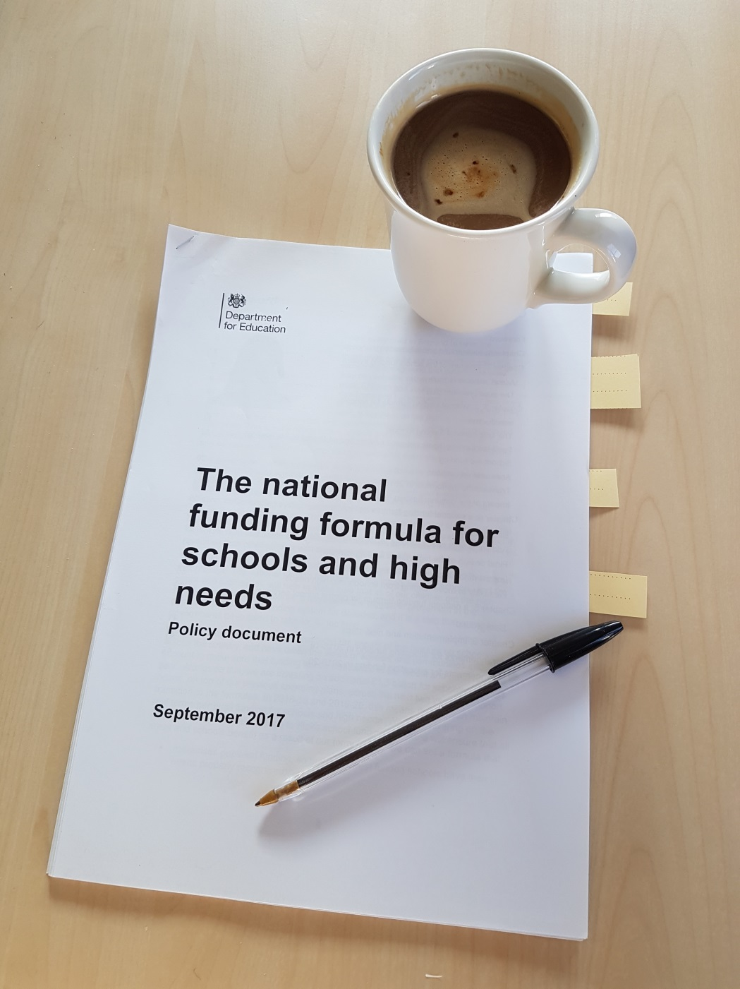

Slide 19
Funding reforms 2013
School budget share
Basic per pupil funding
Deprivation
Looked after children
Mobility
Prior attainment
English as an additional language
Lump sum
Rates
Split Site
Sparsity
Private finance initiative
Area cost adjustment
Pupil led factors
School led factors
Notes:
Creation of 3 blocks
Mainstream school funding – 10 DfE defined factors
High Needs ‘Place-plus’ funding introduced
No new LA funding commitments
Funding delegated / de-delegated / centrally held
End of academy LACSEG

Slide 20
System design
Schools
National
school
budgets
Central
High needs
Early years
Distribution by national funding formulae
Schools Forum
Schools
Central
High Needs
Early Years
Distribution by local formula
Distribution for high needs places and pupil top up
Distribution by local formula
MAT
Individual MAT distribution arrangements
Maintained school
Stand alone Academy
Academy 1
Academy 2
etc
Post -16 institutions
Special School
Alternative provision
Early Years Provider

Slide 21
National Funding Formula
DFE Implementation
Funding allocated nationally and distributed locally
Hard
Remains “long term intention”
National funding direct to schools
Soft
2018/19 and 2019/20

Slide 22
Early Years (95% pass through)
Schools (99.5% Ring Fenced)
High Needs
Central School Services

Slide 23
NFF 2017
School budget share
Age weighted pupil unit
Minimum per pupil level
Deprivation
Mobility
Low prior attainment
English as an additional language
Lump sum
Rates
Split Site
Sparsity
Growth
Area cost adjustment
Pupil led factors
School led factors
Notes:
Creation of 3 blocks
Mainstream school funding – 10 DfE defined factors
High Needs ‘Place-plus’ funding introduced
No new LA funding commitments
Funding delegated / de-delegated / centrally held
End of academy LACSEG

Slide 24
NFF
Funding floor
0.5% 2018-19
1% 2019-20

Slide 25
NFF
Basic per-pupil funding
AWPU rates up
Secondary £4,800 (£4,600)*
*Transitional
New Minimum per Pupil Level factor
KS1&2 £35, KS3 £66, KS4 £74
Applies after NFF pupil led funding plus NFF lump sum and sparsity
Primary £3,500 (£3,300)*

Slide 26
Area cost adjustment
For higher salary cost areas
Uses general and teacher labour markets
HCC: 1.01391 (£1,000 = £1,013.91)
Indicative school level allocations include ACA
ACA not applied to MpPL, funding floor, mobility or premises factors

Slide 27
Primary unit values |  | HCC (2017/18) | NFF proposal (before ACA) | NFF final (before ACA)
AWPU |  | £2,639 | £2,712 | £2,747
Deprivation | FSM | £0 | £980 | £440
 | FSM Ever6 |  | £540 | £540
 | IDACI F | £337 | £200 | £200
 | IDACI E | £672 | £240 | £240
 | IDACI D | £1,408 | £360 | £360
 | IDACI C | £1,410 | £360 | £390
 | IDACI B | £1,683 | £420 | £420
 | IDACI A | £2,222 | £575 | £575
Looked after children |  | £1,983 | £0 | £0
Low attainment |  | £1,377 | £1,050 | £1,050
Mobility |  | £1,028 | Historic | Historic
English additional language |  | £603 | £515 | £515
Sparsity |  | £15,000 | Tapered | Tapered
Lump sum |  | £160,000 | £110,000 | £110,000

Slide 28
Secondary unit values |  | HCC (2017/18) | NFF proposed (before ACA) | NFF final (before ACA)
AWPU - KS3 |  | £3,835 | £3,797 | £3,863
AWPU - KS4 |  | £4,536 | £4,312 | £4,386
Deprivation | FSM | £0 | £1,225 | £440
 | FSM Ever6 |  | £785 | £785
 | IDACI F | £430 | £290 | £290
 | IDACI E | £852 | £390 | £390
 | IDACI D | £1,744 | £515 | £515
 | IDACI C | £1,765 | £515 | £560
 | IDACI B | £1,939 | £600 | £600
 | IDACI A | £2,783 | £810 | £810
Looked after children |  | £1,983 | £0 | £0
Low attainment |  | £1,134 | £1,550 | £1,550
Mobility |  | £400 | Historic | Historic
English additional language |  | £1,560 | £1,385 | £1,385
Sparsity |  | £15,000 | Tapered | Tapered
Lump sum |  | £160,000 | £110,000 | £110,000

Slide 29
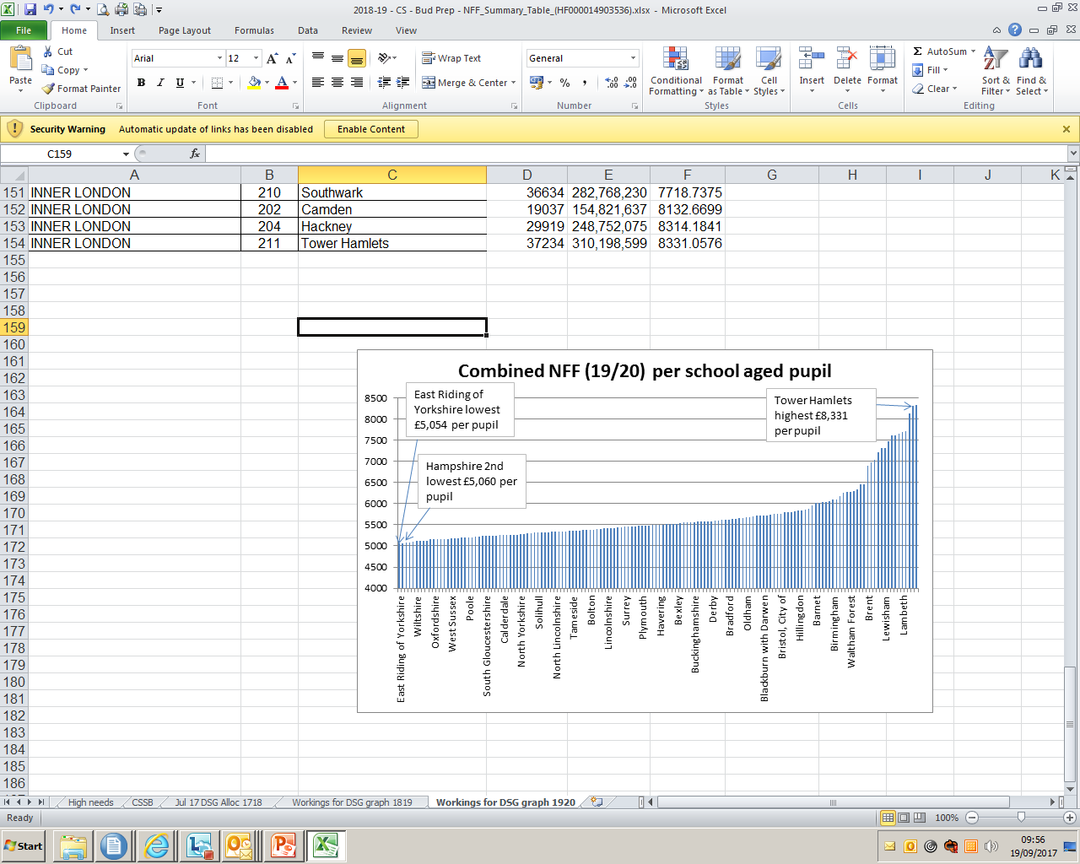
2019-20 Combined budget per school aged pupil (after the National Funding Formula)
Combined budget is the total of the schools, high needs and central services block

Slide 30
NFF | Baseline (2017/18) | Notional NFF 2018-19 | Change |  | Illustrative NFF 2019-20 | Change
 | £'m | £'m | £'m | % | £‘m | £'m | %
Basingstoke | 93.1 | 95.0 | 1.9 | 2.1% | 96.3 | 3.2 | 3.5%
East Hants | 62.2 | 63.7 | 1.5 | 2.4% | 64.8 | 2.6 | 4.1%
Eastleigh | 69.7 | 71.8 | 2.1 | 3.0% | 73.6 | 3.9 | 5.6%
Fareham | 60.0 | 61.8 | 1.8 | 3.0% | 63.5 | 3.5 | 5.8%
Gosport | 45.2 | 45.8 | 0.6 | 1.3% | 46.0 | 0.8 | 1.7%
Hart | 52.4 | 54.0 | 1.7 | 3.2% | 55.8 | 3.4 | 6.5%
Havant | 68.4 | 69.0 | 0.6 | 0.8% | 69.3 | 0.9 | 1.3%
New Forest | 83.9 | 85.7 | 1.7 | 2.1% | 86.8 | 2.9 | 3.5%
Rushmoor | 44.6 | 45.5 | 0.9 | 1.9% | 46.0 | 1.4 | 3.1%
Test Valley | 63.3 | 64.4 | 1.1 | 1.8% | 65.2 | 2.0 | 3.1%
Winchester | 60.7 | 62.2 | 1.5 | 2.5% | 63.7 | 3.0 | 4.9%
Total | 703.6 | 719.0 | 15.4 | 2.2% | 731.1 | 27.5 | 3.9%

Slide 31
NFF | Baseline (2017/18) | Notional NFF 2018-19 | Change |  | Illustrative NFF 2019-20 | Change
 | £'m | £'m | £'m | % | £‘m | £'m | %
All-through | 6.1 | 6.3 | 0.1 | 2.2 | 6.3 | 0.1 | 2.2
1000 + | 6.1 | 6.3 | 0.1 | 2.2 | 6.3 | 0.1 | 2.2
Primary | 393.1 | 400.7 | 7.6 | 1.9 | 407.2 | 14.1 | 3.6
0 - 100 | 13.4 | 13.5 | 0.1 | 0.4 | 13.5 | 0.1 | 0.7
101 - 200 | 84.2 | 84.8 | 0.6 | 0.7 | 85.1 | 0.9 | 1.1
201 - 300 | 128.5 | 130.7 | 2.2 | 1.7 | 131.5 | 3.0 | 2.3
301 - 450 | 132.5 | 135.6 | 3.1 | 2.3 | 139.2 | 6.8 | 5.1
450 + | 34.5 | 36.2 | 1.7 | 4.8 | 37.9 | 3.3 | 9.6
Secondary | 304.3 | 312.0 | 7.7 | 2.5 | 317.6 | 13.3 | 4.4
0 - 400 | 4.3 | 4.3 | 0.2 | 0.5 | 4.3 | 0.4 | 1.0
401 - 600 | 29.0 | 29.6 | 0.5 | 1.8 | 29.7 | 0.6 | 2.2
601 - 800 | 44.4 | 45.3 | 0.9 | 2.0 | 45.6 | 1.2 | 2.8
801 - 1000 | 65.2 | 66.4 | 1.2 | 1.8 | 67.0 | 1.8 | 2.7
1000 + | 161.4 | 166.4 | 5.0 | 3.1 | 171.0 | 9.6 | 5.9
Total | 703.6 | 719 | 15.4 | 2.2 | 731.0 | 27.6 | 3.9

Slide 32
Pupils per year group
Primary < 21.4 pupils
Secondary <120 pupils
All through <62.5 pupils
Average distance to 2nd nearest school
Primary </= 2 miles
Secondary </= 3 miles
All through </= 2 miles
Sparsity funding

Slide 33
Current
Sparsity funding
Fixed sum £15k
48 schools
NFF
Funding Tapered
Primary to £25k
Secondary to £65k

Slide 34
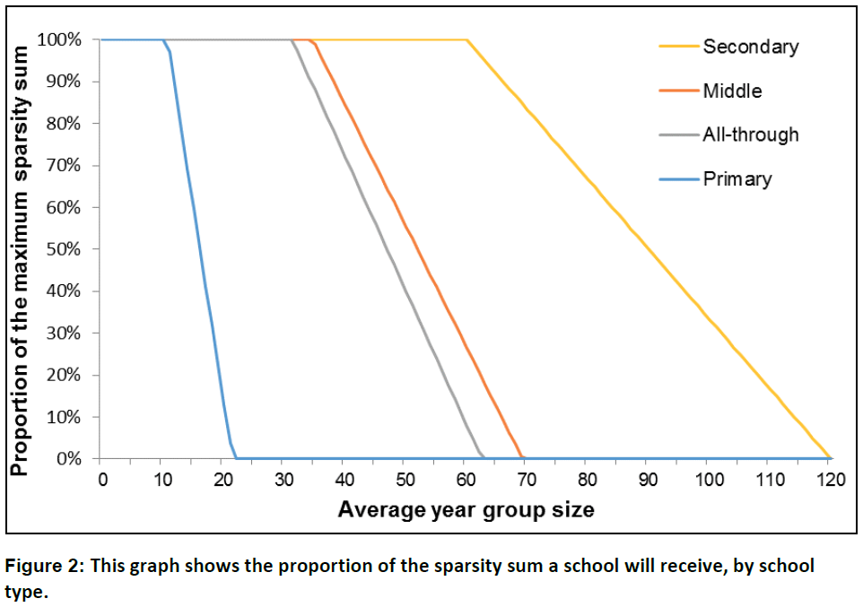
Sparsity funding – Taper by phase

Slide 35
Growth and Premises factors
Historic funding based on 2017-18 budget
No uplift (except for PFI)
DfE to consider future options

Slide 36
Place funding £6k
Pupil-led funding for the pupil
Any further top-up
Mainstream
Resourced provision

Slide 37
Central Services Block
Retained duties Education Services Grant
Formula funded on per pupil basis with 10% weighting for deprivation (FSM6)
Historic commitments

Slide 38
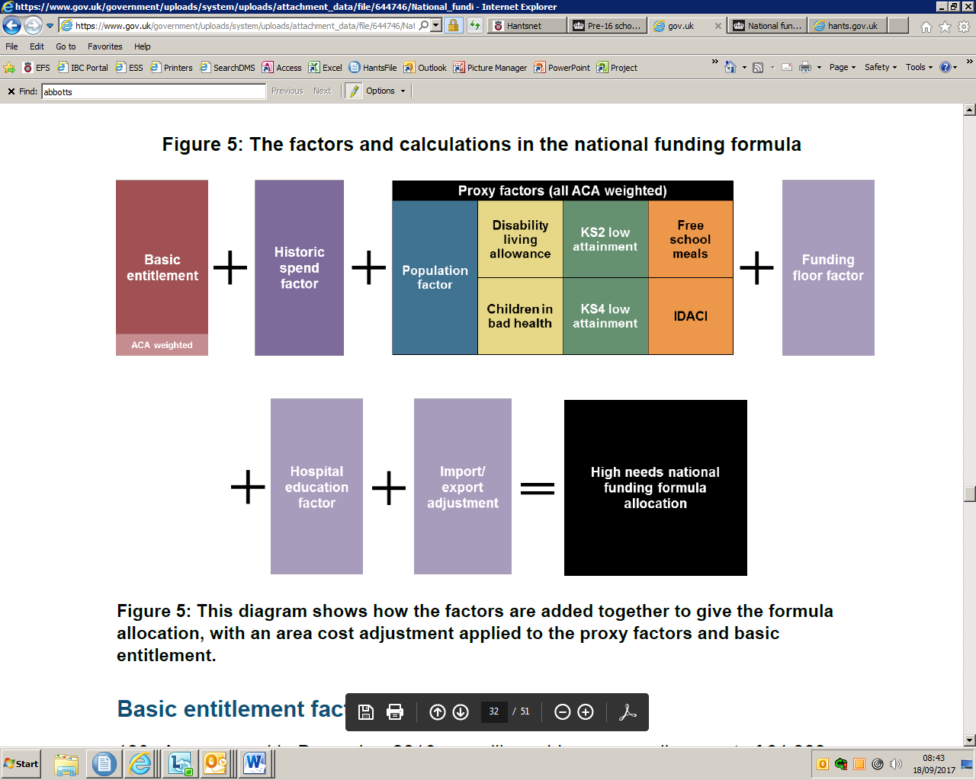
High Needs Block national formula

Slide 39

NFF by school
Use the COLLECT system
The secure access approver in your school will need to add the NFF reports to the list of reports you have access to
There are guidance notes available on the Secure Access login page for both the secure access approver and user
If you are unsure who your secure access approver is, you will need to complete an SA Service Request form

Slide 40
Developing the Hampshire Local Formula

Slide 41
Provisional 2018-19 NFF allocation Distribution between Blocks
 | National Average | South East Average | HCC
Schools | 83.8% | 82.3% | 86.2%
High Needs | 15.0% | 16.5% | 12.8%
Central Services | 1.2% | 1.2% | 1.0%

Slide 42
NFF Hampshire Headline Gains by Block
£0.58m Central Services
£8.7m High Needs
£27.6m Schools
£37m Overall DSG
Phased over 3 years

Slide 43
Schools
High Needs
Revised baseline £105.1m
Central Services
2018-19 £725.2m
2019-20 £737.4m
Revised baseline £709.8m
2018-19 £108.1m
2019-20 £111.0m
Final gain* £113.8m
2018-19 £8.07m
2019-20 £8.17m
Final gain* £8.52m
Revised baseline £7.94m
*subject to next national spending review

Slide 44
Early Years
Historic funding basis in NFF
Budget pressures
High Needs
Growth

Slide 45
Historic funding
Cost Pressures
Rates £715k
Re-organisation £761k

Slide 46
Individual school budgets
Possible deductions:
Transfer up to 0.5% to other Blocks
Schools Block
Rules
Growth fund (and Falling rolls)
Growth fund increase

Slide 47
Transfer from Schools to High Needs Block
The need
High Needs block pressures
Hampshire high delegator to schools so High Needs block low base
High Needs Block gain capped to £3m = half of pressure
Need 0.5% (£3.6m) transfer to assist

Slide 48
Schools block 2018/19 | 2017/18 £’000 | 2018/19 Notional £’000 | Variance £’000
Total | 709,760 | 725,182 | 15,422
Transfer 0.5% |  | -3,626 | -3,626
Schools Funding | 709,760 | 721,556 | 11,796
Made up of
Individual School Budgets | 704,719 | 716,515 | 11,796
Growth Fund | 5,041 | 5,041 | -

Slide 49
NFF vs local formula
Primary: Secondary Ratios
National 1:1.29
Current 1:1.28
NFF Hants = £1.4m secondary to primary
NFF Hants 1:1.27

Slide 50
DfE Hampshire primary:secondary ratio 1:1.27
£11.796m uplift
Distribution
Primary £8.2m
Secondary £3.6m

Slide 51
NFF vs local formula
Reception uplift
Hants £448k
NFF £0
77 Schools £5,818 per school average

Slide 52
NFF vs local formula
Funding Floor
Compares NFF pupil led funding (plus MpPL) with baseline
Baseline is:
17/18 post MFG budget less
premises
mobility
NFF lump sum and
NFF sparsity

Slide 53
NFF vs local formula
Minimum Funding Guarantee/Funding Floor
Current MFG: minus 1.5%
NFF: Option between 0% and minus 1.5% and
Any existing MFG becomes new baseline
Who sits on funding floor depends on local formula
LA can apply for Plus 0.5%

Slide 54
Schools Block Formula
Principles agreed by Schools Forum
No school to lose funding through formula change (no protection for pupil number reduction or rates reduction)
To develop options start with the NFF and identify clear ‘steps’ from it to the local formula
Align the primary:secondary ratio with the NFF

Slide 55
Notional NFF: £725.18m
0.5% transfer - £3.62m
Total SB £721.55m
Growth £5.04m
Recap
18/19 notional schools block
Rates + reorg £1.5m
ISB £716.51m

Slide 56
Schools Block Local Formula
Option A
Proportional reduction of 2% to all values in the NFF
Including minimum per pupil level
Not sparsity or premises factors
Equal impact for all gainers
Broadly mirrors distribution of the NFF but more schools on funding floor
Schools on funding floor get 0.5% per pupil

Slide 57
Schools Block Local Formula
Option B
Unit values consistent with NFF, reduce floor and halve gains
Reduce funding floor to 0%
Halve gains cap at greater of 1.5% of baseline or 10% of gain (MpPL not capped)
Schools on floor receive no increase – typically small schools or those with higher additional needs
Those who gain through MpPL achieve all their gain so favours schools with low additional needs

Slide 58
Schools Block Local Formula
Option C
Apply targeted reduction to unit values
8% reduction to the MpPL
£72 reduction Primary AWPU
£14 reduction to KS3 AWPU
Protects those most dependent on funding floor for gains – primarily small schools and those with high levels of pupils with additional needs
Some reduction in the spread of gains

Slide 59
Distribution of gains | Option A | Option B | Option C
 | Change % | Change % | Change %
Basingstoke | 1.4 | 1.4 | 1.4
East Hants | 1.6 | 1.8 | 1.8
Eastleigh | 2.1 | 2.4 | 2.0
Fareham | 2.2 | 2.4 | 1.9
Gosport | 0.7 | 0.9 | 1.0
Hart | 2.4 | 2.7 | 2.0
Havant | 0.6 | 0.3 | 0.7
New Forest | 1.4 | 1.2 | 1.5
Rushmoor | 1.7 | 1.3 | 2.0
Test Valley | 1.4 | 1.1 | 1.3
Winchester | 1.8 | 1.8 | 1.7

Slide 60
Distribution of gains | Option A | Option B | Option C
 | Change % | Change % | Change %
All-through 1000+ | 1.9 | 2.2 | 2.7
Primary | 1.4 | 1.3 | 1.2
0-100 | 0.3 | 0.0 | 0.3
101-200 | 0.5 | 0.3 | 0.5
201-300 | 1.0 | 0.9 | 0.9
301-450 | 2.0 | 1.6 | 1.8
450+ | 3.6 | 4.6 | 2.6
Secondary | 1.8 | 1.9 | 1.9
0-400 | 0.5 | 0.0 | 0.5
401-600 | 0.9 | 1.0 | 1.7
601-800 | 1.1 | 1.0 | 1.9
801-1000 | 1.2 | 1.1 | 1.4
1000+ | 2.3 | 2.6 | 2.2
Total | 1.6 | 1.6 | 1.6

Slide 61
Consultation
Schools Communication number 15454
Formula change
Schools Forum: December
0.5% School to High Needs Block
Statutory LA decision: January
All Schools Views on
Decisions
Modelling tool provided

Slide 62
Next Steps/Questions

